Slide 1
RAG Playground

Slide 2
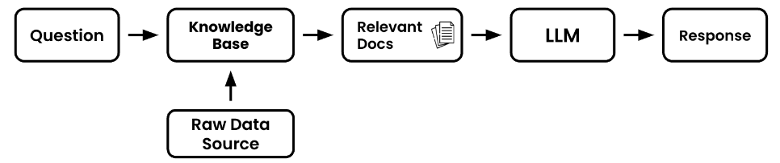
Retrieval Overview
Retrieval Components
Question – This will be the piece of text that you’d like the language model to help reason about or answer
Raw Data Source – This will be the entire collection of raw text
Knowledge Base – This is where the raw data will be prepped and ready to be processed by our retrieval application
Relevant Docs – These are the subset of the documents in your full knowledge base that your retrieval application deems helpful to answer your question

Slide 3
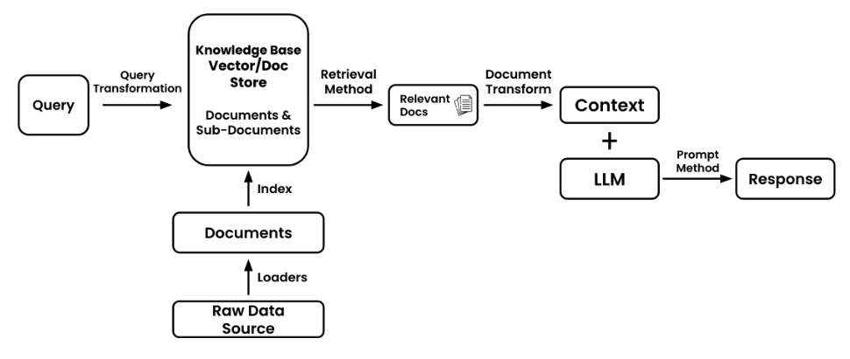
Retrieval Overview
Though this architecture may work for introductory applications, there are number of situations that could make things more complicated
사용자가 잘못된 질문을 한다면 ?
처리할 이미지가 있다면?
PDF 에 구문 분석과 분석이 필요한 테이블이 있다면?
원시 문서(raw document)에 유사성 점수를 매기는 것이 작동하지 않는다면?

Slide 4
Retrieval Overview
Query – The initial piece of data that will guide the retrieval process (e.g. user question, chat history, image, audio, prompt, table, or other various data)
Query Transformation – The process of modifying or reformatting the original query to make it more suitable for retrieval
Raw Data Source – Original collection of information. Unprocessed unstructured from which you’ll extract. (e.g. website, images, picture, other application)
Document Loaders – Tools or functions that extract data from a raw source
Documents – Individual units of data or information that have been extracted and are ready for indexing. (e.g. individual pieces of texts, single customer records)
Index – Data structure that organizes information from your documents that makes retrieval faster, more efficient or better performance
Knowledge Base – A structured repository that contains indexed documents from which the retrieval process extracts documents from. This is often the combination of a vector store and document store
Retrieval Method – The technique or algorithm used to search for and extract the most relevant documents from the knowledge base in response to a query
Relevant Docs – The subset of documents that the retrieval method determines to be most useful in addressing the query
Document Transform – The process of further refining or reformatting the relevant documents to make them more suitable for the language model. This could include summarization, compression (removing information) or other transformations
Context – The combined content derived from the transformed documents that provide the necessary background or information for the language model to generate its response
Large Language Model (LLM) – The machine learning model that will generate a response based on the context and prompt it’s given
Prompting Method – The technique or method used to present the context to the language model. This also includes chaining different prompts together
Response – The final answer or output generated by the language model based on the context and prompting method

Slide 5
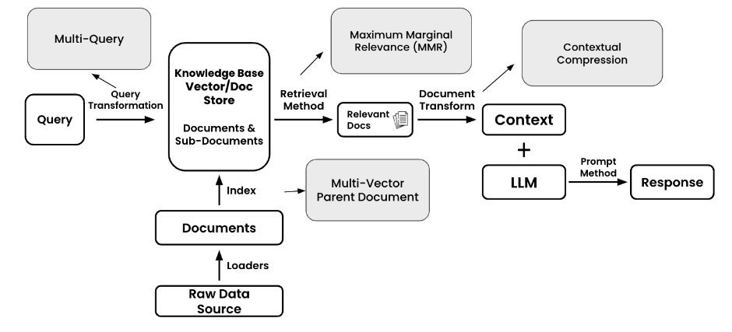
Retrieval Inventory
Full Stack Retrieval - Inventory

Slide 6
Retrieval Inventory
Below is a list of various retrieval techniques and resources grouped by which part of the stack they influence
Query Transformation – Augment, structure, or enhance your input query
Multi-Query – Generate additional questions/queries based on your original query to return more holistic documents
Index – Adjust your data structures and associations
Multi-Vector – In addition to you’re the normal embeddings of your documents it is sometimes helpful to have multiple alternative embeddings per document. These can include embeddings of summary, hypothetical questions, or any other custom text
Parent Document Retriever – A version of multi-vector where large chunks are further split up into smaller(child) chunks
Retrieval Methods – The method in which you pull documents out of your knowledge base
Top-K Similarity Search – Select the top K similar documents that match your query from your vector store.
Maximum Marginal Relevance (MMR) – Return similar but diverse documents. Great for when you’d like to remove redundancy in your context
Document Transform – Transform your documents before using them as context with your LLM
Contextual Compression – Extract contextually relevant information from your retrieved docs. Generally used to try and to increase signal:noise ratio

Slide 7
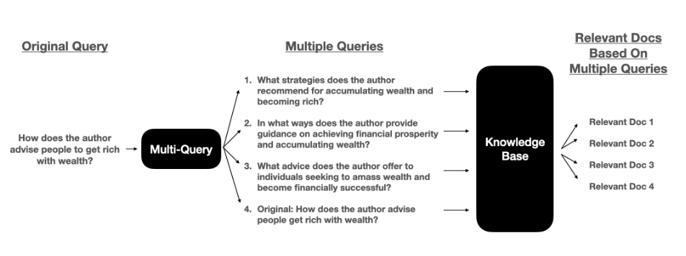
Query Transformation
Multi-Query
Why is this helpful?
Generally builders will use Multi-Query for two main reasons: Enhance a suboptimal query & Expand a results set
Enhance a suboptimal query
Users don't always give the best queries - They are just trying to user your product, not construct the perfect query.
To help with this, we turn to the multi-query method to help us fill in any gaps to a users query.
Expand a results set
With multiple queries, you'll likely get more results back from your database. The aim of multi-query is to have an expanded results sets which might be able to answer questions better than docs from a single query.
These results will be deduplicated (in case the same document comes back multiple times) and then used as context in your final prompt.

Slide 8
Indexing
Multi-Vector

Slide 9
Indexing
Parent Document Retriever

Slide 10
Document Loaders
Text Splitting (chunking)

Slide 11
Retrieval Methods
Maximum Marginal Relevance (MMR)

Slide 12
Retrieval Methods
Top-K Similarity Search

Slide 13
Document Transform
Contextual Compression

