Slide 1
Visualizing Your Data
The basics of visualization
Modeling data using data models
Reporting and alerting
The Pivot tool

Slide 2
The Basics of Visualization

Slide 3
Success in data visualization does not start with data visualization.
Cole Nussbaumer Knaflic, Storytelling with Data: A Data Visualization Guide for Business Professionals
Notes:
We have to know our audience and the story we are trying to tell.

Slide 4
Why Visualize Data?
Data alone is not very interesting to look at
Non-technical people might not be interested in tabular data
Visualizing data is more human centric
Humans are pattern recognizing machines
From an early age, we are taught to visualize data
Visualizations are art, and therefore have an emotional impact on us

Slide 5



Dimensions
Customer
Purchase Price
Date / Time
Dimension Something you want to measure
Notes:
A dimension is something we want to measure by. Think of a dimension as one side of a cube—that’s why we call cubes “three dimensions”
What are the dimensions of a cube? Height, width, and depth.
What if we want to measure something else, say date/time, customer, and purchase price?
Now, when we get a bunch of dates/times, a bunch of customers, and a bunch of purchase prices, we have a cube made up of smaller cubes.
Each small cube is one date/time, one customer, and one purchase price. This is called the grain. The grain is the lowest level of detail that satisfies the business requirement and that is in our data set.

Slide 6
Dataset
Time/Date | Customer | Purchase Price
Notes:
In Splunk, a dataset is a collection of data that (usually) knowledge managers define and maintain for a specific business purpose. I data set is full of dimensions by which you measure the data.

Slide 7
Data Model
Notes:
In Splunk, a data model is a collection of data sets. The Pivot tool we saw earlier in the class is powered by data models. Knowledge managers create data models so that data analysts can easily consume the data and use the Pivot tool to create reports and visualizations. This allows data analysts and business users to create powerful visualizations without needing to know SPL or the inner workings of Splunk.

Slide 8
Data Visualization Context
Understand your audience
Executives usually have different needs than individual contributors
Publicly available dashboards might display different data than internal-only reports and dashboards
Understand your own goals
What is the message for which you are using this visualization?
Like the famous “author’s purpose” consider the PIE: do you want to persuade, inform, or entertain?

Slide 9
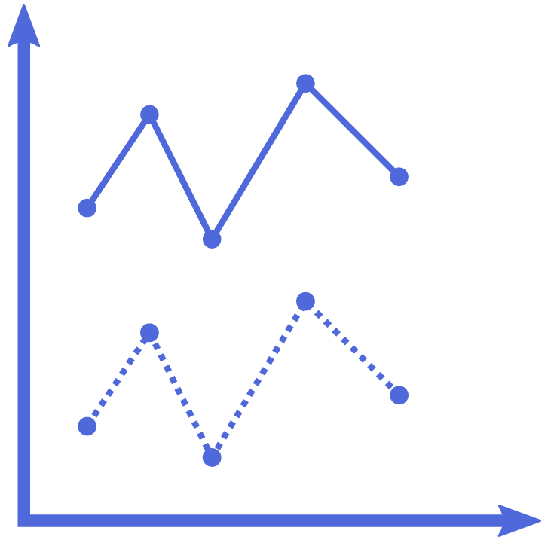




Types of Visualizations in Splunk
13.2 Hours
Average Ticket Resolution Time
Notes:
Here are just a few of Splunk’s chart types. These are the ones I see most often.
PIE – shows a single dimension with the slices representing frequency or density of values in a field.
Line – Show how a value changes over time
Area – Show changes in an aggregated over time
Column/Bar – Show discrete values. Great for comparing
Single value – When you have a number to communicate, use a single value.
Gauge – Show an aggregated metric compared to a range
Table / Heatmap

Slide 10
Data Models

Slide 11
Data Models
Make machine data easier to use
Simplify complex data through abstraction
Group specific types of data
© Adam Frisbee, adamfrisbee.com

Slide 12

Data Models
We see data models all the time in the “real world.”
$$a=\frac{1}{2}bh$$
© Adam Frisbee, adamfrisbee.com

Slide 13
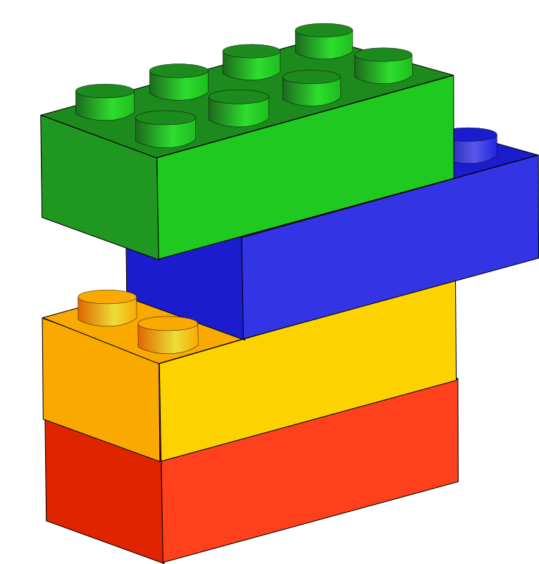
Data Models
Stacks of datasets
Datasets are stacks of knowledge objects
Knowledge objects include
Saved searches, field extractions, tags, and more
© Adam Frisbee, adamfrisbee.com, image from Open Clipart

Slide 14
Data Models
Root Events
Event Constraints
Event Knowledge
Child Events
Constraints
Knowledge Objects
Root Searches
Search Constraints
Search Knowledge
Child Searches
Constraints
Data Model
Knowledge Objects
© Adam Frisbee, adamfrisbee.com, image from Open Clipart
Notes:
Data models are hierarchical. They start with either a root event or root search. You can also have a root transaction, but one of the other two roots have to exist first.
Roots
These roots have constraints. At the root level, constraints should be broad. In fact, roots are required to have and index-level constraint.

Slide 15
Data Models
Events – most commonly used
Event constraints – Must include an index constraint (index=)
Searches – Spunk saved searches that include transforming commands, etc.
Search constraints – Constrained to the full search string (Must include an index constraint (index=))
Transactions – Combine multiple events from one or many sources into a single event
Transaction constraints – must be legally formed transaction search
© Adam Frisbee, adamfrisbee.com

Slide 16
Data Models
Fields
Can be added to roots and children
Children inherit all fields from their parent
Auto extracted – Splunk automatically discovered fields
Eval – A field generated as a result of an eval expression
Lookup – Fields that are the result of a lookup
Regular expression – Fields extracted by regex
© Adam Frisbee, adamfrisbee.com

Slide 17
Reporting and Alerting

Slide 18
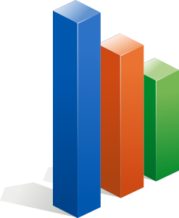

Reporting and Alerting
Reports and alerts are knowledge objects in Splunk
To create reports and alerts, you need a Splunk Enterprise license
The free license disables these features
© Adam Frisbee, adamfrisbee.com, images from Open Clipart

Slide 19
Reporting and Alerting
Reports
Saved searches that can run on a schedule and perform an action
Send an e-mail to report consumers
Embed on a web page
Update a dashboard panel
Run a script
© Adam Frisbee, adamfrisbee.com

Slide 20
Reporting and Alerting
Reports
Scheduled reports can run
Every hour
Every day
Every week
Every month
On a chron schedule that you define
You can stagger the report running window
Useful if you have a lot of reports running at the same time
© Adam Frisbee, adamfrisbee.com

Slide 21
Reporting and Alerting
Alerts
Can be scheduled or in real-time
Triggered when the results of a search meet a specific condition that you define
For example, if the search host=firewall1 user=* authentication=failed returns anything, trigger an alert
© Adam Frisbee, adamfrisbee.com

Slide 22
Reporting and Alerting
Alerts
Alert actions can include
Send an email
Trigger a script
Use a webhook
List in triggered alerts
Use an app (like PagerDuty or Slack)
© Adam Frisbee, adamfrisbee.com

Slide 23
The Pivot Tool

Slide 24

Why Use the Pivot Tool
Create dashboards, reports, and alerts without using SPL
Provides a drag-and-drop interface to Splunk users
Pivot functionality is built on data models

Slide 25
Basic Pivot Functions
Filter
Split by Row
Split by Column
Column Value
Notes:
Filtering reduces the size of the result set; the more you can filter at the beginning the more efficient use of Splunk resources (processing power, etc.). All pivots are filtered by a time range. The narrower you can define the time range, the better.
Split by row splits out the pivot results by row
Split by column split out the pivot results by column
Column value is numeric and represents aggregates, like sums and averages. Where the field is not numeric, this is used for counting the occurrences in a field.

Slide 26
Notes:
The reason it’s called pivot, like pivot tables in Excel or another spreadsheet, is because you can

Slide 27
Notes:
Literally pivot the rows and columns.

Slide 28
Build a dashboard
Explore an existing data model
Create visualizations in the pivot tool
Build a basic data model

Slide 29
Explored the pivot editor
Built reports and alerts
Built a data model

