Slide 1
Deploying Splunk
Deployment models
Storing data on disk
Licensing
Apps and add-ons

Slide 2
Deployment Models

Slide 3
Splunk Deployment Models
Cloud
On Premises
Notes:
Splunk offers two broad types of deployments, with every subtype we will talk about available in both Splunk Cloud or On Premises. To deploy an advanced configuration in Splunk Cloud, you’ll need to work with your Splunk representative, but anyone can provision a free Splunk Cloud trial with the basic deployment model.

Slide 4
The Splunk Data Pipeline
Input
Parsing
Indexing
Forwarded data, uploaded data, network data, scripts
Examines the data, adds metadata
Data divided into events. Writes the data to the disk in "buckets"
Searching
User interaction with the data
Notes:
No matter the type of deployment, the Splunk data pipeline is the same: Input, Parsing, Indexing, and Searching (IPIS)
To scale your system, you can split this functionality across multiple specialized instances of Splunk Enterprise. That’s right, no matter how large you scale, you are installing one of two types of Splunk instances: a forwarder, or a Splunk enterprise installation.
Input
Consumption of data from sources
Splunk does not look at the data contents here
Parsing – happens on the indexer or heavy forwarder
Examines, analyzes, and transforms the data
Identifying timestamps
Annotating data with metadata
Indexing
Takes the parsed data and writes it to indexes on disk, in the form of flat files stored on the indexer
Searching
Manages all the aspects of how the user interacts with the data.

Slide 5
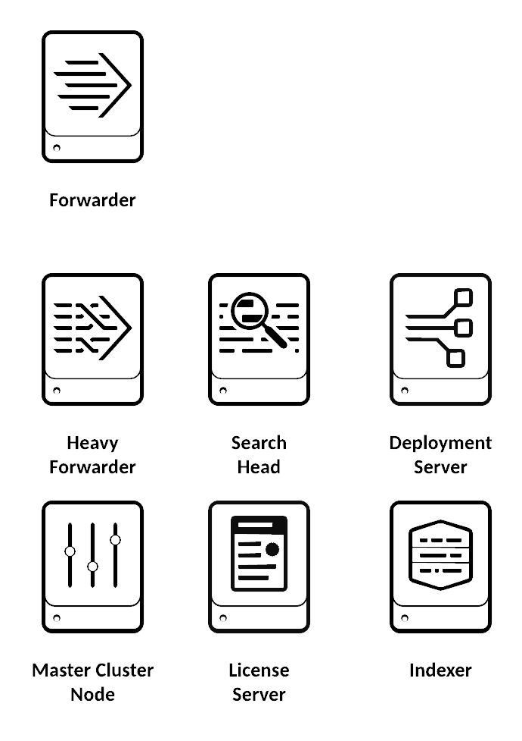
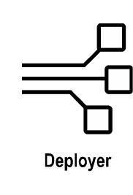
Splunk Deployment Models
© Adam Frisbee, adamfrisbee.com
Notes:
These are the physical components that make up any Splunk deployment. They can be configured to serve one of the four functions of Splunk (Data input, parsing, indexing, or searching).
There are only two different software packages you need to build any of these components.
Universal forwarders have a specific “light” software package that has minimal configuration
Everything else is a full version of Splunk Enterprise; you just configure it differently for different functions

Slide 6
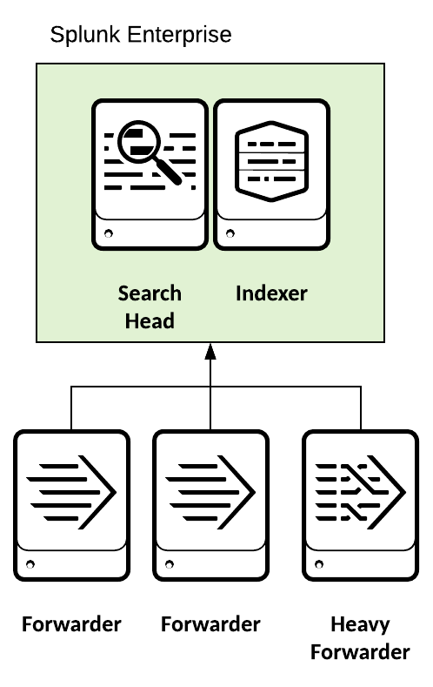
Splunk Deployment Models
Departmental Deployment
A single search head/indexer
Up to 10 forwarders
Appropriate for up to 10 users
© Adam Frisbee, adamfrisbee.com
Notes:
Let’s take a look at a few representative deployment types
The first one is a small or departmental deployment. In this scenario, you install Splunk Enterprise on a Windows or Linux machine.
It serves as the combined search head and indexer.
In this scenario, there are up to ten forwarders or heavy forwarders and 10 users

Slide 7
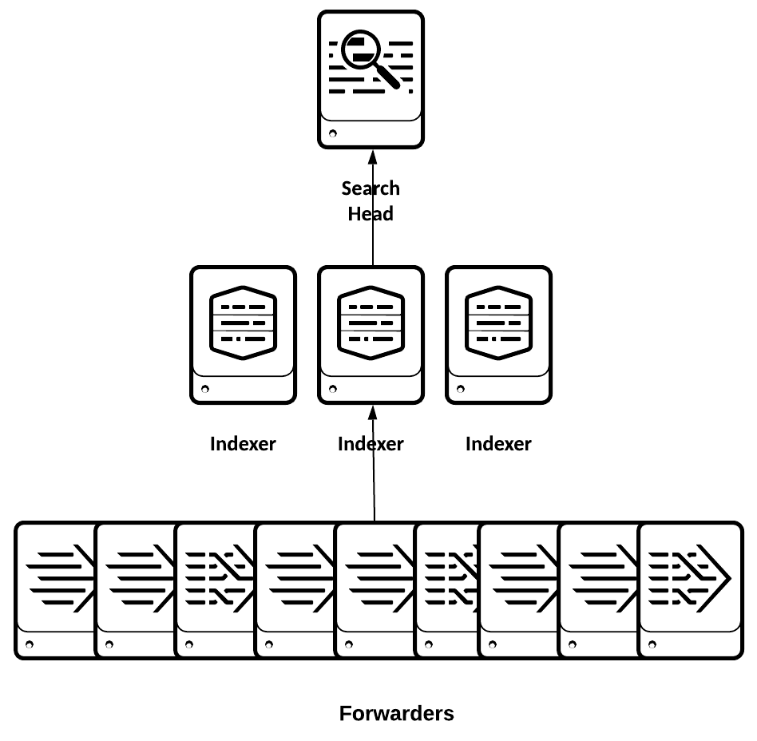
Splunk Deployment Models
Small Enterprise Deployment
A single search head
Two to three indexers
100 to 200 forwarders
© Adam Frisbee, adamfrisbee.com
Notes:
The second scenario is a small enterprise deployment
In this deployment we have a single, independent search head
Two to three load balanced indexers
100 to 200 forwarders
100 users

Slide 8
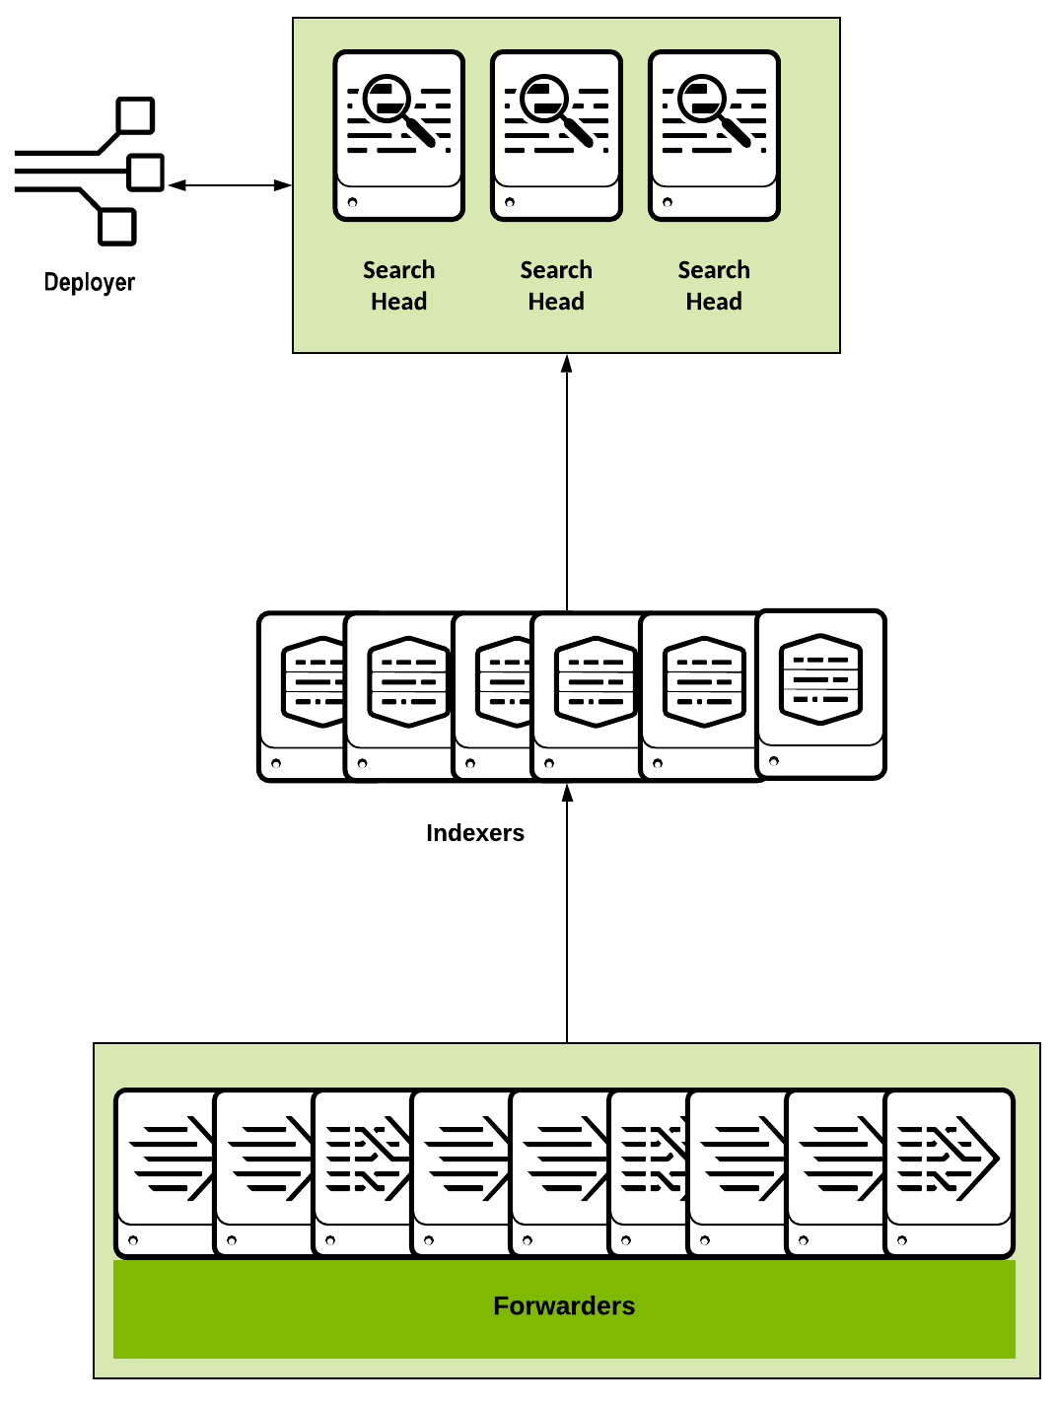
Splunk Deployment Models
Distributed Search Head
Search head cluster
Deployer
Many indexers
Thousands of load- balanced forwarders
© Adam Frisbee, adamfrisbee.com
Notes:
The third type of deployment is a distributed search head. In this configuration we build a search head cluster, governed by a deployer (not to be confused with a deployment server!). The deployer governs the members of the search head cluster. It distributes apps, files, configuration updates to all of the members through what is called a configuration bundle. A search head cluster is a group of search heads that serves as a central resource for searching. You can run the same searches, view the same dashboards, and access the same search results from any search head in the cluster. One of the members is assigned to be the search head cluster captain, and schedules jobs and replication activities among the cluster.

Slide 9
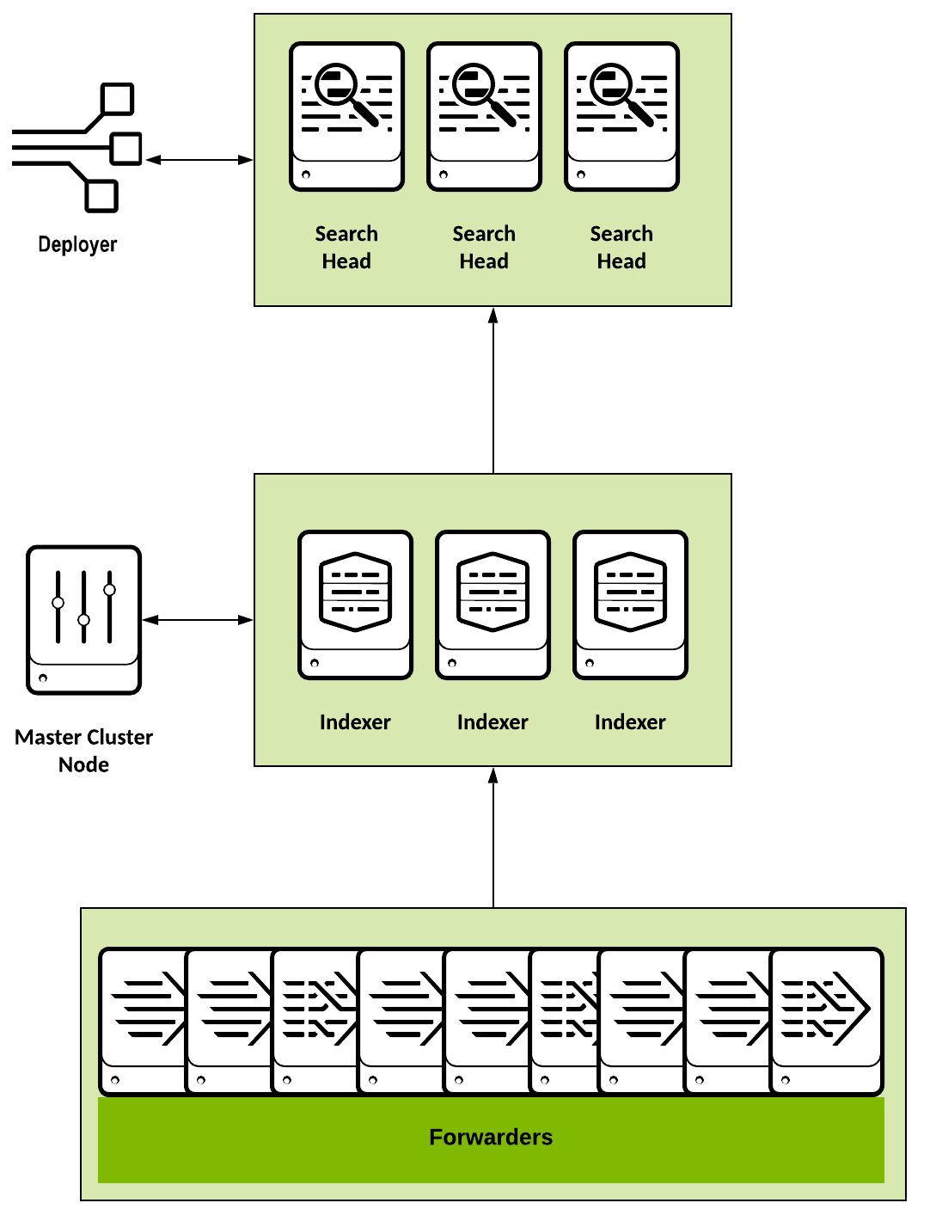
Splunk Deployment Models
Large Enterprise Deployment
Search head cluster
Indexer cluster
Thousands of load-balanced forwarders
© Adam Frisbee, adamfrisbee.com
Notes:
The fourth type of deployment has nearly infinite scalability superpowers. In this configuration we build search head clusters, indexer clusters, or both. This allows for near boundless horizontal scalability.
Here’s what clustering does:
An indexer cluster is a group of Splunk Enterprise indexers that are configured to replicate each others' data, so that the system keeps multiple copies of all data. This process is known as index replication. By maintaining multiple, identical copies of Splunk Enterprise data, the cluster prevents data loss while promoting data availability for searching. Splunk Enterprise clusters feature automatic failover from one indexer to the next. This means that, if one or more indexers fail, incoming data continues to get indexed and indexed data continues to be searchable.

Slide 10
How Splunk Stores Data

Slide 11

How Splunk Stores Data
A repository for Splunk data
Splunk transforms incoming data into events, and stores it in indexes
An event is a single row of data
© Adam Frisbee, adamfrisbee.com
Notes:
Index
When Splunk processes raw data, it adds that data to indexes. Indexes map to places on the disk, which Splunk calls “buckets”
Splunk comes with several indexes, and you can create your own indexes as well.
The default index is called “main”, Splunk also has an “_internal” index that stores internal logs and a few other indexes come with Splunk.

Slide 12

How Splunk Stores Data
A single row of data
Data is specified by fields (key=value pairs)
Splunk adds default fields to all events
[Fri Sep 09 10:42:29.902022 2011] [core:error] [pid 35708:tid 4328636416] [client 72.15.99.187] File does not exist: /usr/local/apache2/htdocs/favicon.ico
© Adam Frisbee, adamfrisbee.com
Notes:
Event
An event is a single row of data
Events have fields, which are key=value pairs. Splunk automatically looks for clear “key=value” entries in the data and creates fields. Splunk also looks for common key/value pairings that don’t necessarily have an equal sign.
Splunk also adds default fields to all events. They are
Timestamp
Host: the hostname or IP address of the source system
Source: name of the file, stream, or other input from which the event originates
Sourcetype: the format of the data. For example, Apache log files have a specific format, shown here in green

Slide 13
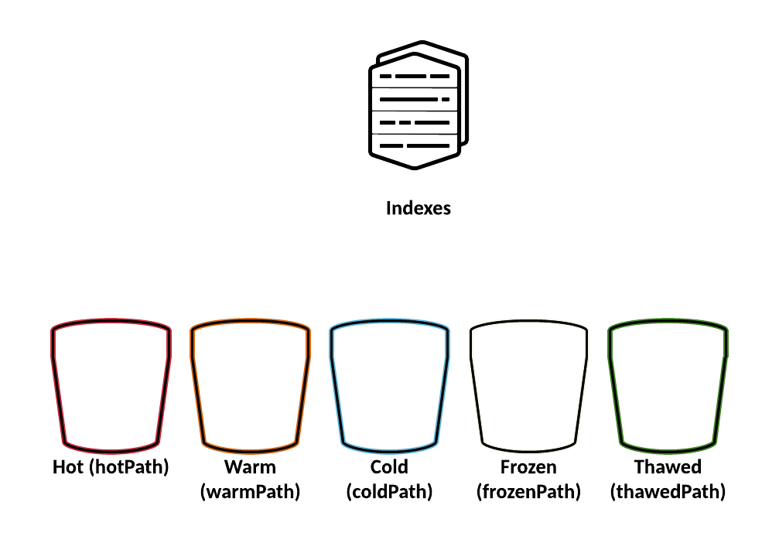
How Splunk Stores Data
© Adam Frisbee, adamfrisbee.com
Notes:
In Splunk, an index contains compressed raw data and associated index files.
These index files are spread out into different directories depending on their age.
Splunk calls these directories buckets
There are six buckets, but only five of them are important for us to talk about
Hot: Newly indexed data. An index has one or more hot buckets.
Warm: Data rolled from the hot bucket with no active writing. An index has many warm buckets.
Cold: Buckets rolled from warm and moved to a different location. An index has many cold buckets.
Frozen: Rolled from cold. The indexer deletes frozen buckets by default, but you can chose to archive them first.
Thawed: Buckets restored from an archive.

Slide 14

How Splunk Stores Data
$SPLUNK_HOME/var/lib/splunk/defaultdb/db/*
$SPLUNK_HOME/var/lib/splunk/defaultdb/db/*
$SPLUNK_HOME/var/lib/splunk/defaultdb/colddb/*
Location that you specify
$SPLUNK_HOME/var/lib/splunk/defaultdb/thaweddb/*
© Adam Frisbee, adamfrisbee.com
Notes:
Each bucket is a subdirectory. For example, in the hotPath, after the db/ we can have multiple hot buckets. Buckets have specific naming conventions (subdirectories) that we won’t go into here.

Slide 15
How Splunk Stores Data
Retirement
Archive
Back up
Configure Index Sizes
Partition index data
© Adam Frisbee, adamfrisbee.com
Notes:
Other things you can do with buckets
Set a retirement and archiving policy
Manually archive and restore from archive
Back up your data
Configure index sizes
Partition index data

Slide 16
Licensing

Slide 17

Splunk Licensing
You license data ingested per day, not data stored
Daily indexing volume is measured from midnight to midnight by the clock on the license master
© Adam Frisbee, adamfrisbee.com, Image from Open Clipart
Notes:
Other things that do not count against your license
Splunk internal log data
Duplicate data
Metadata

Slide 18
Splunk Licensing >
Standard
Enterprise Trial
Sales Trial
Dev/Test
Free
Industrial IoT
Forwarder
© Adam Frisbee, adamfrisbee.com
Notes:
License types
Standard Splunk Enterprise License
Available through a Splunk representative
Pay for different data consumption needs
Enterprise Trial License
Downloads and installs with product
Limited to 500 mb per day
Valid for 60 days, then converts into free
Sales Trial
Splunk sales representatives can customize trial licenses for more volume or longer durations for a specific POC
Dev/Test
Restricted to non-production Splunk staging environments
Free license
500 MB/day, no expiration
Also very limited features
No login
No alerting
No distributed architecture
etc.
Industrial IoT
A specialized license for Internet of Things use cases. Gives you access to Splunk Enterprise and a specific set of Splunk apps.
Forwarder license
Allows a Splunk instance to be installed as a heavy forwarder.

Slide 19
Starting with version 6.5, Splunk Enterprise no longer disables search when you exceed your licensed data ingestion quota.

Slide 20
Splunk Licensing
Warning
Violation
No enforcement
© Adam Frisbee, adamfrisbee.com
Notes:
If you exceed your licensed daily volume on any one calendar day, you get a warning
If you get five or more warnings in a rolling 30 day period, you are in violation
If you are in violation, Splunk will continue to send you messages, but it will not disable your search or any features. Splunk does this to allow for unexpected temporary bursts of data volume

Slide 21
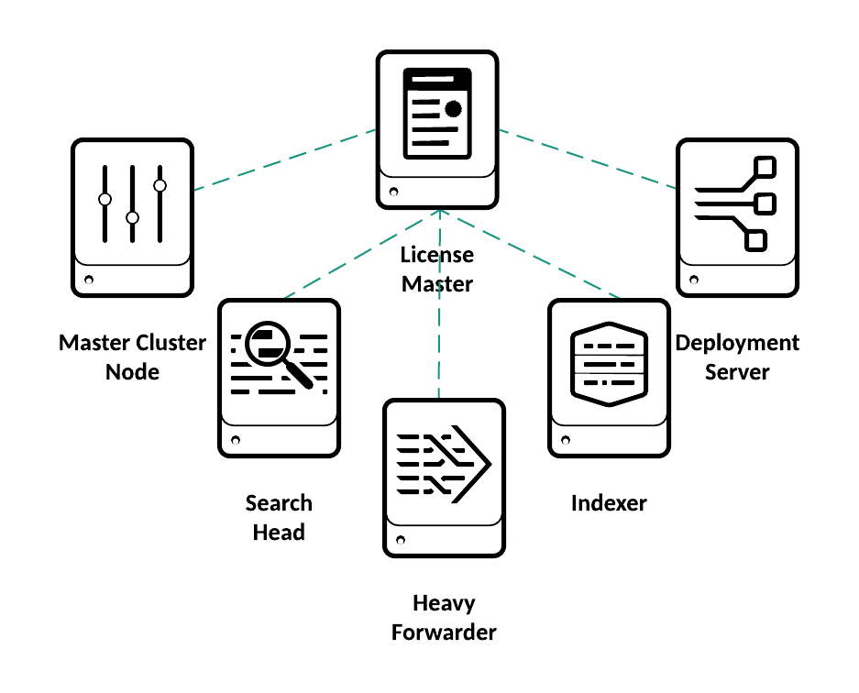
Splunk Licensing
© Adam Frisbee, adamfrisbee.com
Notes:
In a distributed environment, most Splunk Enterprise instances need access to an enterprise license
The exception is heavy forwarders, which only need a forwarder license, unless they are already indexing data, in which case they need enterprise licenses
The ideal way is to set up a license master and have all of the Splunk instances in your environment talk to the master to get their licenses
A collection of licenses whose individual licensing volume amounts aggregate to serve as a single unified amount of indexing volume is called a stack

Slide 22
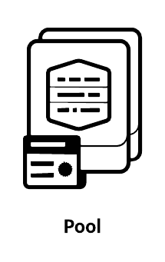
Splunk Licensing
License pools are created from license stacks
Pools are sized for specific purposes
Managed by the license master
Indexers and other Splunk Enterprise instances are assigned to a pool
© Adam Frisbee, adamfrisbee.com
Notes:
LICENSE POOLS are created from license stacks
Specific quantities of licensing volume can be allocated for specific purposes
The license master manages license pools
Indexers and other Splunk Enterprise instances are assigned to a pool
Splunk recommends not assigning forwarders to a license pool, since they have unique license types

Slide 23
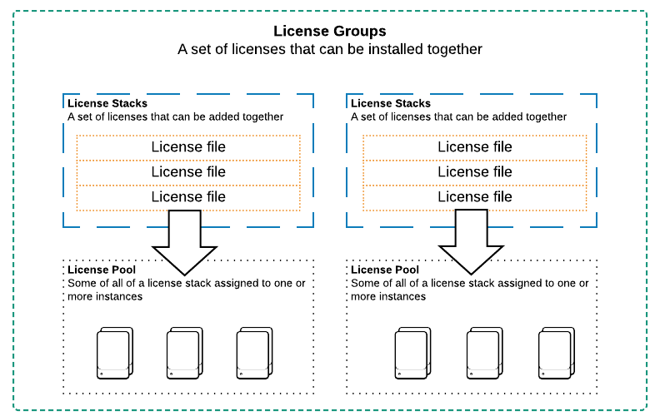
Splunk Licensing
© Adam Frisbee, adamfrisbee.com
Notes:
LICENSE GROUPS are sets of license stacks. A stack can only be a member of one group, and only one group can be “active” at any given time.
The groups are:
Enterprise/Sales Trial: Allows stacking of purchased enterprise licenses
Enterprise Trial: Default group. Cannot stack licenses
Free: No stacking
Forwarders: No stacking

Slide 24
Splunk Apps

Slide 25
Splunk Apps
Apps
Add-ons
Visualization
Data enrichment
Analysis
Tags
Reports & dashboards
Data models
User interface
Datasets
© Adam Frisbee, adamfrisbee.com
Notes:
Apps extend Splunk’s functionality
They enhance the user experience with built in dashboards, reports, alerts, saved searches, etc.
Add-ons primarily support apps
They enrich the incoming data with tags, data models, datasets, etc.
Apps and add-ons can be created by individuals, third party companies (Cisco), or Splunk
Apps and add-ons that are built by Splunk carry the ”Splunk Built” logo
Apps and add-ons that are certified by Splunk carry the “Splunk Certified” logo

Slide 26

Splunk Apps
foo.conf
bar.conf
baz.conf
© Adam Frisbee, adamfrisbee.com, Images from Open Clipart
Notes:
An app is a collection of Splunk configuration files

Slide 27
Splunk Apps
© Adam Frisbee, adamfrisbee.com, Images from Open Clipart
Notes:
An add-on is a subset of an app
Add-ons specify data collection, but do not have GUIs because they are part of the larger app

Slide 28
Splunk Apps
Splunkbase.com
Premium
Free
AppInspect Passed
Splunk Built
© Adam Frisbee, adamfrisbee.com
Notes:
Apps are downloaded from Splunkbase.com
Most apps are free, however there are a few premium apps for which you’ll need a license.
These include:
Splunk App for Enterprise Security
Splunk App for PCI Compliance
Splunk App for IT Service Management
Splunk App for User Behavior Analytics
Splunk App for VMware
Splunk App for Microsoft Exchange

Slide 29
Index data
Look at the indexes-”buckets”-on disk
Explore a license
Add the homework data set
Install an app
Download and install an app
Look at the .conf files

Slide 30
Splunk deployment topologies and when to use them
Indexes and storing data
How to not violate your license
Extending Splunk with apps and add-ons

