Slide 1
Introduction to Microsoft's new Quantum Development Kit
with Visual Studio 2017
https://github.com/achocoza

Slide 2
Description
This talk covers the basics of Q# and explains how it is used for quantum computing and prepares to the audience to start developing applications with Q# with simulators in Visual Studio 2017. Alicia will explain using an example showing how the Development Kit is installed and how to begin using the quantum development techniques.

Slide 3
Table of Contents:
Quantum computing concepts
Managing quantum machines and drivers
What is Q#?
Quantum development Techniques
Q# standard libraries
Q# Programming Language
Q# library reference
Installing Development Kit in Visual Studio 2017
Using Samples and learn how to make your own simulator
More Information

Slide 4
1.Quantum computing concepts

Slide 5
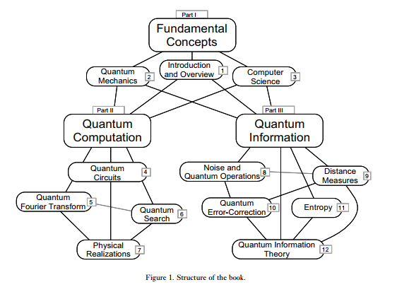

Slide 6
What is Quantum Computing?
A host of new computer technologies have emerged within the last few years, and quantum computing is arguably the technology requiring the greatest paradigm shift on the part of developers. Quantum computers were proposed in the 1980s by Richard Feynman and Yuri Manin. The intuition behind quantum computing stemmed from what was often seen as one of the greatest embarrassments of physics: remarkable scientific progress faced with an inability to model even simple systems. You see, quantum mechanics was developed between 1900 and 1925 and it remains the cornerstone on which chemistry, condensed matter physics and technologies ranging from computer chips to LED lighting ultimately rests. Yet despite these successes, even some of the simplest systems seemed to be beyond the human ability to model with quantum mechanics. This is because simulating systems of even a few dozen interacting particles requires more computing power than any conventional computer can provide over thousands of years!

Slide 7
The Development of Quantum Theory
In 1900, Planck made the assumption that energy was made of individual units, or quanta.
In 1905, Albert Einstein theorized that not just the energy, but the radiation itself was quantized in the same manner.
In 1924, Louis de Broglie proposed that there is no fundamental difference in the makeup and behavior of energy and matter; on the atomic and subatomic level either may behave as if made of either particles or waves. This theory became known as the principle of wave-particle duality: elementary particles of both energy and matter behave, depending on the conditions, like either particles or waves.
In 1927, Werner Heisenberg proposed that precise, simultaneous measurement of two complementary values - such as the position and momentum of a subatomic particle - is impossible. Contrary to the principles of classical physics, their simultaneous measurement is inescapably flawed; the more precisely one value is measured, the more flawed will be the measurement of the other value. This theory became known as the uncertainty principle, which prompted Albert Einstein's famous comment, "God does not play dice."

Slide 8
What is a quantum?
It’s a discrete quantity of energy proportional in magnitude to the frequency of the radiation it represents.
A qubit, or quantum bit , is a unit of quantum information.
A qubit can have 2 states 1/0, and works like a wire.
https://docs.microsoft.com/en-us/quantum/quantum-concepts-1-intro?view=qsharp-preview

Slide 9
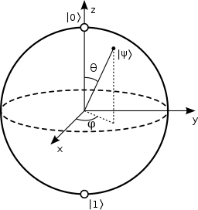
Bloch Sphere
In quantum mechanics, the Bloch sphere is a geometrical representation of the pure state space of a two-level quantum mechanical system (qubit), named after the physicist Felix Bloch.
The Bloch sphere is a unit 2-sphere, with antipodal points corresponding to a pair of mutually orthogonal state vectors. The north and south poles of the Bloch sphere are typically chosen to correspond to the standard basis vectors |0 and |1 respectively, which in turn might correspond e.g. to the spin-up and spin-down states of an electron.
https://docs.microsoft.com/en-us/quantum/quantum-concepts-4-qubit?view=qsharp-preview

Slide 10
Quantum Machines (simulations)
We will define additional quantum machine classes to support other types of simulation and to support execution on topological quantum computers. Allowing the algorithm to stay constant while varying the underlying machine implementation makes it easy to test and debug an algorithm in simulation and then run it on real hardware with confidence that the algorithm hasn't changed.

Slide 11
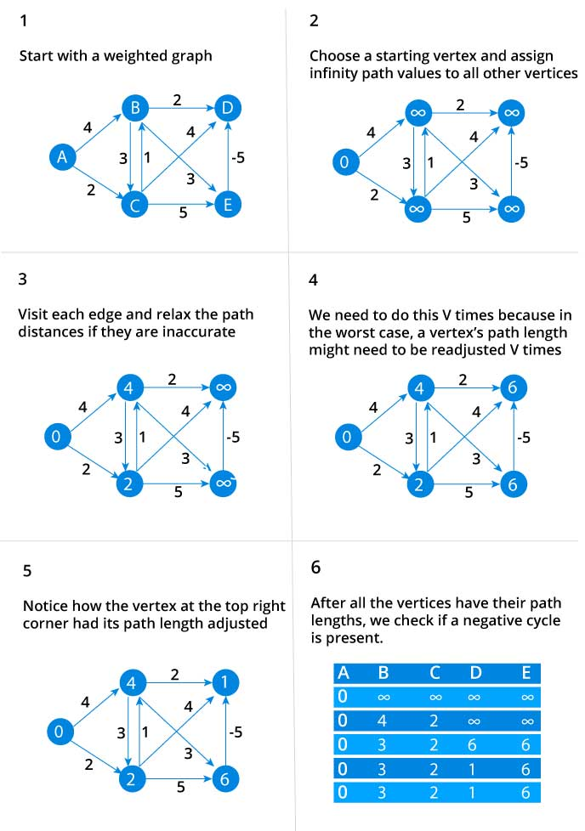
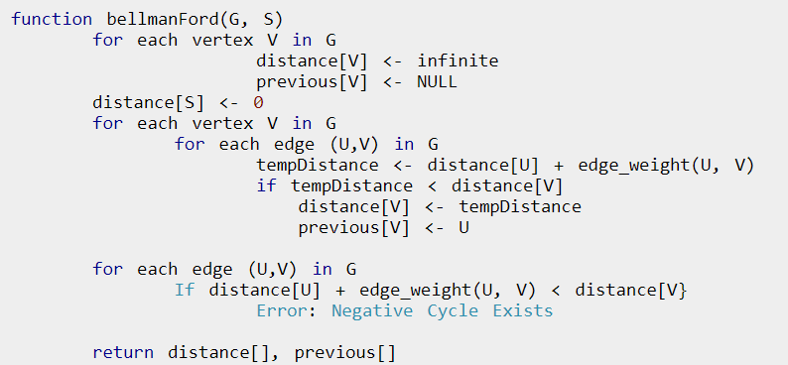
Bell algorithm
We need to maintain the path distance of every vertex. We can store that in an array of size v, where v is the number of vertices.
We also want to able to get the shortest path, not only know the length of the shortest path. For this, we map each vertex to the vertex that last updated its path length.
Once the algorithm is over, we can backtrack from the destination vertex to the source vertex to find the path.

Slide 12
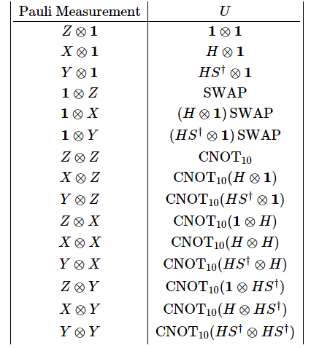

Pauli Mesaurements
The matrix of Pauli are threes (X,Y,Z)

Slide 13
QUANTUM CIRCUITS
Behavior is governed by quantum mechanics
Signal states are qubit vectors
Operations are defined by linear algebra over Hilbert
space and represented by unitary matrices
Gates and circuits must be reversible (information-lossless)
Number of output lines = Number of input lines
States cannot be copied so fan-out (“cloning”) is not allowed
Many universal gate sets and physical implementation
technologies exist (the best ones are not obvious)

Slide 14
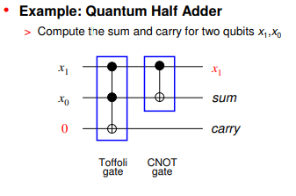
QUANTUM CIRCUITS
http://vlsicad.eecs.umich.edu/BK/Slots/cache/www.eecs.umich.edu/~jhayes/JPH_DACslides_Jun03.pdf

Slide 15


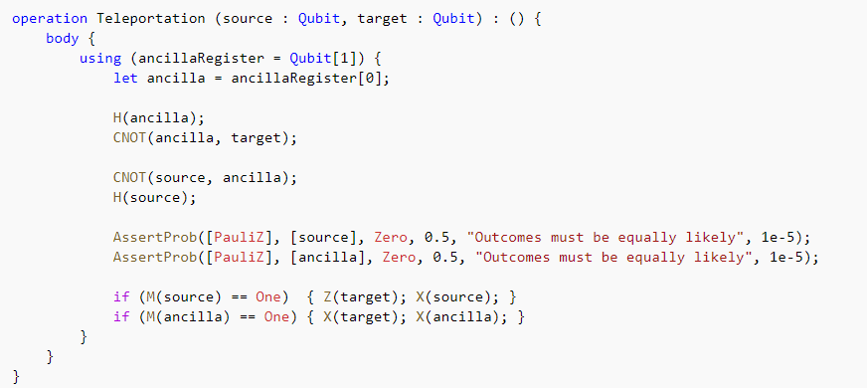
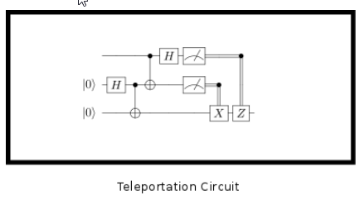
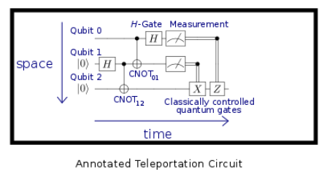
QUANTUM CIRCUITS
https://docs.microsoft.com/en-us/quantum/quantum-computer-trace-simulator-1?view=qsharp-preview

Slide 16
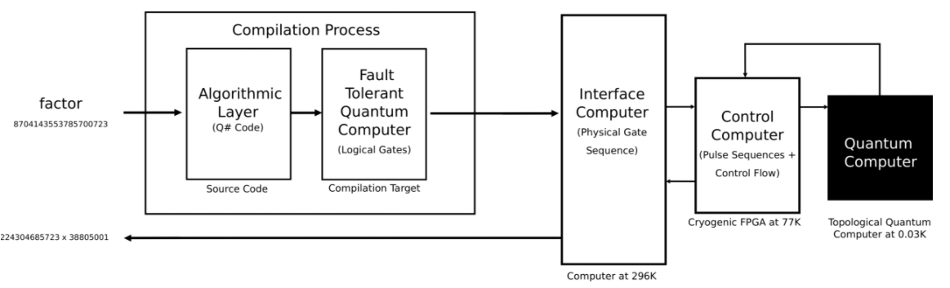
Quantum Computing Enviroment

Slide 17
2.Managing quantum machines and drivers

Slide 18
The Quantum Development Kit Execution Model
In Writing a quantum program, we executed our quantum algorithm by passing a Quantum Simulator object to the algorithm class's Run method. The Quantum Simulator class executes the quantum algorithm by fully simulating the quantum state vector, which is perfect for running and testing Teleport. See the Concepts guide for more on quantum state vectors.
Other target machines may be used to run a quantum algorithm. The machine is responsible for providing implementations of quantum primitives for the algorithm. This includes primitive operations such as H, CNOT, and Measure, as well as qubit management and tracking. Different classes of quantum machines represent different execution models for the same quantum algorithm.

Slide 19
Quantum Machines
In Writing a quantum program, we executed our quantum algorithm by passing a Quantum Simulator object to the algorithm class's Run method. The Quantum Simulator class executes the quantum algorithm by fully simulating the quantum state vector, which is perfect for running and testing Teleport. See the Concepts guide for more on quantum state vectors.
Other target machines may be used to run a quantum algorithm. The machine is responsible for providing implementations of quantum primitives for the algorithm. This includes primitive operations such as H, CNOT, and Measure, as well as qubit management and tracking. Different classes of quantum machines represent different execution models for the same quantum algorithm.
https://docs.microsoft.com/en-us/quantum/quantum-simulatorsandmachines?view=qsharp-preview

Slide 20
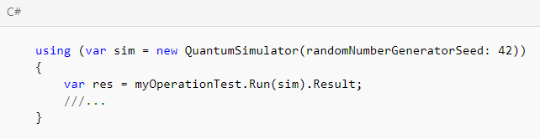
IDisposable
The QuantumSimulator class implements IDisposable thus the Dispose method should be called once the instance of the simulator is not used anymore. The best way to do this is to wrap the simulator within a using statement, as in the example above.
Seed
The QuantumSimulator uses a random number generator to simulate quantum randomness. For testing purposes, it is sometimes useful to have deterministic results. This can be accomplished by providing a seed for the random number generator in the QuantunSimulator's constructor via the randomNumberGeneratorSeed parameter:

Slide 21
Threads
The QuantumSimulator uses OpenMP to parallelize the linear algebra required. By default OpenMP uses all available hardware threads, which means that programs with small numbers of qubits will often run slowly because the coordination required will dwarf the actual work. This can be fixed by setting the environment variable OMP_NUM_THREADS to a small number. As a very rough rule of thumb, 1 thread is good for up to about 4 qubits, and then an additional thread per qubit is good, although this is highly dependent on your algorithm.

Slide 22
3. What is Q#?

Slide 23
What is Q#?
Q# (Q-sharp) is a domain-specific programming language used for expressing quantum algorithms. It is to be used for writing sub-programs that execute on an adjunct quantum processor, under the control of a classical host program and computer.
Q# provides a small set of primitive types, along with two ways (arrays and tuples) for creating new, structured types. It supports a basic procedural model for writing programs, with loops and if/then statements. The top-level constructs in Q# are user defined types, operations, and functions.

Slide 24
Natural model for quantum computation
In this model, there are three levels of computation:
Classical computation that reads input data, sets up the quantum computation, triggers the quantum computation, processes the results of the computation, and presents the results to the user.
Quantum computation that happens directly in the quantum device and implements a quantum algorithm.
Classical computation that is required by the quantum algorithm during its execution.

Slide 25
The Type Model
Q# provides several primitive types, out of which all other types are constructed:
The Int type represents a 64- bit signed (two's complement) integer.
The Double type represents a double-precision floating-point number.
The Bool type represents a Boolean value, either true or false.
The Qubit type represents a quantum bit or qubit. Qubits are opaque to the user; the only operation possible with them, other than passing them to another operation, is to test for identity (equality). Ultimately, actions on Qubits are implemented by calling operations in the Q# standard library.
The Pauli type represents an element of the single-qubit Pauli group. This type is used to denote the base operation for rotations and to specify the basis of a measurement. This type is a discriminated union with four possible values: PauliI, PauliX, PauliY, and PauliZ.
The Result type represents the result of a measurement. This type is a discriminated union with two possible values: One and Zero. Zero indicates that the +1 eigenvalue was measured; One indicates the -1 eigenvalue.
The Range type represents a sequence of integers.
The String type is a sequence of Unicode characters that is opaque to the user once created. This type is used to report messages to a classical host.

Slide 26
Other Types
Array types: Given any valid Q# type 'T, there is a type that represents an array of values of type 'T. This array type is represented as 'T[]; for example, Qubit[] or Int[][].
Tuple Type: Given any valid Q# types 'T1, 'T2, 'T3, etc., there is a type that represents a tuple of values of types 'T1, 'T2, 'T3, etc., respectively. This tuple type is represented as ('T1, 'T2, 'T3, …). Any number of types may be tupled together.
Singleton Tuple Equivalence: It is possible to create a singleton (single-element) tuple, ('T1), such as (5) or ([1;2;3]). However, Q# treats a singleton tuple as completely equivalent to a value of the enclosed type. That is, there is no difference between 5 and (5), or between 5 and (((5))), or between (5, (6)) and (5, 6).

Slide 27
4. Quantum development Techniques

Slide 28
Structure of Q# Source Files
Minimally, a Q# source file consists of a namespace declaration, which specifies a .NET namespace which will contain the definitions in the source file. Definitions from other Q# source files and libraries can be included using the open statement. For instance, most of the operations defining fundamental gates are defined in the Microsoft.Quantum.Primitive namespace. To make this available to our code, we simply open that namespace at the top of each file:
namespace Example {
open Microsoft.Quantum.Primitive;
// ...
}
https://docs.microsoft.com/en-us/quantum/quantum-techniques-1-qsharp_filestructure?view=qsharp-preview

Slide 29
Operations and Functions
As described above, the most basic building block of a quantum program written in Q# is an operation, which can either be called from classical .NET applications, e.g., using a simulator, or by other operations within Q#. Each operation takes an input, produces an output, and minimally consists of a body listing one or more instructions. For instance, the following operation takes a single qubit as its input, then calls the built-in X operation on that input:
operation BitFlip(target : Qubit) : () {
body {
X(target);
}
}
https://docs.microsoft.com/en-us/quantum/quantum-techniques-2-operationsandfunctions?view=qsharp-preview

Slide 30

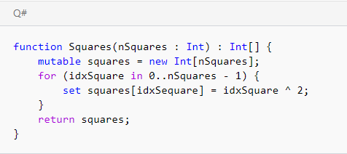
Local Variables
A value of any type in Q# can be assigned to a variable for reuse within an operation or function by using the let keyword. For instance:
Mutability
As an alternative to creating a variable with let, the mutable keyword will create a special mutable variable that can be changed after it is initially created by using the set keyword. If a mutable variable is an array type, then the elements of that array can also be changed. This is very useful, for instance, for creating arrays programmatically:
https://docs.microsoft.com/en-us/quantum/quantum-techniques-3-localvariables?view=qsharp-preview

Slide 31
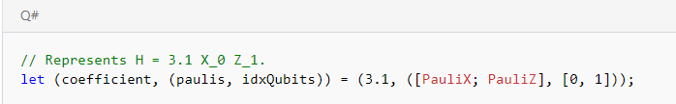
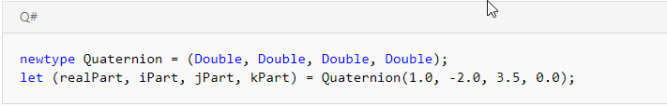
Deconstruction
In addition to assigning a single variable, the let keyword also allows for unpacking the contents of a tuple type. An assignment of this form is said to deconstruct the elements of that tuple. For instance, if we model a term in a Hamiltonian by a tuple, then we can use deconstruction to access the different data that we need to simulate under that term:
We can also use deconstruction to access the different parts of a user-defined type:
https://docs.microsoft.com/en-us/quantum/quantum-techniques-3-localvariables?view=qsharp-preview

Slide 32
5. Q# standard libraries

Slide 33
Introduction to the Q# Standard Libraries
Q# is supported by a range of different useful operations, functions, and user-defined types that comprise the Q# standard library. The Q# standard library is split into two main parts:
The prelude: operations and functions defined as a part of the target machine and compiler, typically in classical native .NET code. In general, different target machines may have different implementations of the prelude appropriate to each system.
The canon: operations and functions defined in Q# building on the logic defined in the prelude. The canon implementation is agnostic with respect to target machines.
The Microsoft.Quantum.Development.Kit NuGet package installed during installation and validation provides a target machine which implements the prelude by calling into a local simulator, while the Microsoft.Quantum.Canon package provides an implementation of the canon that references definitions in the prelude.

Slide 34
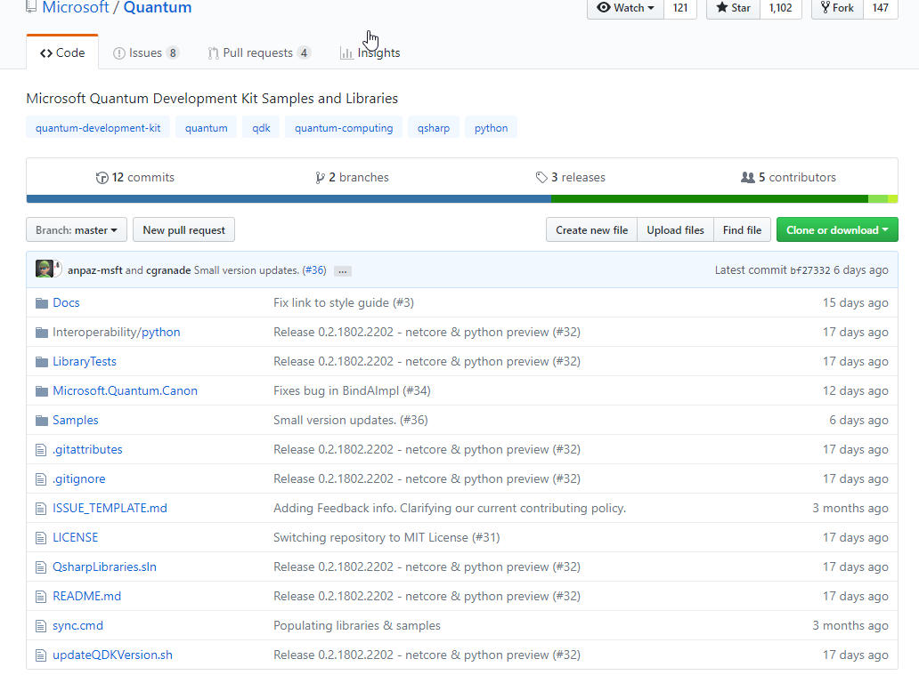
Licensing
The canon is an extensive collection of library functions and operations and is open source, licensed under the MIT license. It can be obtained from the Microsoft/Quantum repository on GitHub.
Microsoft's Quantum Development Kit also provides specialized library functions and operations that are licensed under a Microsoft Research license. These can be obtained from the Microsoft/Quantum-NC repository on GitHub.

Slide 35
6. Q# Programming Language

Slide 36
Primitive Types
The Q# language provides a small set of primitive types that can be used throughout operations and functions.
Int: Represents 64-bit signed integers, e.g.: 2, 107, -5.
Double: Represents double-precision floating point numbers, e.g.: 0.0, -1.3, 4e-7.
Bool: Represents a condition which can either be true or false.
Pauli: Represents one of the Pauli matrices, either PauliI, PauliX, PauliY, or PauliZ.
Result: Represents the result of a measurement in the computational basis, either Zero for |0⟩|0⟩ or One for |1⟩|1⟩.
Range: Represents a consecutive sequence of integers, denoted by start..step..stop. E.g: 1..2..7 represents the sequence 1,3,5,71,3,5,7.
String: Represents a message to be reported in the case of an error or diagnostic event.
https://docs.microsoft.com/en-us/quantum/quantum-techniques-4-typemodel?view=qsharp-preview

Slide 37
Tuple Types
Given zero or more different types T0, T1, ..., Tn, we can denote a new tuple type as (T0, T1, ..., Tn). Values of the new tuple type are tuples formed by sequences of values from each type in the tuple. For instance, (3, false) is a tuple whose type is the tuple type (Int, Bool). The types used to construct a new tuple type can themselves be tuples, as in (Int, (Qubit, Qubit)). Such nesting is always finite, however, as tuple types cannot under any circumstances contain themselves.
Tuples are a powerful concept used throughout Q# to collect values together into a single value, making it easier to pass them around. In particular, using tuple notation, we can express that every operation and callable takes exactly one input and returns exactly one output.
In Q#, a tuple type with exactly one element is considered to be equivalent to the type of that element alone, a property known as singleton tuple equivalence. For instance, there is no difference between the types Qubit, (Qubit), and ((((Qubit)))). In particular, this means that an operation or function whose input tuple or output tuple type has one field can be thought of as taking a single argument or returning a single value.
https://docs.microsoft.com/en-us/quantum/quantum-techniques-4-typemodel?view=qsharp-preview

Slide 38
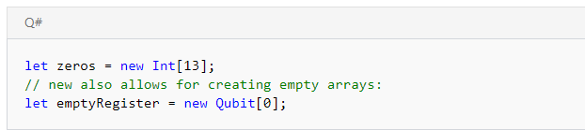
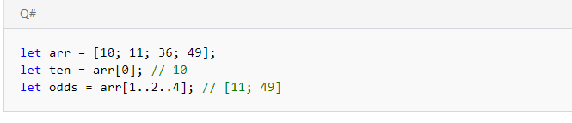
Array Types
Given any other type T, the type T[] denotes an array of values of that type. For instance, a collection of integers is denoted Int[], while an array of arrays of (Bool, Pauli) values is denoted (Bool, Pauli)[][]. Alternatively, an array can be created from its size using the new keyword:
https://docs.microsoft.com/en-us/quantum/quantum-techniques-4-typemodel?view=qsharp-preview

Slide 39
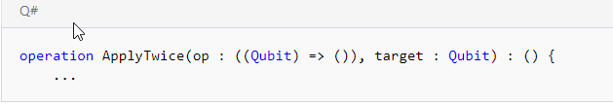
Operation and Function Types
As noted above, operations and functions are values in and of themselves in Q#. The types of these values are constructed from the types of the input and output tuples that each operation and function takes and returns. To see this in practice, let's consider the ApplyTwice example from above:
https://docs.microsoft.com/en-us/quantum/quantum-techniques-4-typemodel?view=qsharp-preview

Slide 40

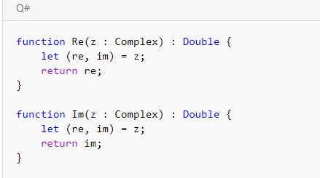
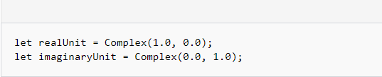
User-Defined Types
The final way to construct new types in Q# is with user-defined types (UDTs). For any tuple type T, we can declare a new user-defined type that is a subtype of T with the newtype statement. In the Microsoft.Quantum.Canon namespace, for instance, complex numbers are defined as a user-defined type:
https://docs.microsoft.com/en-us/quantum/quantum-techniques-4-typemodel?view=qsharp-preview

Slide 41
7. Q# library reference

Slide 42
Common Libraries
Microsoft.Quantum.Simulation.Simulators.QCTraceSimulatorsNamespace
DistinctInputsCheckerException
GateTimes
InvalidatedQubitsUseCheckerException
MetricsCountersNames
MetricsNames
MetricsNames.DepthCounter
MetricsNames.WidthCounter
PrimitiveOperationsGroupsNames
QCTraceSimulator
QCTraceSimulatorConfiguration
QubitTimeMetricsException
StatisticsNames
UnconstrainedMeasurementException

Slide 43
8.Installing Development Kit in Visual Studio 2017

Slide 44
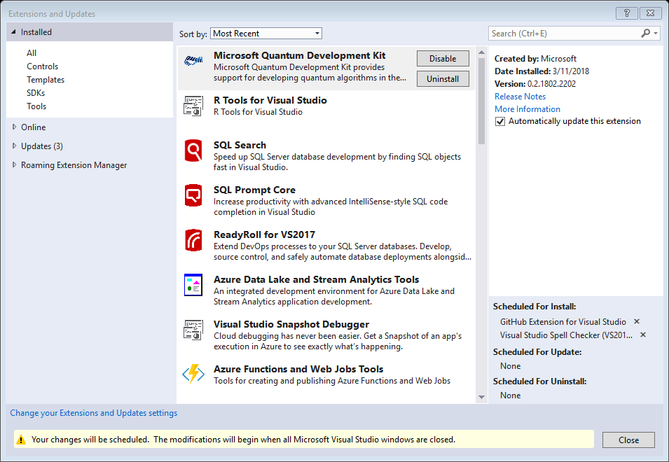

Slide 45
Prerequisites
Required Prerequisites
A 64-bit installation of Windows, macOS, or Linux. (the Microsoft Quantum Development Kit has been tested under Ubuntu Linux, but may work on other distributions).
The .NET Core SDK 2.0 or later.
Optional Prerequisites
A development environment with .NET Core support:
For Windows: We recommend Visual Studio 2017 and the Microsoft Quantum Development Kit extension. You can also use Visual Studio Code and the Microsoft Quantum Development Kit for Visual Studio Code extension.
For macOS or Linux: We recommend Visual Studio Code and the Microsoft Quantum Development Kit for Visual Studio Code extension.
If you do not have Visual Studio installed, you can download Visual Studio 2017 Community Edition for free.

Slide 46
Installing a Validating the Q# Development Enviroment
In Writing a quantum program, we wrote a simple C# driver for our bell algorithm. A C# driver has 4 main purposes:
Constructing the target machine
Computing any arguments required for the quantum algorithm
Running the quantum algorithm using the simulator
Processing the result of the operation

Slide 47
9. Using Samples and learn how to make your own simulator

Slide 48
Writing a Quantum Program
Step 1: Before of Beginning check that you have installed the Development Kit
https://marketplace.visualstudio.com/items?itemName=quantum.DevKit
Step 2: Check that you have installed the NuGet Package for Microsoft.Quantum.Canon, Go to Tools/NuGet Package Manager / Package Manager Console… and
Install-Package Microsoft.Quantum.Canon -Version 0.2.1802.2202-preview
Step 3: Create a Project and Solution
Open up Visual Studio 2017. Go to the File menu and select New > Project.... In the project template explorer, under Installed > Visual C#, select the Q# Application template. Make sure you have .NET Framework 4.6.1 selected in the list at the top of the New Projectdialog box. Give your project the name Bell.

Slide 49
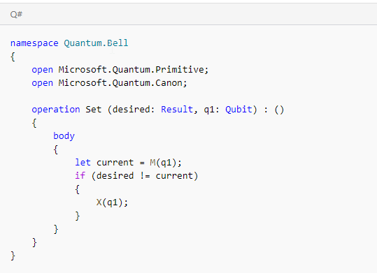
Writing a Quantum Program
Step 4: Enter the Q# Code

Slide 50
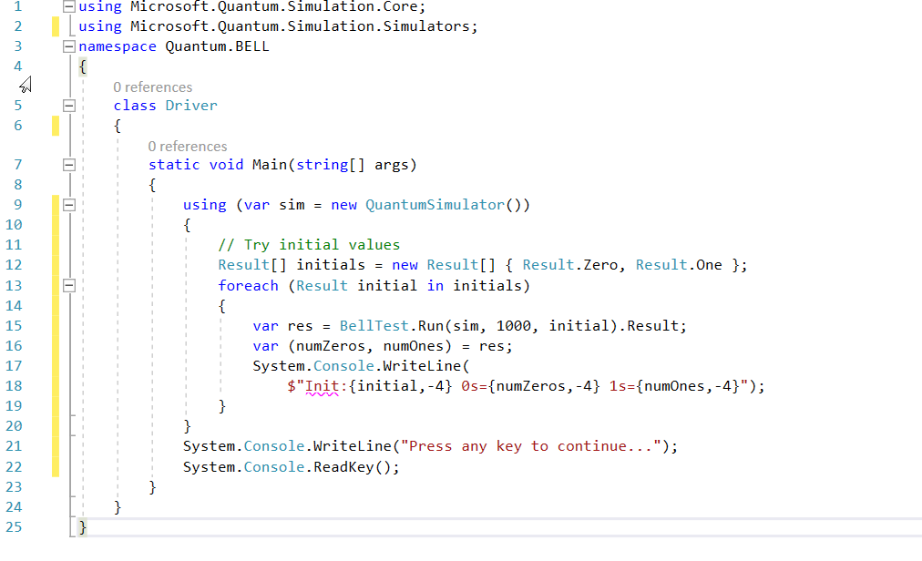
Writing a Quantum Program
Step 5: Enter the C# Code

Slide 51
10. More Information

Slide 52
Basic quantum computing
Nielsen, M. A. & Chuang, I. L. (2010). Quantum Computation and Quantum Information. Quantum Computation and Quantum Information, UK: Cambridge University Press, 2010.
Kitaev, A. Y., Shen, A., & Vyalyi, M. N. (2002). Classical and quantum computation (Vol. 47). Providence: American Mathematical Society.
Kaye, P., Laﬂamme, R., & Mosca, M. (2007). An introduction to quantum computing. Oxford University Press.
Rieﬀel, E. G., & Polak, W. H. (2011). Quantum computing: A gentle introduction. MIT Press.

Slide 53
Elementary techniques for building controlled gates
Barenco, A., Bennett, C. H., Cleve, R., DiVincenzo, D. P., Margolus, N., Shor, P., ... & Weinfurter, H. (1995). Elementary gates for quantum computation. Physical Review A, 52(5), 3457.
Jones, C. (2013). Low-overhead constructions for the fault-tolerant Toﬀoli gate. Physical Review A, 87(2), 022328

Slide 54
Techniques for preparing quantum states
Shende, V. V., Markov, I. L., & Bullock, S. S. (2004). Minimal universal two-qubit controlled-NOT-based circuits. Physical Review A, 69(6), 062321.
Ozols, M., Roetteler, M., & Roland, J. (2013). Quantum rejection sampling. ACM Transactions on Computation Theory (TOCT), 5(3), 11.
Grover, L., & Rudolph, T. (2002). Creating superpositions that correspond to eﬃciently integrable probability distributions. arXiv preprint quant-ph/0208112.
Farhi, E., Goldstone, J., Gutmann, S., & Sipser, M. (2000). Quantum computation by adiabatic evolution. arXiv preprint quant-ph/0001106.

Slide 55
Approaches for synthesizing circuits out of H, T and CNOT gates
Kliuchnikov, V., Maslov, D., & Mosca, M. (2013). Asymptotically optimal approximation of single qubit unitaries by Cliﬀord and T circuits using a constant number of ancillary qubits. Physical Review Letters, 110(19), 190502.
Ross, N. J., & Selinger, P. (2014). Optimal ancilla-free Cliﬀord+ T approximation of z-rotations. arXiv preprint arXiv:1403.2975.
Kliuchnikov, V. (2013). Synthesis of unitaries with Cliﬀord+ T circuits. arXiv preprint arXiv:1306.3200.
Jones, N. C., Whitﬁeld, J. D., McMahon, P. L., Yung, M. H., Van Meter, R., Aspuru-Guzik, A., & Yamamoto, Y. (2012). Faster quantum chemistry simulation on fault-tolerant quantum computers. New Journal of Physics, 14(11), 115023.

Slide 56
Approaches for quantum arithmetic
Takahashi, Y., & Kunihiro, N. (2005). A linear-size quantum circuit for addition with no ancillary qubits. Quantum Information & Computation, 5(6), 440-448.
Draper, T. G. (2000). Addition on a quantum computer. arXiv preprint quant-ph/0008033.
Soeken, M., Roetteler, M., Wiebe, N., & De Micheli, G. (2017, March). Design automation and design space exploration for quantum computers. In 2017 Design, Automation & Test in Europe Conference & Exhibition (DATE) (pp. 470-475). IEEE.

Slide 57
Methods for fast quantum sampling (amplitude amplification) and probability estimation
Brassard, G., Hoyer, P., Mosca, M., & Tapp, A. (2002). Quantum amplitude ampliﬁcation and estimation. Contemporary Mathematics, 305, 53-74.
Grover, L. K. (2005). Fixed-point quantum search. Physical Review Letters, 95(15), 150501.
Berry, D. W., Childs, A. M., & Kothari, R. (2015, October). Hamiltonian simulation with nearly optimal dependence on all parameters. In Foundations of Computer Science (FOCS), 2015 IEEE 56th Annual Symposium on (pp. 792-809). IEEE.

Slide 58
Algorithms for quantum simulation
Lloyd, S. (1996). Universal Quantum Simulators. Science (New York, NY), 273(5278), 1073.
Berry, D. W., Childs, A. M., Cleve, R., Kothari, R., & Somma, R. D. (2015). Simulating Hamiltonian dynamics with a truncated Taylor series. Physical Review Letters, 114(9), 090502.
Low, G. H., & Chuang, I. L. (2017). Optimal Hamiltonian simulation by quantum signal processing. Physical Review Letters, 118(1), 010501.
Low, G. H., & Chuang, I. L. (2016). Hamiltonian simulation by qubitization. arXiv preprint:1610.06546.
Reiher, M., Wiebe, N., Svore, K. M., Wecker, D., & Troyer, M. (2017). Elucidating reaction mechanisms on quantum computers. Proceedings of the National Academy of Sciences, 201619152.
Wiebe, N., Berry, D. W., Høyer, P., & Sanders, B. C. (2011). Simulating quantum dynamics on a quantum computer. Journal of Physics A: Mathematical and Theoretical, 44(44), 445308.
Peruzzo, A., McClean, J., Shadbolt, P., Yung, M. H., Zhou, X. Q., Love, P. J., ... & Obrien, J. L. (2014). A variational eigenvalue solver on a photonic quantum processor. Nature communications, 5.

Slide 59
Procedures for quantum optimization
Durr, C., & Høyer, P. (1996). A quantum algorithm for ﬁnding the minimum. arXiv preprint quantph/9607014.
Farhi, E., Goldstone, J., & Gutmann, S. (2014). A quantum approximate optimization algorithm. arXiv preprint arXiv:1411.4028.
Brandao, F. G., Svore, K. M. (2017). Quantum Speed-ups for Semideﬁnite Programming. In Annual Symposium on Foundations of Computer Science (FOCS 2017).

