Slide 1

AI Text to Speech (TTS) and Speech to Text (STT)
Revolutionizing Modern Communication

Slide 2
Agenda
Introduction to TTS and STT: Fundamentals and Applications
Advancements and Challenges in TTS and STT
Use Cases and Applications: From Virtual Assistants to Accessibility
Networking and Discussion: The Future of AI-driven Speech Technologies

Slide 3
What is Text-to-Speech?
At its essence, TTS is a synthesis process that converts text into spoken words. This process has had a rich historical development, evolving from simple text-reading machines to the sophisticated systems we use today. Today, TTS relies on advanced deep learning algorithms and neural networks, allowing for the development of more natural and expressive voices.

Slide 4
The process behind TTS technology is a series of complex yet fascinating steps.
1. Initially, the system performs text analysis, dissecting sentences and words to understand their structure and meaning.
2. This is followed by linguistic processing, where the text is converted into phonemes. Think of it as translating the written word into a language that machines can understand and speak.
3. Subsequently, a linguistic processing component interprets the analyzed text, assigning appropriate prosody, rhythm, and intonation to create a natural flow.
4. The final act is voice synthesis, where the magic truly happens. Here, the voice synthesis component generates the audible output, producing speech that closely mimics human conversation.

Slide 5
Introduction to TTS and STT
TTS: Converting Written Text into Spoken Voice
STT: Transforming Spoken Language into Text Format
Key for Seamless Interactions Between Humans and Devices
Enhanced by Deep Learning Models for Natural Sounding Voices

Slide 6
Advancements in TTS and STT
Deep Learning Models: From WaveNet to Tacotron
Improvements in Natural Language Processing
Voice Biometrics for Personalization and Security

Slide 7
Challenges in TTS and STT
Recognizing Diverse Accents and Dialects
Managing Background Noise and Speech Overlapping
Continuous Need for High-Quality Training Data

Slide 8
Use Cases and Applications
Audiobooks, Virtual Assistants, and Navigation Systems
Voice Typing, Transcriptions, and Voice Commands
Smart Homes, Educational Tools, and Customer Service Enhancements

Slide 9
Sample to use
Implementing Text-to-Speech in C# using System.Speech.Synthesis – CodeProject
https://learn.microsoft.com/en-us/azure/ai-services/speech-service/get-started-text-to-speech?tabs=windows%2Cterminal&pivots=programming-language-csharp
https://learn.microsoft.com/en-us/azure/ai-services/speech-service/
How to use whisper openai api with node js javascript - unitedtoptech.com
https://www.youtube.com/watch?v=VfJN4U0KAis&ab_channel=UnitedTopTech
https://platform.openai.com/docs/api-reference/audio

Slide 10
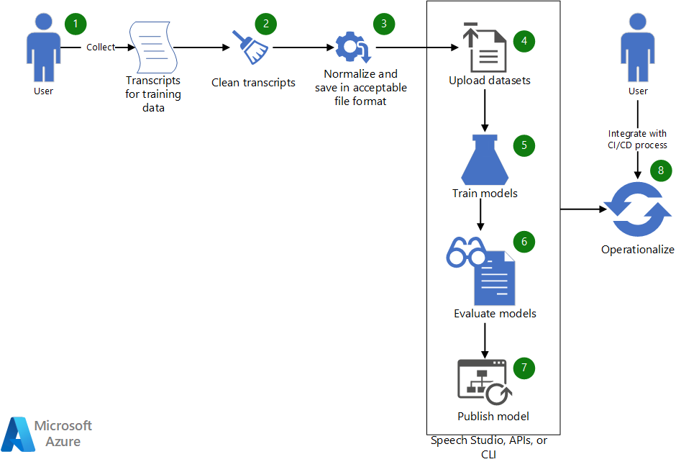
Azure
https://www.youtube.com/watch?v=GoH6wcOEsnQ&t=29s&ab_channel=NeuralTTS
Workflow
Collect existing transcripts to use to train a custom speech model.
If the transcripts are in WebVTT or SRT format, clean the files so that they include only the text portions of the transcripts.
Normalize the text by removing any punctuation, separating repeated words, and spelling out any large numerical values. You can combine multiple cleaned-up transcripts into one to create one dataset. Similarly, create a dataset for testing.
After the datasets are ready, upload them by using Speech Studio. Alternatively, if the dataset is in a blob store, you can use Azure Speech-to-text API and the Speech CLI. In the API and the CLI, you can pass the dataset's URI an input to create a dataset for model training and testing.
In Speech Studio or via the API or CLI, use the new dataset to train a custom speech model.
Evaluate the newly trained model against the test dataset.
If the performance of the custom model meets your quality expectations, publish it for use in speech transcription. Otherwise, use Speech Studio to review the word error rate (WER) and specific error details and determine what additional data is needed for training.
Use the APIs and CLI to help operationalize the model building, evaluation, and deployment process.
Learning how works
Azure-Samples

Slide 11
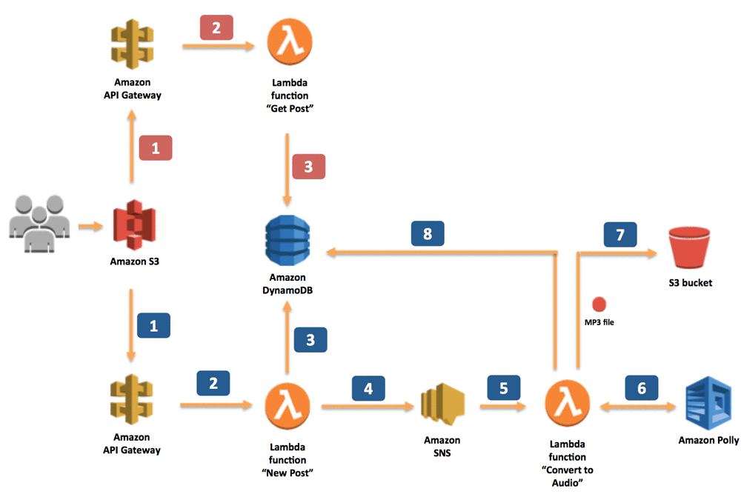
Amazon Polly
When the application sends information about new posts:
The information is received by the RESTful web service exposed by Amazon API Gateway. In our scenario, this web service is invoked by a static webpage hosted on Amazon Simple Storage Service (Amazon S3).
Amazon API Gateway sets off a dedicated Lambda function, “New Post,” which is responsible for initializing the process of generating MP3 files.
The Lambda function inserts information about the post into a DynamoDB table, where information about all posts is stored.
To run the whole process asynchronously, we use Amazon SNS to decouple the process of receiving information about new posts and starting their conversion.
Another Lambda function, “Convert to Speech,” is subscribed to our SNS topic whenever a new message appears (which means that a new post should be converted into an audio file). This is the trigger.
The “Convert to Speech” Lambda function uses Amazon Polly to convert the text into an audio file in the specified language (the same as the language of the text).
The new MP3 file is saved in a dedicated S3 bucket.
Information about the post is updated in the DynamoDB table. Then, the reference (URL) to the S3 bucket is saved with the previously stored data.
https://aws.amazon.com/blogs/machine-learning/build-your-own-text-to-speech-applications-with-amazon-polly/

Slide 12
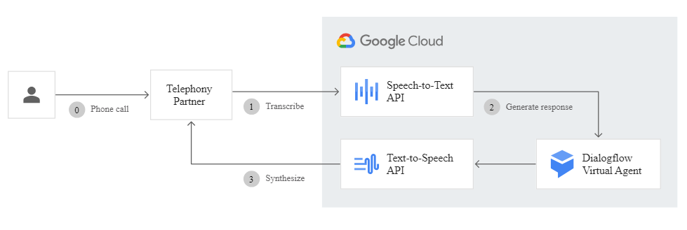
Google
https://cloud.google.com/text-to-speech#voicebots-in-contact-centers
https://www.youtube.com/watch?v=OK1ZmlaFIV8&t=9s&ab_channel=GoogleCloudTech
https://cloud.google.com/text-to-speech

Slide 13
Networking and Discussion
Exploring the Future of AI-driven Speech Technologies
Engaging with Enthusiasts and Experts
Ideas Exchange and Thought-Provoking Discussions

Slide 14
Text To Speech (TTS) Articles:
BASE TTS: Lessons from building a billion-parameter Text-to-Speech model on 100K hours of data
Largest text-to-speech AI model yet shows ’emergent abilities’
Conventional and contemporary approaches used in text to speech
Best text-to-speech software of 2024 | TechRadar
Text-to-Speech Synthesis: an Overview | by Sciforce - Medium
NaturalSpeech: End-to-End Text to Speech Synthesis with …
Text-to-Speech (TTS) Engine in 119 Voices | Nuance
Text-to-Speech: Lifelike Speech Synthesis | Google Cloud
Text-to-Speech - Neural TTS Synthesis | Microsoft Azure
Text-to-Speech (TTS) - Amazon Polly
IBM Watson Text to Speech: Convert written text into natural …
Text-to-Speech(TTS) Voices Demo I ReadSpeaker
Text-to-Speech Software 2024: The Ultimate Guide
The Best Text-to-Speech (TTS) Software Programs and Online …
What is Text-to-Speech (TTS) and How it Works | ReadSpeaker
How Does Text-to-Speech Technology Work?
Text-to-Speech for Developers - IBM Watson
Text-to-Speech: The Rise of the Synthetic Voice
The Future of Text-to-Speech Technology for Business
The Impact of Text-to-Speech in Education

Slide 15
Speech To Text (STT) Articles:
Decoding State Street Corporation (STT): A Strategic SWOT Insight
Here’s Why State Street Corporation (STT) is a Strong Value Stock
State Street Corporation Common Stock (STT) - Nasdaq
Speech to Text: Convert or Transcribe Audio to Text | IBM Watson
Speech-to-Text: Automatic Speech Recognition | Google Cloud
Speech-to-Text - Transcribe Audio | Microsoft Azure
Amazon Transcribe – Automatic Speech Recognition - AWS
What is Speech Recognition? | Nuance
How Does Speech Recognition Technology Work?
The Future of Speech Recognition Technology
The Role of Speech Recognition in Healthcare
Speech Recognition for Learning
Speech Recognition in the Automotive Industry
The Impact of Speech Recognition on Customer Service
The Benefits of Speech Recognition in the Workplace
Speech Recognition in the Era of AI
The Challenges of Implementing Speech Recognition
The Evolution of Speech Recognition Technology
The Role of Speech Recognition in Smart Homes
How Speech Recognition is Changing the World

Slide 16
Text To Speech (TTS) Git Hub Repositories:
Mozilla TTS: A deep learning for Text to Speech (TTS) system by Mozilla.
Awesome TTS Samples: A list of TTS papers with audio samples provided by the authors.
Coqui AI TTS: A TTS repository by Coqui AI.
DeepSpeech: An open-source speech-to-text engine developed by Mozilla.
Tacotron 2: A deep learning-based TTS system developed by Google.
WaveNet: A deep generative model for raw audio waveforms developed by DeepMind.
FastSpeech: A fast and efficient TTS system developed by Microsoft Research Asia.
Glow-TTS: A Generative Flow for Text-to-Speech via Monotonic Alignment Search.
EATS: End-to-End Adversarial Text-to-Speech.
Flowtron: An Autoregressive Flow-based Generative Network for Text-to-Speech Synthesis.
Tacotron2+DCA: Location-Relative Attention Mechanisms For Robust Long-Form Speech Synthesis.
GAN-TTS: High Fidelity Speech Synthesis with Adversarial Networks.
Multi-lingual Tacotron2: Learning to Speak Fluently in a Foreign Language: Multilingual Speech Synthesis and Cross-Language Voice Cloning.
MelNet: A Generative Model for Audio in the Frequency Domain.
FastSpeech: Fast, Robust and Controllable Text to Speech.
ParaNet: Parallel Neural Text-to-Speech.
Transformer-TTS: Neural Speech Synthesis with Transformer Network.
Multi-speaker Tacotron2: Transfer Learning from Speaker Verification to Multispeaker Text-To-Speech Synthesis.
Tacotron2+GST: Style Tokens: Unsupervised Style Modeling, Control and Transfer in End-to-End Speech Synthesis.
Tacotron2: Natural TTS Synthesis by Conditioning WaveNet on Mel Spectrogram Predictions.

Slide 17
Speech To Text (STT) Git Hub Repositories:
SST Examples: A collection of example serverless apps built with SST.
Serverless Stack Resources SST Sample: A sample SST app deploying the notes app resources from the Serverless Stack guide.
Azavar SST API: Streamlined Sales Tax developer code and sample code for interacting with the SST website API.
SST Demo AI App: Sample AI movies app built with Ion.
SST API Auth Auth0: API authentication with Auth0.
SST API Auth Cognito: API authentication with Cognito.
SST API Auth Facebook: API authentication with Facebook.
SST API Auth Google: API authentication with Google.
SST API Auth JWT Auth0: JWT authentication with Auth0.
SST API Auth JWT Cognito User Pool: JWT authentication with Cognito User Pool.
SST API Auth Twitter: API authentication with Twitter.
SST Bucket Image Resize: Automatically resize images uploaded to S3.
SST Cron Job: A simple serverless Cron job.
SST CRUD API DynamoDB: Building a CRUD API with DynamoDB.
SST GraphQL Apollo: Building a serverless GraphQL API with Apollo.
SST GraphQL AppSync: Building a serverless GraphQL API with AppSync.
SST Layer Chrome AWS Lambda: Using Chrome in AWS Lambda.
SST Pub Sub: A simple pub/sub system with SNS.
SST Queue: A simple queue system with SQS.
SST Rest API Custom Domain: Using a custom domain in an API.

Slide 18
Text To Speech (TTS) Tools:
Google Cloud Text-to-Speech: Converts text into natural-sounding speech in 220+ voices across 40+ languages.
OpenAI API: Provides a speech endpoint based on their TTS model.
ElevenLabs: Converts text to speech for free with their AI voice generator.
VEED.IO: Allows you to record your voice and create a personalized voice profile to add automatic AI voiceovers to your videos.
NaturalReader: Converts a wide range of documents and text into speech.
Murf: An AI voiceover platform that turns text into speech.
Amazon Polly: Turns text into lifelike speech.
Play.ht: Converts blog posts into podcasts.
Voice Dream Reader: A mobile and tablet app that turns text into speech.
Lovo.ai: An AI-based voice generator and text-to-speech platform.
Speechify: Turns text in any format into natural-sounding speech.
Microsoft Azure Text to Speech: Transcribes spoken audio to text in more than 100 languages.
Whisper by OpenAI: An automatic speech recognition (ASR) system trained on 680,000 hours of multilingual data.
IBM Watson Text to Speech: Turns text into lifelike speech.
Amazon Polly: Turns text into lifelike speech.
SpeechKit: Offers a wide range of realistic synthetic voices for your applications.

Slide 19
Speech To Text (STT) Tools:
Amazon Transcribe: Uses a deep learning process called automatic speech recognition (ASR) to convert speech to text quickly and accurately.
Speechmatics: Offers a highly accurate, low latency ASR system for converting speech into text.
DeepSpeech by Mozilla: An open-source Speech-To-Text engine.
Kaldi: A toolkit for speech recognition.
CMU Sphinx: A group of speech recognition systems developed at Carnegie Mellon University.
Julius: A high-performance, two-pass large vocabulary continuous speech recognition (LVCSR) decoder software for speech-related researchers and developers.
Wit.ai: Provides APIs for Speech-To-Text conversion.
Vosk: An offline open-source speech recognition toolkit.
OpenSeq2Seq: A toolkit for sequence-to-sequence models implemented in TensorFlow.
ESPnet: An end-to-end speech processing toolkit.
NeMo: A toolkit for creating AI applications built around neural modules.
VoxForge: A free speech corpus and acoustic models for open-source speech recognition engines.
WebRTC VAD: A Voice Activity Detector (VAD) library, using MATLABS.
Soniox: A cloud-based speech recognition service.
AssemblyAI: A powerful API for transcribing audio to text.

Slide 20
Aditional AI Tools
Mubert: https://mubert.com/ (Create music through text)
Wavtool: https://wavtool.com/ (Create music with effects in the voice)
Luma labs https://lumalabs.ai/ (Convert multidimensional objects)
Compose ai https://www.compose.ai/
Usechatgpt AI https://www.usechatgpt.ai/
Leia Pix https://convert.leiapix.com/
Blocklade labs https://www.blockadelabs.com/
Tome https://tome.app/
Wisecut https://www.wisecut.video/
Clipchamp https://clipchamp.com/es/
Flawlees https://www.flawlessai.com/
Humata: https://www.humata.ai/
ChatPDF AI https://www.chatpdf.com/

Slide 21
Conclusion
TTS and STT: Transformative Technologies for Communication
Ongoing Challenges and the Promise of Future Innovations
Encouragement for Further Exploration and Learning

