Slide 1
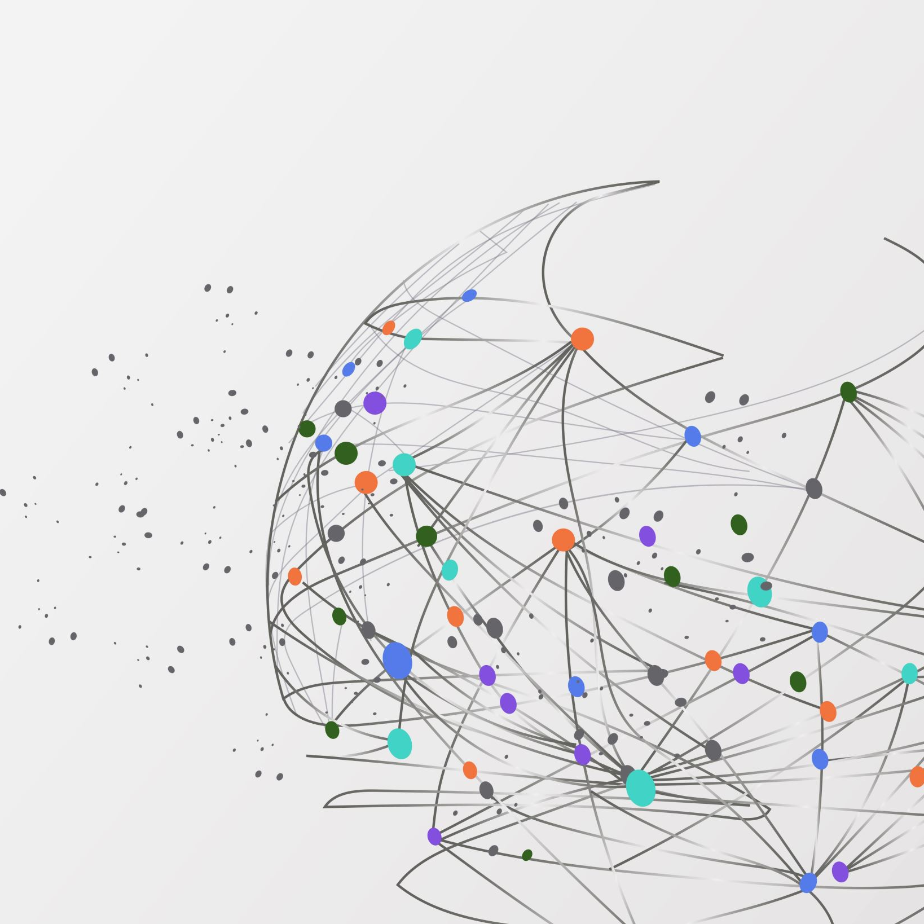
HDFS Log File Anomaly Detection
Group 6
Akshita Chooramani
Afreen Shakeel

Slide 2
Topic
Pre-Processing of Data
Exploratory Data Model
Tentative Model Choice

Slide 3
Pre-Processing of Data

Slide 4
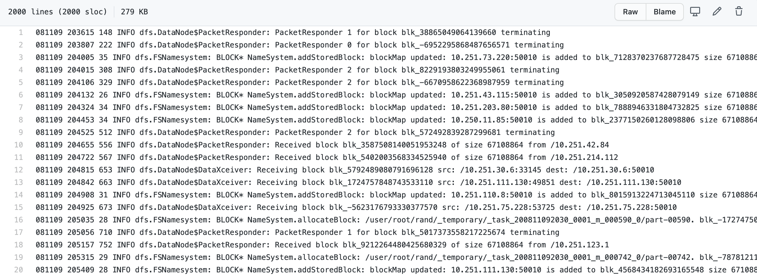
Raw data

Slide 5
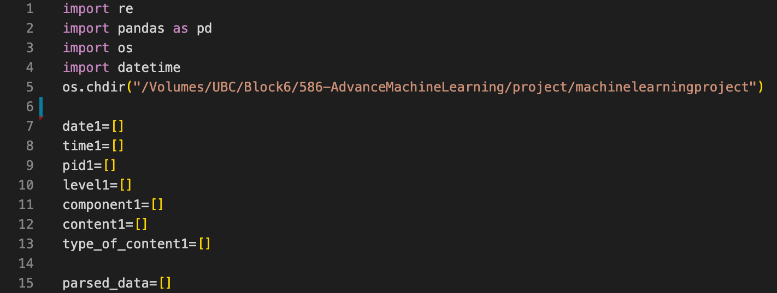
Cleaning of raw data

Slide 6
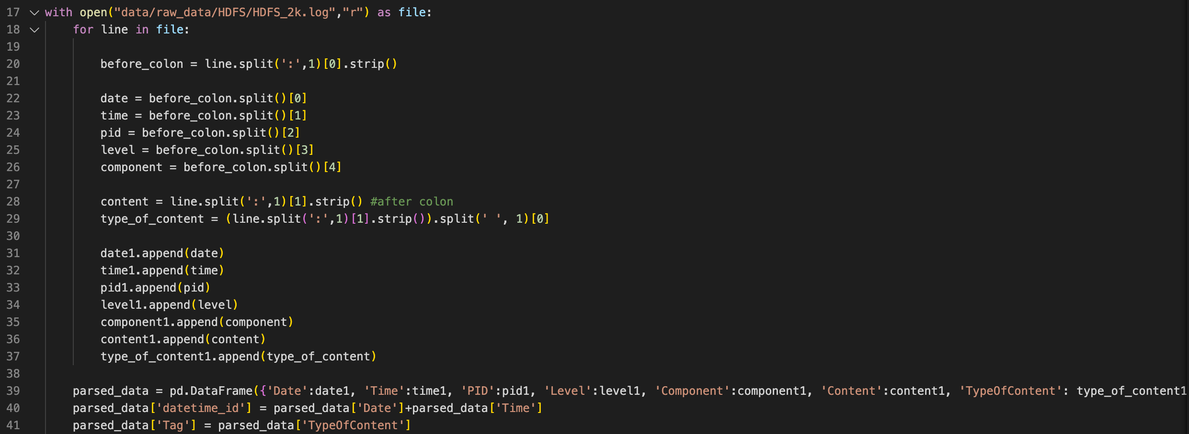
Creating a data frame

Slide 7
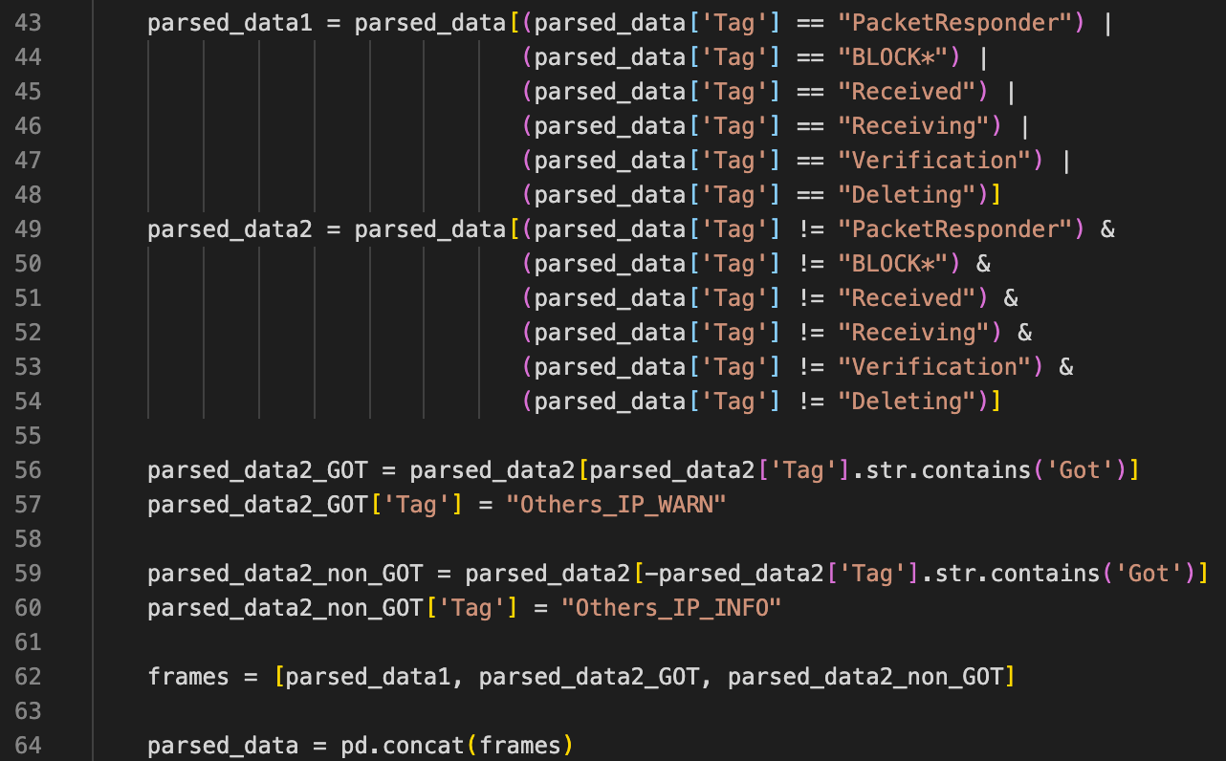
Wrangling to get TAG

Slide 8
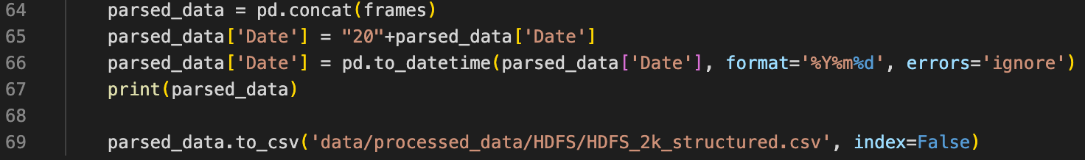
Wrangling to fix date

Slide 9
Exploratory Data Analysis

