Slide 1
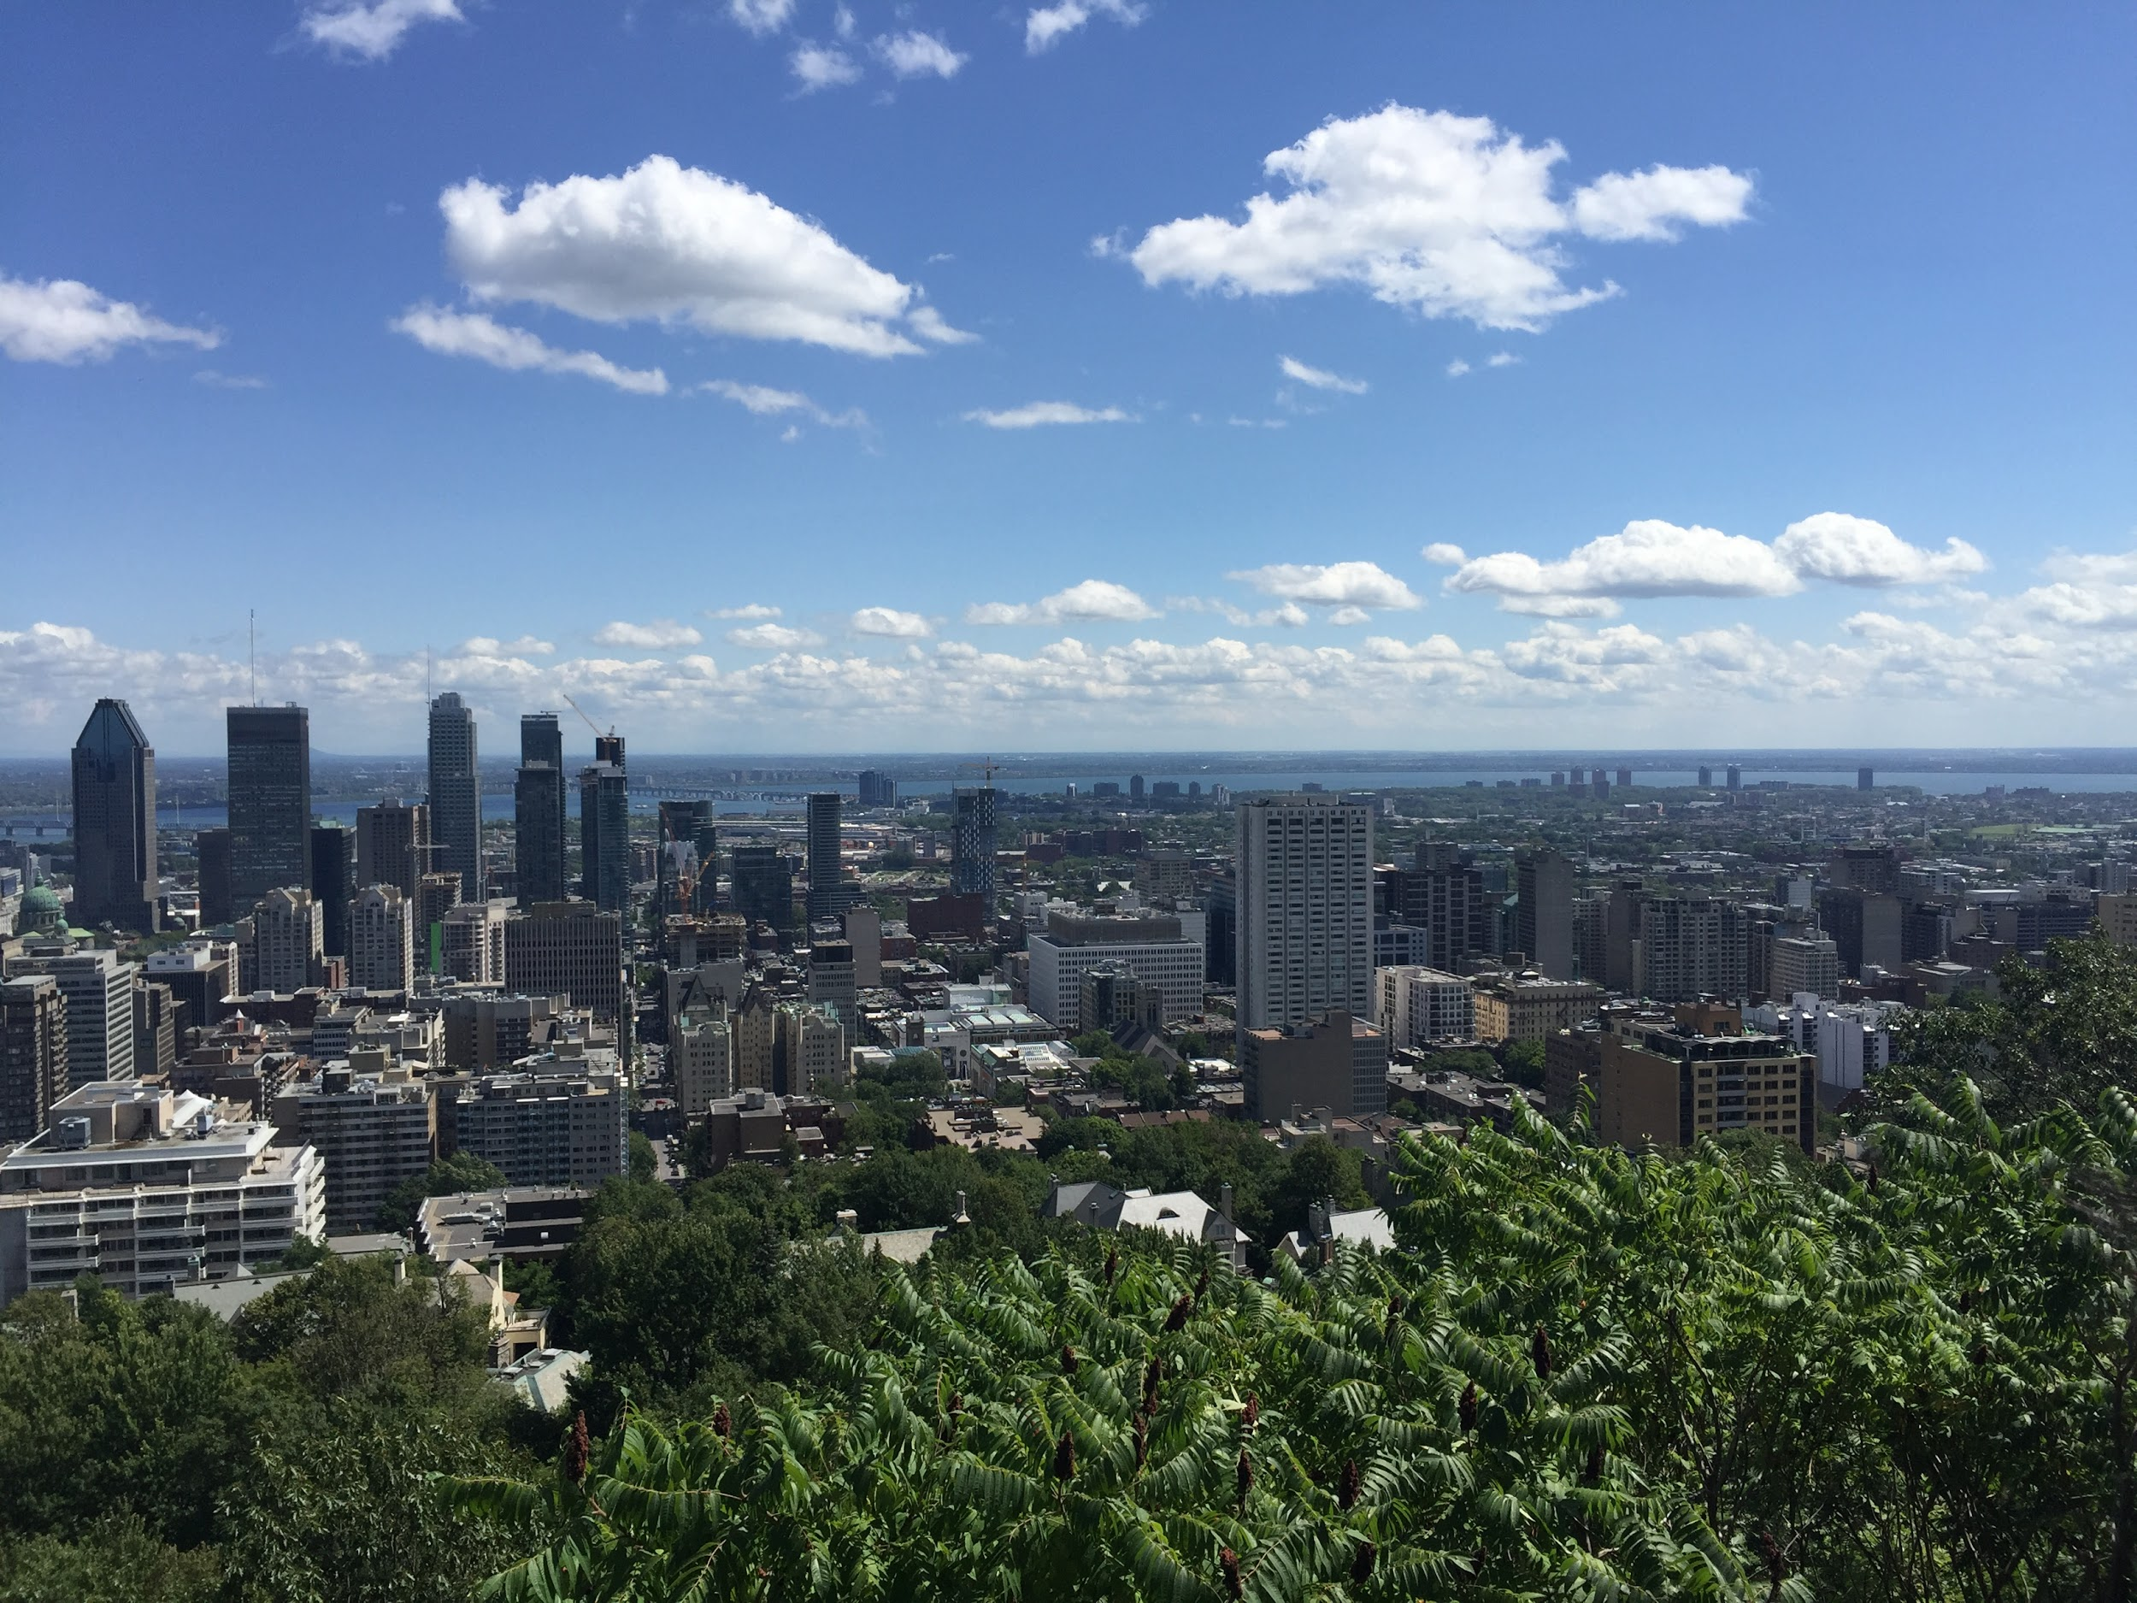
Association for Computers in the Humanities
JOB SLAM 2017 @ the Annual General Meeting

Slide 2
Looking for Applicants
JOB SLAM 2017 @ the Annual General Meeting

Slide 3
Contact: Miriam Posner, UCLA
DH Academic Administrator
Coordinate UCLA's DH program
https://recruit.apo.ucla.edu/apply/JPF03207
miriam.posner@gmail.com

Slide 4
Contact: Sara Sikes, University of Connecticut
Greenhouse Studios Mellon Fellow
Greenhouse Studios | Scholarly Communications Design at the University of Connecticut
Research fellow with an anticipated start date of October 2017.
http://academicjobsonline.org/ajo/jobs/9421
sara.sikes@uconn.edu

Slide 5
Contact: Melodee Beals, Loughborough Univeristy
PostDoctoral Reserach Assistant for Oceanic Exchanges
Text encoding; meta data entry / cataloguing; historical periodical research and case study development; possibly programming / tool development and room to develop role in own direction
http://mhbeals.com/curriculumvitae/
m.h.beals@lboro.ac.uk

Slide 6
Contact: Susan Schreibman, Maynooth Univesity
Programmer
Lead developer for the Letters of 1916 project
https://www.maynoothuniversity.ie/foras-feasa/our-people/susan-schreibman
https://www.maynoothuniversity.ie/human-resources/vacancies/programmer-foras-feasa
susan.schreibman@mu.ie

Slide 7
Contact: Susan Schreibman, Maynooth Univesity
Project Manager
PM of the Letters of 1916 project as it transitions to Letters 1916-23
https://www.maynoothuniversity.ie/foras-feasa/our-people/susan-schreibman
https://www.maynoothuniversity.ie/human-resources/vacancies/project-manager-12-month-contract-foras-feasa
susan.schreibman@mu.ie

Slide 8
Jean Bauer + Rebecca Sutton Koeser
Center for Digital Humanities
@ Princeton
https://cdh.princeton.edu/blog/2017/08/10/are-you-our-new-dh-developer/
jabauer@princeton.edu
rebecca.sutton.koeser@princeton.edu

Slide 9
Matthew Lincoln, Getty Research Institute
Currently: Senior Software Engineer
https://jobs-getty.icims.com/jobs/3004/software-engineer-sr/job
mlincoln@getty.edu

Slide 10
Elli Mylonas, Brown University
Job: Digital Humanities Librarian
https://brown.wd5.myworkdayjobs.com/en-US/staff-careers-brown/job/John-D-Rockefeller-Jr-Library/Digital-Humanities-Librarian_REQ136748

Slide 11
Elli Mylonas, Brown University
Job: Director Center for Digital Scholarsip
https://brown.wd5.myworkdayjobs.com/en-US/staff-careers-brown/job/John-D-Rockefeller-Jr-Library/Director-of-the-Center-for-Digital-Scholarship_REQ131042-1

Slide 12
Job Seekers
JOB SLAM 2017 @ the Annual General Meeting

Slide 13
Jim McGrath, Brown University
Currently: Postdoctoral fellow in Digital Public Humanities
https://www.dropbox.com/s/gh5qv4hcvmgdbxh/mcgrath_cv_July2017_PUBLIC.pdf?dl=0
james_mcgrath@brown.edu

Slide 14
Jeri Wieringa, George Mason University
Digital History; Text Analysis; Python; Front-end Development; Digital Archiving and Preservation
http://jeriwieringa.com/about/
jeri.elizabeth@gmail.com

Slide 15
Ben Brumfield
Programming; Project Architecture
http://www.brumfieldlabs.com/
benwbrum@gmail.com

Slide 16
Dot Porter
Freelance
Dotporterdigital.org
Dot.Porter@gmail.com

Slide 17
Quinn Dombrowski
Agile Humanities Agency
agilehumanities.ca
admin@agilehumanities.ca

Slide 18
Anyone Else?
JOB SLAM 2017 @ the Annual General Meeting

