Slide 1
Multi Party Conference Chat Application (MPCC)
Group-01 Members-
Abhishek
Akash
Anjali
Ramani
Vijay

Slide 2
Content
Introduction
Module And Description
Tools
DFD
Use Case Diagram
Application Description
Conclusion

Slide 3
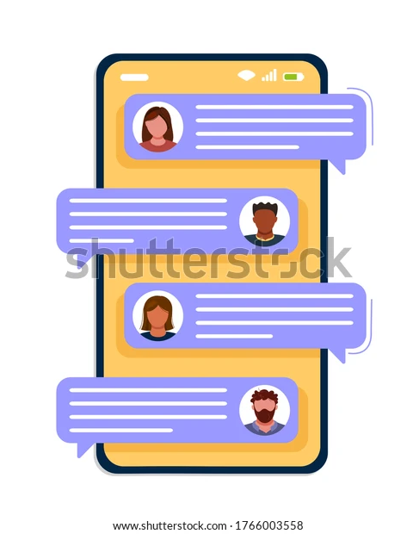
Introduction
The Multi Party Conference Chat Application provides Clients to connect with the server and exchange messages between them.
The Server will be able to connect with multiple Clients and host a chat session between them.
The User has to register on the Application and then has to log on to it.
The chat will contain the User’s User ID.

Slide 4
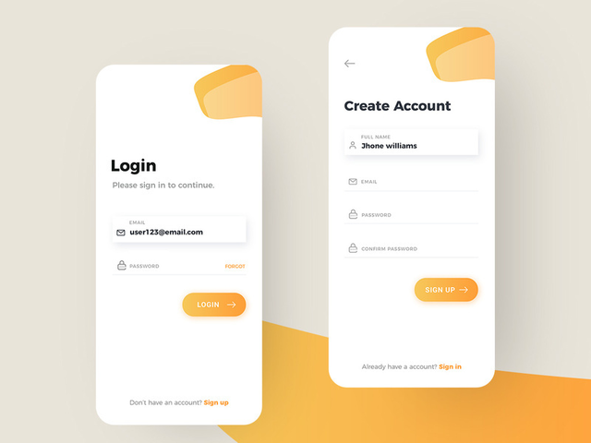
Modules And Description
Login And Registration- User needs to login first to access the Application.
So if the user is not a registered user, the user needs to get registered first by giving the details to the server . The server save the details of the user in a registered file.

Slide 5

Active session
When the client reconnect to the server, the server connects the client to a new session instead of the original session.
However, when we check the server, it says that the original session is still active and didn't enter a disconnected state.
When attempting to reconnect to a disconnected session, users are required to specify their login credentials.

Slide 6

Multiple Active User Chat Management
Concurrent server means a server has a capability of handling multiple clients at the same time parallelly.
In this requirement, we have to maintain a concurrent server to serve multiple client connection/chat request.

Slide 7

Encryption And Decryption Management
Encryption: Encryption has to be used for sending user-id, password and messages in order to attain security in the chat system.
Encryption is method by which information is converted into a secret code that hides the information true meaning.
It is used to protect the data.
Decryption: Decryption has to be used for receiving user-id, password and messages in order to attain security in the chat system.
Decryption is the process that transforms encrypted information into its original format.
To do this parties with private conversation use an encryption scheme called an algorithm and the keys to encrypt and decrypt messages.

Slide 8
Tools
1.Ubuntu Terminal.
2.C++ language.
3.GitHub.
4.draw.io

Slide 9
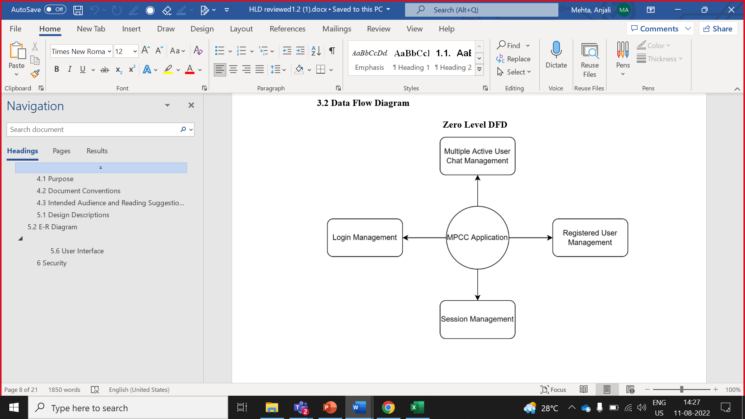
Data Flow Diagram (DFD)
Zero Level

Slide 10
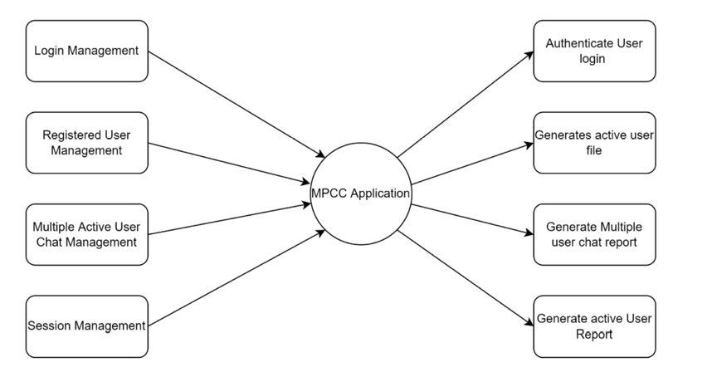
First level

Slide 11
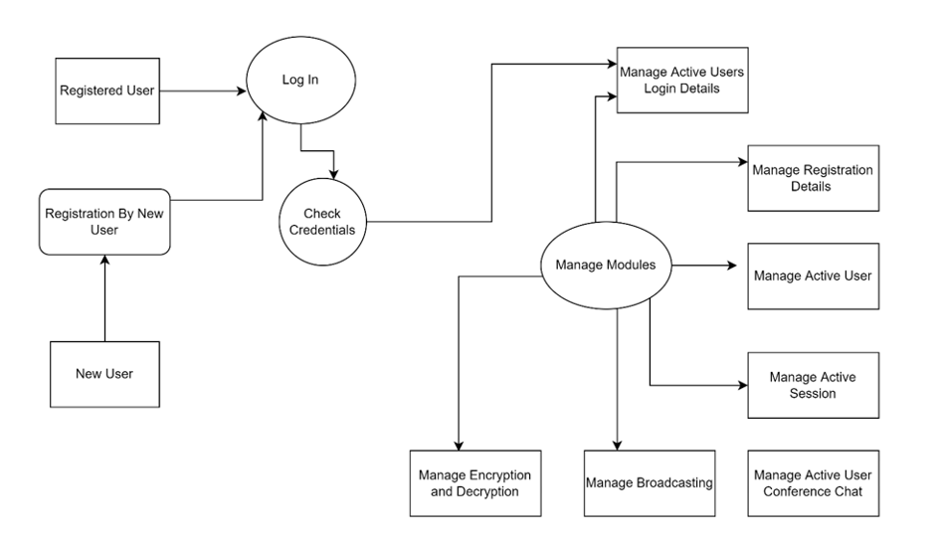
Second level

Slide 12
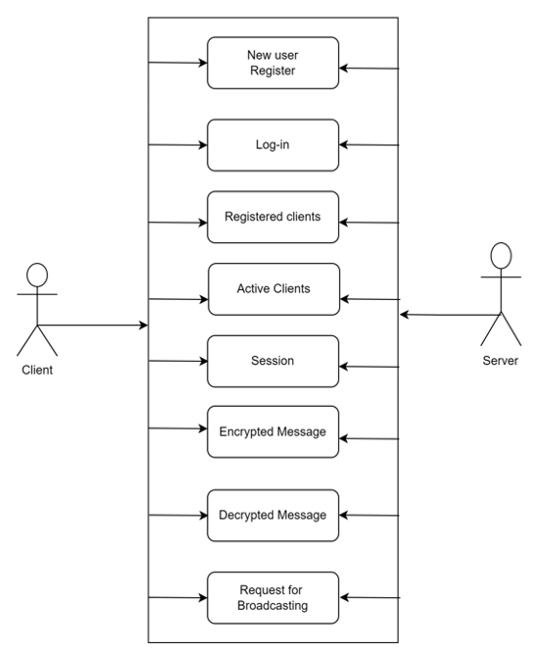
Use case Diagram

Slide 13
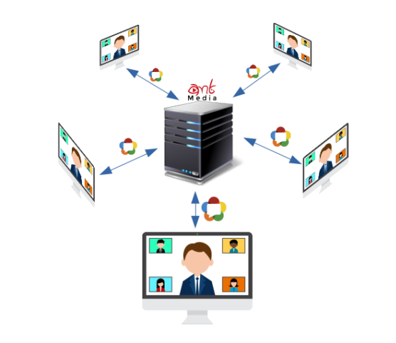
Application Description
The Chat Application provides Clients to connect with the Server and exchange messages between them.
The system is basically constructed using C++ language. The Server will be able to connect with multiple Clients.
At the beginning the Client has to register on the system and then has to login on the system as a registered user.
The system will check for the details entered by the Client, If found correct it will take the client to the active user area.

Slide 14

Conclusion
MPCC Application user interface is simple and user friendly to be easily used by every age group.
MPCC user interface is consistent. The design is consistent. Increasing consistency increases the familiarity, and hence increases the usability.
MPCC Application provides the user with clarity. There is nothing which confuses the user, as it becomes an obstacle for the user in interacting with the Application.
It allows multiple users to conference chat.
It allows client to broadcast message .
Message will be encrypted and decrypted by the server end .

Slide 15


