Slide 2
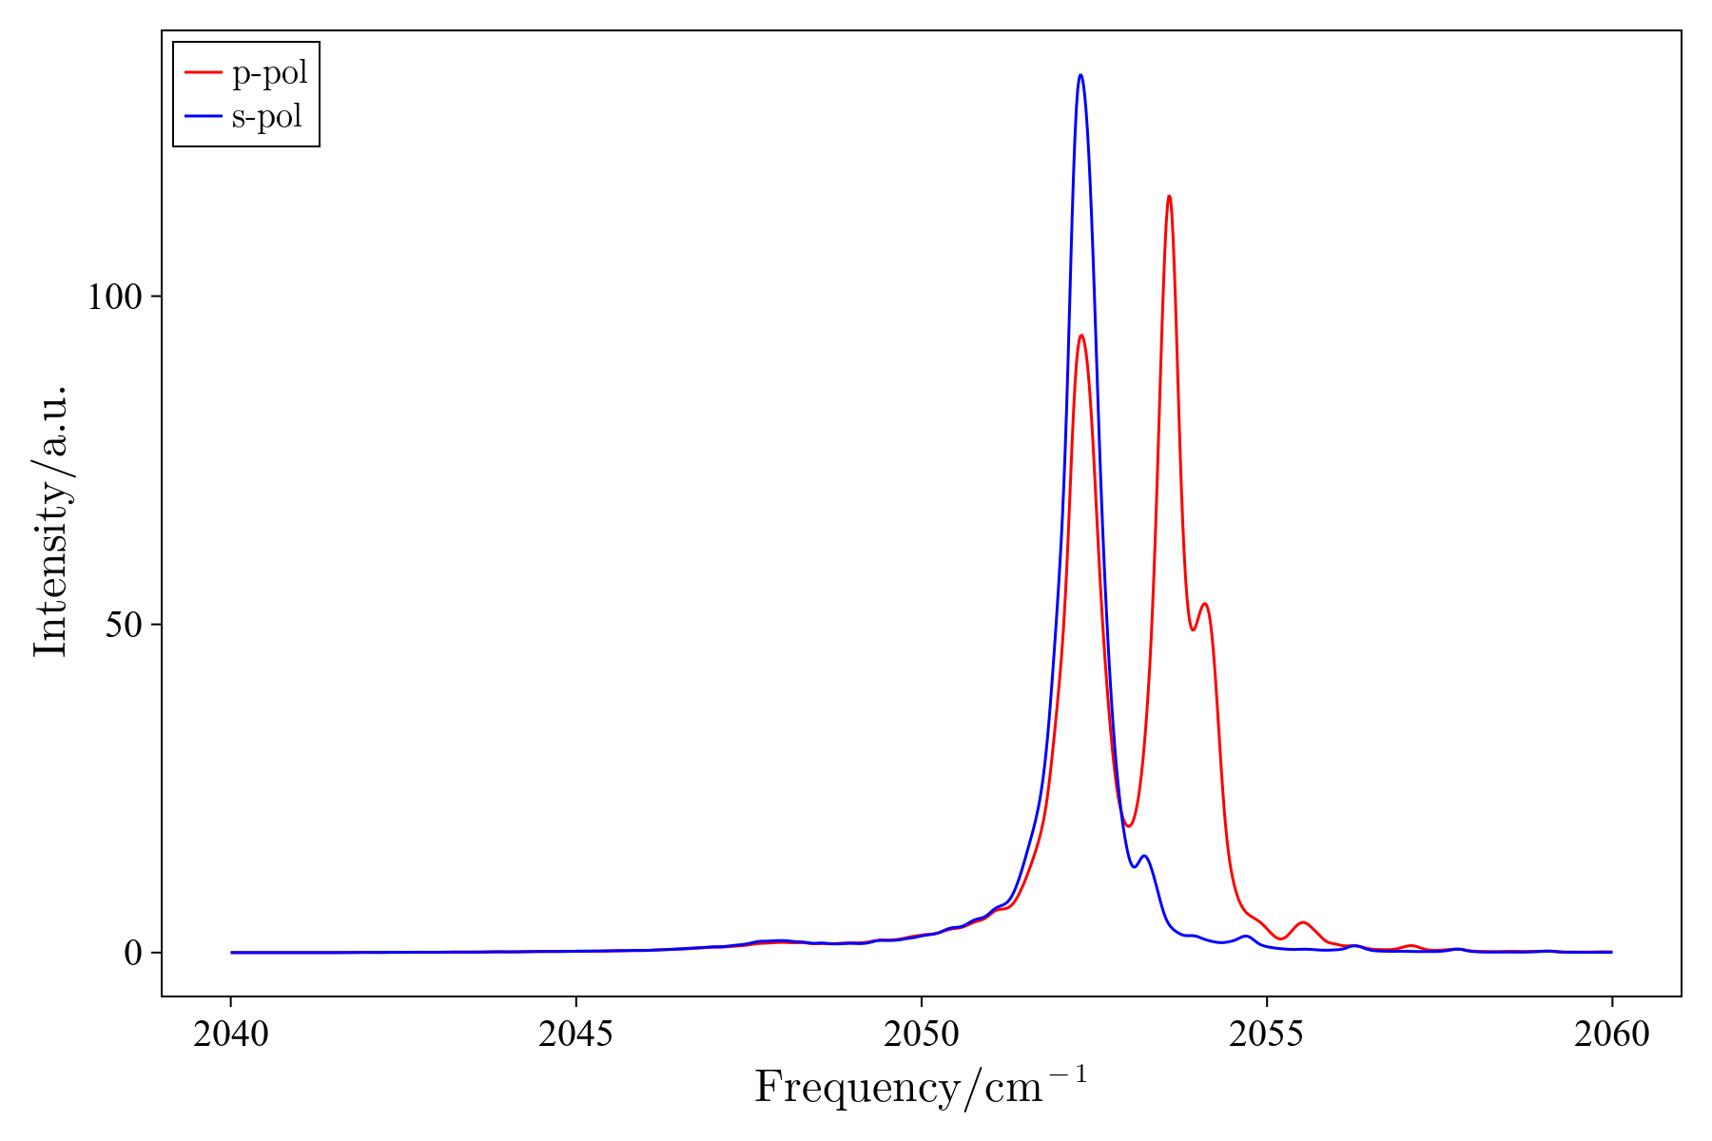
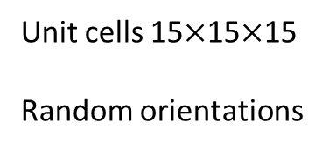
Unit cells 15$×$15$×$15
Random orientations
Notes:
Takes about 5 mins

Slide 3
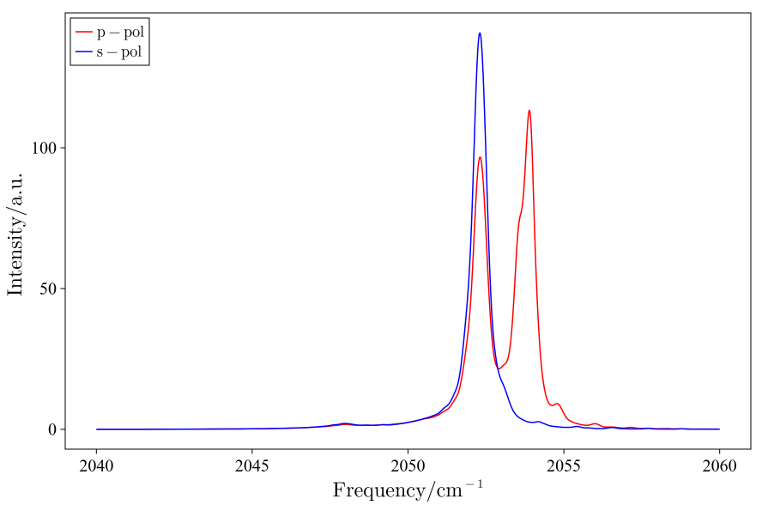
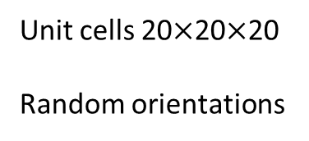
Unit cells 20$×$20$×$20
Random orientations
Notes:
Takes about 33 mins

Slide 4
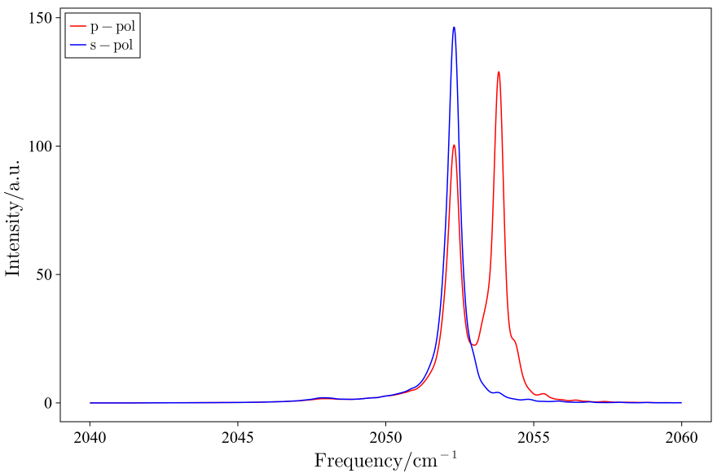
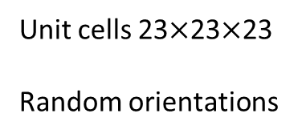
Unit cells 23$×$23$×$23
Random orientations
Notes:
Takes about 150 mins

Slide 5
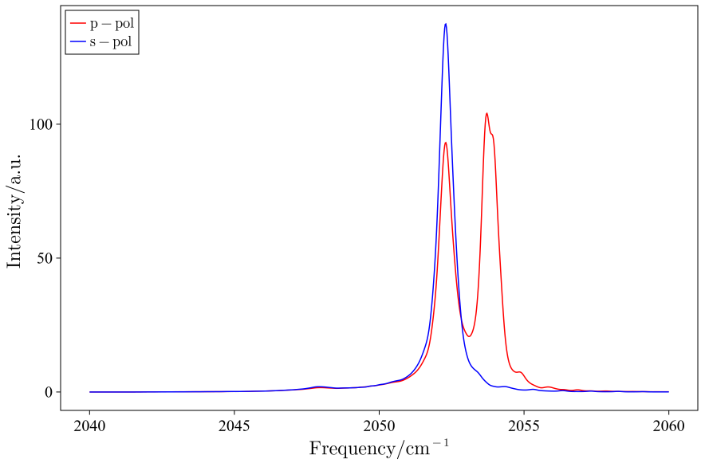
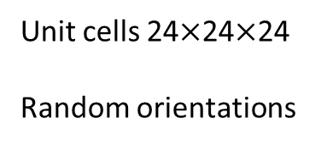
Unit cells 24$×$24$×$24
Random orientations
Notes:
Takes about 196 mins

Slide 6
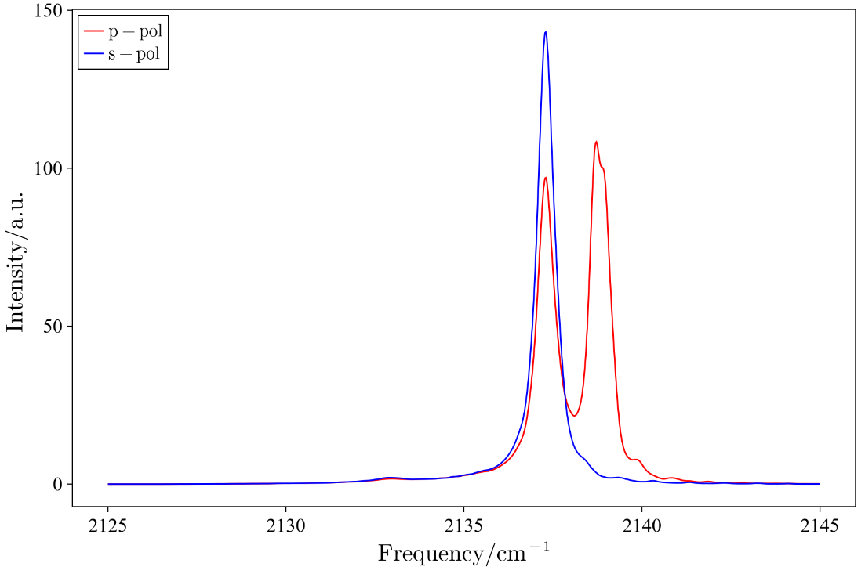
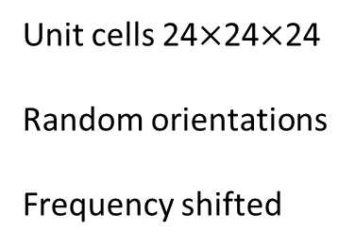
Unit cells 24$×$24$×$24
Random orientations
Frequency shifted
Notes:
Takes about 196 mins

Slide 7
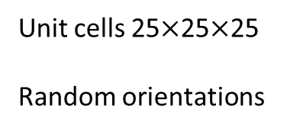
Unit cells 25$×$25$×$25
Random orientations
Notes:
After around 300 mins crashes
OutOfMemoryError()

