Slide 2
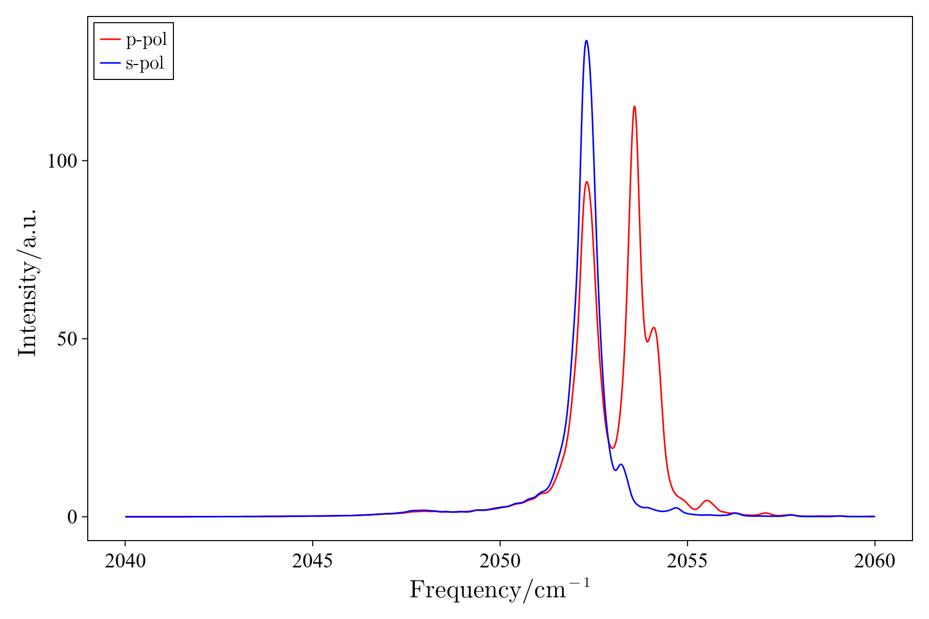
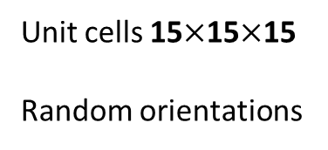
Unit cells 15$×$15$×$15
Random orientations
Notes:
Takes about 5 mins

Slide 3
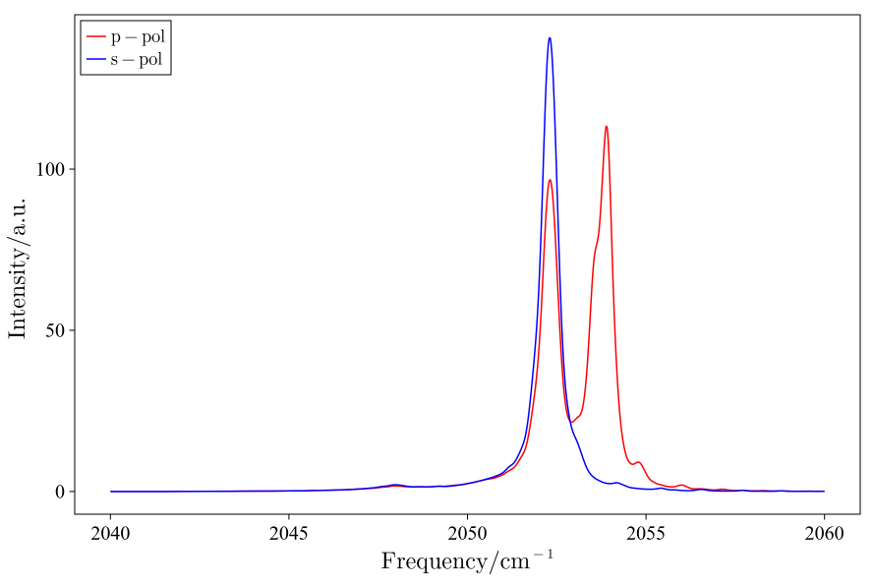
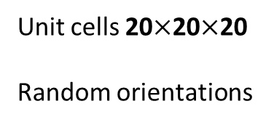
Unit cells 20$×$20$×$20
Random orientations
Notes:
Takes about 33 mins

Slide 4
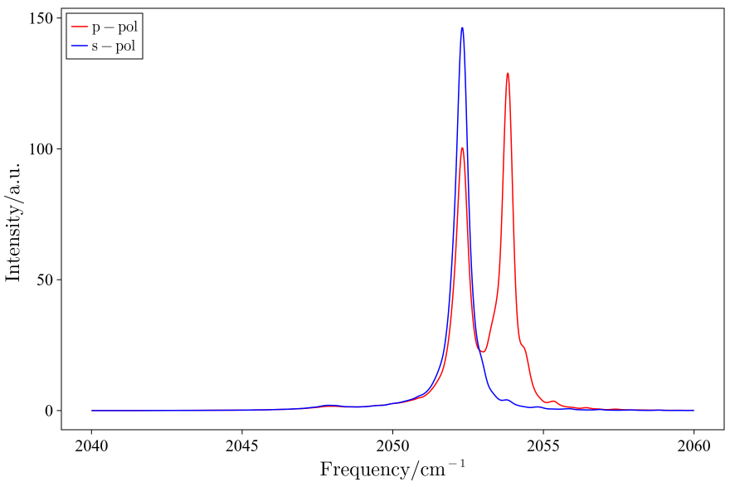
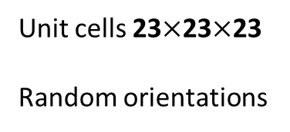
Unit cells 23$×$23$×$23
Random orientations
Notes:
Takes about 150 mins

Slide 5
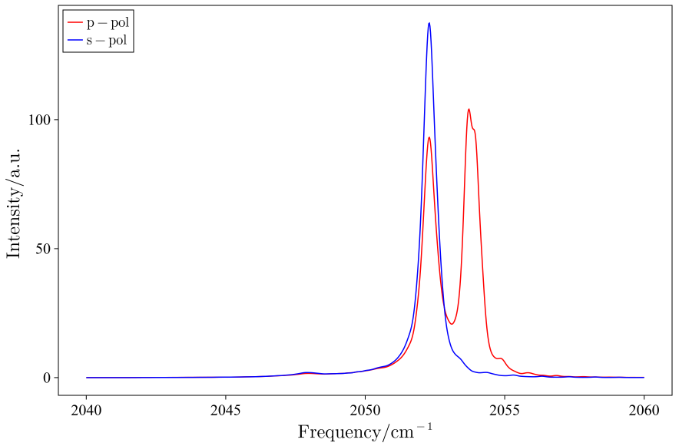
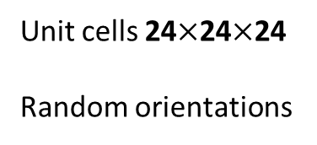
Unit cells 24$×$24$×$24
Random orientations
Notes:
Takes about 196 mins

Slide 6
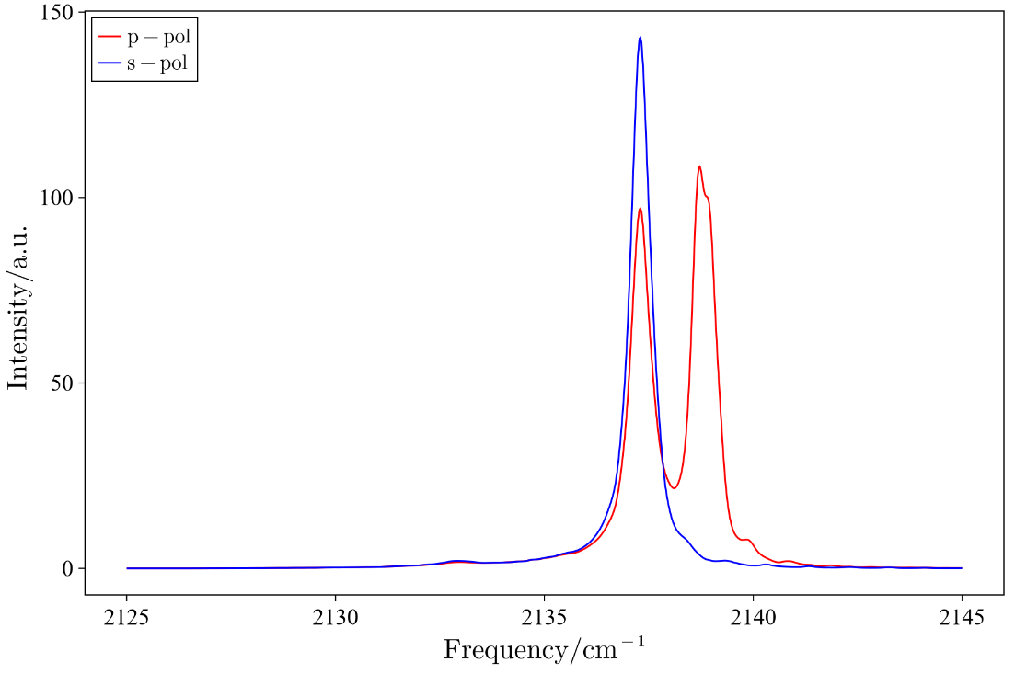
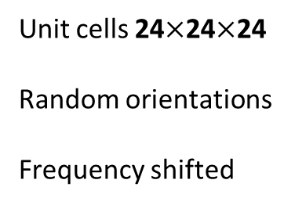
Unit cells 24$×$24$×$24
Random orientations
Frequency shifted
Notes:
Takes about 196 mins

Slide 7
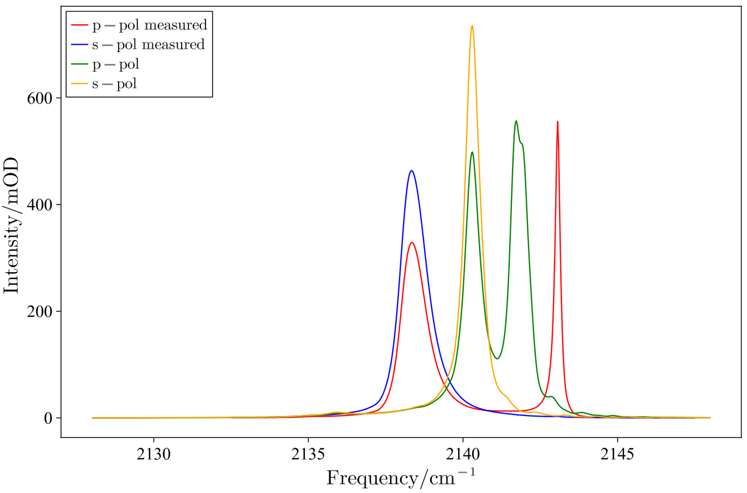
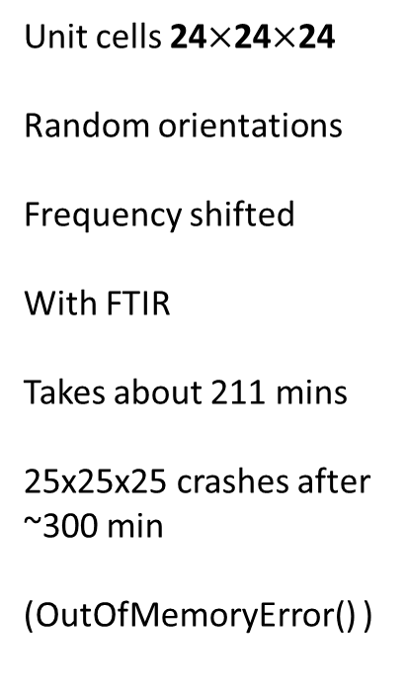
Unit cells 24$×$24$×$24
Random orientations
Frequency shifted
With FTIR
Takes about 211 mins
25x25x25 crashes after ~300 min
(OutOfMemoryError() )

Slide 8
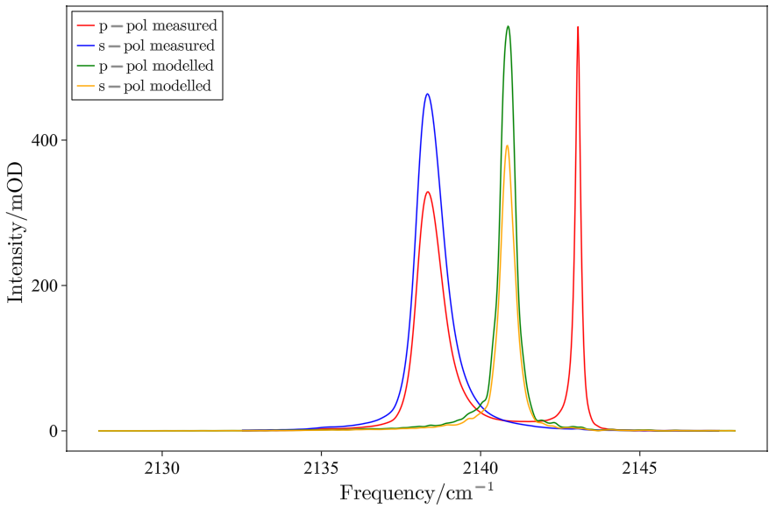
Unit cells 10x10x10
Random orientations
Frequency shifted
With FTIR
With periodic boundary conditions in z at ν0 = 2138.0

Slide 9
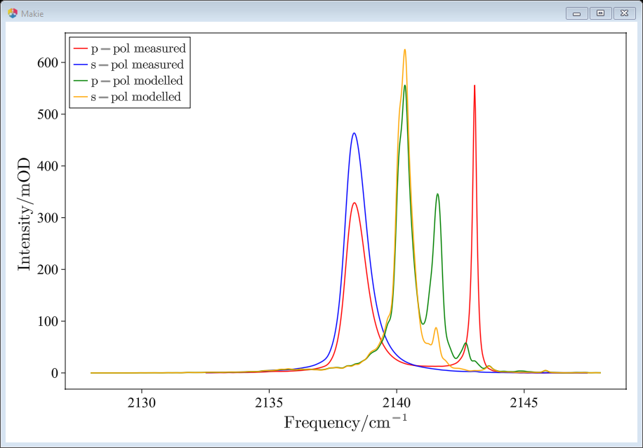
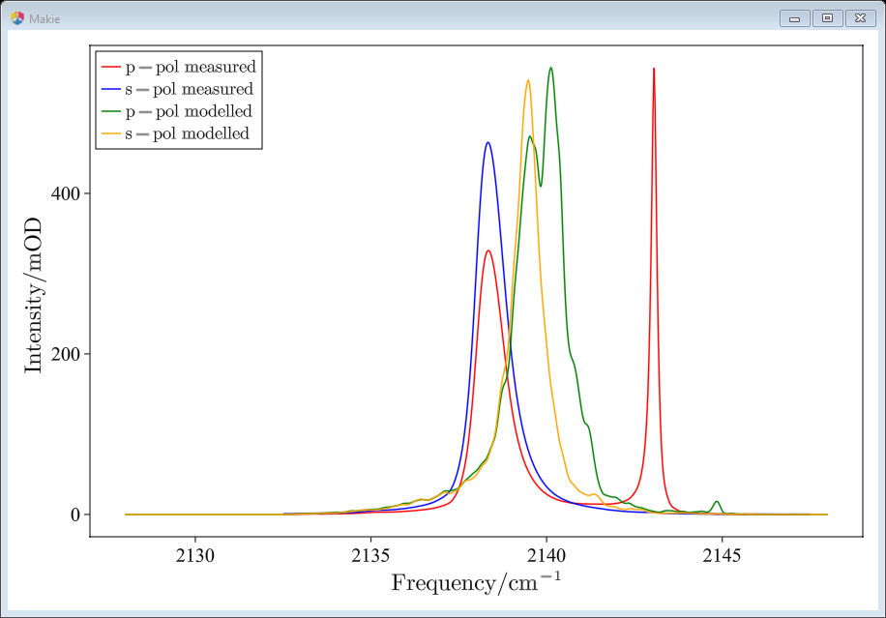
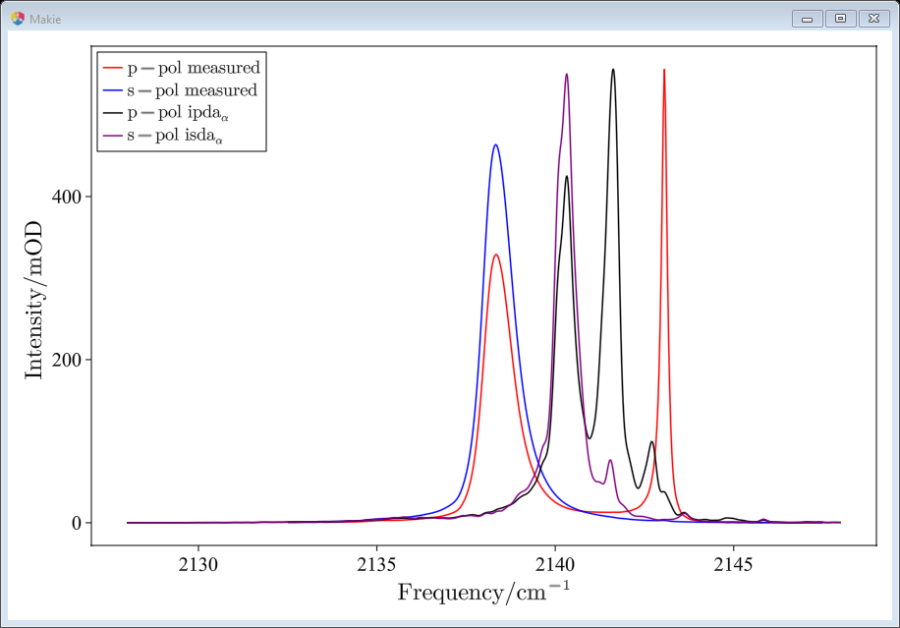
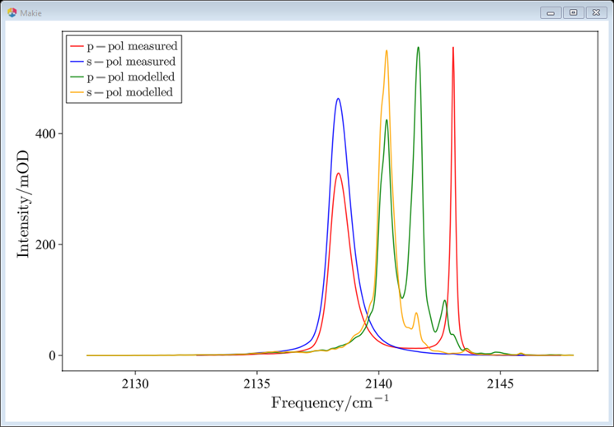
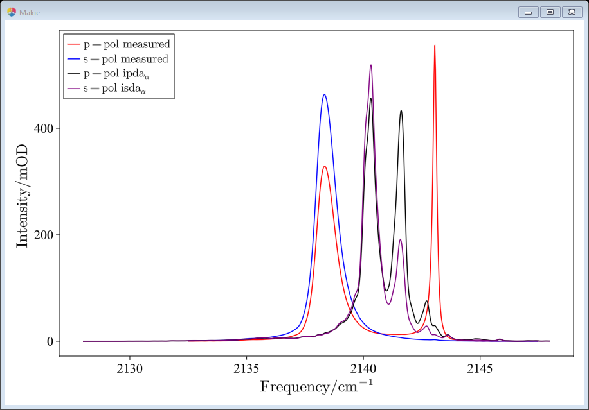
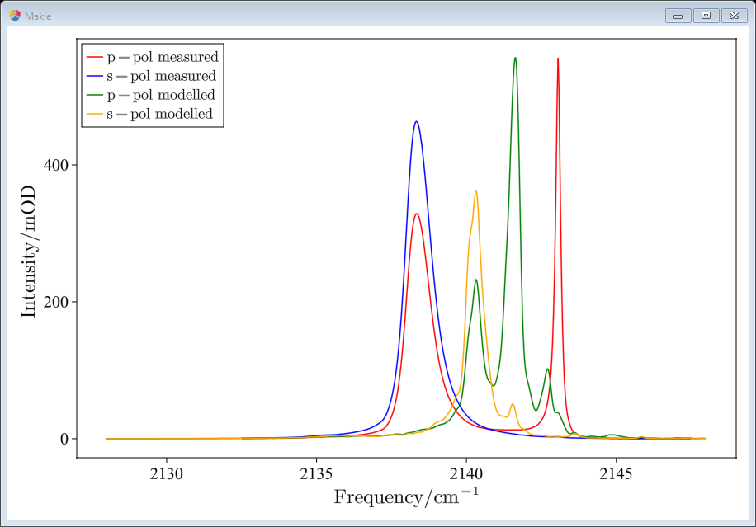
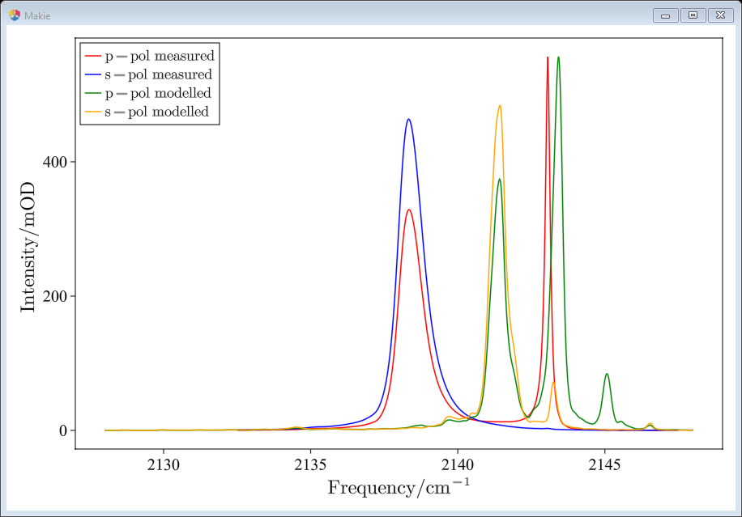
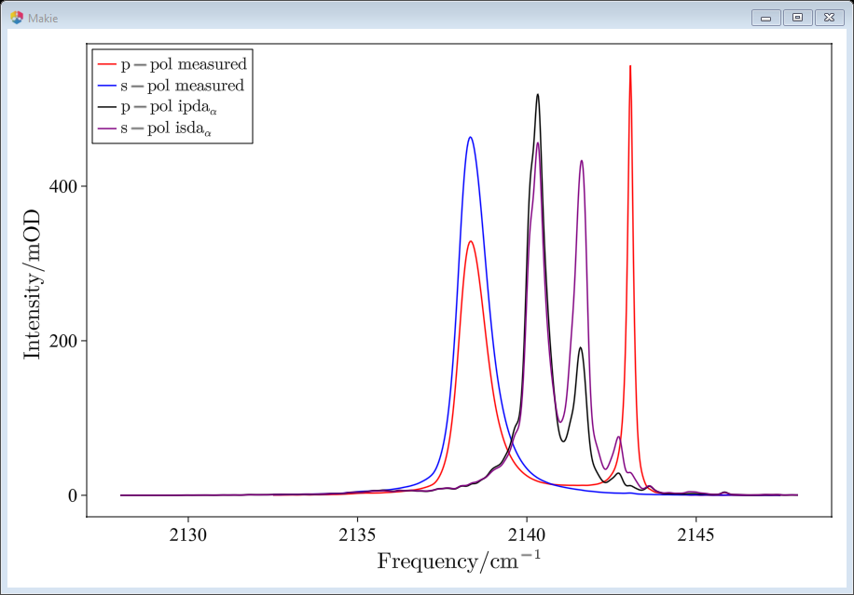
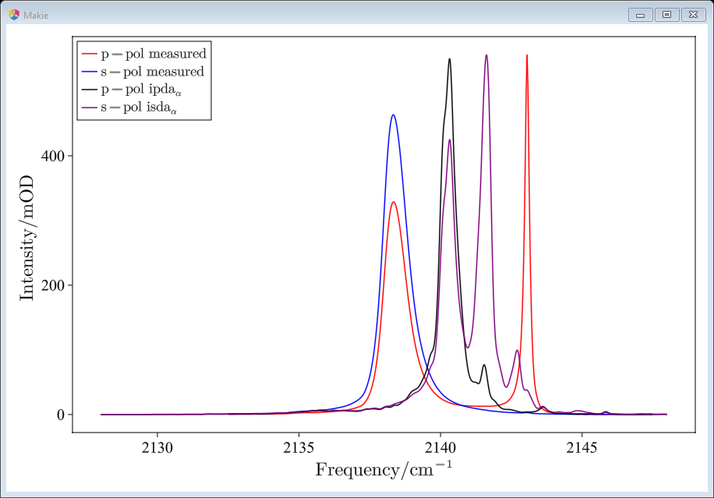
For 10x10x10 crystal,
ν0 = 2138.0
Incident angle |  | µ01 @ 45° |  | α @ 45,0.105
30 |  | 0.08 |  | 0
45 |  | 0.105 |  | 30
60 |  | 0.13 |  | 60
 |  |  |  | 90
Choose Theta = 50°, $α$=0 and µ01 increased to 0.195 (0.105 before) to match measured spectra

Slide 10
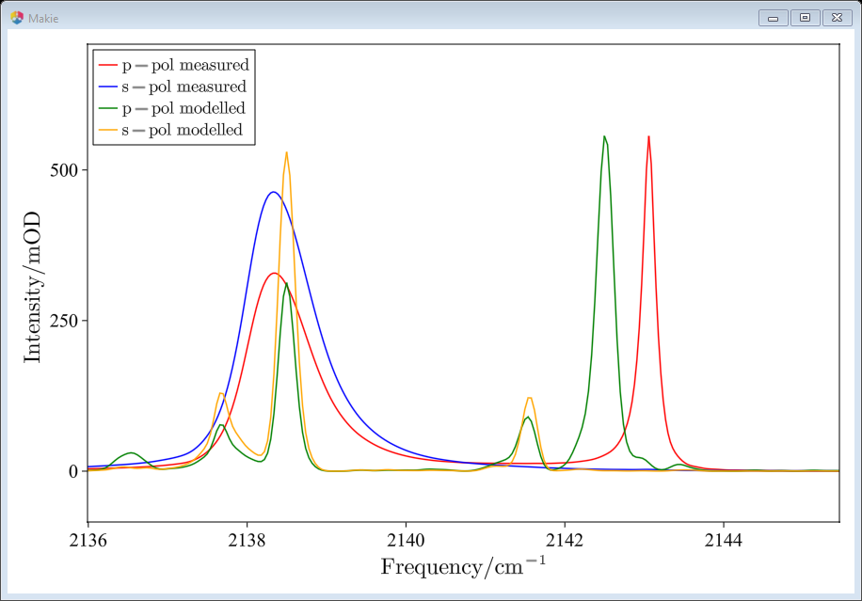
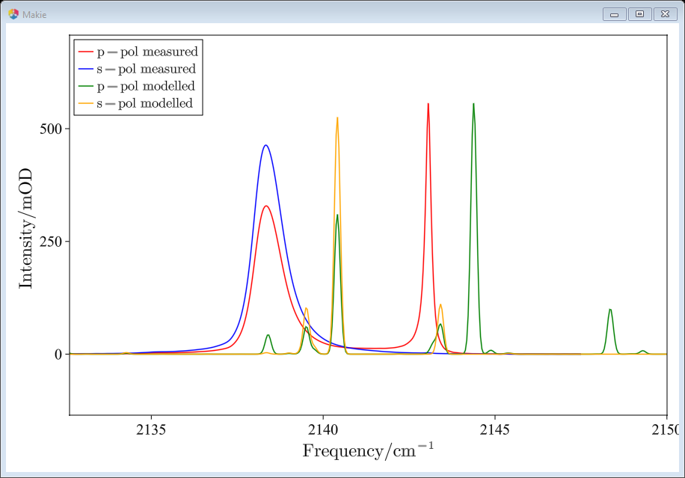
Choose Theta = 50°, $α$=0 and µ01 increased to 0.195 (0.105 before) to match measured spectra, 8x8x8
Randomised on
Randomised off
Notes:
ν0 = 2130.937

Slide 11
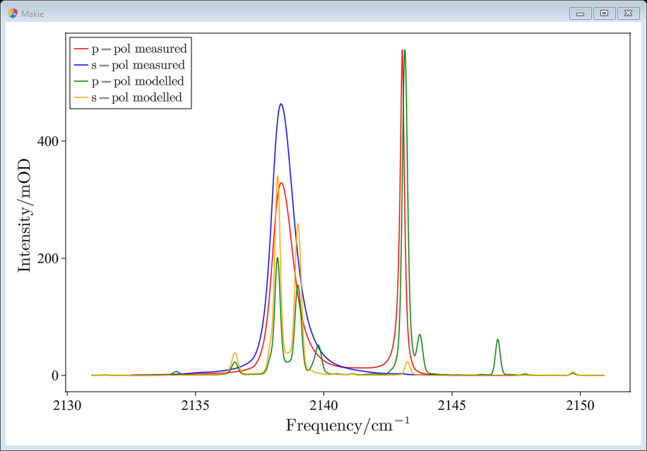
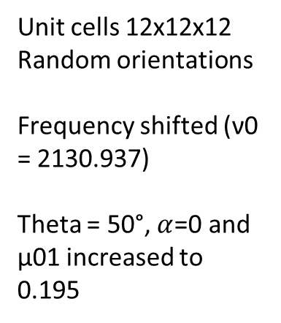
Unit cells 12x12x12
Random orientations
Frequency shifted (ν0 = 2130.937)
Theta = 50°, $α$=0 and µ01 increased to 0.195
Notes:
Takes about 44s

Slide 12
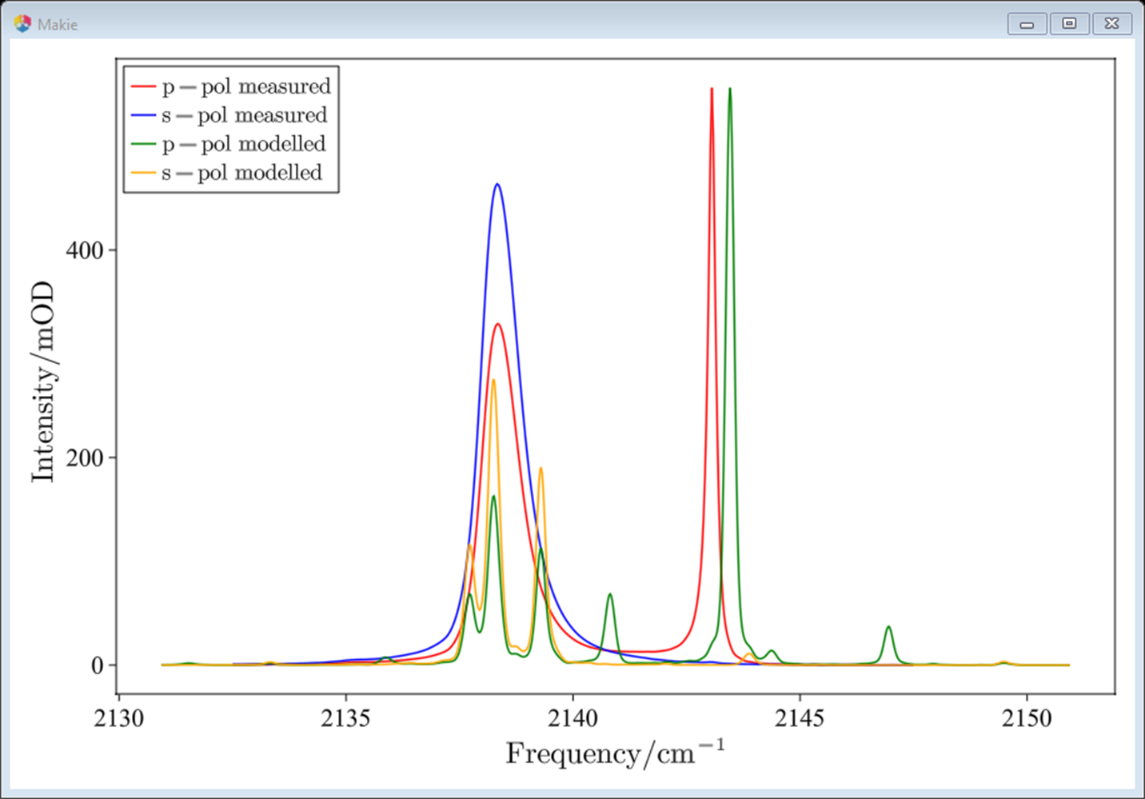
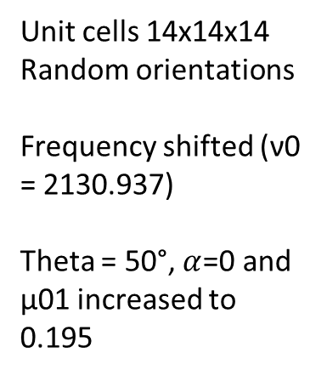
Unit cells 14x14x14
Random orientations
Frequency shifted (ν0 = 2130.937)
Theta = 50°, $α$=0 and µ01 increased to 0.195
Notes:
Takes about 2 mins

Slide 13
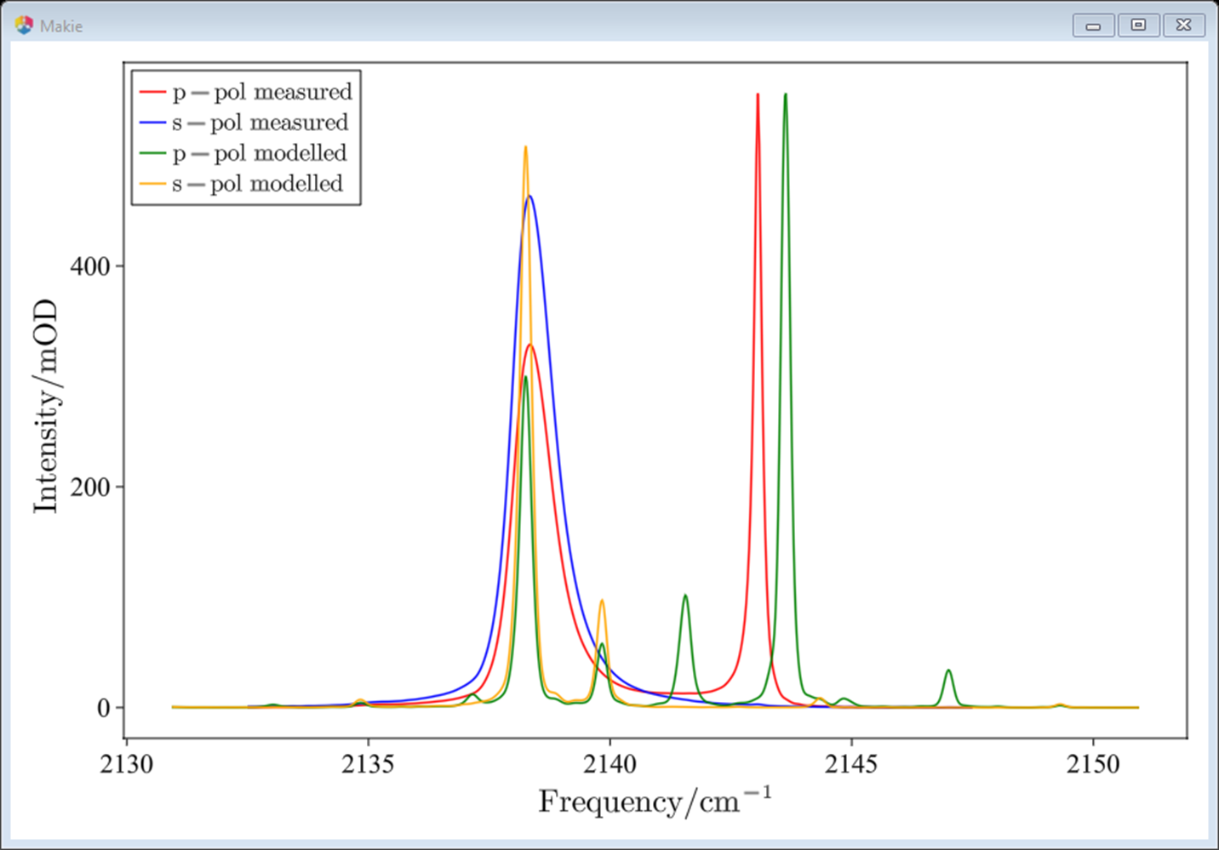
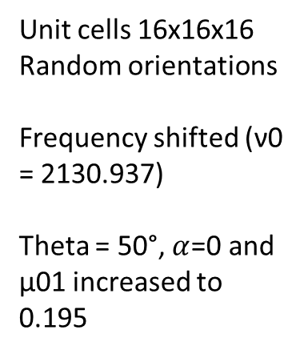
Unit cells 16x16x16
Random orientations
Frequency shifted (ν0 = 2130.937)
Theta = 50°, $α$=0 and µ01 increased to 0.195
Notes:
Takes about 6 min

Slide 14
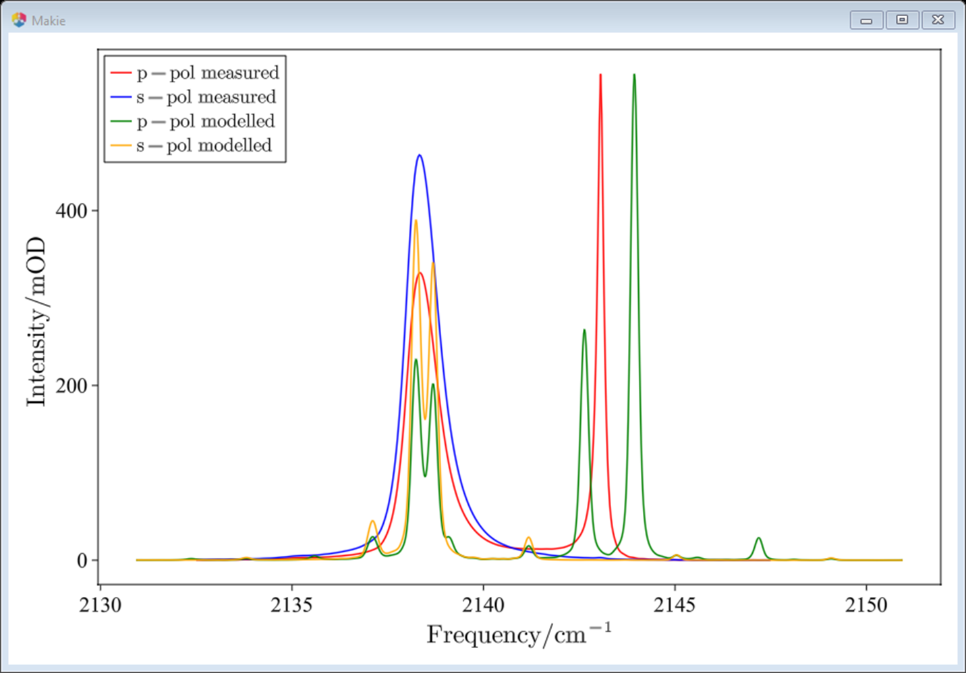
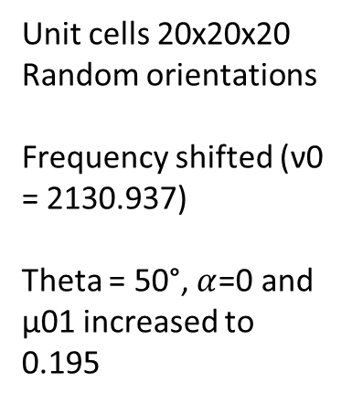
Unit cells 20x20x20
Random orientations
Frequency shifted (ν0 = 2130.937)
Theta = 50°, $α$=0 and µ01 increased to 0.195
Notes:
Takes about 30 min

Slide 15
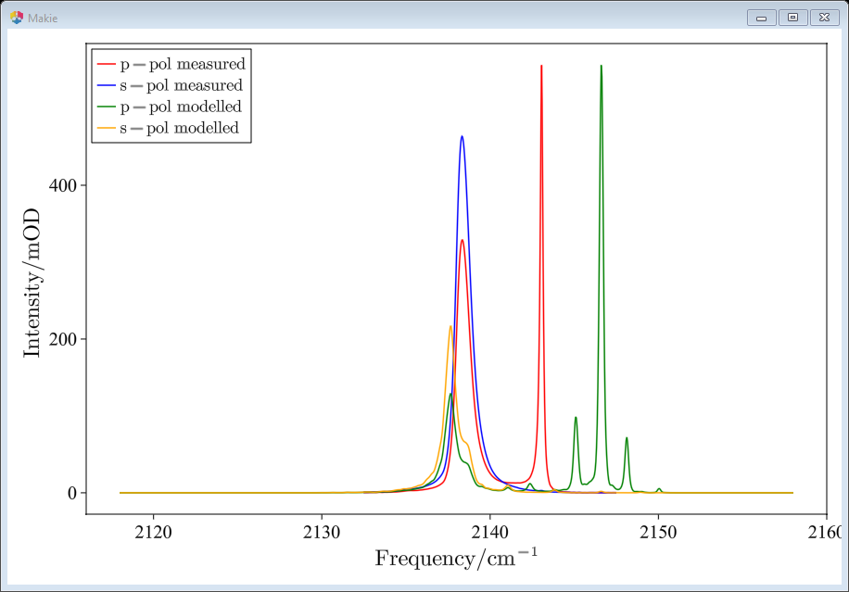
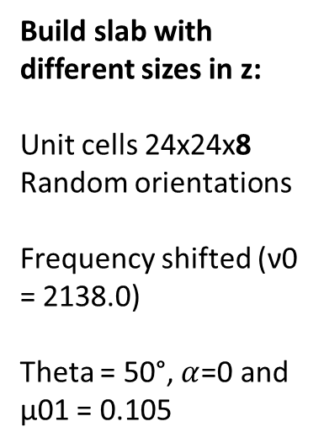
Build slab with different sizes in z:
Unit cells 24x24x8
Random orientations
Frequency shifted (ν0 = 2138.0)
Theta = 50°, $α$=0 and µ01 = 0.105
Notes:
~7 mins

Slide 16
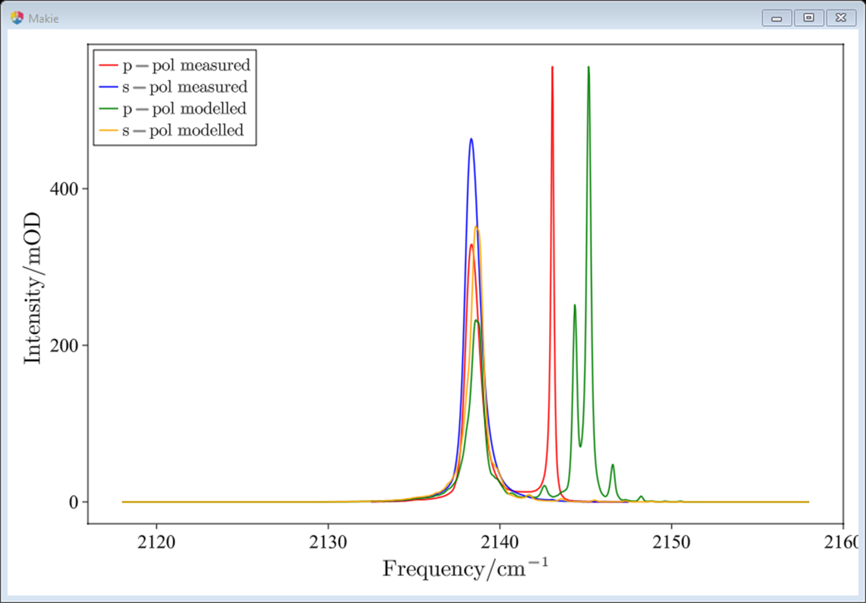
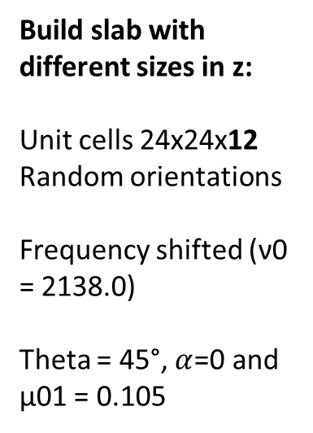
Build slab with different sizes in z:
Unit cells 24x24x12
Random orientations
Frequency shifted (ν0 = 2138.0)
Theta = 45°, $α$=0 and µ01 = 0.105
Notes:
~20 mins

Slide 17
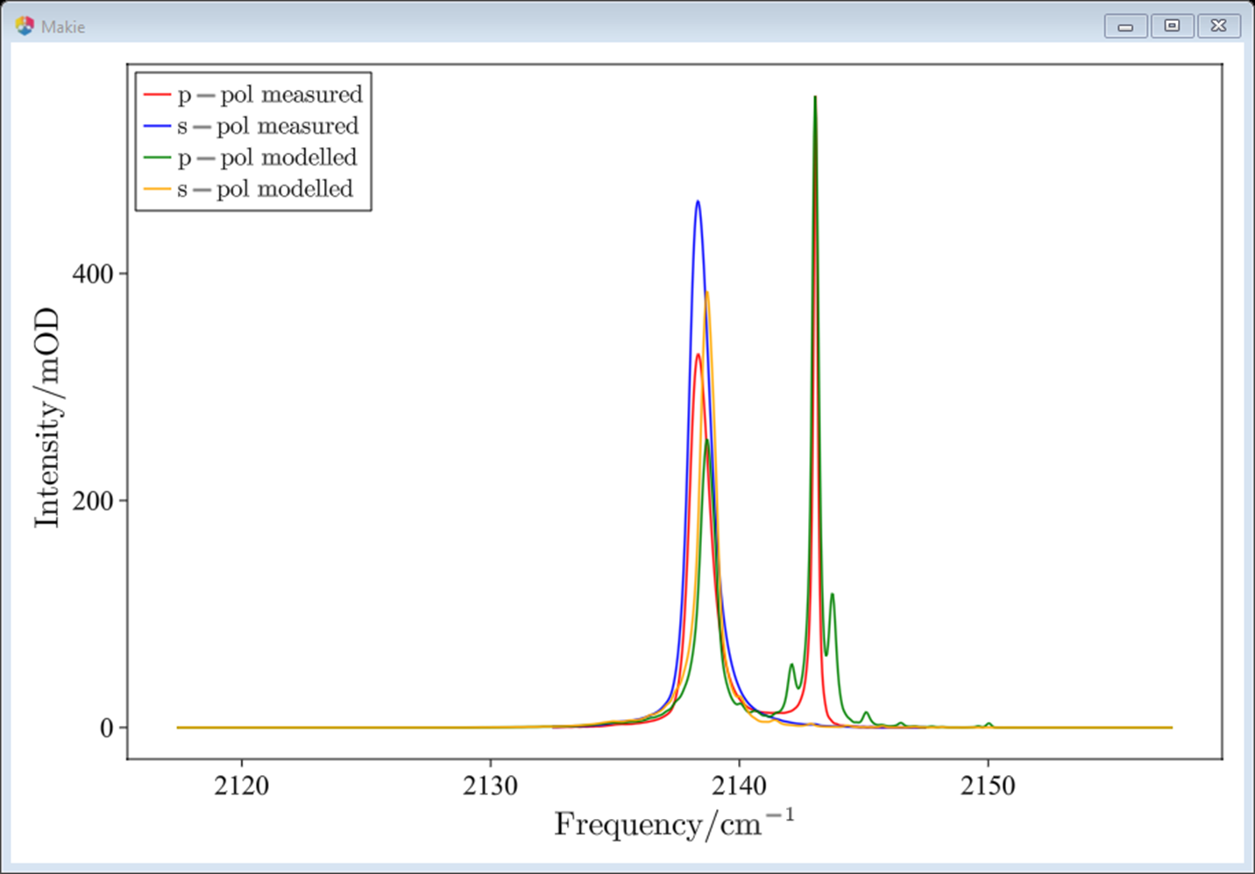
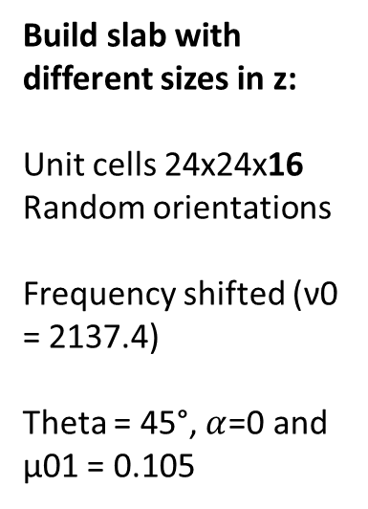
Build slab with different sizes in z:
Unit cells 24x24x16
Random orientations
Frequency shifted (ν0 = 2137.4)
Theta = 45°, $α$=0 and µ01 = 0.105
Notes:
~43 mins

Slide 18

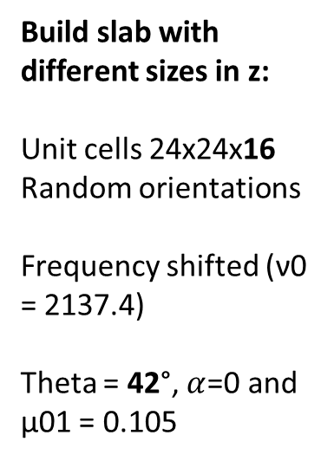
Build slab with different sizes in z:
Unit cells 24x24x16
Random orientations
Frequency shifted (ν0 = 2137.4)
Theta = 42°, $α$=0 and µ01 = 0.105
Notes:
~45 mins

Slide 19
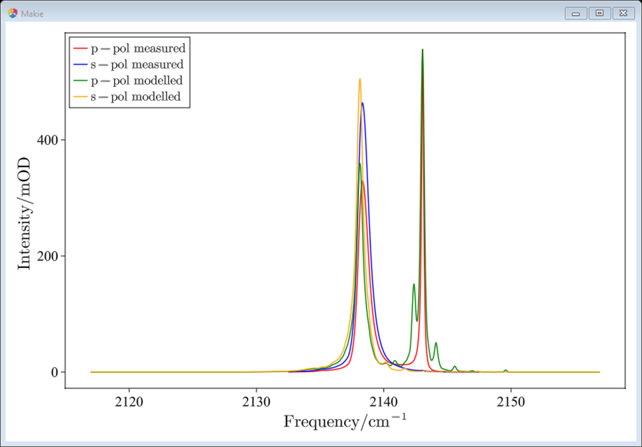
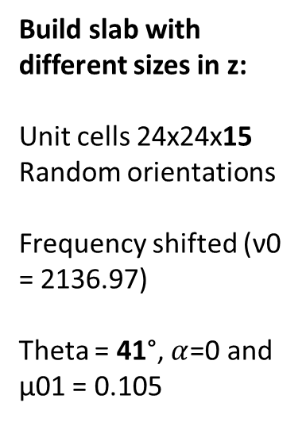
Build slab with different sizes in z:
Unit cells 24x24x15
Random orientations
Frequency shifted (ν0 = 2136.97)
Theta = 41°, $α$=0 and µ01 = 0.105
Notes:
~38 mins
Best would be somehting like 15.5 -> only integers possible -> 48x48x30 is good but computationally too expansive.

Slide 20

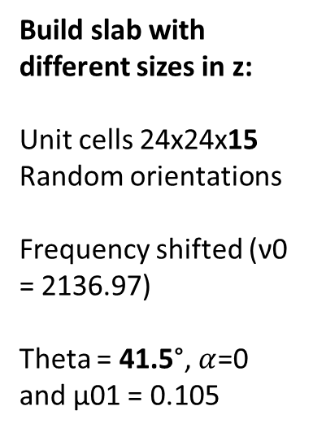
Build slab with different sizes in z:
Unit cells 24x24x15
Random orientations
Frequency shifted (ν0 = 2136.97)
Theta = 41.5°, $α$=0 and µ01 = 0.105

Slide 21

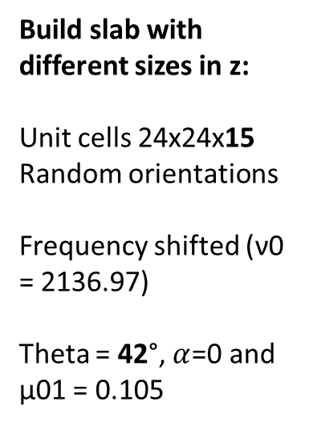
Build slab with different sizes in z:
Unit cells 24x24x15
Random orientations
Frequency shifted (ν0 = 2136.97)
Theta = 42°, $α$=0 and µ01 = 0.105

Slide 22
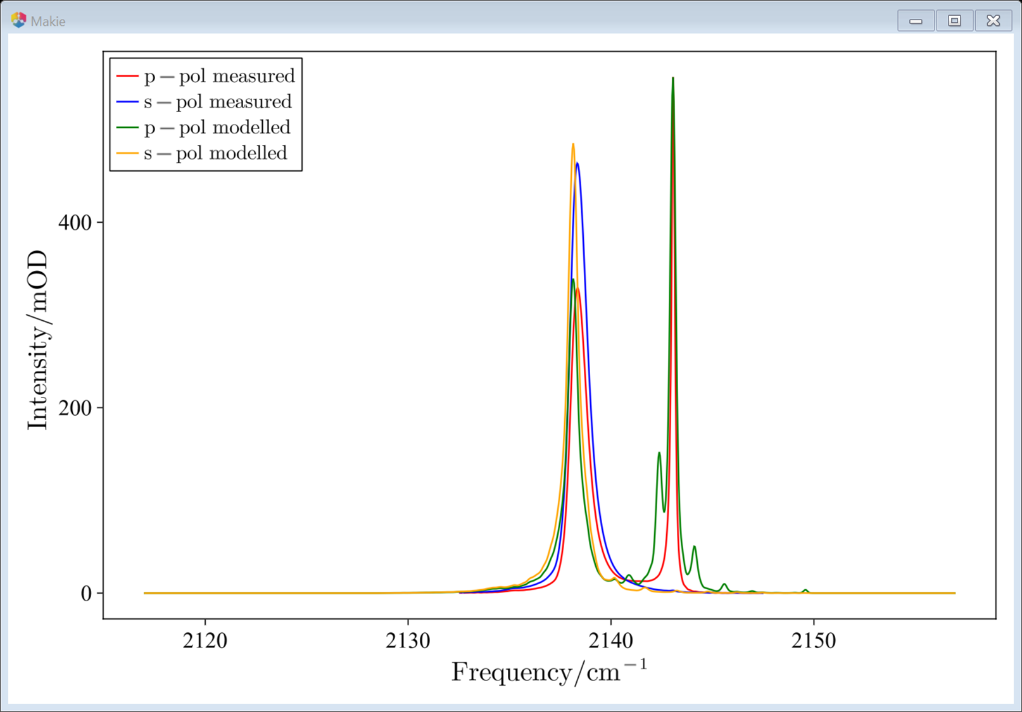
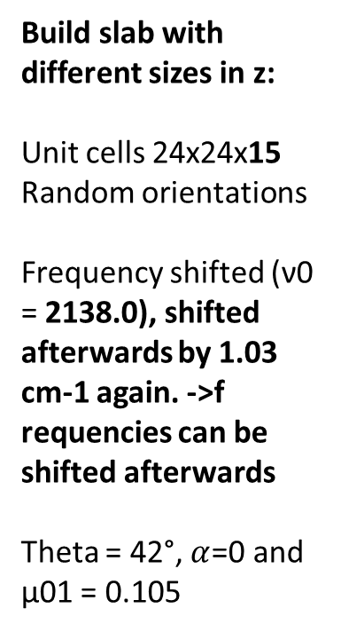
Build slab with different sizes in z:
Unit cells 24x24x15
Random orientations
Frequency shifted (ν0 = 2138.0), shifted afterwards by 1.03 cm-1 again. ->f requencies can be shifted afterwards
Theta = 42°, $α$=0 and µ01 = 0.105

Slide 23

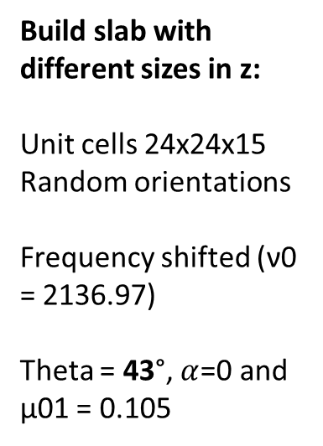
Build slab with different sizes in z:
Unit cells 24x24x15
Random orientations
Frequency shifted (ν0 = 2136.97)
Theta = 43°, $α$=0 and µ01 = 0.105

Slide 24
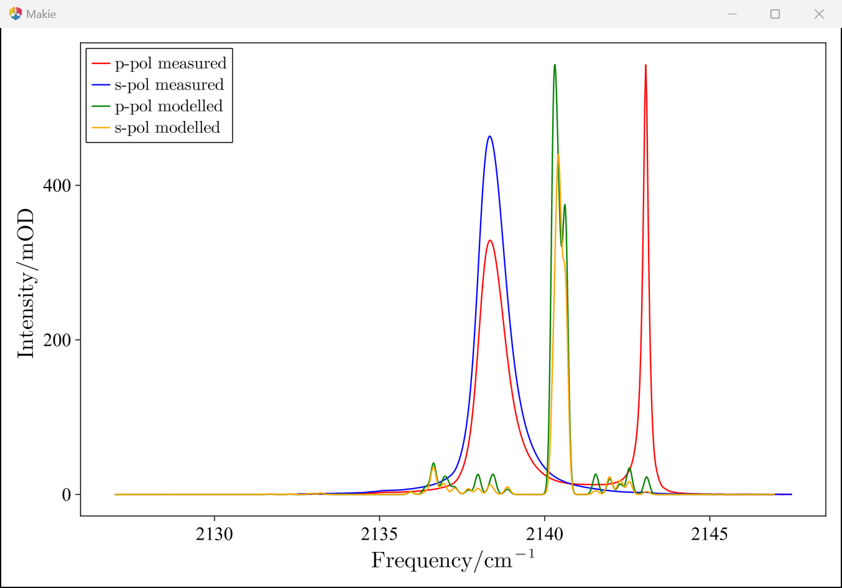
Convergence tests with periodic boundary conditions switched on for all axis:
2x2x2:
rand on
ν0 = 2136.97
43° inc α = 0*degrees

Slide 25
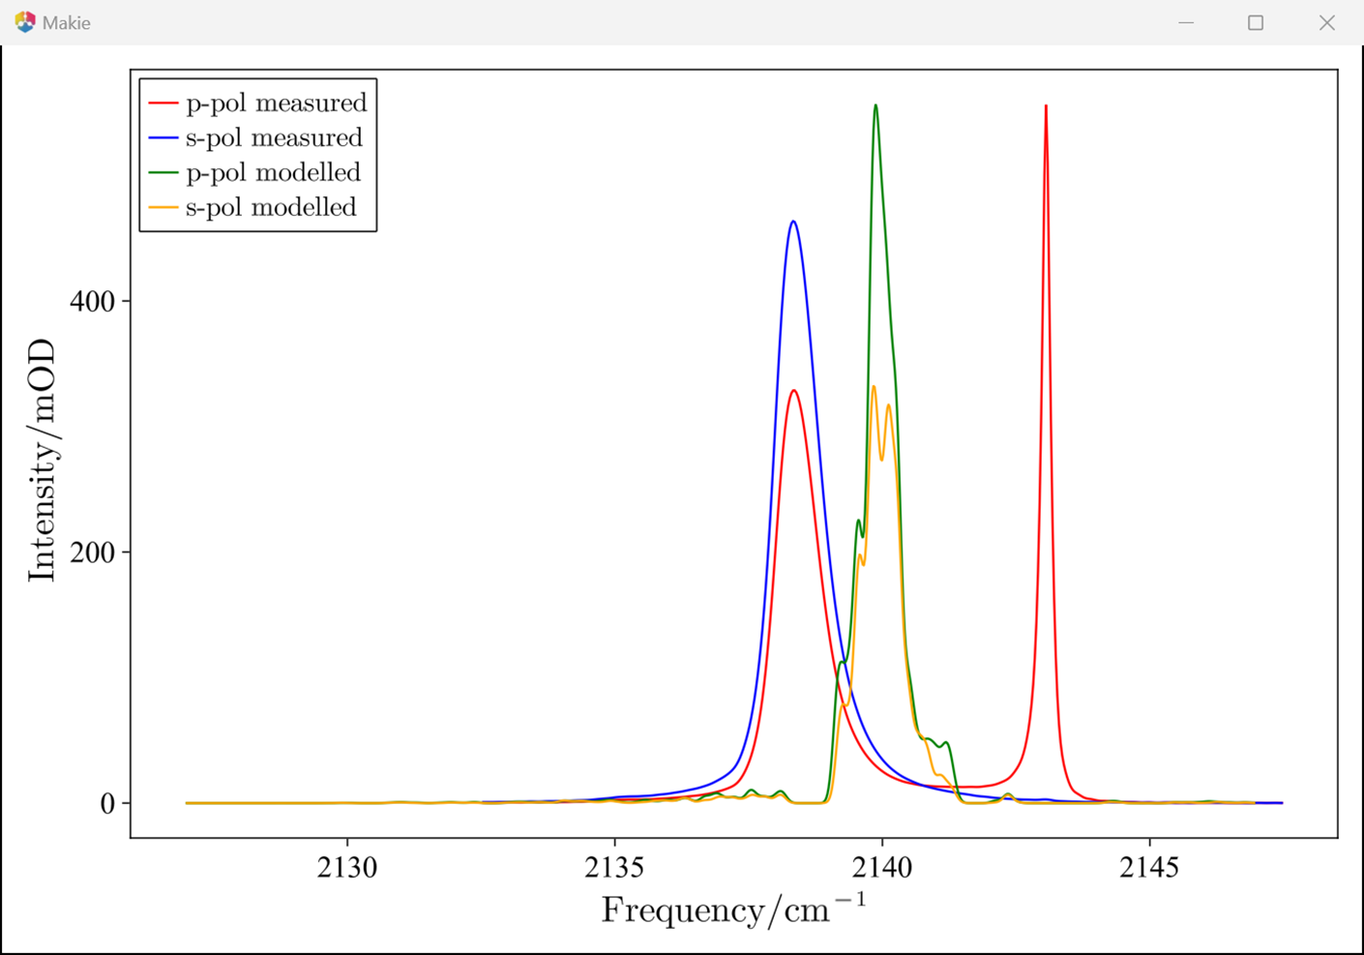
Convergence tests with periodic boundary conditions switched on for all axis:
4x4x4:
rand on

Slide 26
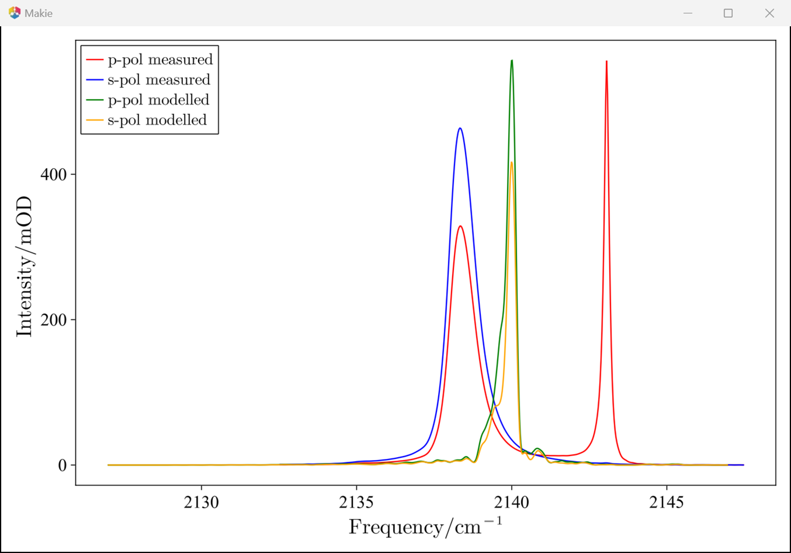
Convergence tests with periodic boundary conditions switched on for all axis:
6x6x6:
rand on

Slide 27
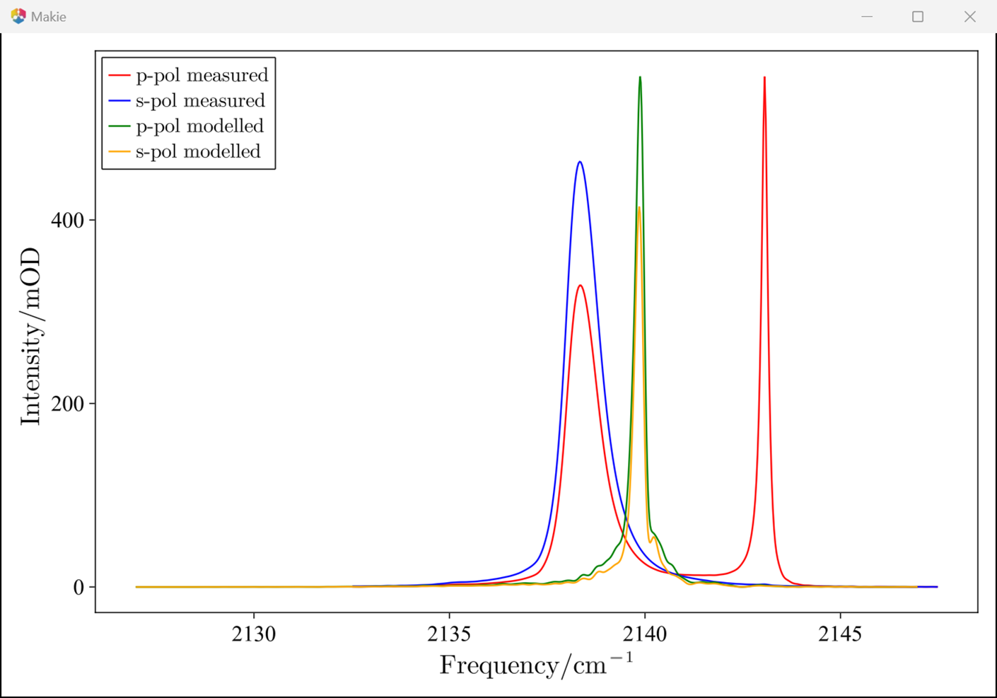
Convergence tests with periodic boundary conditions switched on for all axis:
8x8x8:
rand on

Slide 28

Convergence tests with periodic boundary conditions switched on for all axis:
10x10x10:
rand on
Notes:
Takes 1min 16s

Slide 29

Convergence tests with periodic boundary conditions switched on for all axis:
12x12x12:
rand on
Notes:
Takes 6 min 51s

Slide 30

Convergence tests with periodic boundary conditions switched on for all axis:
14x14x14:
rand on
Notes:
Takes 12 min

Slide 31

Convergence tests with periodic boundary conditions switched on for all axis:
16x16x16:
rand on
Notes:
Takes 34 min

Slide 32

Convergence tests with periodic boundary conditions switched on for all axis:
18x18x18:
rand on
Notes:
Takes 46 min
18x18x18 not possible with Lenovo laptop (8GB)

Slide 33

Convergence tests with periodic boundary conditions switched on for all axis:
20x20x20:
rand on
Notes:
Takes 51 min
18x18x18 not possible with Lenovo laptop (8GB)

Slide 34

Convergence tests with periodic boundary conditions switched on for all axis:
24x24x24:
rand on
Notes:
Takes 226 min
18x18x18 not possible with Lenovo laptop (8GB)

Slide 35







Convergence tests for interaction cut-off radius with periodic boundary conditions switched on for all axis:
10x10x10:
rand on
Cut-off radius / m
5e-9
1e-8
1e-7
1e-14
1e-13
Cut-off radius / m
1e-12
1e-11
1e-10
1e-9
1e-8
Cut-off radius / m
3e-10
4e-10
5e-10
7e-10
9e-10
R_cut / m
5.64e-10 (a0_CO)
1e-1
Notes:
On laptop: takes about 1 min to calc.
If r12 > interaction_cut_off_radius: interaction is switched off -> ( [(dot(eu[n1][:], eu[n2][:]) - 3.0*dot(en, eu[n1][:])*dot(en, eu[n2][:])) / r12^3] is set to 0
Does not make sense, as the periodic boundary conditions anyhow gives a maximum interaction radius of box-length / 2.

Slide 36
Testing of time of force calculation with boundary conditions along all axis
copy_size | time / mins
24 | 20
34 | OutOfMemoryError()
25 | 27
30 | After 45 min OutOfMemoryError()
27 | 47
28 | OutOfMemoryError()
27, no boundary cond in z | 49

Slide 37




H-matrix calculation procedure:
Use large simulation box: 40x40x10 (blue)
Index all molecs. in box and get central cuboid (orange) with same height
Do calculationof IR spectrum with inner cuboid with h-matrix of large simulation box, to maximum interaction range
Change size of cuboid (10x10x10, 20x20x10, 30x30x10 etc) to get convergence
Finally vary size z=10 to check if whole computation makes sense
Without centred piece at 10x10x4:
With centre piece at 4x4x4:
40
10
10
40
Need to take sum of large h-matrix and f(n1,n2) of small box here:
With different periodic boundary conditions in large vs small. So f(n1,n2) with small box interaction and small box periodic boundary conditions

Slide 38


Need to take sum of large h-matrix and f(n1,n2) of small box here:
With different periodic boundary conditions in large vs small. So f(n1,n2) with small box interaction and small box periodic boundary conditions
Large simulation box
Small sim box
Using ev[n1] + unit1*(μ11 - μ00)*μ00*large_h_matrix_sum[n1]
Which is wrong!
with centre piece at 4x4x4 now the IR spectrum changes to:
Then changed to diagonal elements: h[n1,n1] = large_h_matrix_sum[n1]
And get:

Slide 39





Fixed some error in code so that always the same unit vectors are used for the small simulation box as the large one!
Without randomisation now the simulation box and the spectrum looks like this:
WITH randomisation now the simulation box and the spectrum looks like this:
10x10x4 large box
4x4x4 small box

Slide 40




10x10x4,
Subset: small_box_size_fraction =
= 5
=4
=3
= 2
=1

Slide 41








Without randomisation:
Small_box_size_fraction
=5
=4
=3
Now get largest possible box (40x40x10) and repeat subset: small_box_size_fraction =
= 5
=4
=3
= 2
=1
Too large to calculate
Notes:
Time for 40x40x10 large sim box: t= 30 min

Slide 42

h[n1,n1] += 0
h[n2,n2] += 0
h[n1,n1] += force
h[n2,n2] += force
Notes:
Does not make a difference in ir_spectra_centre

Slide 43


Testing new code with comparison to previous IR spectra from ir_spectra function
2x2x1:
Now with new code and ir_spectra_centre function with same size (centre sim box has same size as large simulation volume)
Is the same.

Slide 44


Now get the smaller simulation box
1x1x1:
Spectrum changes

Slide 45



Testing new code with comparison to previous IR spectra from ir_spectra function
4x4x2
Now with new code and ir_spectra_centre function with same size (centre sim box has same size as large simulation volume)
Is the same.

Slide 46




Now get the smaller simulation box
1x1x2:
Spectrum changes
2x2x2:
3x3x2

Slide 47






1x1x1 with Randomisation: false
4x4x1 With 1x1x1 small box
20x20x1 With 1x1x1 small box

Slide 48






2x2x2 with Randomisation: false
8x8x2 With 2x2x2 small box
20x20x2 With 2x2x2 small box

Slide 49






3x3x2 with Randomisation: false
8x8x2 With 3x3x2 small box
20x20x2 With 3x3x2 small box

Slide 50






3x3x3 with Randomisation: false
8x8x3 With 3x3x3 small box
20x20x3 With 3x3x3 small box

Slide 51






4x4x4 with Randomisation: false
8x8x4 With 4x4x4 small box
20x20x4 With 4x4x4 small box

