Slide 1
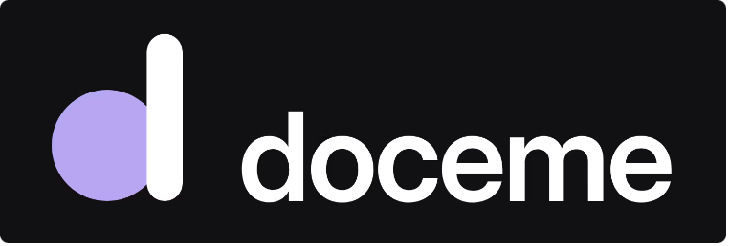
What if the best way to learn was to teach?
Notes:
Hello, I'm Norhène Benabbou, an English teacher. Think of the moment you really understood something. Very often, it was when you had to explain it to someone else. That simple idea is the heart of Doceme.

Slide 2

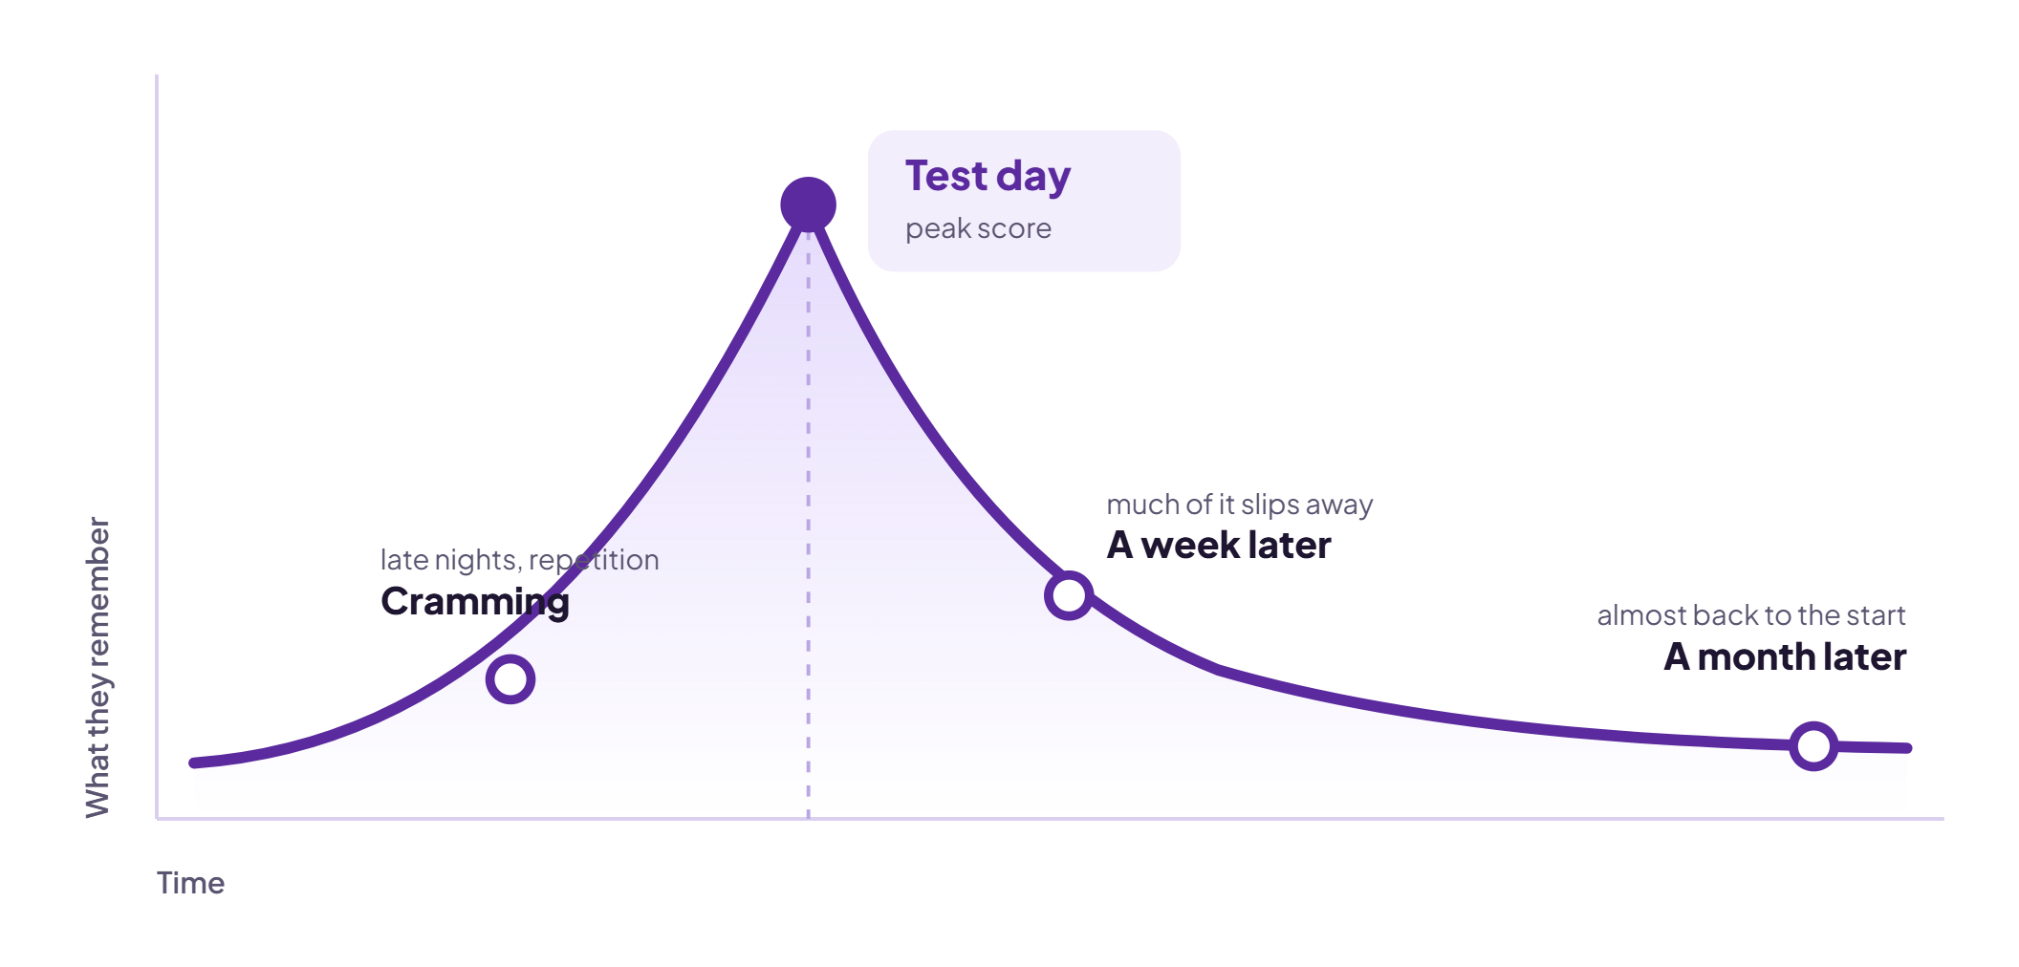
Students memorise for the test, then forget.
Notes:
In our classrooms, students memorise the lesson, pass the test, and forget it a few weeks later. They can repeat the rule, but they can't explain it. And teachers have no simple way to see what their students truly understand.

Slide 3
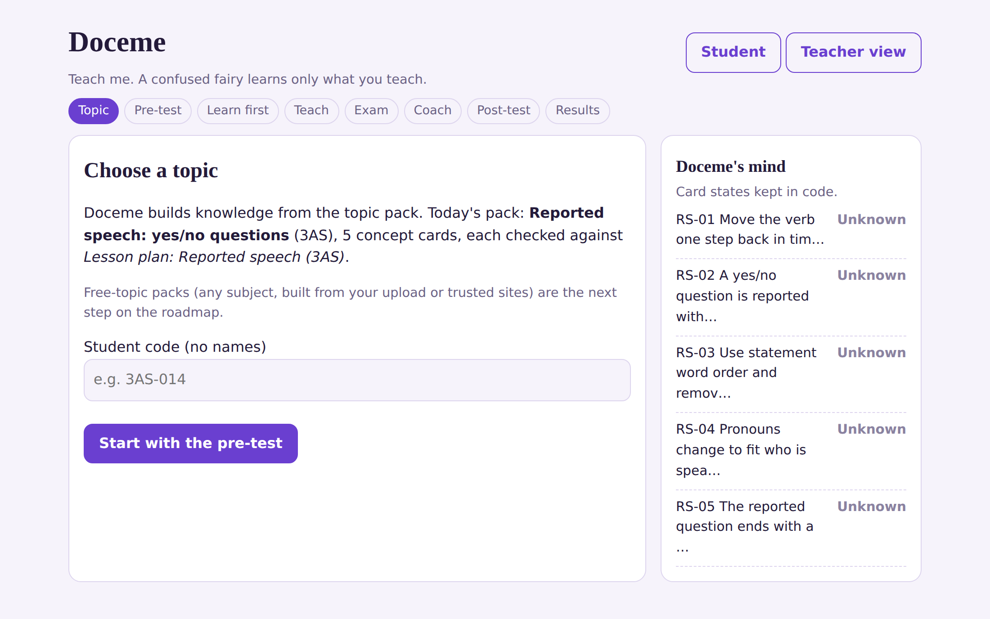
Doceme: the student becomes the teacher.
Notes:
Doceme flips the roles: the student becomes the teacher. Doceme is a fairy learner who starts out knowing nothing about the topic. Its knowledge is a record kept in code, one state per rule, so it only knows what the student explained. This is the first screen: the student chooses the topic, enters a student code with no name, and then starts with a pre-test.

Slide 4
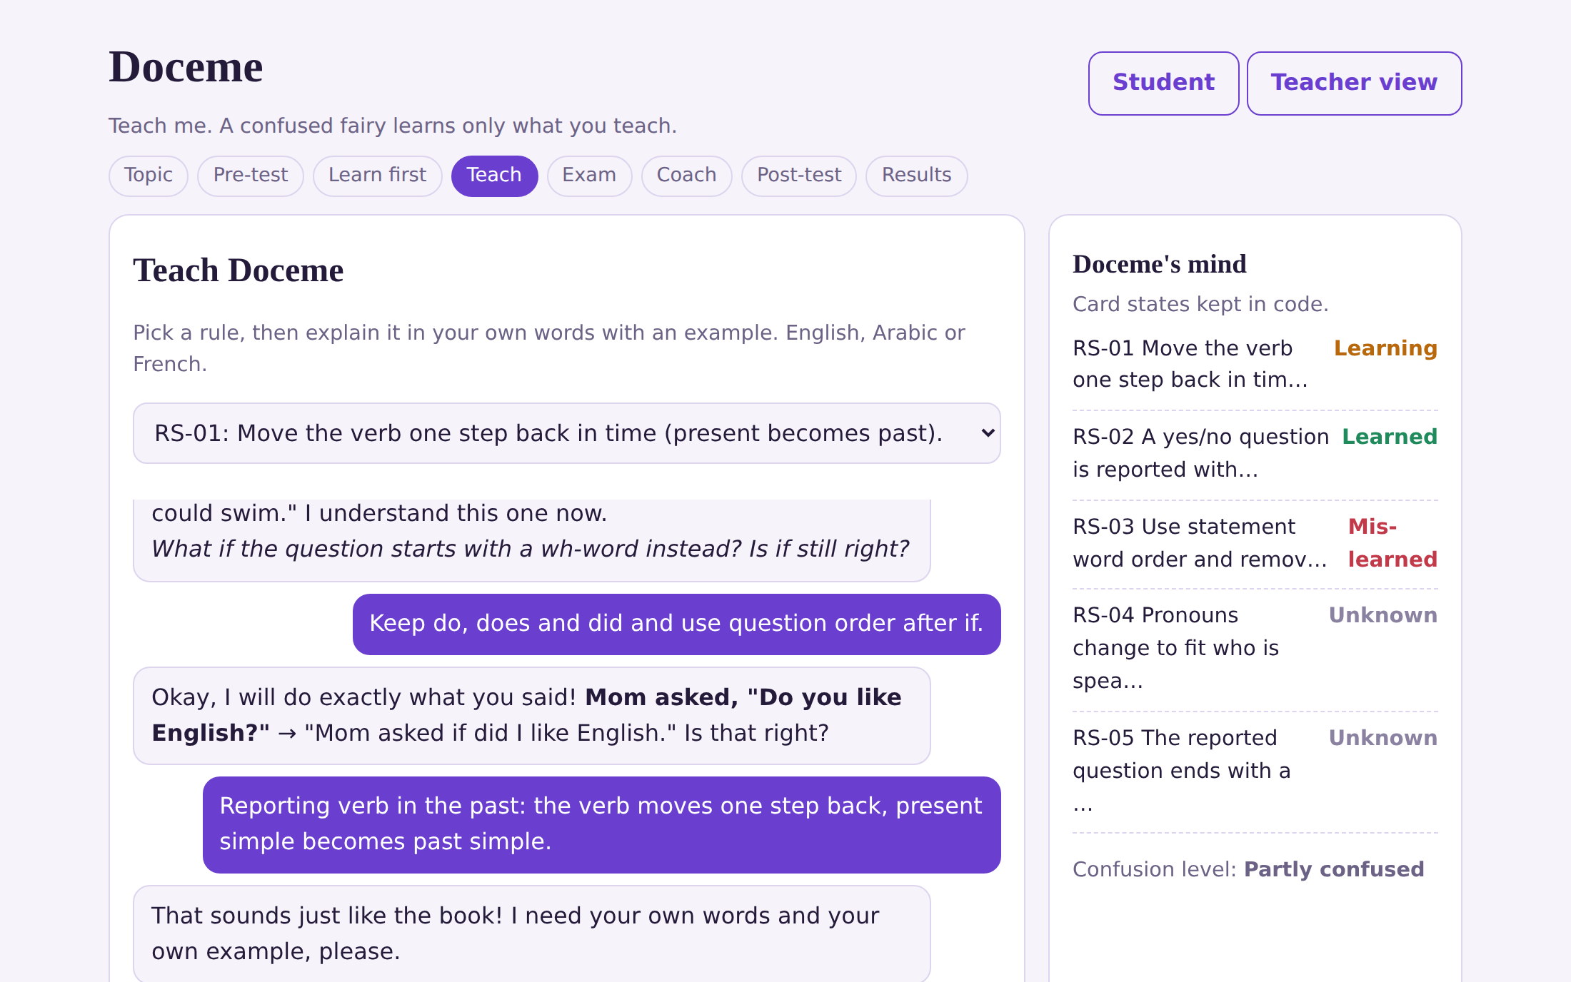




Learn → Teach → Doceme's exam → Your gain
Notes:
Here is a session. After a five-question pre-test and a short worked example, the student teaches Doceme one rule at a time, with an example, in English, Arabic or French. On the right is Doceme's mind: each rule is Unknown, Learning, Learned or Mis-learned. In this example the student explained one rule well, taught a wrong idea that Doceme applied faithfully, copied the lesson and was asked for their own words, and explained one rule in Arabic, which is recorded for the teacher. Then Doceme takes an exam, one item per rule, and its answers follow what it was taught. A coach shows what was taught well, weakly or not at all, and which lesson section to review.

Slide 5
Doceme knows only what the student taught it.
Its knowledge is a record kept in code, one state per rule.
A wrong explanation gives a wrong answer, so students see their own mistakes.
Copying the lesson is flagged: Doceme asks for your own words and example.
Other tools give answers. Doceme asks the student to explain.
Notes:
Most AI tutors give answers. Doceme does the opposite: it asks the student to explain. And it cannot pretend: its knowledge is a record in code, so a rule the student did not teach is answered wrongly, a wrong idea is applied as it was taught, and copied text is flagged. To be honest about the limits: today Doceme's replies come from rules and templates, not a language model, and grading uses keywords.

Slide 6
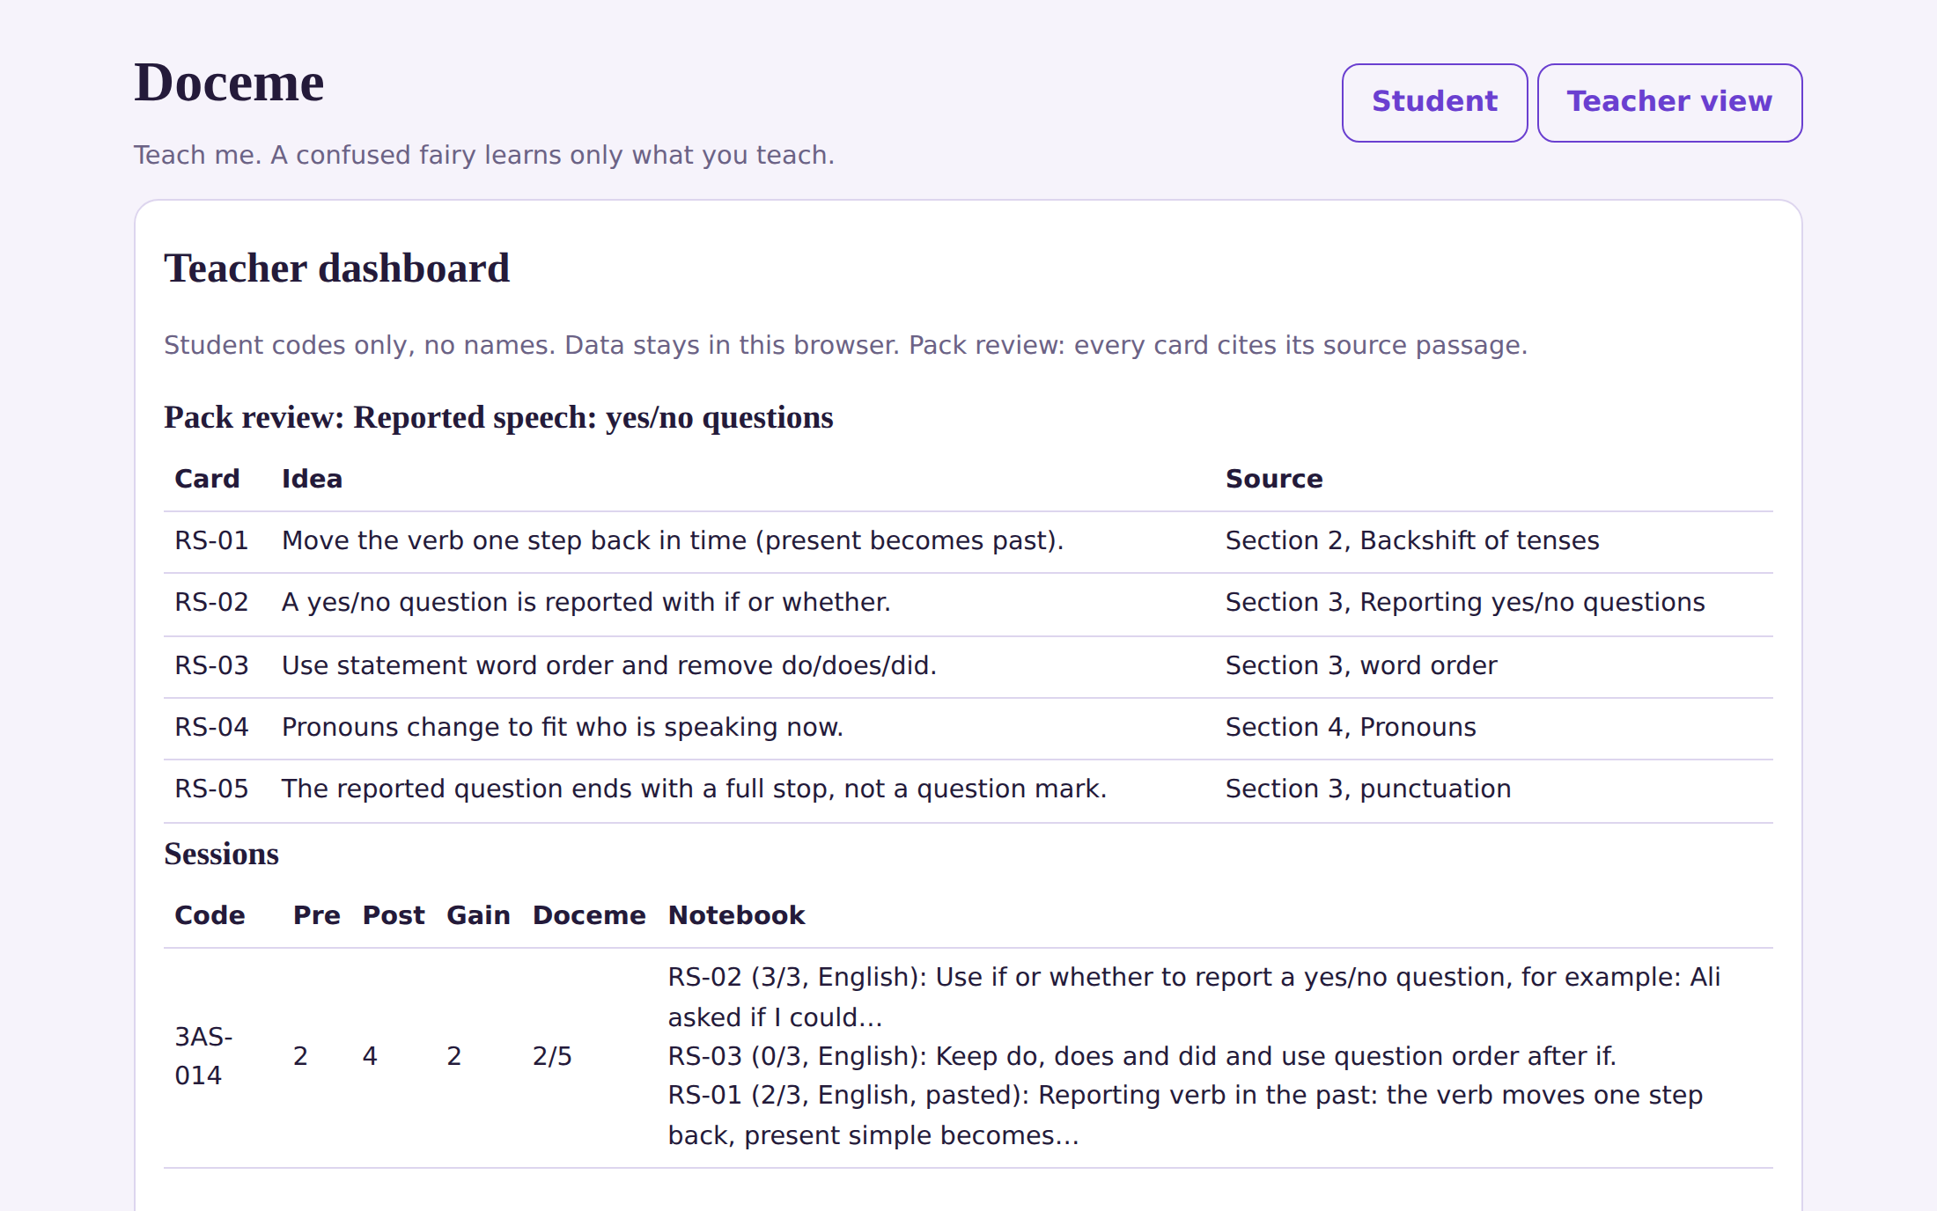
Teachers see what each student taught.
Notes:
This is the teacher view. For each student code it shows the pre-test, the post-test, the gain, Doceme's exam score and the notebook of what the student actually taught, with the rubric score and the language used. It also shows a pack review table: each concept card with the lesson section it comes from. Data stays in the browser on that device. Today this view has no password and shows one student at a time; class averages and approval of packs are next steps.

Slide 7
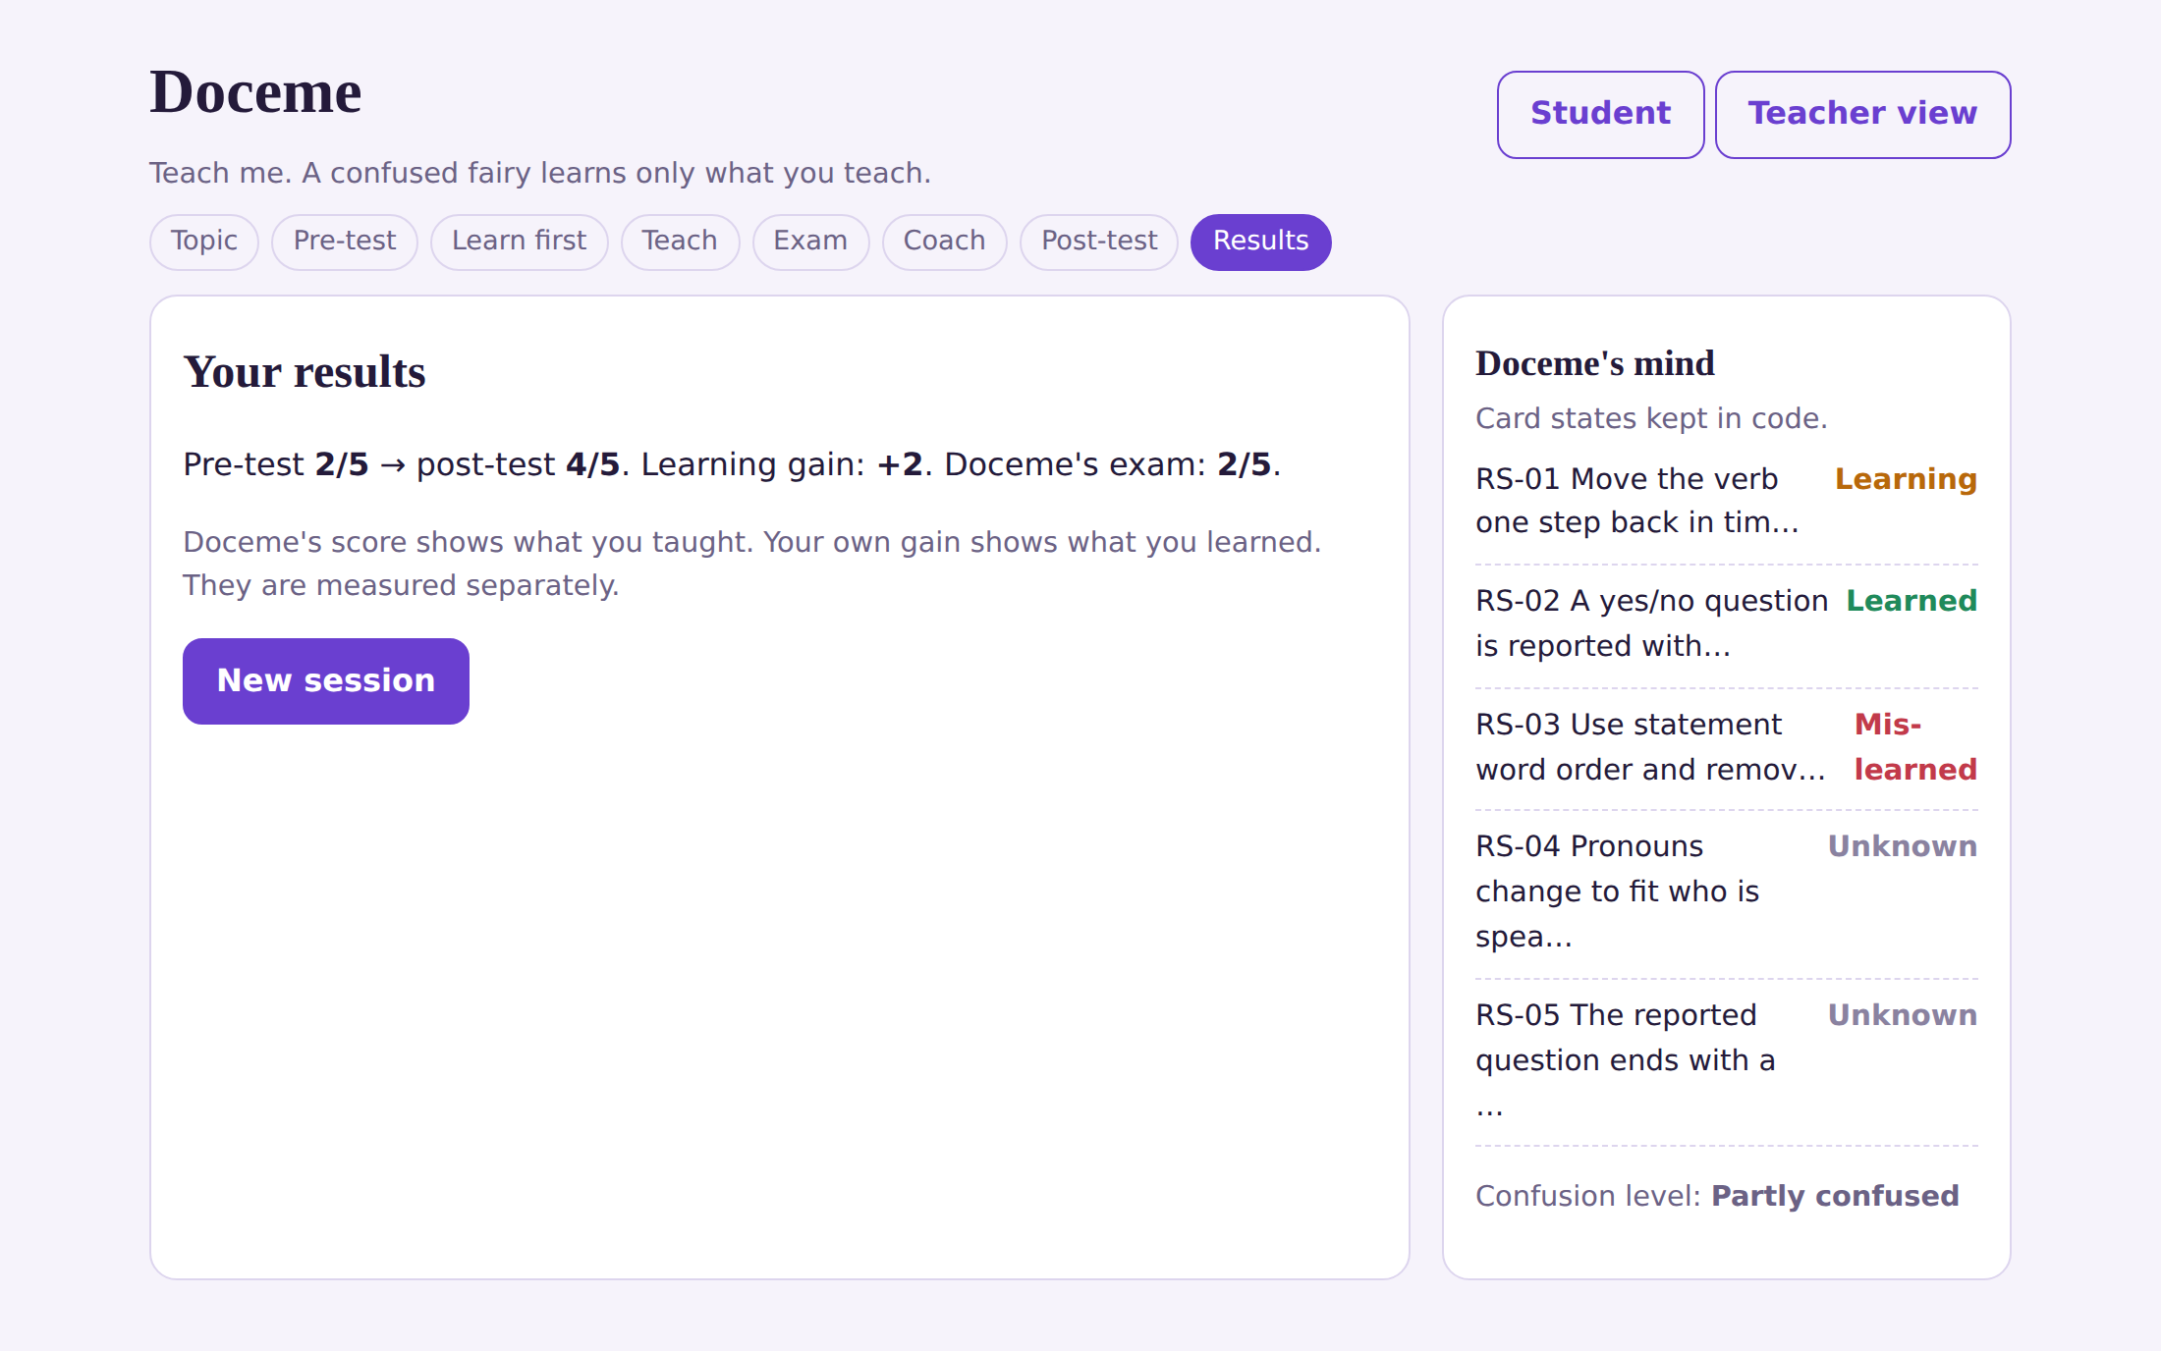
Works today for one topic. Next: a class pilot.
Notes:
Doceme works from start to finish for one topic: reported speech, yes/no questions, 3AS, with five concept cards. At the end the student sees the pre-test, the post-test and the gain, here from 2 to 4 in a demo session. Doceme's own exam score is shown separately, because it measures what was taught, not what was learned. Not built yet: free topic choice, a language model, teacher login and approval. In the next three months: a pack builder that turns an uploaded lesson into cited concept cards, a language model that only phrases Doceme's replies, and a pilot with real classes. Our plan is to keep it free for students and offer schools a licence, which we still have to test.

Slide 8

The team behind Doceme
Looking for: schools to pilot Doceme in class, and mentors and partners to guide us.
Norhene Benabbou — Founder & Team Leader
Wassim Achouri — Content Curator
Notes:
Doceme started as my idea. I'm Norhène Benabbou, founder and team leader, an English teacher at university and in secondary school. I lead the vision and provide the learning resources the AI learner is built on. Merouane Kanoune is our CTO and lead developer, a full-stack engineer in machine learning, computer vision and mobile. He takes Doceme from prototype to a real AI app on web and mobile. Wassim Achouri is our content curator. He shapes the storyboard and structure of the project and leads our documentation. We are looking for schools to pilot Doceme in class, and for mentors and partners to guide us. Help us make every student a teacher. Thank you.

