Slide 1
Implementing a HTTP Server- Client with Raspberry Pi
ECE 591 – Assignment 2
Anand Kumar

Slide 2
Summary of Results
File Size | Avg Time for transfer(seconds) | Standard Deviation(seconds)
100 Bytes | 0.018 | 0.01
10 Kilobytes | 0.025 | 0.015
1 Megabytes | 0.3047 | 0.0524
10 Megabytes | 2.286 | 0.126

Slide 3
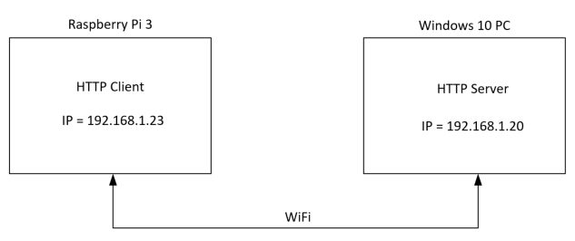
Setup Block Diagram
A windows 10 http server hosted the files in this experiment
A Raspberry Pi3 was used as a http client in this experiment
The HTTP server and the client were assigned static IP addresses shown in the block diagram
The server and the client both had Python 3.7.4 installed

Slide 4
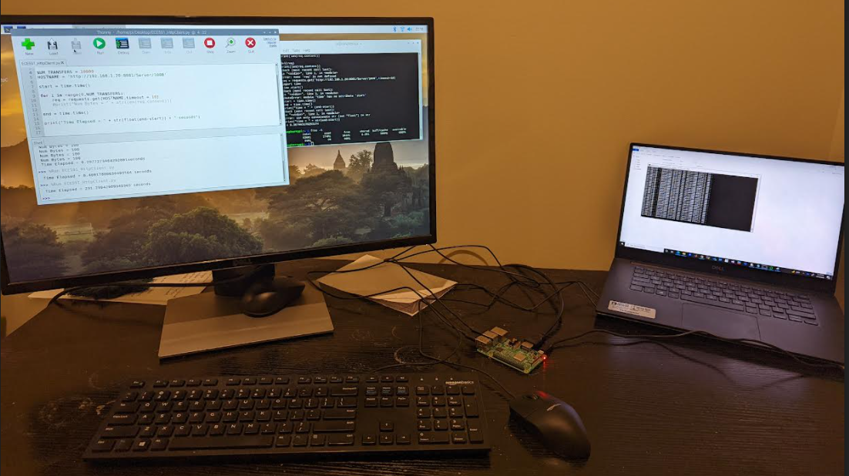
Actual Setup
HTTP Server
(Windows 10 Laptop)
HTTP Client
(Raspberry Pi3)

Slide 5
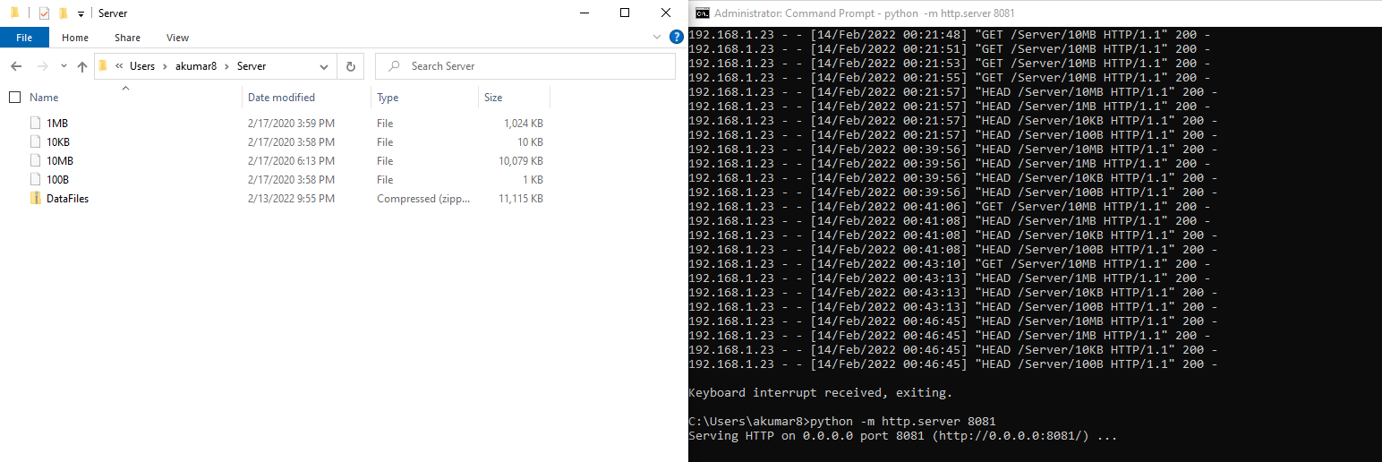
Deploying the Server
Server was hosted at the location “C:\Users\akumar8” on the Windows PC.
A HTTP server was deployed on Port 8081 from the above location using the python cmd, “python –m http.server 8081”
Files used for the experiment were stored in a sub-directory called “Server”

Slide 6
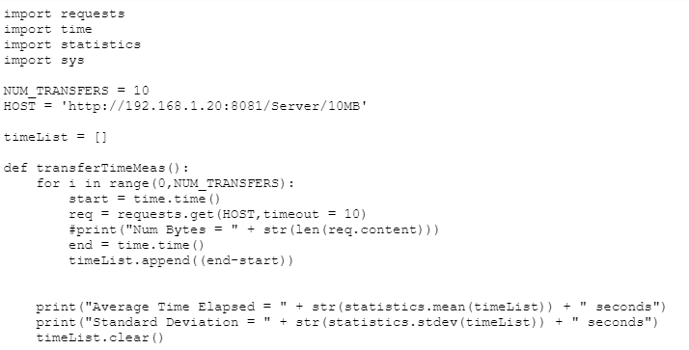
Transferring Files to the Client
The code listing for fetching files from the http server is shown on the right
Python requests module was used to implement the HTTP client
Python time module was used to benchmark the file transfer time
Python statistics module was used to average the time and calculate standard deviation

