Slide 1


Slide 2






unlocking the potential : azure container apps in action
ACHRAF BEN ALAYA
Contact : www.achrafbenalaya.com
achrafbenalaya@outlook.com @AchrafBenAlaya
ABOUT ME
Cloud Architect
DevSecOps
Microsoft Certified Trainer
Speaker
Blogger

Slide 3
AGENDA
1. Deploying Frontend and Backend Application with Azure Container Apps
2. Setting up Backend Access Restriction to Internal Apps
3. Adding Domain Names to Azure Container Apps
4. Managing Environment Variables, Secrets, and Azure Key Vault
5. Scaling Out Azure Container Apps
6. Persisting Storage with Azure Fileshare
7. Authentication with Azure Container Apps
8. Single Revision vs. Multiple Revisions Consideration
9. App Container Jobs
10. DevOps Integration
11. Terraform Implementation

Slide 4
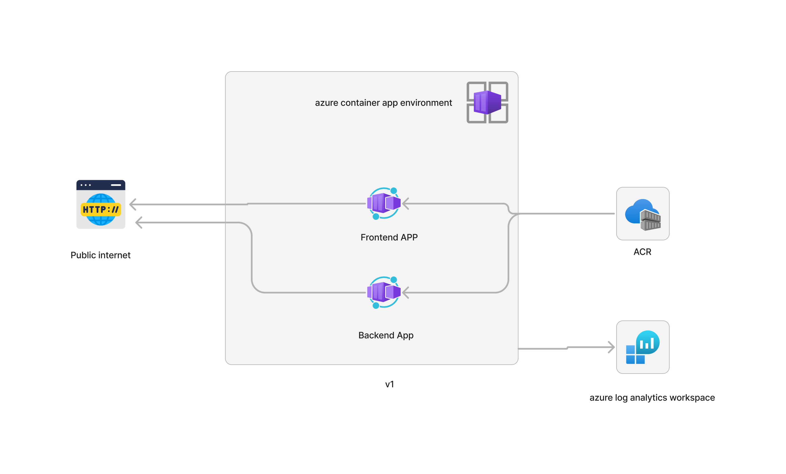

Slide 5
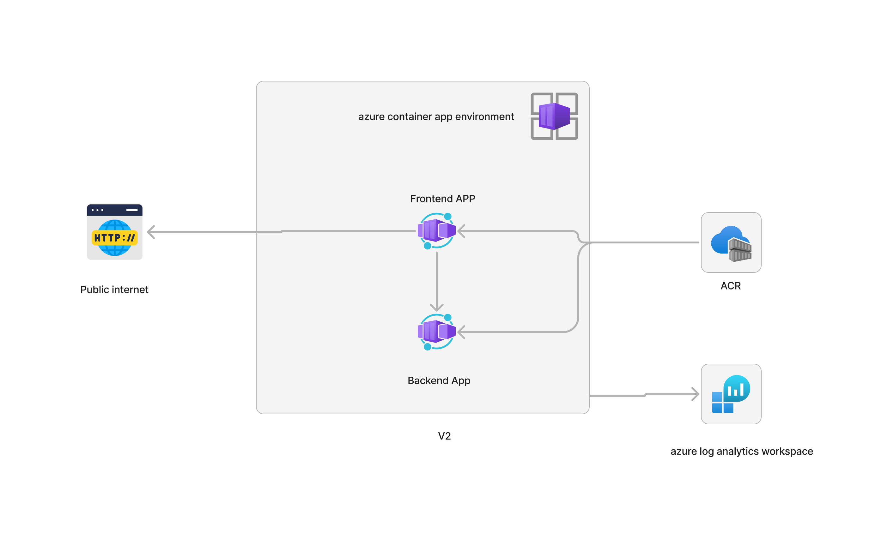

Slide 6
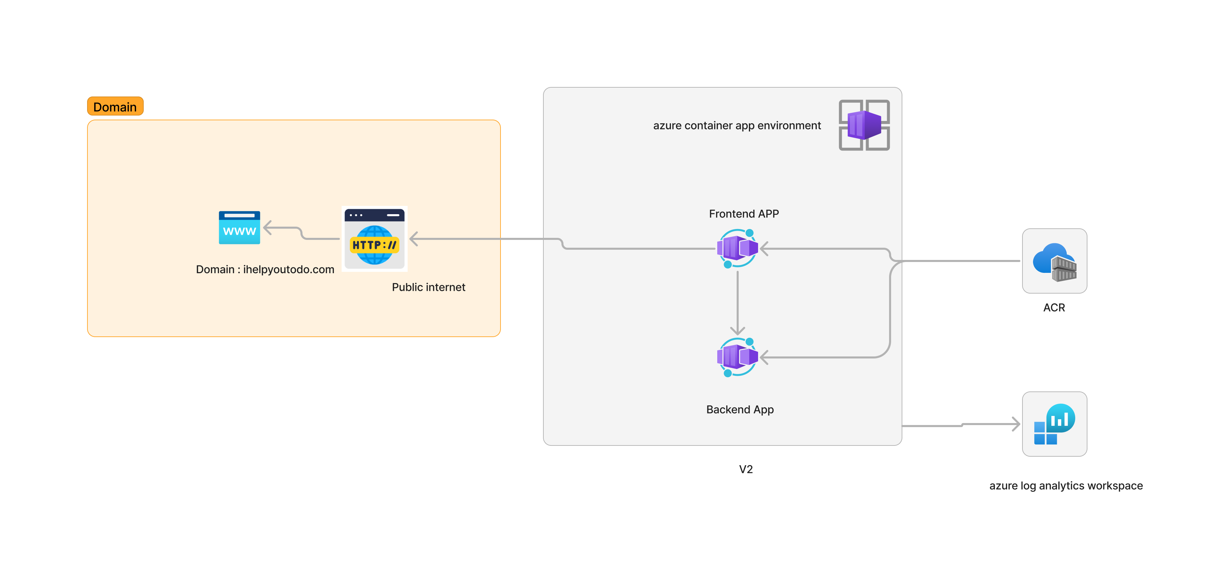

Slide 7
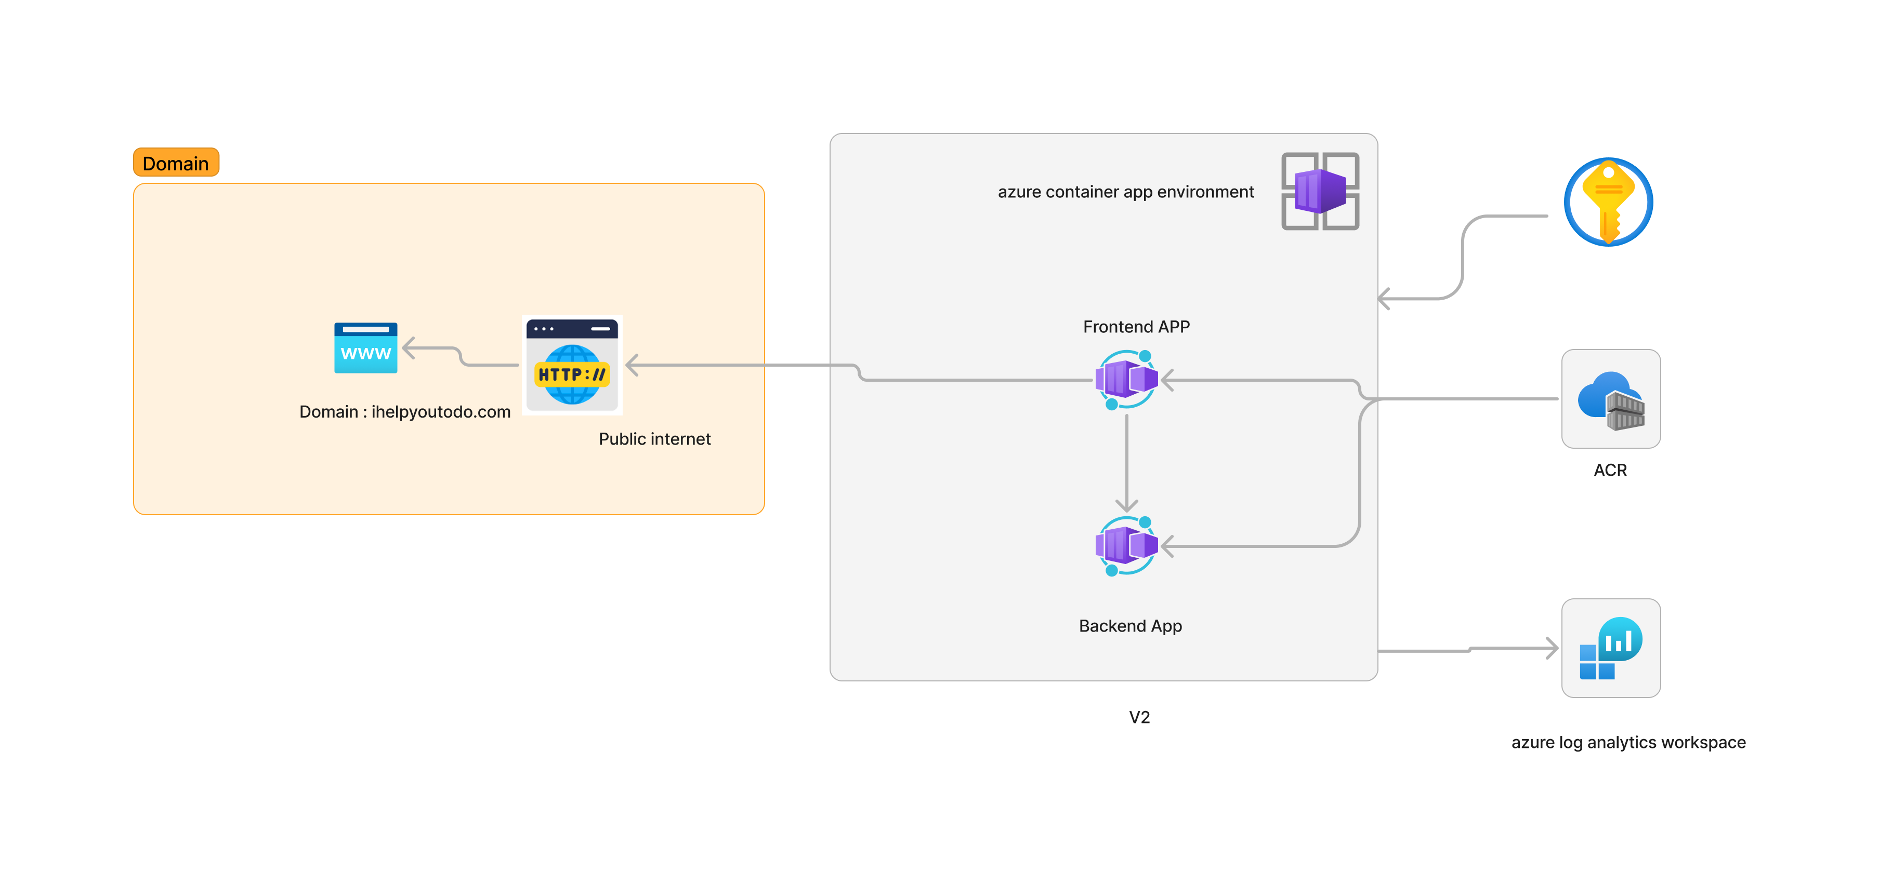
Env secrets

Slide 8
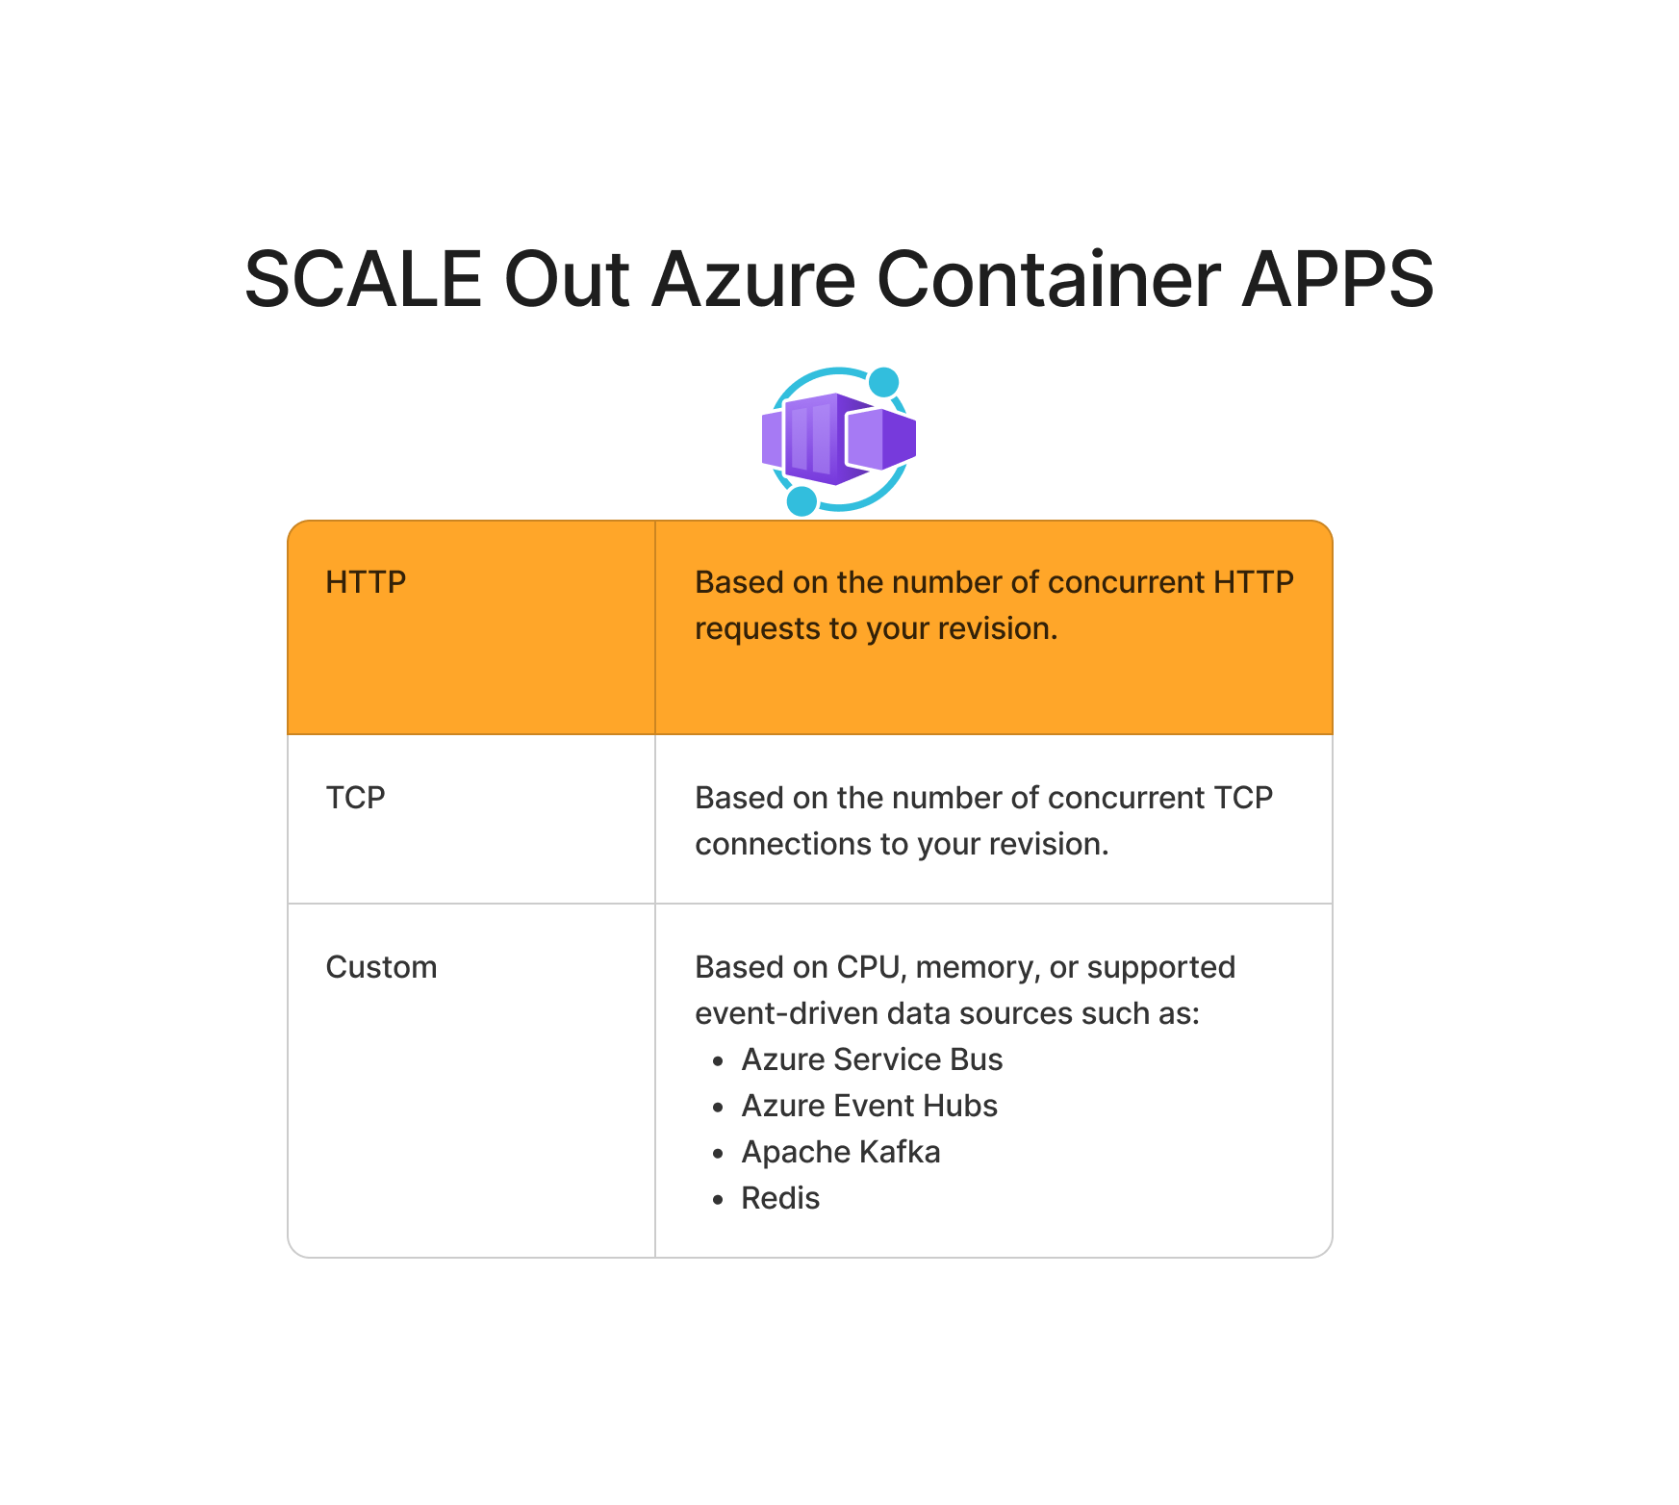

Slide 9
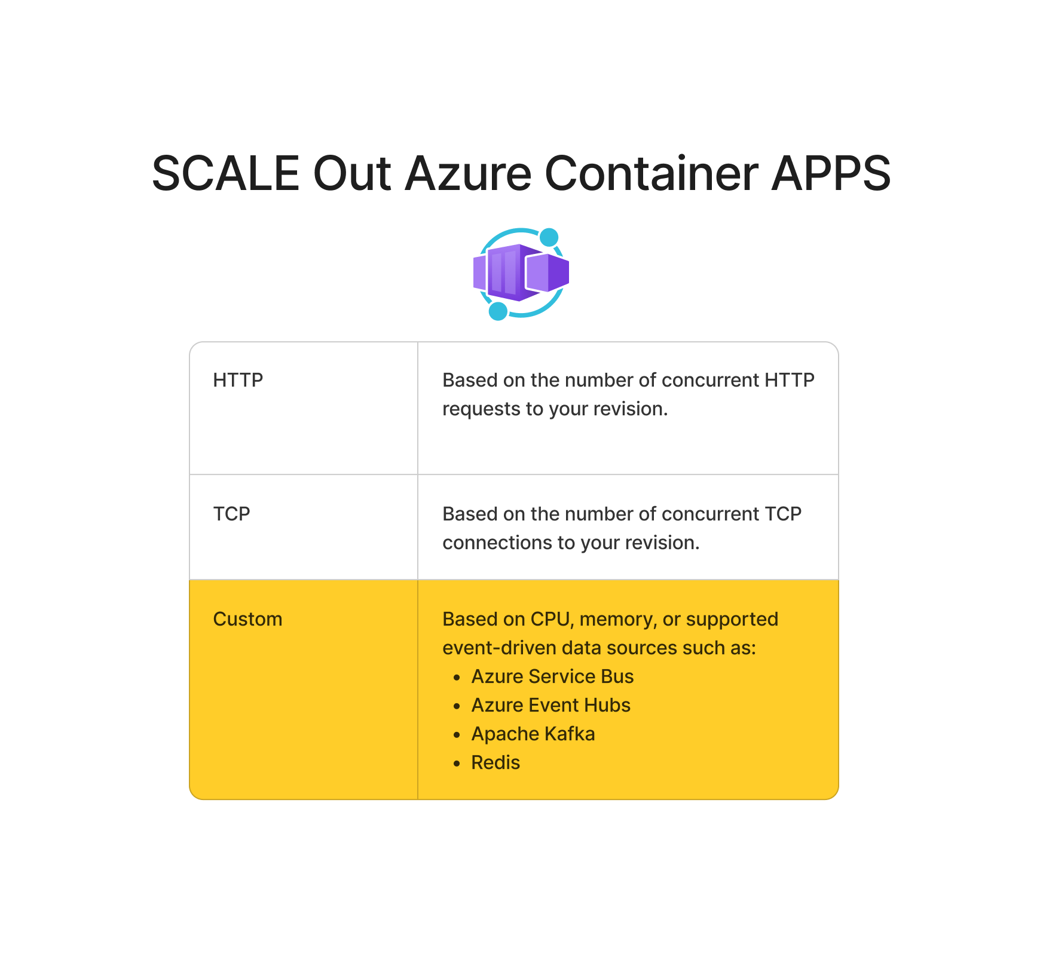

Slide 10
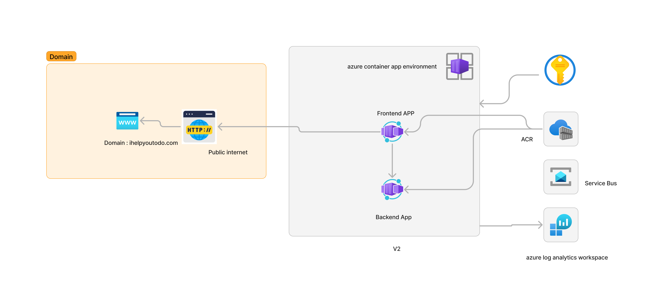

Slide 11
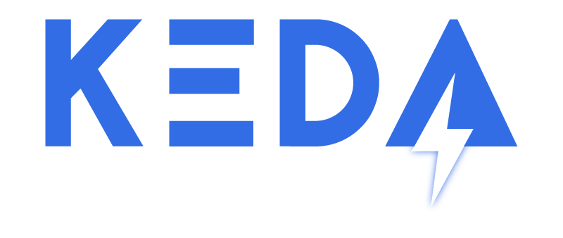
KEDA (Kubernetes Event-Driven Autoscaling) is an open-source project that enhances Kubernetes scalability by dynamically adjusting the number of pods based on event-driven workloads. It enables efficient resource utilization, automates scaling decisions, and supports a wide range of event sources for a flexible and responsive containerized environment. KEDA simplifies the management of applications in Kubernetes by intelligently scaling workloads based on demand.

Slide 12
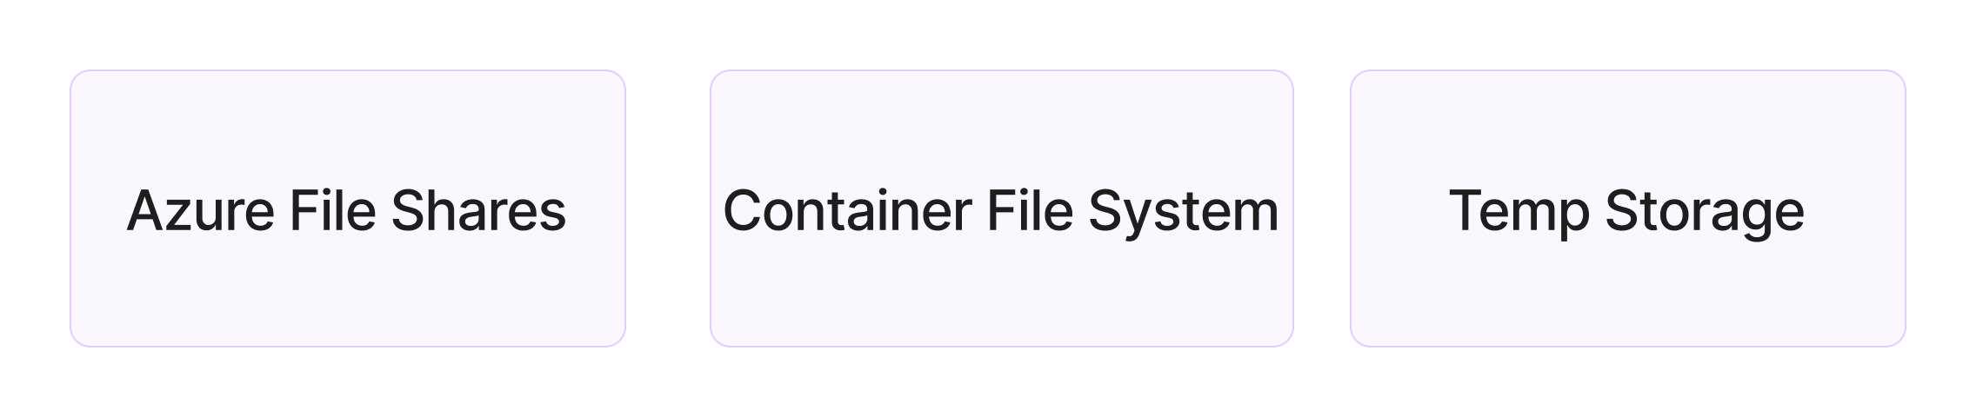

Slide 13
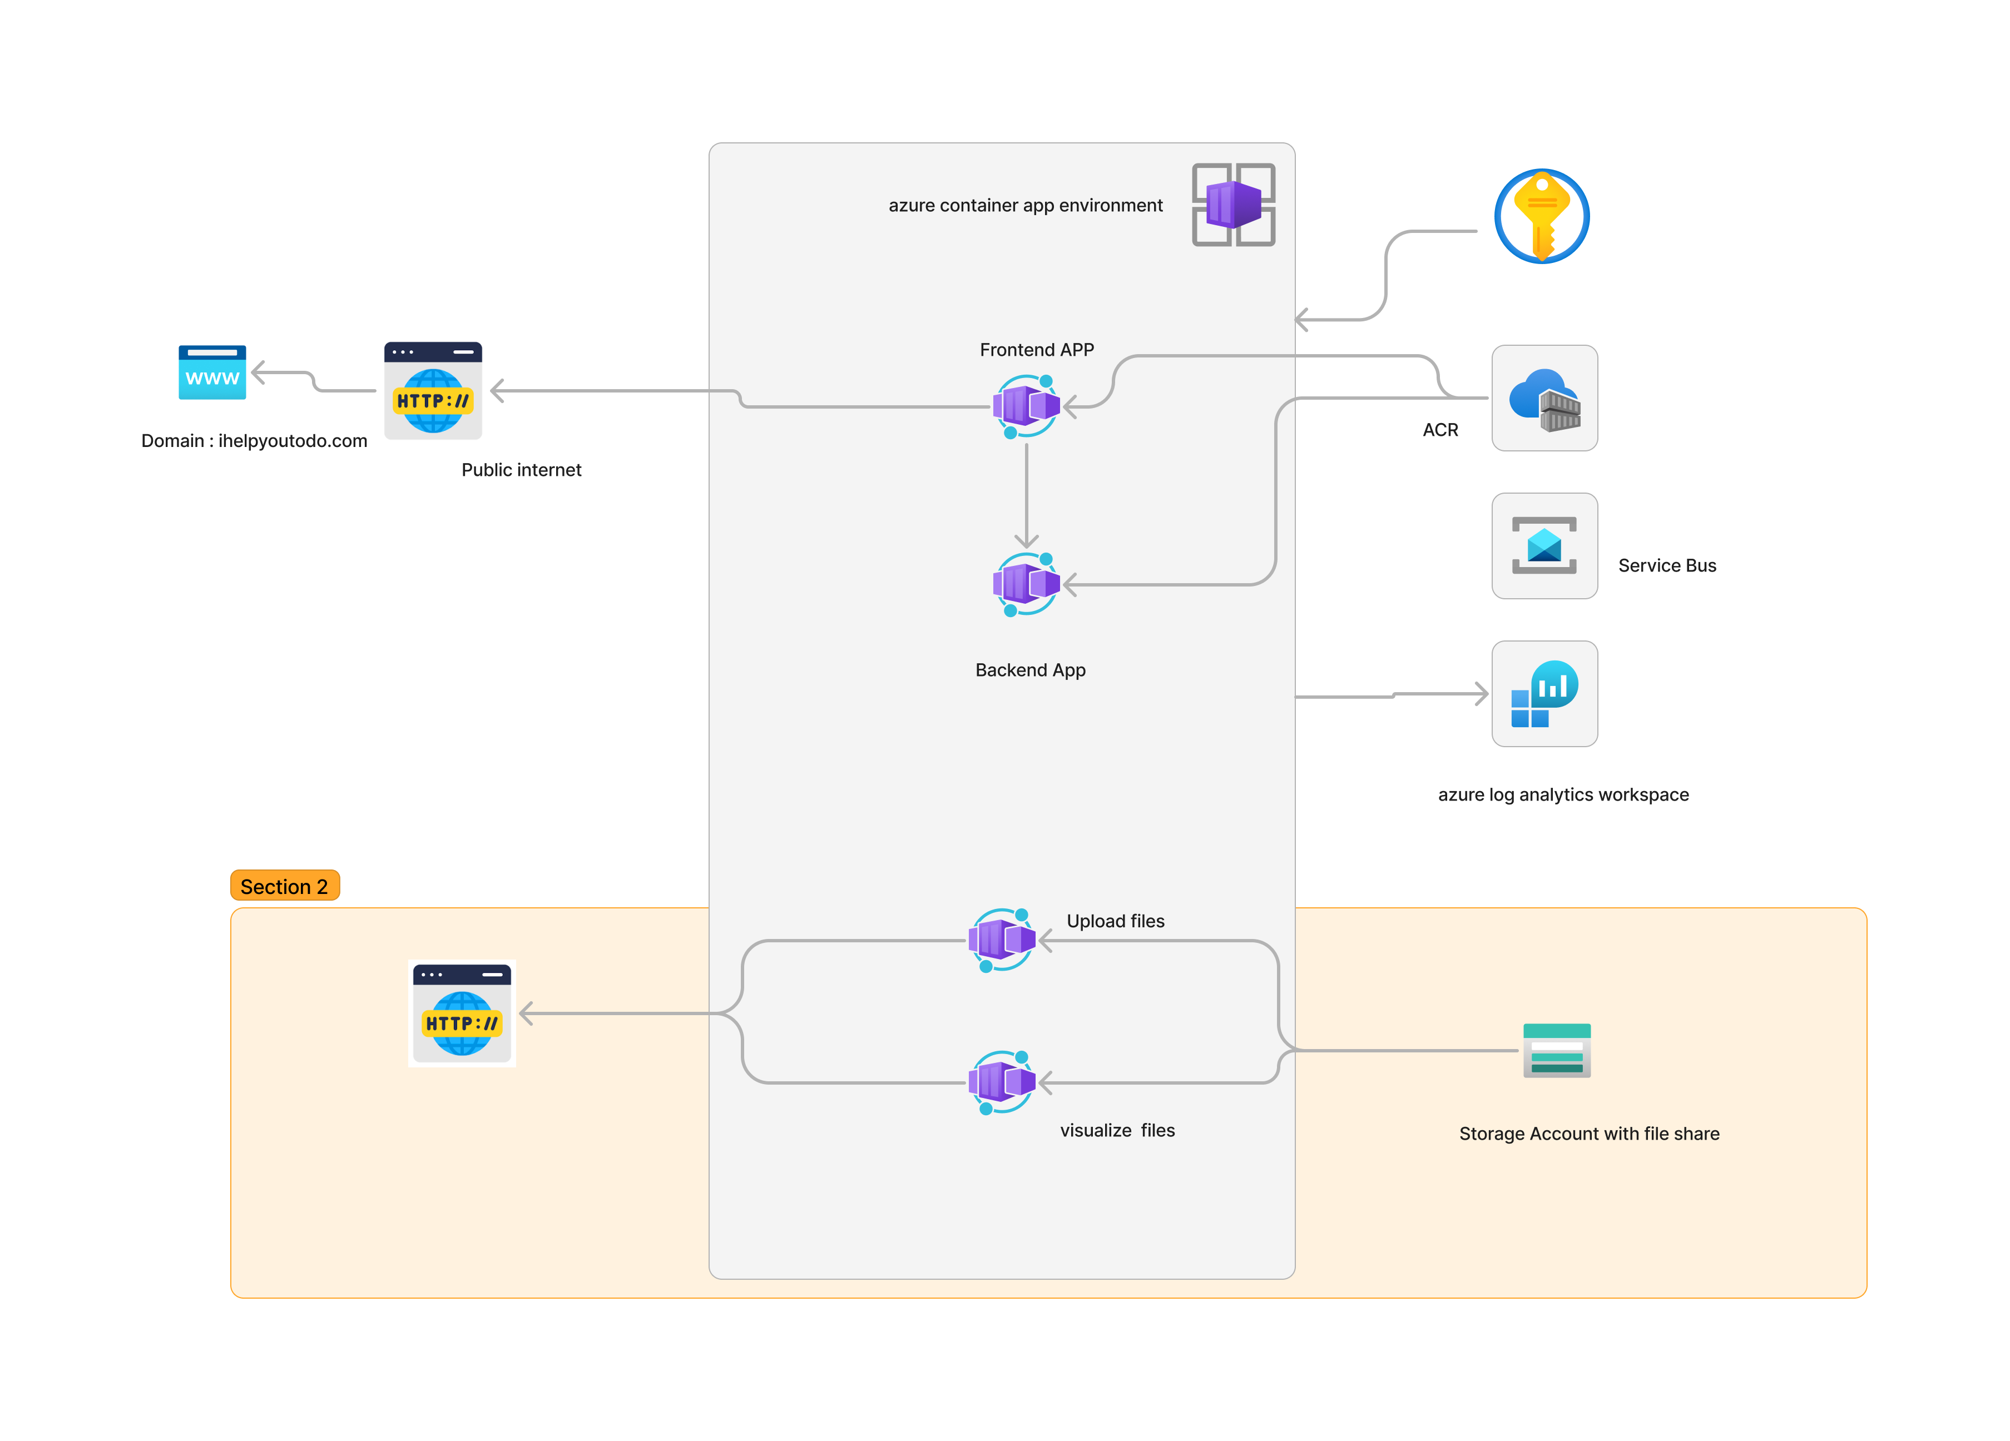

Slide 14
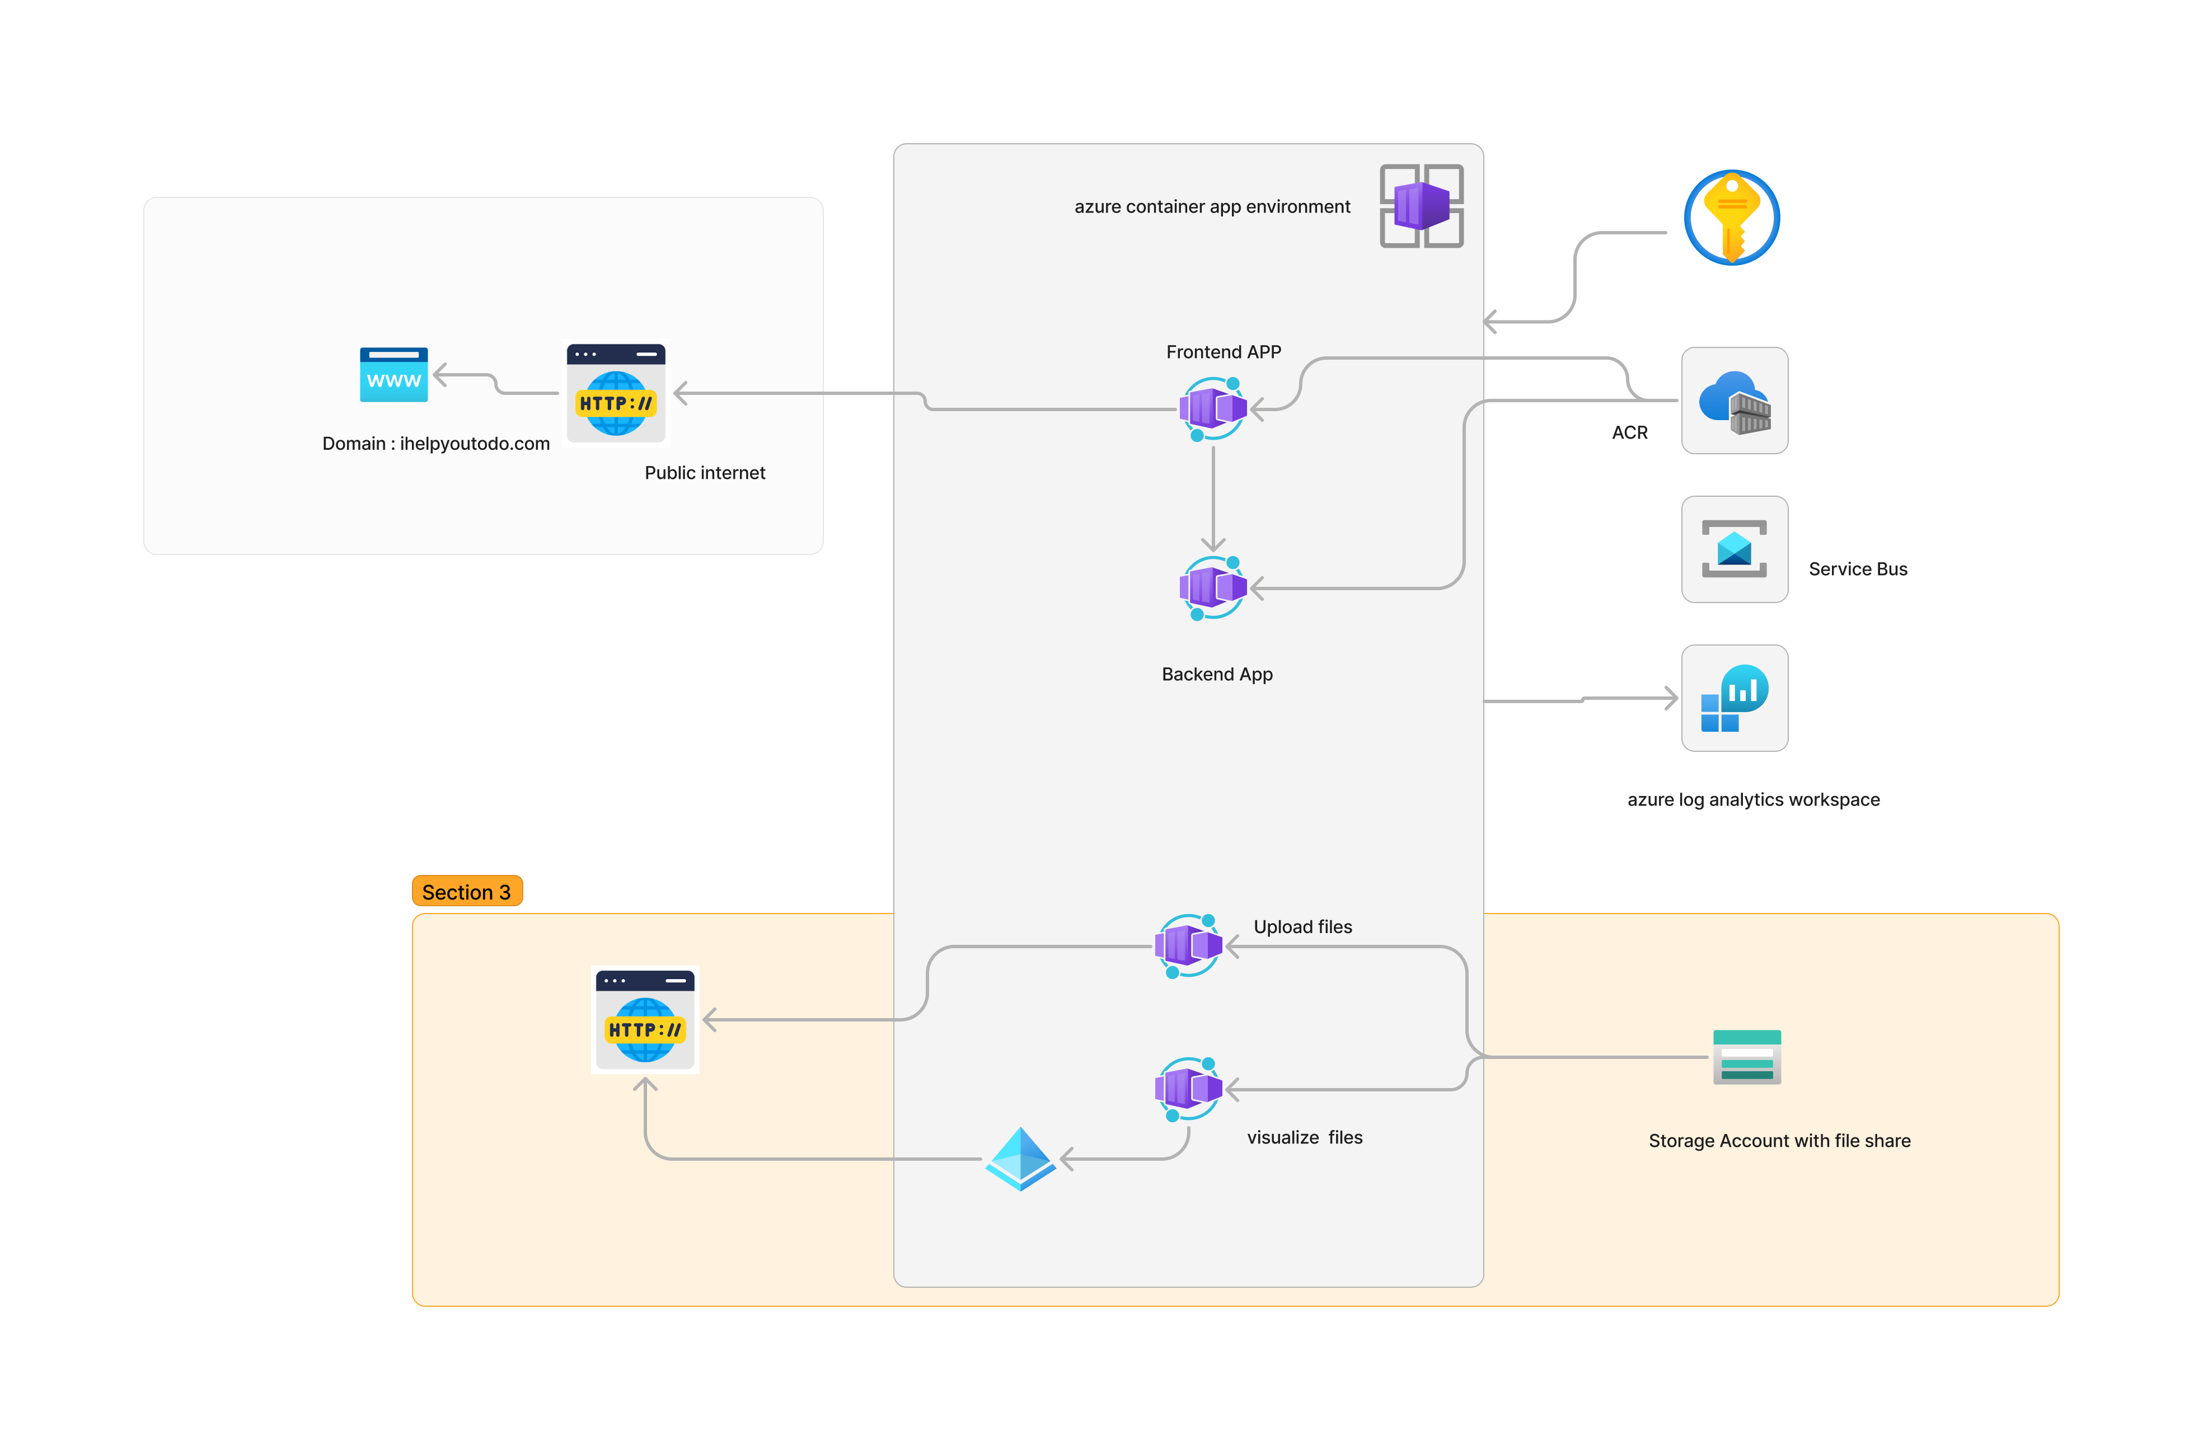
Authentification

Slide 15
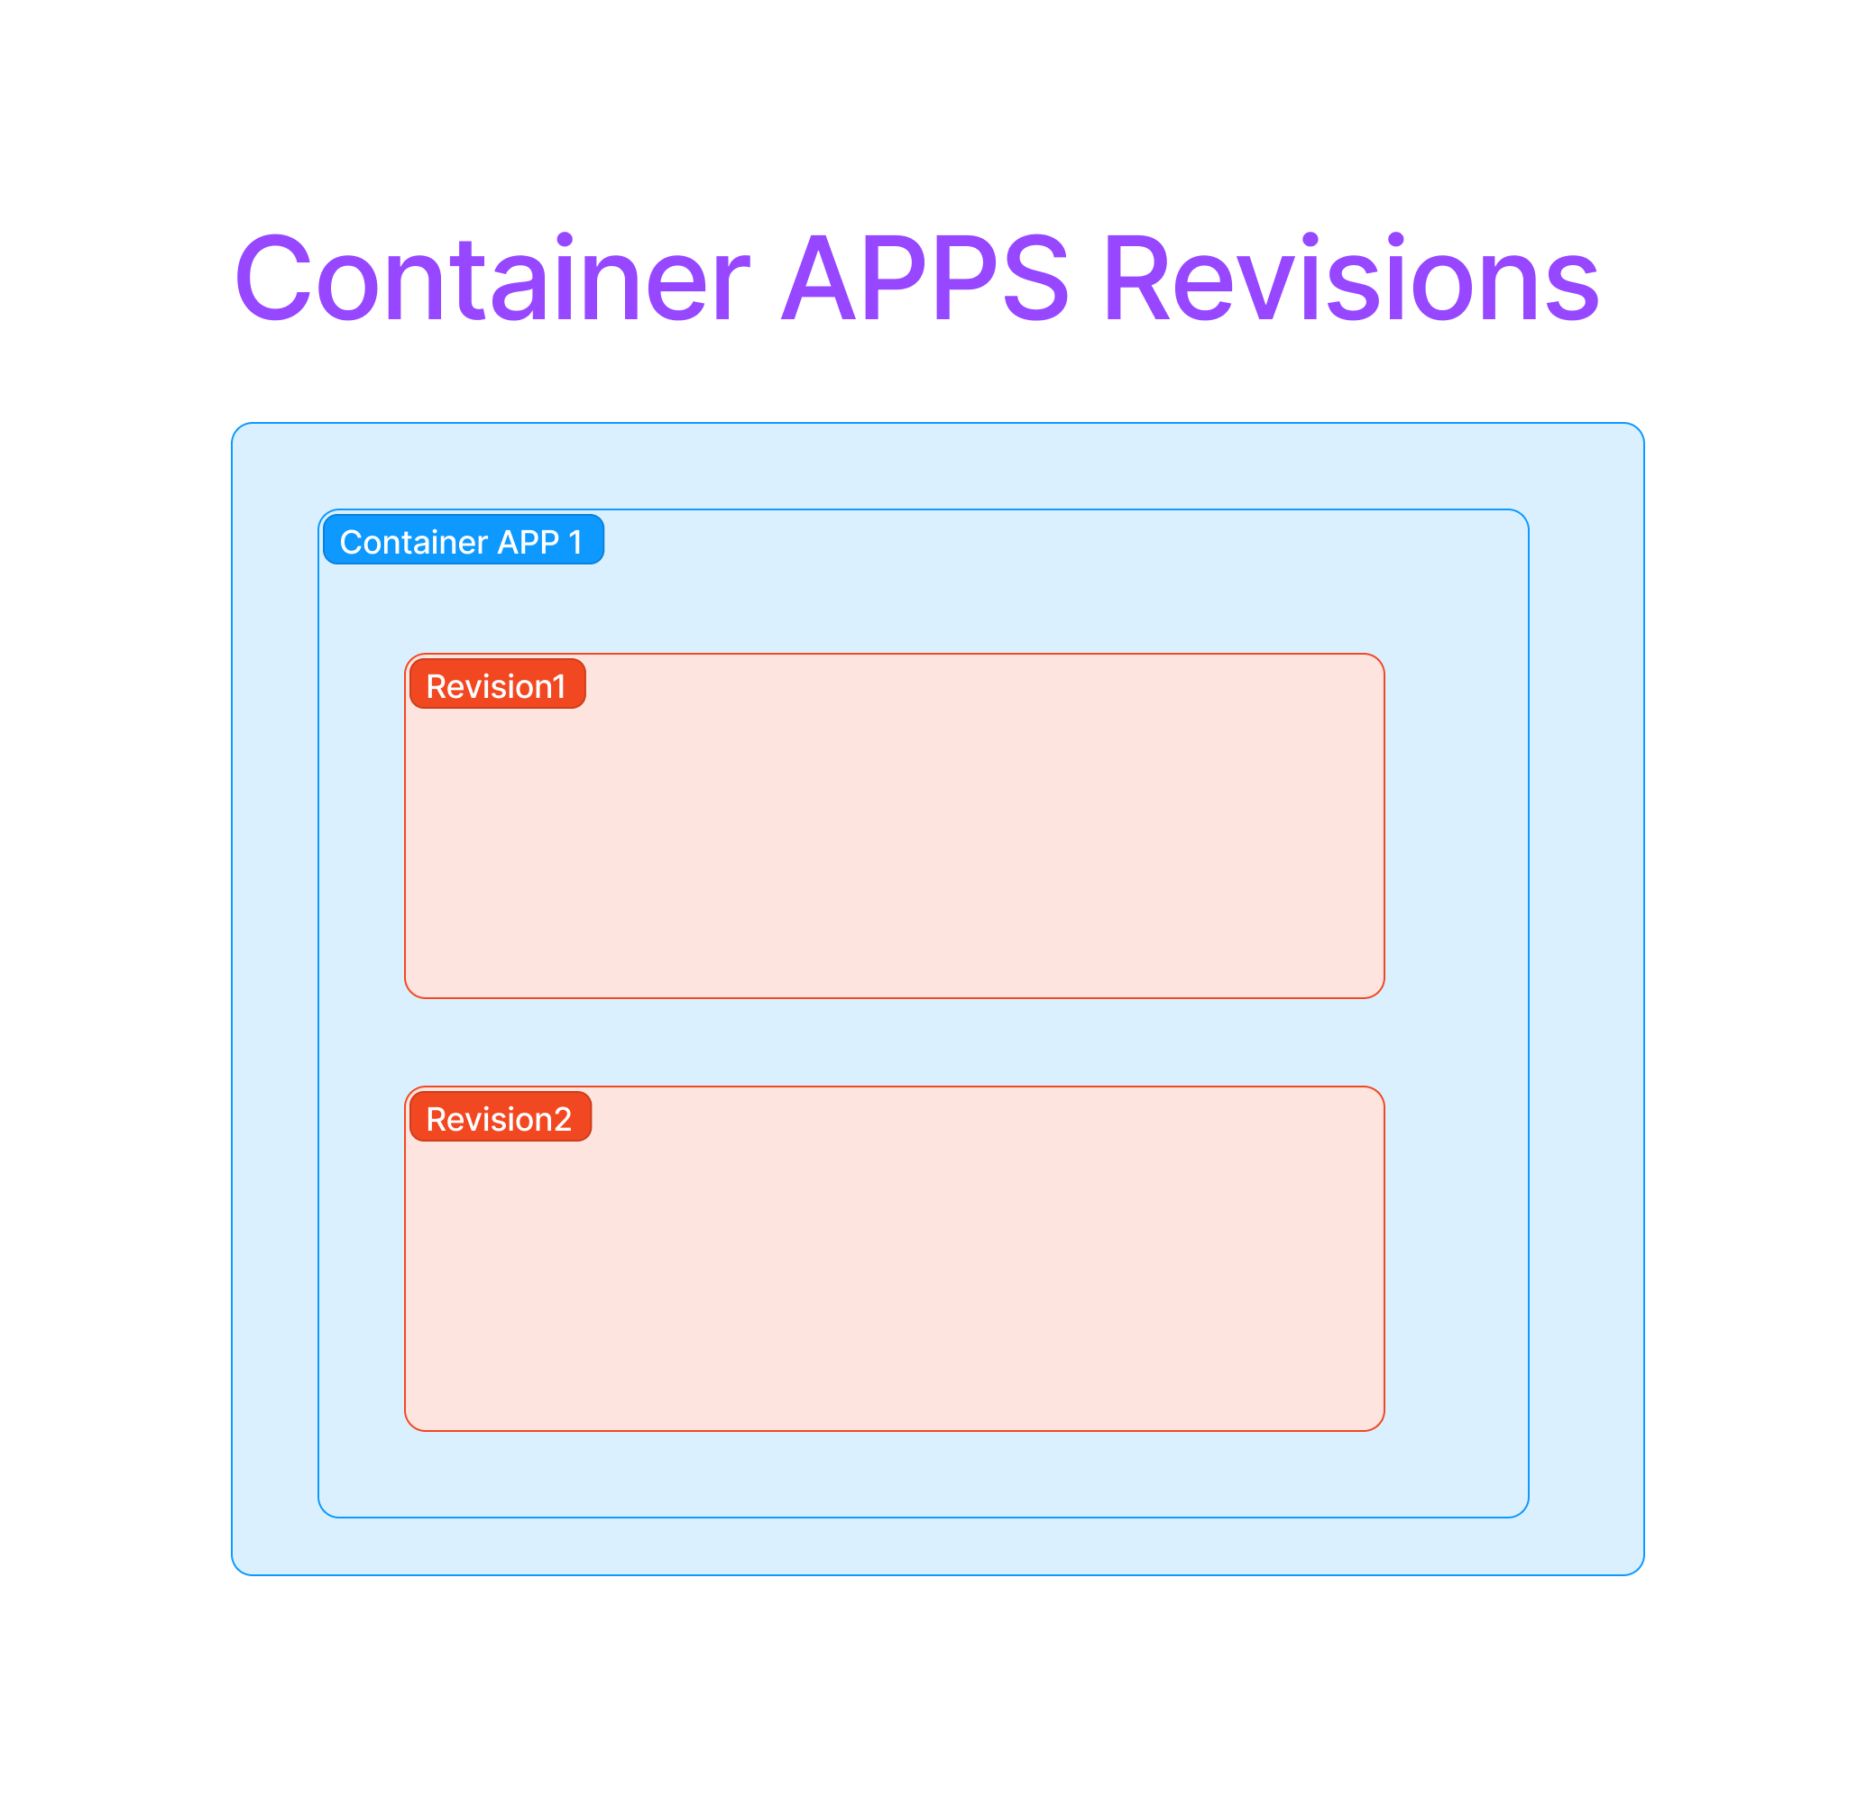
Revisions in Container APPS can be used in order to : Versioning and Revisions:
Azure Container Apps may allow you to deploy multiple versions or revisions of your containerized application. This is particularly useful in scenarios where you want to update your application with new features, bug fixes, or improvements without disrupting the running services.
Rolling Updates:
Revisions could be associated with concepts like rolling updates, where you can gradually update instances of your application without downtime. This is achieved by deploying a new revision alongside the existing one, and the service gradually directs traffic to the new version.
A/B Testing:
Revisions may also be utilized for A/B testing purposes. By deploying different revisions of your application with slight variations, you can test user engagement and performance to make informed decisions about which version is more effective.
Configuration Changes:
Revisions might also be associated with changes in configuration. You can update configurations for a specific revision without affecting other running revisions, allowing for flexible management of application settings.
Health Monitoring:
Azure Container Apps may provide features for health monitoring of different revisions. This includes the ability to monitor the performance and health of each revision separately, ensuring that your application is running as expected.

Slide 16
