Slide 1
WireContext
WireDefinition
descriptors
cache
Environment
environment-factory
Context
environment
Context
...
...

Slide 2

1. Create task in someone’s tasklist
TASKS
task
2. User task
completion
triggers execution

Slide 3
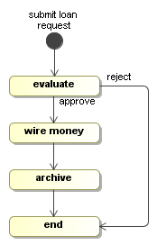
Process
Service
Execution
Service
Management
Service
Command
Service
Environment
Interceptor
Interceptor
Interceptor
Commands
Activity
API
Client
API
Event
Listener
API

Slide 4
environment.get(CommandService.class);
RetryInterceptor
EnvironmentInterceptor
StandardTransactionInterceptor
DefaultCommandService

Slide 5
start new
process
instance
external
trigger
external
trigger
time
transaction / request
process execution

Slide 6
main

Slide 7
main
billing
shipping

