Slide 1



Construction of a datamart based on Jobs POSTING
Made by : Soulala Achraf
Supervised by: Prof Jihad Zahir

Slide 2
Table Of Contents
01
02
03
Conception
Data integration
Data reporting
04
05
Challenges faced
Future perspectives

Slide 3
Introduction
Understanding economic trends in the broadest terms—which industries are expanding, which are on the downswing—can be as straightforward as keeping up with the business headlines. But it’s not quite as easy to get a similar grasp of the job market: not merely which jobs are growing and which are disappearing, but which skills are increasingly in demand—and which are becoming obsolete.

Slide 4
01
Conception
trace the path of the project

Slide 5

Identifying the process
the main objective is collecting the maximum of information that would be enough to describe each job. By the end of this process, we will be able to answer this several questions:
What type of jobs is this?
Where this job is located?
How much this job is required by the companies?
What is the industry of this job?
…

Slide 6
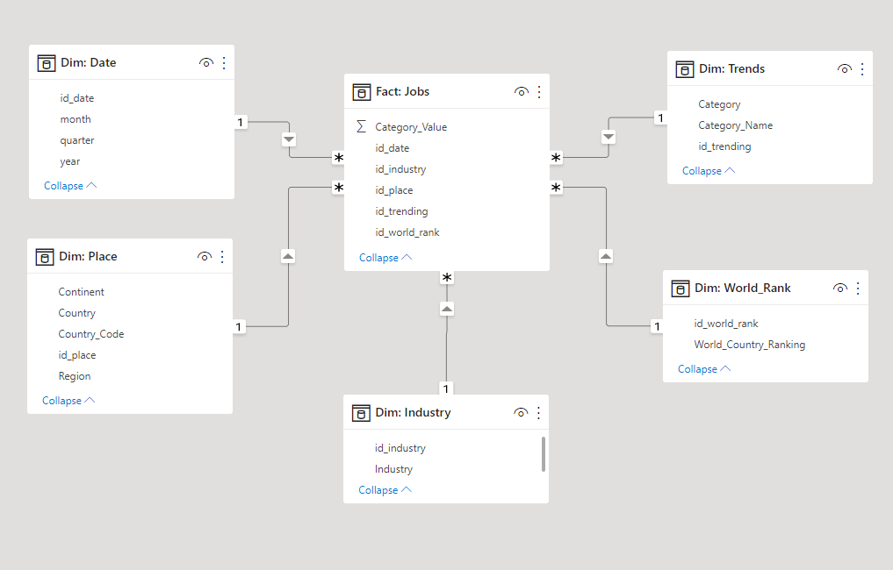
Star Schema
The schema shows the fact table, named ‘jobs’, which contains the measures and attached to the multiple dimensions:
Date
Place
Industry
Trends
World Rank(Source: http://www.hartford-hwp.com/archives/10/150.html)

Slide 7
02
Data Integration
Settle the project

Slide 8



ETL
Extract data
Load data
Transform data
Retrieves raw data from an unstructured data pool and migrates it into a temporary
Loads the structured data into a database so it can be properly analyzed and used
Structures and converts the data to match the correct target source

Slide 9

Data Extraction
Jobs and skills data from LinkedIn's Economic Graph provides csv file that include the necessary data between December 2019 and June 2021.
All the files were downloaded using a scrapping script based on selenium (python framework).

Slide 10

Data Transformation
Talend is an ETL tool for Data Integration. It provides software solutions for data preparation, data quality, data integration, application integration, data management and big data.
It was used in this project for different activities:
Merge files.
Format the data (Remove special characters, strings handling, substitute data…).
Create new dimensions (World ranking)
feed the database (Create tables, set constraints, modify table format…).
Update our database.
..

Slide 11
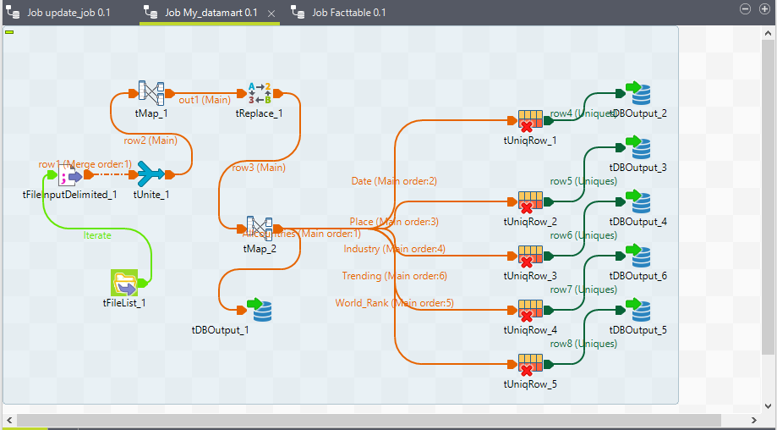
Job 1
Merge files, format data then charge it in the database

Slide 12
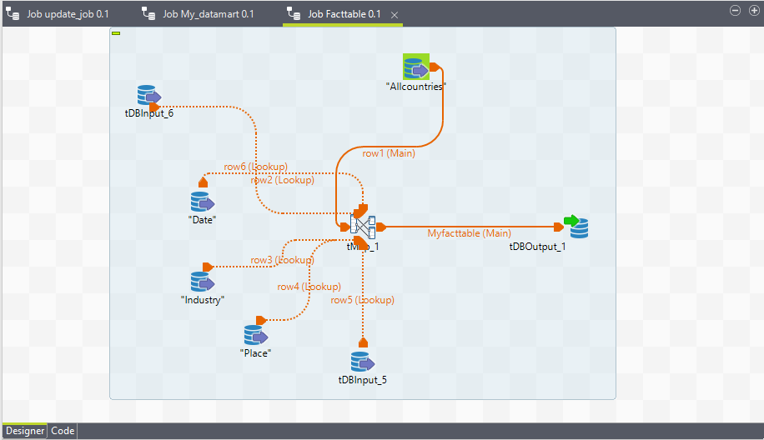
Job 2
Feed the fact table from the dimensions tables

Slide 13
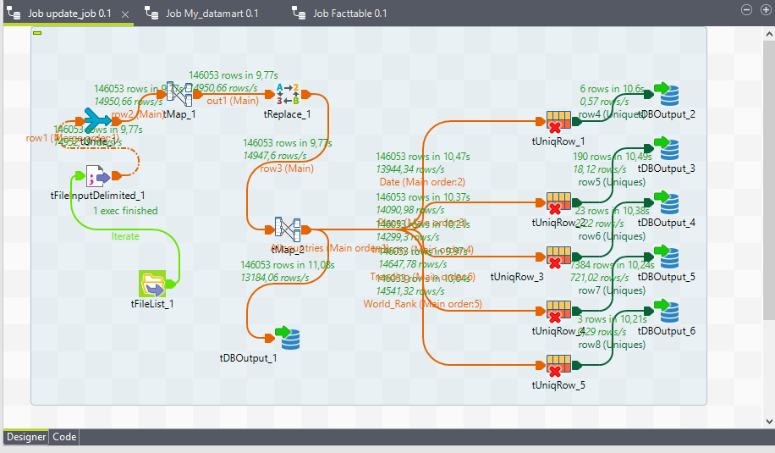
Job 3
Update the data mart by adding new data and append it with the old one

Slide 14

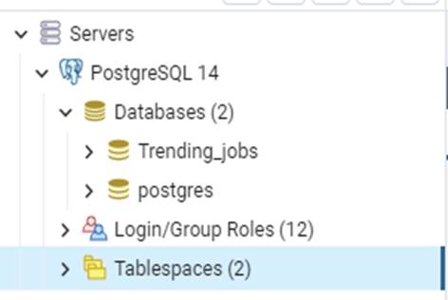
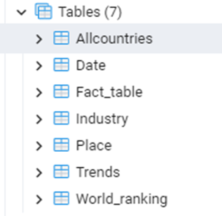
Data loading
PostgreSQL is a powerful, open source object-relational database system with over 30 years of active development that has earned it a strong reputation for reliability, feature robustness, and performance.

Slide 15
03
Data Reporting
visualize and analyze

Slide 16


Data Reporting
Power BI is a collection of software services, apps, and connectors that work together to turn your unrelated sources of data into coherent, visually immersive, and interactive insights.

Slide 17
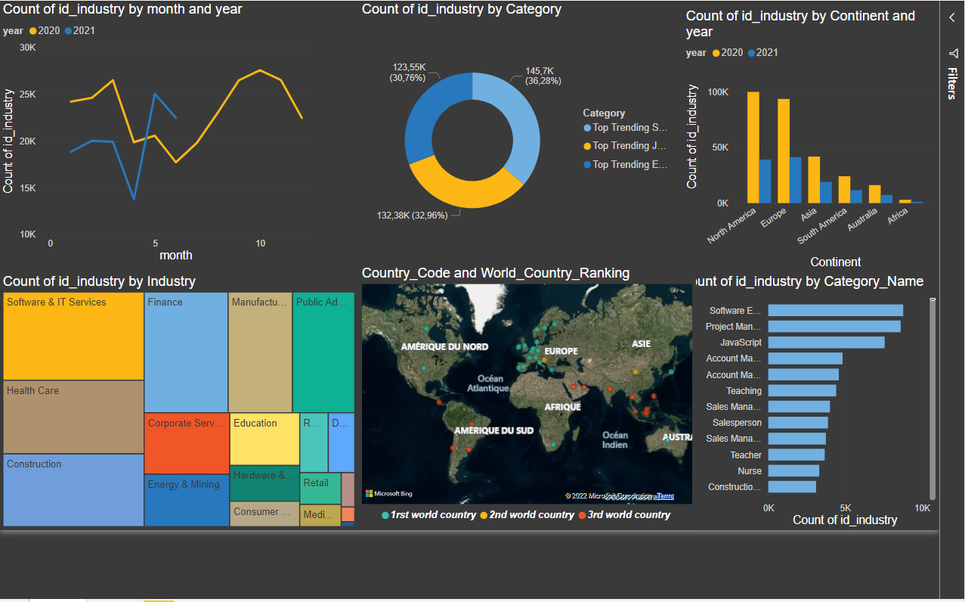
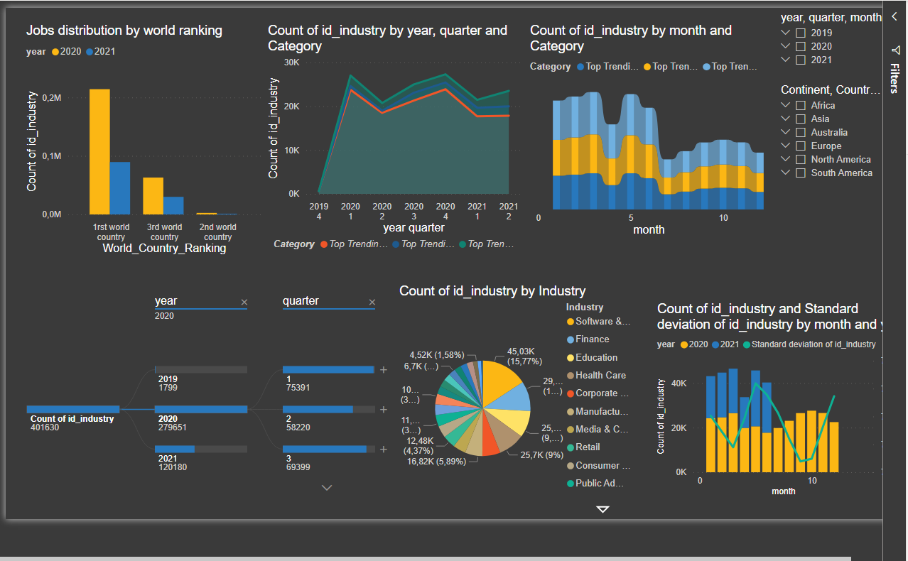
Data Reporting
The data can be visualized in different aspects

Slide 18
04
Challenges faced
Data collection problems

Slide 19
Challenges faced
Data extraction
Undefined data
The scrapping needs time and fast internet
The industry and the regions were undifened for some rows(Ex: South Africa)

Slide 20
05
Future perspectives
Improve the project performance

Slide 21
Future perspectives
data sources
New facts
New dimensions
Collect data from other jobs posting websites
Salary
Type of job(part-time, continuous)
Diplomat required
Job missions
Recruiting status

Slide 22
THANK YOU FOR YOUR ATTENTION

