Slide 1

Exam 2 review: some intuition on windows

Slide 2
Outline
Goal is to provide some more intuition into how window width and shape affect both spectrum estimation and window-based FIR filter design
Window width
Window shape and mainlobes/sidelobes
Convolution with windows for spectrum estimation
# points in DFT/FFT

Slide 3
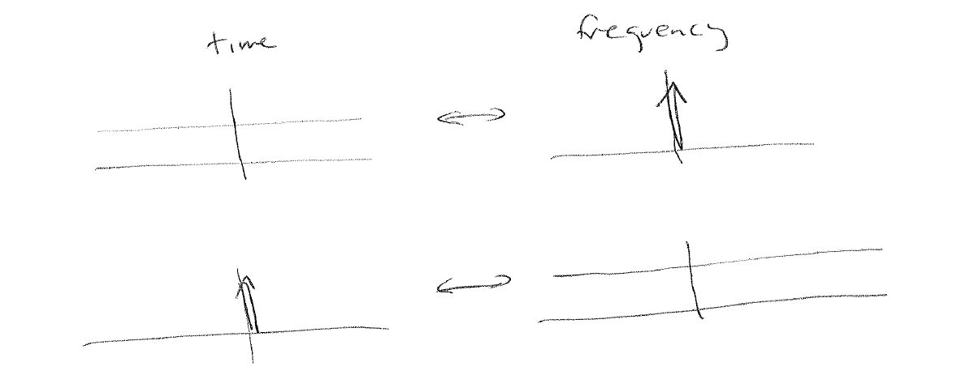
Window width preliminary: Fourier transform pairs
We know that a constant value at all times transforms to a delta function in frequency, and vice versa:

Slide 4
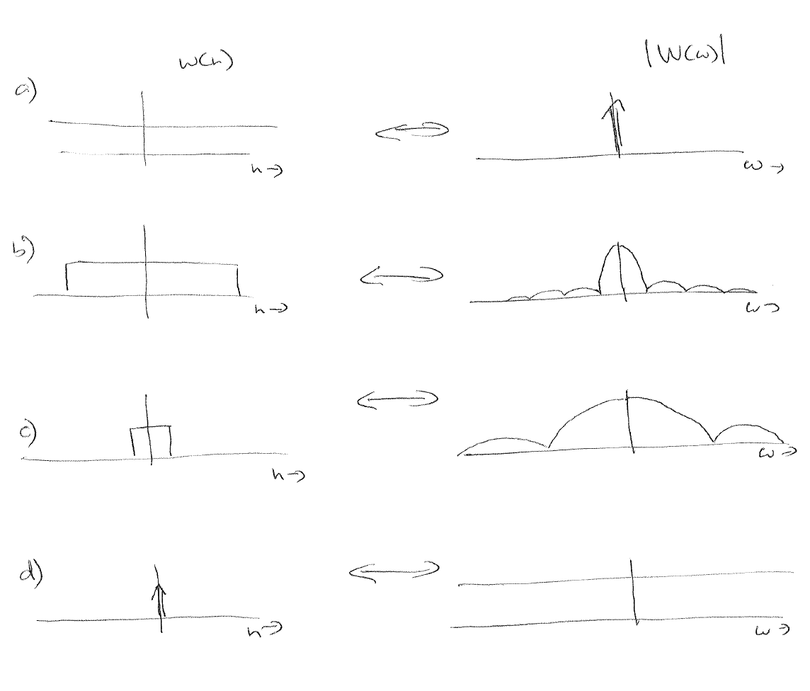
1) Window length and mainlobe size
We can think of different window lengths as varying between these extremes:
Really long window is like constant
1-sample window is like delta function
In between, we get varying widths, with mainlobe width increasing as window length decreases

Slide 5
2) Window shape and mainlobe width
The rectangular window fully weights all the samples it is applied to.
Other windows give reduced weight to samples at the ends.
In some sense, this makes them “shorter” as they are most strongly influenced by a shorter amount of data
As seen before, shorter windows -> wider mainlobe -> worse resolution

Slide 6
2) Window shape and sidelobe width
With Fourier transforms, a sharp transition in one domain causes “ringing” in the other domain
Sharp transition at ends of rectangular time window -> oscillations in frequency (sinc) -> high sidelobes
The smoother the taper as a window approaches zero at the ends of the window, the less ringing/ lower sidelobes in frequency (Blackman tapers more gradually than Hann, therefore has lower sidelobes)

Slide 7
Convolving with windows – spectrum estimation (deterministic signals)
To estimate the spectrum, we take a portion of our signal, multiply by a window to get v(n) = w(n)x(n), then take the DFT/FFT
We always multiply by a window – even if we just pick out N points, we are multiplying by N-point rectangular window
Multiplication in time means we have convolution in frequency, so our estimated spectrum will be smeared by the window
Example sketches on next page…
the narrower the mainlobe and the lower the sidelobes, the better our estimate will be

Slide 8
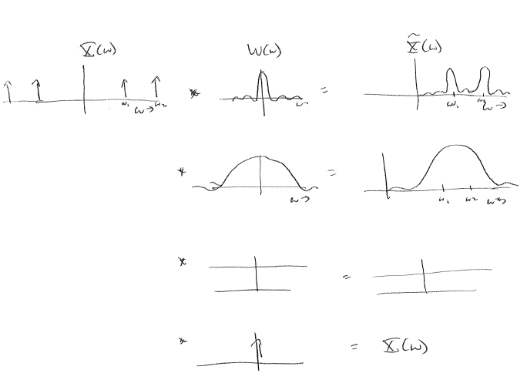
Convolving with windows – spectrum estimation (deterministic signals)
True spectrum
Window spectrum
Estimated spectrum (ω>0)
Longer window
Shorter window
1-sample window
Infinitely long window

Slide 9
Spectrum estimation and number of DFT points
Remember that in the first half of the course, we just worked with the DTFT – which transforms from sampled time n into continuous radian frequency ω
It was only in the second half that we introduced the DFT / FFT – transforms from sampled time n into discretized radian frequency ω_k (or frequency bin k)
The following mental picture might be helpful:
Think of the convolution X(ω)*W(ω) as happening in continuous frequency. This will help you remember that the mainlobe width, which determines frequency resolution, just depends on the window properties (length, type).
The DFT/FFT is used to evaluate the smeared spectrum (X*W). The number of DFT/FFT points determines how many points we get when sampling the smeared spectrum. By taking extra points via zeropadding, we get a more “continuous” view of X*W but are not changing the underlying resolution

