Slide 1

EE-125: Digital Signal Processing Lecture: Review of Fourier Transforms

Slide 2
Outline
Start on Fourier transforms and frequency response
Relationships between different Fourier transforms
Discrete-time Fourier transform (DTFT)
Definition
Useful transform pairs
EE125 video on transform pairs is at https://youtu.be/F1qfDnVNWPY

Slide 3
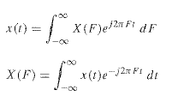
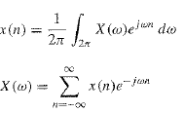
Fourier Transforms: Continuous vs. Discrete-time
x(t)
_{A/D converter}
x[n]
Continuous time (CT)
Stability analysis: Laplace (control theory)
Frequency analysis (unless periodic)
Continuous-time Fourier transform (CTFT)
Discrete time (DT)
Stability analysis: Z
Frequency analysis (unless periodic)
Discrete-time Fourier transform (DTFT)

Slide 4
Three questions
x(t)
_{A/D converter}
x[n]
Continuous time (CT) Discrete time (DT)
x(t), X(f) x(n), X(ω)
1) How are CT quantities (time t, frequency f) related to DT quantities (sample n, radial frequency ω)?
Wait until next lecture – sampling theory
2) Why do all these transforms use exponentials?
Partly: a) many physical systems are described by differential equations (wave eqn, etc.) whose solutions are exponentials; b) difference equations (for DT systems) are solved by exponentials
3) How can all the different transforms be organized?

Slide 5
Organizing the Fourier transforms
Matlab1
 | Periodic | Aperiodic
CT | CT Fourier series x(t), c_{k} | CTFT x(t), X(f)
DT | DT Fourier series x(n), c_{k} | DTFT x(n), X(ω)
Our focus now
Chap 7
Looking ahead:
For computer implementation, discrete quantities are most natural
Later (in Chap 7) we’ll discretize frequency as well as time:
Discrete Fourier Transform (DFT) ; x(n) <-> X(k)
We’ll do this by repeating our data to make signals periodic; close link between DFT and DT Fourier series
The FFT is just a fast algorithm for computing the DFT

Slide 6
Relationship of Z to DTFT

Slide 7
Fourier transform pairs – square pulse / sinc
Things to notice:
More compact in time <-> less compact in frequency
Problem: this means that to reconstruct a perfect pulse, we need to include frequencies out to infinity!

Slide 8
Gibb’s phenomena and reconstruction

Slide 9
DTFT properties (see P&M Table 4.5)
Linearity: a x1(n) + b x2(n) <-> a X1(ω) + b X2(ω)
Time shifting: x(n-k) <-> exp(-j ω k) X(ω)
Frequency shift: exp(j ω0 n) x(n) < - > X(ω−ω0)
Time reversal: x(-n) <-> X(-ω)
Parseval: Σ (energy in time) = Σ (energy in frequency)
Convolution and multiplication relations - Very useful!
x1 * x2 <-> X1(ω) X2(ω) x1(n) x2(n) <-> X1(ω) * X2(ω)

Slide 10
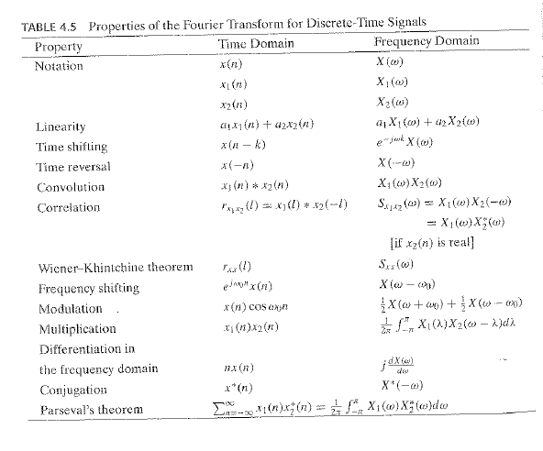
DTFT properties (Table 4.5)
1)
2)
3)
5)
Ignore
for now
2)
5)
5)
4)

Slide 11
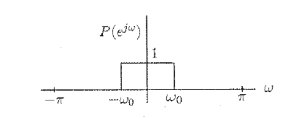
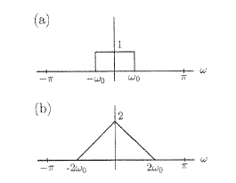
Convolution <-> Multiplication
Say p(n) has the transform:
What is Fourier transform of p * p ? Common choices were:

Slide 12
Convolution <-> Multiplication
What is Fourier transform of p * p ? Common choices were:
Note: Linear systems can attenuate or boost response at a frequency, but can’t shift energy to new frequencies

