Slide 1
Guitar Tuner
Embedded Systems – Fall 2019
Antoni Chrobot

Slide 2
Guitar Tuner
Generate tones using audio codec
Display currently set tone on seven segment display

Slide 3
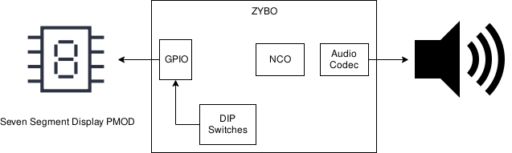
Block Diagram

Slide 4
Challenges
Original plan was to use microphone to interpret sound using FFT
Did not have confidence that I could finish on time, so I instead I took a more simple approach to the same problem

Slide 5

Hope you Enjoyed!

