Slide 1
Investigating Pixel 3
Android 10
Notes:
https://digitalcorpora.s3.amazonaws.com/corpora/mobile/android_10/Non-Cellebrite%20Extraction/Pixel%203.zip

Slide 2
Introduction to Android

Slide 3
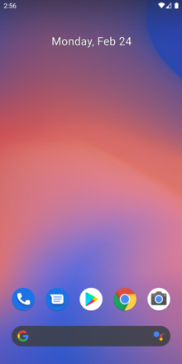
What is Android?
Android is a mobile operating system
based on a modified version of the Linux kernel
was unveiled in November 2007
Android is open-source software
its source code is known as Android Open-Source Project (AOSP)
Most Android devices ship with additional proprietary software pre-installed, including
Google Mobile Services: Google Chrome, YouTube, Google Maps
Google Play Service: Backup, Contacts Sync, Account Manager
Notes:
https://en.wikipedia.org/wiki/Android_(operating_system)
https://en.wikipedia.org/wiki/Google_mobile_services

Slide 4
Google controls AOSP
Google controls and maintains AOSP
Core Development by Google
Open Source Contribution
Apache License 2.0
Google manages the release schedule, documentation, and feature roadmap for AOSP
Examples of AOSP-derived projects
Amazon Fire OS,
LineageOS: completely open-source and community-driven
Huawei HarmonyOS

Slide 5
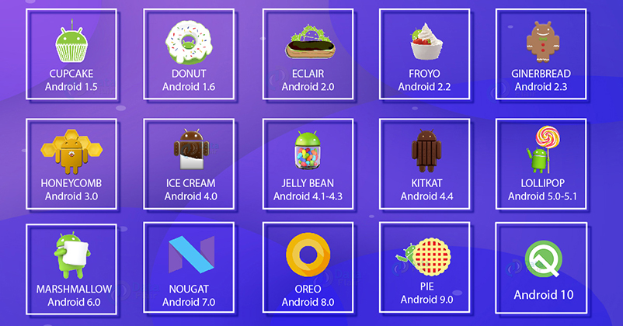
History of Android (1-10)
Code Name
Version Name

Slide 6
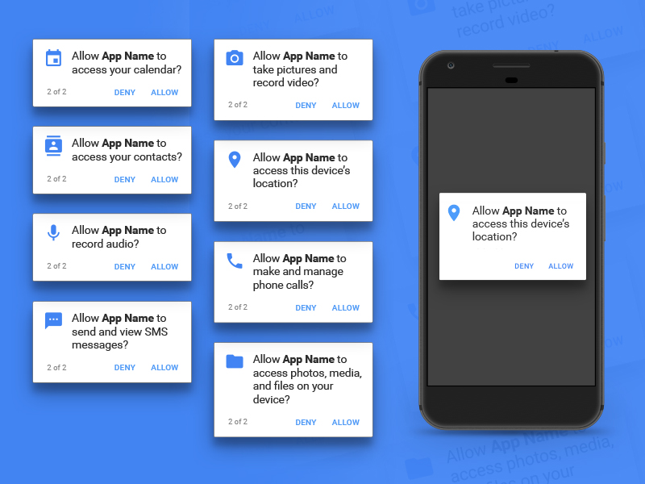
History of Android (11)
Launched in September 2020
The most significant changes revolve around privacy
Pushes the background location permission even deeper into the system
makes it more difficult for apps to request
Removes an app's ability to see what other apps are installed on your phone
Android permission prompts to ensure privacy
https://www.sketchappsources.com/resources/source-image/android-permission-groups-prompts.jpg

Slide 7
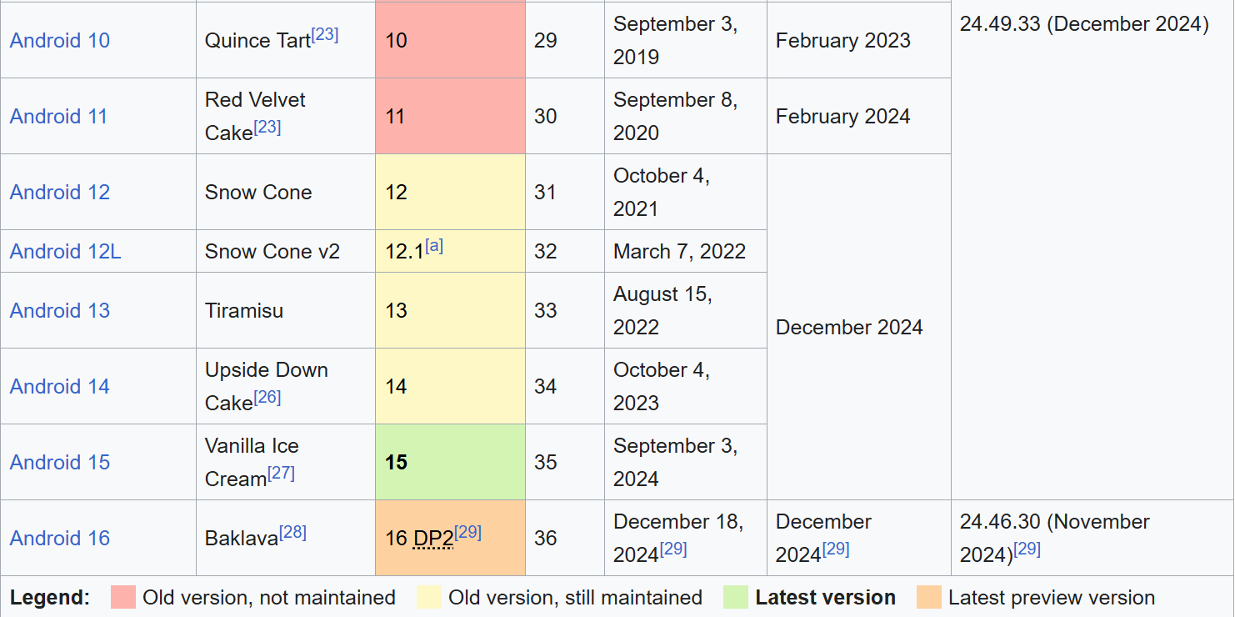
History of Android (11-16)
https://en.wikipedia.org/wiki/Android_version_history

Slide 8
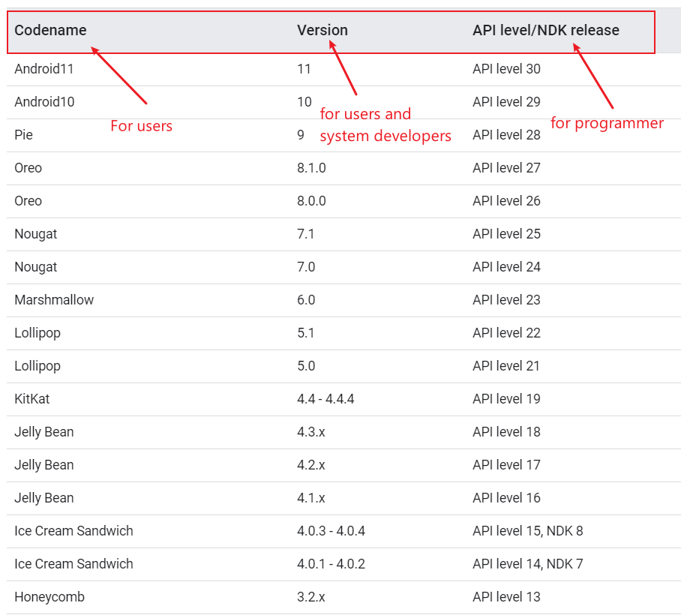
Codename, Version, API
The Android NDK is a toolset that lets you implement parts of your app in native code, using languages such as C and C++.
blueline
Notes:
https://source.android.com/setup/start/build-numbers

Slide 9
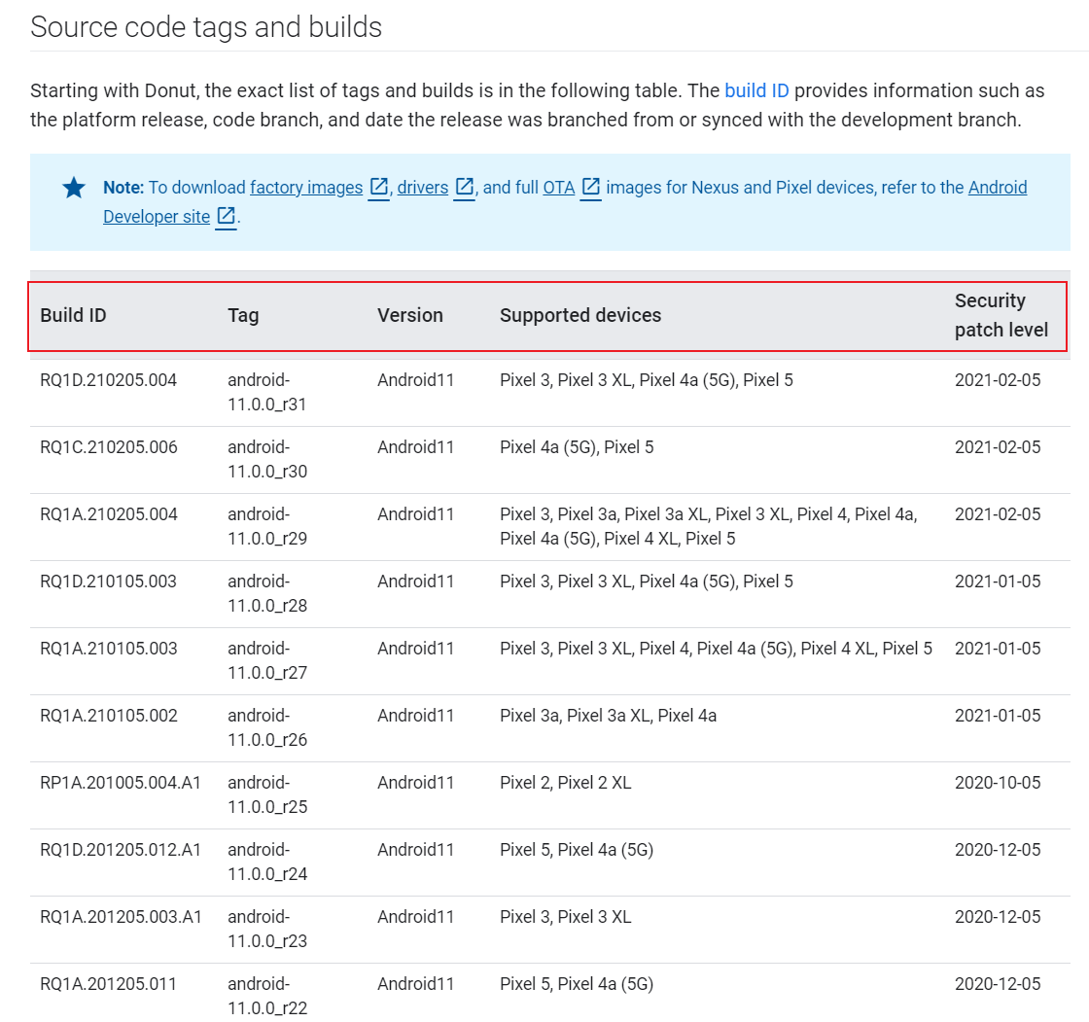
Source code tags and builds
build ID provides information such as the platform release, code branch, and date the release was branched from or synced with the development branch.
Notes:
https://source.android.com/setup/start/build-numbers
Each stage of the Android boot process involves completing specific tasks, preparing for the next stage, and then handing over control to the subsequent stage. Here's a breakdown of how this works across the key stages:
---
### **1. Boot ROM (Read-Only Memory)**
- **Tasks Completed**:
- Executes when the device is powered on.
- Detects the boot media (e.g., internal storage or external memory) to locate the bootloader.
- Loads the first-stage bootloader into RAM.
- **Preparation for Next Stage**:
- Initializes minimal hardware components (e.g., CPU, clocks).
- Ensures external RAM is ready for use.
- **Control Transfer**:
- Hands control to the **bootloader**.
---
### **2. Bootloader**
- **Tasks Completed**:
- Sets up initial memory configurations.
- Loads the Linux kernel and its associated RAM disk (temporary file system) into memory.
- Handles security checks (e.g., locked/unlocked bootloader).
- **Preparation for Next Stage**:
- Configures file systems, additional memory, and low-level security options.
- Prepares the environment for the kernel to execute.
- **Control Transfer**:
- Jumps to the **Linux kernel** after decompressing it in memory.
---
### **3. Linux Kernel**
- **Tasks Completed**:
- Initializes hardware drivers (e.g., interrupt controllers, memory management units, caches).
- Sets up virtual memory and scheduling mechanisms.
- **Preparation for Next Stage**:
- Mounts the root file system.
- Locates the `init` process (found in `/system/core/init`) to serve as the first user-space process.
- **Control Transfer**:
- Passes control to the **init process**.
---
### **4. Init Process**
- **Tasks Completed**:
- Parses initialization scripts (`init.rc` or `init<machine name>.rc`).
- Sets up system services, file systems, and other parameters defined in the script.
- **Preparation for Next Stage**:
- Launches core system services and processes.
- Starts the **Zygote process**, which preloads common application classes and initializes the Dalvik/ART runtime.
- **Control Transfer**:
- Hands control to the **Zygote process**.
---
### **5. Zygote and Dalvik/ART**
- **Tasks Completed**:
- Preloads common application classes and resources into memory.
- Initializes the Android Runtime (ART) or Dalvik Virtual Machine (DVM).
- **Preparation for Next Stage**:
- Speeds up app launches by sharing preloaded code across all apps.
- Prepares the environment for launching the **System Server**.
- **Control Transfer**:
- Passes control to the **System Server**.
---
### **6. System Server**
- **Tasks Completed**:
- Starts core Android services:
- Activity Manager, Package Manager, Window Manager, etc.
- Telephony registry, alarm manager, sensor service, Bluetooth service, etc.
- Manages system-wide functionalities like notifications, location services, and audio settings.
- **Preparation for Next Stage**:
- Completes the initialization of the Android framework.
- Broadcasts the `ACTION_BOOT_COMPLETED` intent to signal that the boot process is complete.
- **Control Transfer**:
- Allows third-party apps and services to start running by responding to the `ACTION_BOOT_COMPLETED` broadcast.
---
### **7. User-Space Services and Apps**
- **Tasks Completed**:
- Third-party apps and services register to receive the `ACTION_BOOT_COMPLETED` broadcast.
- Custom services or apps can perform actions (e.g., setting alarms, initializing background tasks).
- **Preparation for Next Stage**:
- The system is now fully operational, and the user interface is ready for interaction.
- **Control Transfer**:
- Control is handed over to the user, who can interact with the device.
---
### Summary Table of Boot Process Stages
| **Stage** | **Tasks Completed** | **Preparation for Next Stage** | **Control Transfer** |
|-----------------------|-------------------------------------------------------------------------------------|------------------------------------------------------------------|---------------------------------|
| **Boot ROM** | Detects boot media, loads bootloader | Initializes minimal hardware | Bootloader |
| **Bootloader** | Loads kernel and RAM disk, handles security | Configures memory, file systems, and low-level settings | Linux Kernel |
| **Linux Kernel** | Initializes hardware drivers, sets up memory management | Mounts root file system, locates `init` process | Init Process |
| **Init Process** | Parses `init.rc`, starts core services | Launches Zygote process | Zygote |
| **Zygote** | Preloads app classes, initializes ART/Dalvik | Prepares environment for System Server | System Server |
| **System Server** | Starts core Android services (Activity Manager, etc.) | Broadcasts `ACTION_BOOT_COMPLETED` | User-space apps/services |
| **User-Space Apps** | Responds to `ACTION_BOOT_COMPLETED`, performs custom actions | Fully operational system | User Interaction |
---
This sequential flow ensures that each stage builds upon the previous one, creating a stable and functional Android environment by the time the user gains control.

Slide 10
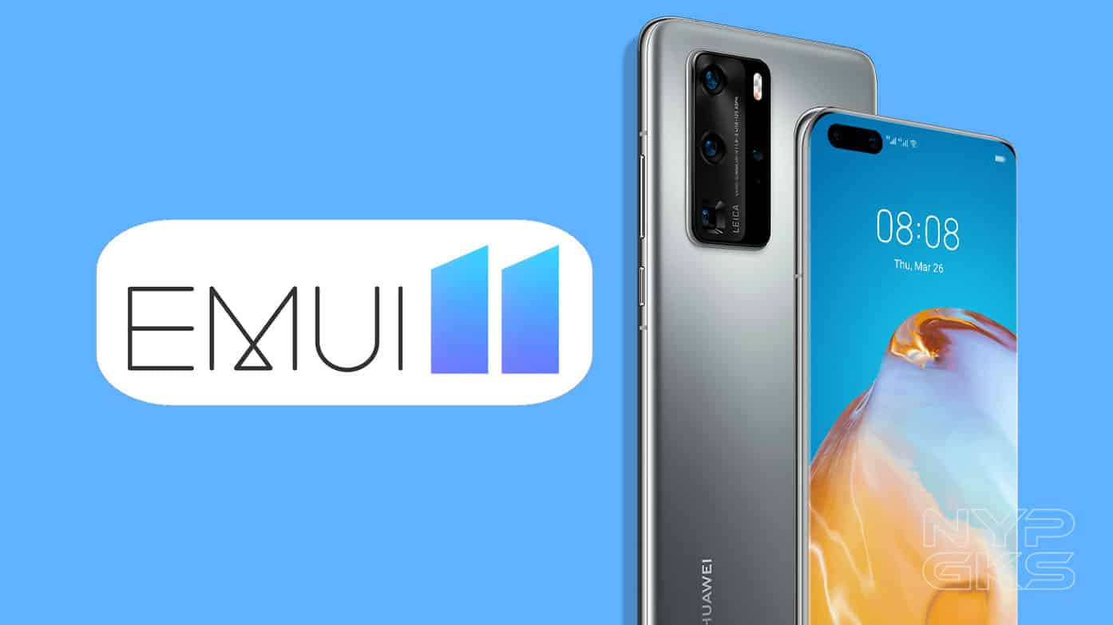
What is Stock Android and Android Skins?
Unmodified version of Android
known as vanilla or pure Android
Companies can modify Android
adding a custom skin
new features.
Popular skins
Samsung Experience,
HTC Sense,
EMUI (Huawei), and
OxygenOS (OnePlus)

Slide 11
Stock Android
Advantages
Fast updates
Bloatware-free: pre-installed software can’t be deleted from a device, unless you root it.
Popular stock Android smartphones are those made by Google
older Nexus devices
Pixel, Pixel 2, and Pixel 3 handsets
Android holds over 71% of the global mobile OS market share
as of November 2020 (StatCounter)

Slide 12
Android Architecture

Slide 13
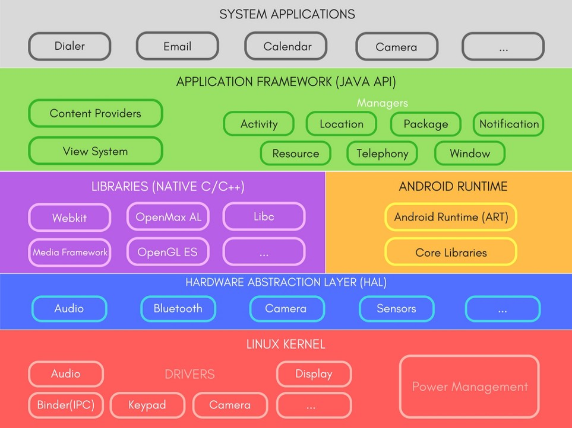
Apps we use every day
Java APIs for developer
A set of Libraries and Android Runtime.
most important
defines a standard interface for hardware vendors to implement
Security, Process management, Memory management, Device management
Multitasking
Notes:
https://medium.com/@deepamgoel/understanding-android-architecture-1f0fb4b52f90
https://source.android.com/devices/architecture

Slide 14


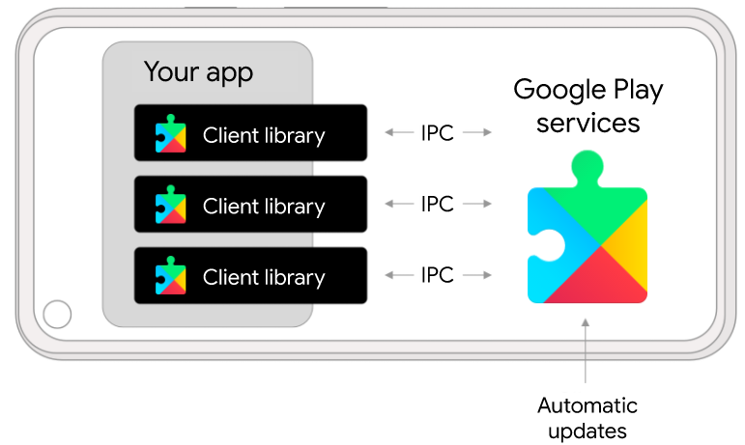
google mobile services (GMS)
Google Play Services
(Google Service Framework, GFS)
1.Google Backup
2.Play Store Services
3.Contacts Sync
4.Account Manager
Google Play services receives regular updates that contain improvements and bug fixes.
Notes:
https://developers.google.com/android/guides/overview

Slide 15
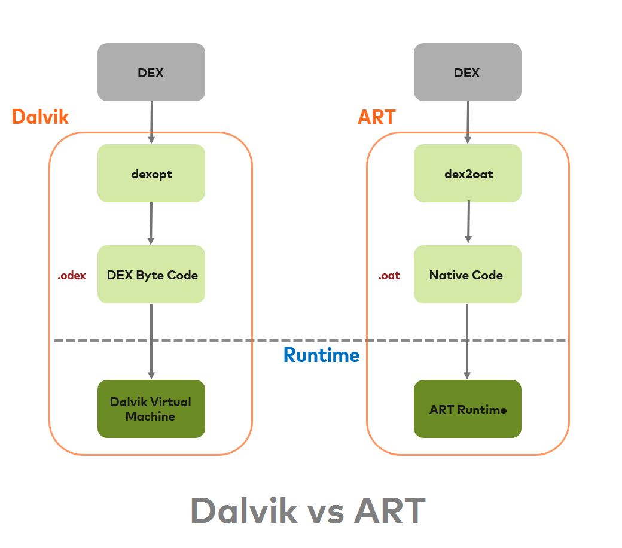
Android RunTime (ART)
.Java
.dex
Source code
DEX
Resource and Native code
zip
.APK
install
install
ART is the system within the Android operating system that executes applications
by translating their bytecode (DEX/Dalvik Executable) into machine code that the device's processor can understand
old: Dalvik Virtual Machine(DVM) till Kitkat
ART is faster than DVM
ART does ahead-of-time (AOT) compiles higher-level program languages to machine code
.oat: : optimized version of a Dalvik Executable (.dex) file used in ART
.odex: After Android 8.0: optimize Android apps' compilation and loading process.
Resource and Native code
Optimized Dalvik EXcutable
.oat: Of Ahead Time, a reordering of Ahead Of Time
Do not trust extensions: .dex can be DEX or OAT, .odex are OAT, .oat are OAT, …
Notes:
https://medium.com/android-news/closer-look-at-android-runtime-dvm-vs-art-1dc5240c3924
https://stackoverflow.com/questions/28435860/what-does-oat-mean
The Dalvik Virtual Machine (DVM) was named after the Dalvik village in Iceland, which is the hometown of Dan Bornstein, the Google engineer who led the development of Dalvik.

Slide 16
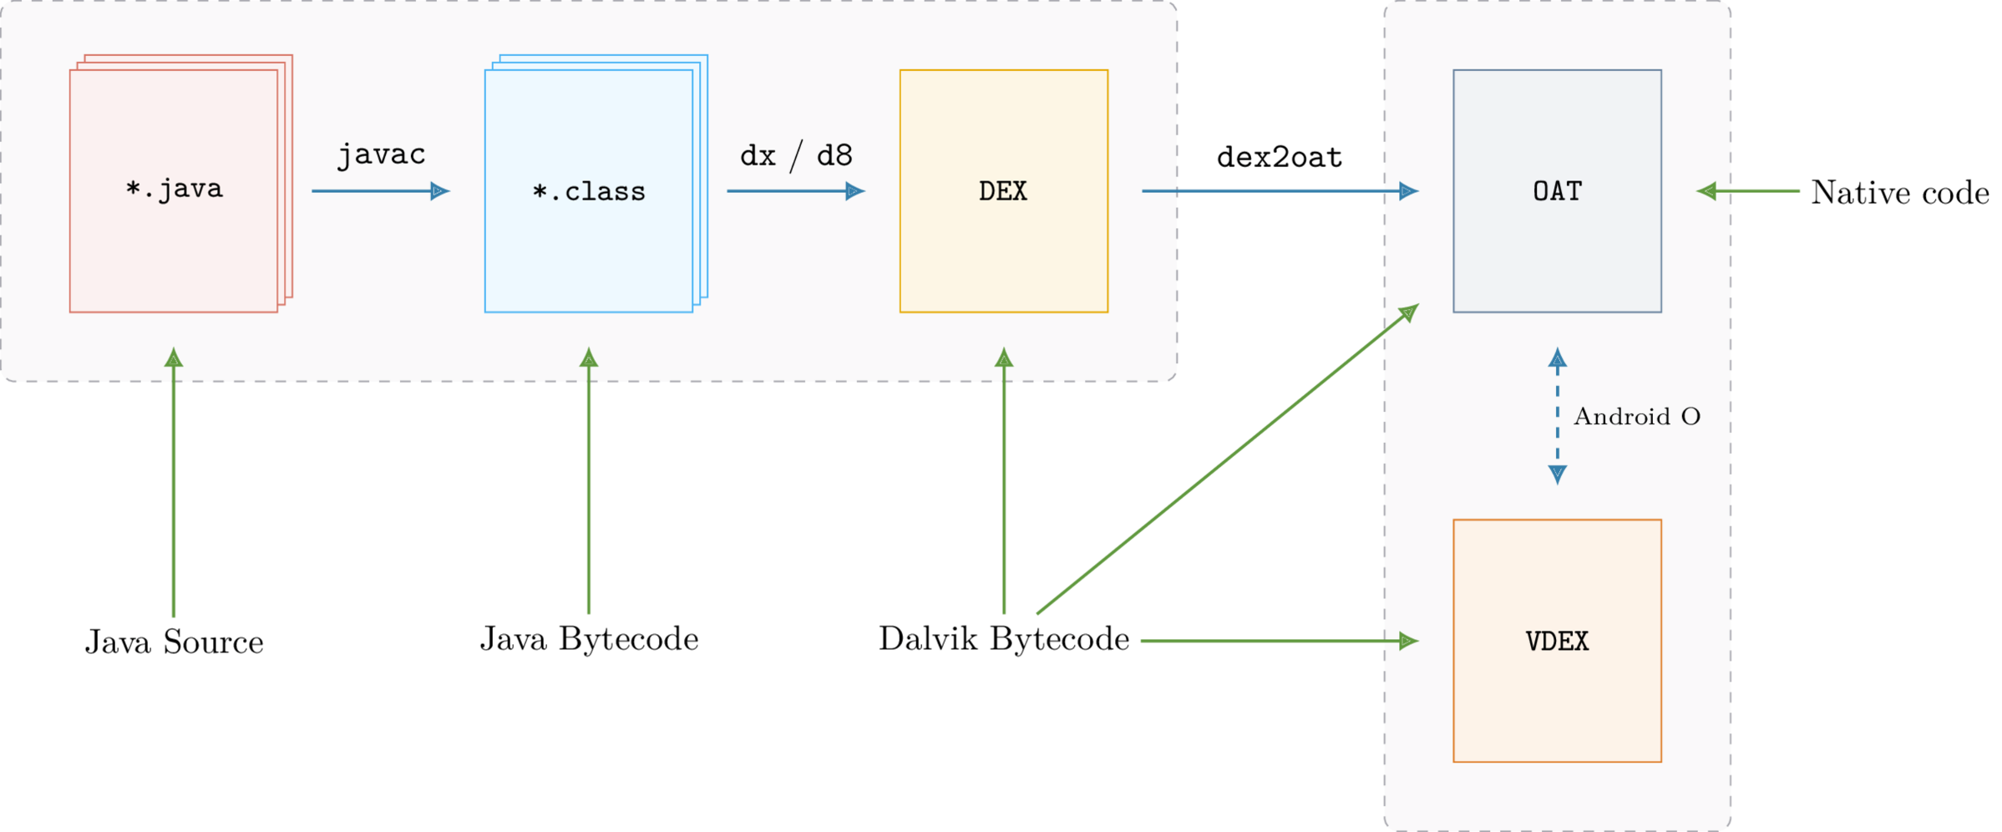
The process of converting Java sources into the OAT
low-level programming languages, such as C or C++, that can be directly executed by a computer's hardware or a specific processor architecture
Dalvik Executable
Verified DEX
https://lief.quarkslab.com/doc/latest/tutorials/10_android_formats.html
Notes:
https://lief.quarkslab.com/doc/latest/tutorials/10_android_formats.html

Slide 17
Android Booting Process

Slide 18
Android booting process needs multiple stages
Start from users press the power button
to a fully functional user interface
Perform a series of checks and configurations to properly launch the OS on the diverse hardware of different Android devices
initialize various hardware components
load the necessary software components like the kernel
prepare the system environment by setting up services and processes

Slide 19
Key Android boot process stages
Boot ROM: The initial stage, where the basic hardware is initialized, and the bootloader is loaded
Bootloader: Loads the Linux kernel into memory and sets up necessary configurations for the system to run
Kernel: Initializes the hardware drivers and starts the "init" process
Init process: Responsible for mounting file systems, starting core services, and launching the "Zygote" process
Zygote process: Preloads common application classes into memory, significantly speeding up app launch times, and inits Dalvik VM
System Server: Starts various Android system services, e.g., the Activity Manager, Package Manager, and Window Manager.
User-space Apps: Provide service to customers
prepare hardware
prepare service

Slide 20
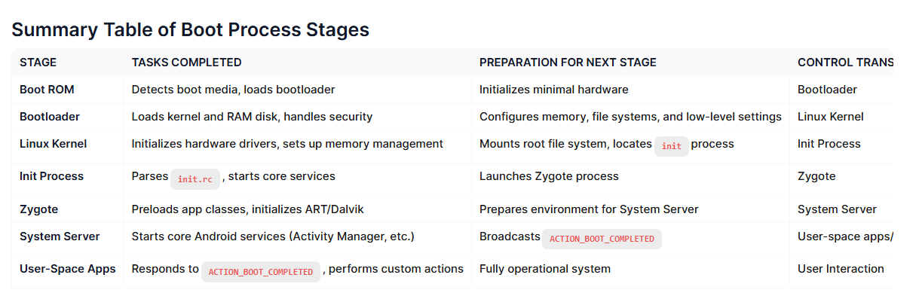
Each stage of the Android boot process involves completing specific tasks, preparing for the next stage, and then handing over control to the subsequent stage.

Slide 21
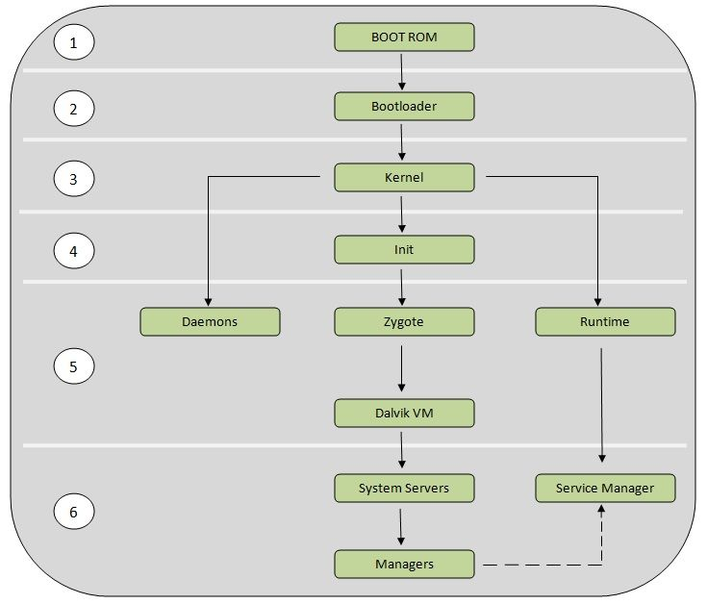
Android Booting Process
Boot ROM (Read-only Memory)
The bootloader
The Linux kernel
The init process
Zygote and Dalvik
The System server
Android ROM is a specific version of the Android operating system that runs on a phone

Slide 22
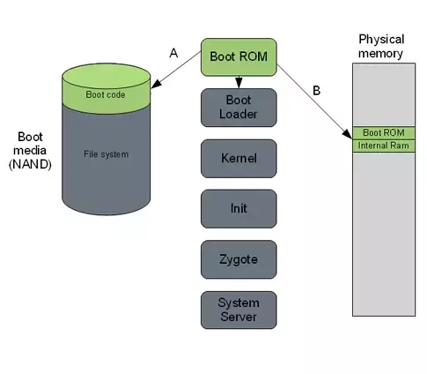
1. Boot ROM (Read-only Memory)
Power On and Boot ROM code starts executing
A: ROM Code detects the boot media to determine where to find the boot loader.
B: ROM Code loads the first stage Bootloader into RAM, and the Bootloader starts executing in RAM.
Notes:
https://community.nxp.com/t5/i-MX-Processors-Knowledge-Base/The-Android-Booting-process/ta-p/1129182
https://www.quora.com/How-does-Android-boot-process-work

Slide 23
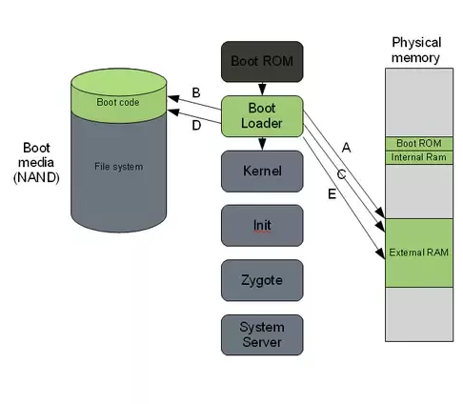
2. Bootloader
A special program to set up initial memories and load the kernel to RAM.
Kernel and Ramdisk (a temporary filesystem to assist in loading the real root filesystem) are flashed to /root partition
locked by manufacturers
Must unlock bootloader to root Android devices
get system permission to acquire data for forensic investigations
Notes:
https://community.nxp.com/t5/i-MX-Processors-Knowledge-Base/The-Android-Booting-process/ta-p/1129182
https://www.quora.com/How-does-Android-boot-process-work
GNU GRand Unified Bootloader

Slide 24
A. The first boot loader stage will detect and set up external RAM (Initialize minimal hardware, e.g., CPU, clocks).
B. Once external RAM is available and the system is ready to run something more significant, the first stage will load the main bootloader and place it in external RAM.
C. The second stage of the bootloader is the first major program that will run.
This may contain code to set up file systems, additional memory, network support, and other things.
On a mobile phone, it may also be responsible for loading code for the modem CPU and setting up low-level memory protections and security options.

Slide 25
D. Once the bootloader is done with any special tasks it will look for a Linux kernel to boot.
It will load this from the boot media (or some other source depending on system configuration) and place it in the RAM.
It will also place some boot parameters in memory for the kernel to read when it starts up.
E. Once the boot loader is done it will perform a jump to the Linux kernel
usually some decompression routine, and the kernel assumes system responsibility.

Slide 26
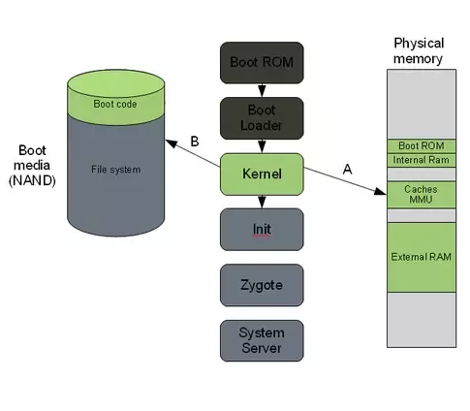
3. The Linux kernel
Set up everything that is needed for the system to run.
Initialize interrupt controllers
Set up memory protections, caches and scheduling.
A. Once the memory management units and caches have been initialized, the system will be able to use virtual memory and launch user space processes.
B. The kernel will look in the root file system for the init process (found under system/core/initial the Android open-source tree) and launch it as the initial user space process.

Slide 27
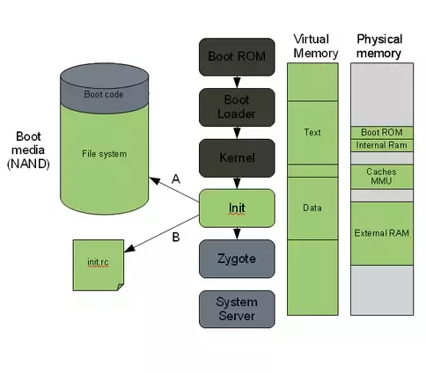
4. The init process
.rc. Early Unix used run commands(rc) for the name of the operating system's boot script
The "grandmother" of all system processes.
Every other process in the system will be launched from this process or one of its descendants.
A. The init process in Android will look for a file called init.rc. or init<machine name>.rc
This is a script that describes the system services, file system and other parameters that need to be set up.
The script is placed in system/core/rootdir in the Android open-source project.
B. The init process will parse the init script and launch the system service processes.

Slide 28
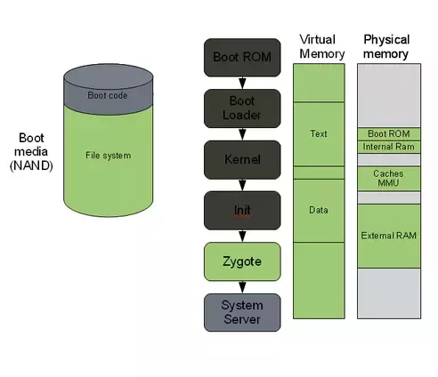
5. Zygote and Dalvik
A process of Android Runtime
The Zygote is launched by the init process and will basically just start executing and initializing the Dalvik VM.
Zygote enables library sharing across the Dalvik VM, achieving a lower memory footprint and minimal startup time.

Slide 29
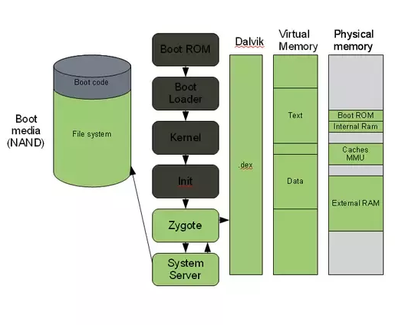
6. The system server
The system server is the first java component to run in the system.
Core services: Creating the Activity Manager, Starting telephony registry, context manager, system contact providers Starting alarm manager, sensor service, window manager, Bluetooth service, mount service
Other services: Starting hardware service, Starting NetStat service, connectivity service, Notification Manager, Device Storage Monitor service, Location Manager, Search Service, Clipboard Service, checkin service, Wallpaper service, Audio Service, Headset Observer, AdbSettings Observer

Slide 30
7. Start your own service
Once the System Server is up and running and the system boot has completed
there is a standard broadcast action called ACTION_BOOT_COMPLETED.
To start your own service
register an alarm or otherwise make your application perform some action after boot
register to receive this broadcast intent.

Slide 31
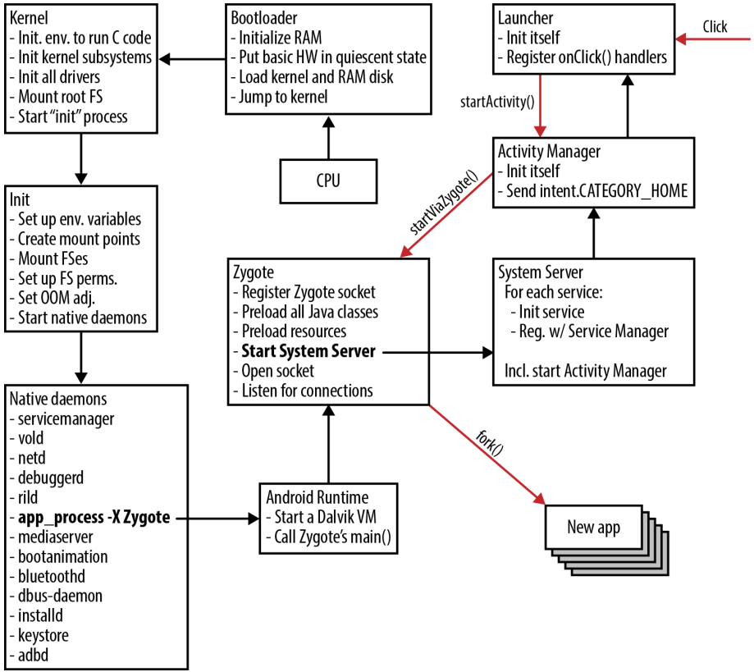
Booting process with focus on Zygote
Notes:
https://medium.com/@voodoomio/what-the-zygote-76f852d887d9

Slide 32
Android partition layout
mapping booting process to file partitions

Slide 33
Android partition
Boot
System
Recovery
Data
Cache
Misc
Android partitions are logical storage units made inside the device's persistent storage
logically divide the available space into sections that can be accessed independently of each other
each partition has a distinct role in the functionality of the device
Common partitions
/boot: to boot a phone, including kernel and RAMDISK (a few config files)
/system: entire Android OS, mounted by system.img, Not include Google GMS and GSF,
/recovery:
an alternative boot partition that lets you boot the device into a recovery model for performing advanced recovery and maintenance operations on it
When flash a custom recovery such as TWRP or CWM, you are overwriting this partition
Notes:
https://forum.xda-developers.com/t/android-partitions-explained.3657183/
https://forum.xda-developers.com/t/info-android-device-partitions-and-filesystems.3586565/

Slide 34
Common partitions (continues)
/data: called userdata,
including contacts, messages, settings, and installed apps
factory reset will wipe it
many forensic information can be found here
/metadata: is used when a device is encrypted
/cache
stores frequently accessed data
forensics data can be found here before it is wiped
/misc
miscellaneous system settings in the form of on/off switches
may include CID (Carrier or Region ID), USB configuration and certain hardware settings, etc
if it is corrupt or missing, several of the device’s features will not function normally

Slide 35
Common partitions (continues)
/sdcard
SD storage space to store your media, documents, downloads, pictures, videos, ROMs etc.
a symlink to /storage/emulated/0 (for compatibility)
/sd-ext
not a standard Android partition, but has become popular in the custom ROM scene
an additional partition on your SD card that acts as the /data partition when used with certain ROMs that have special features called APP2SD+ or data2ext enabled.
/Product
contain customizations (e.g., locales or carriers ) makes Android possible to use a single system image for multiple software
/vendor
vendor specific binary
contains any binary that isn't distributable to AOSP.
share code based on SoC (system on a chip)

Slide 36
Acquisition

Slide 37
Mobile Forensics Steps
Preparation
Seizure
Acquisition
Analysis
Report

Slide 38
Acquisition
Physical acquisition
bit-by-bit copy or disk imaging, tricky
Logical acquisition
extracting the logical storage objects, such as files and directories
data may be modified
Evidence only (Logical acquisition)
message, call log, contacts, social apps, GPS, images, videos, and
other common activates, browser history

