Slide 1
AOSP Apps Investigations
Part 3: Investigating calendar services
Notes:
https://digitalcorpora.s3.amazonaws.com/corpora/mobile/android_10/Non-Cellebrite%20Extraction/Pixel%203.zip

Slide 2
Calendar services

Slide 3
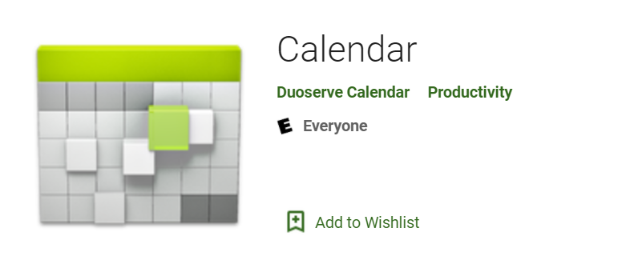
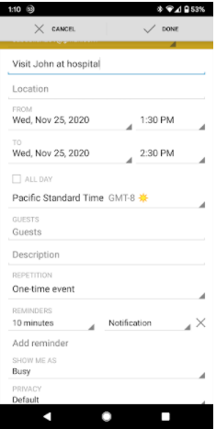
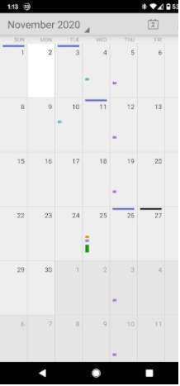
What are calendar services?
APIs provided by the AOSP
It manages and interacts with calendar data
through Calendar Provider com.android.providers.calendar
Services features
allow applications and sync adapters to access, modify, and synchronize calendar events, reminders, and other related data on a user's device
Pre-installed Calendar apps use these services
Google Calendar or Samsung Calendar

Slide 4
Evidence extracted from calendar services
Date/time of appointments
Place of appointment
Events created
Attendees
Note: In this case, there isn't any data to look at in any of the tables

Slide 5
Sample questions related to calendar service
What is the date of the scheduled event?
Who are the attendees?
For which date is the reminder set?
Are there any other events saved by the suspect?

Slide 6
Investigate calendar services

Slide 7
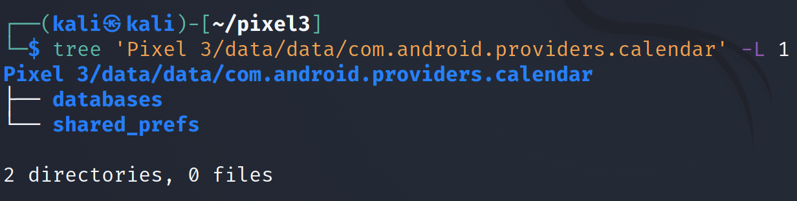
Calendar services folder structure
Notes:
Cmd: tree 'Pixel 3/data/data/com.android.providers.calendar' -L 1

Slide 8
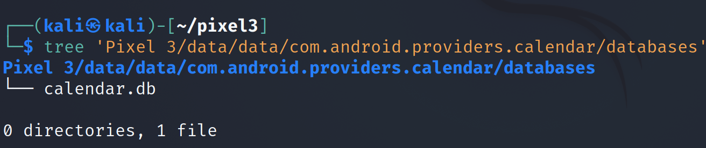
calendar.db location
Notes:
Cmd: tree 'Pixel 3/data/data/com.android.providers.calendar/databases'

Slide 9
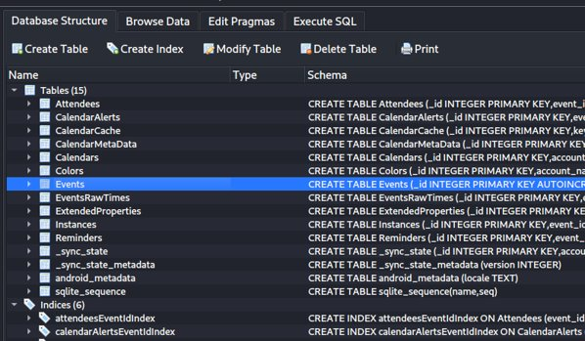
Examine calendar.db
Tables in database
Tables to focus on: attendees, events, reminders
In this case there isn't any data to look at in any of the tables
Notes:
Cmd: sqlitebrowser 'Pixel 3/data/data/com.android.providers.calendar/databases/calendar.db'

Slide 10
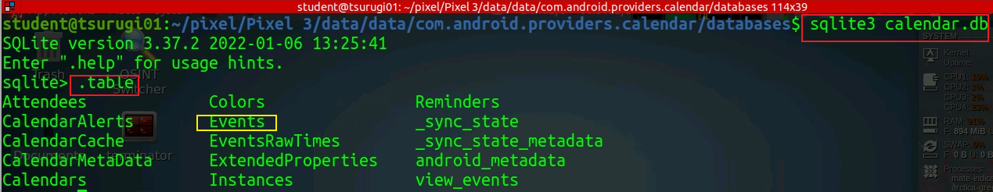
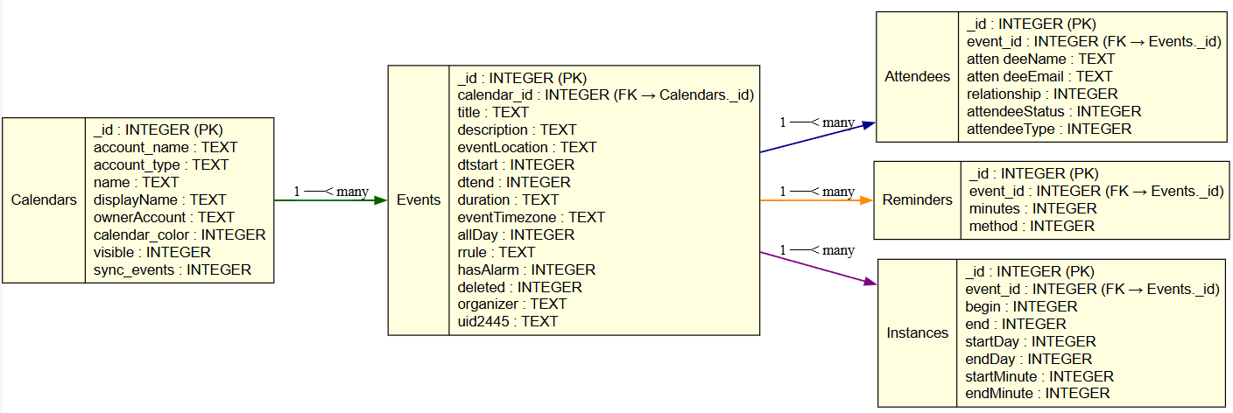
Data Model
Notes:
digraph CalendarDB {
rankdir=LR;
node [shape=record, style=filled, fillcolor=lightyellow, fontname="Helvetica"];
Calendars [label="{Calendars|_id : INTEGER (PK)\laccount_name : TEXT\laccount_type : TEXT\lname : TEXT\ldisplayName : TEXT\lownerAccount : TEXT\lcalendar_color : INTEGER\lvisible : INTEGER\lsync_events : INTEGER\l}"];
Events [label="{Events|_id : INTEGER (PK)\lcalendar_id : INTEGER (FK → Calendars._id)\ltitle : TEXT\ldescription : TEXT\leventLocation : TEXT\ldtstart : INTEGER\ldtend : INTEGER\lduration : TEXT\leventTimezone : TEXT\lallDay : INTEGER\lrrule : TEXT\lhasAlarm : INTEGER\ldeleted : INTEGER\lorganizer : TEXT\luid2445 : TEXT\l}"];
Attendees [label="{Attendees|_id : INTEGER (PK)\levent_id : INTEGER (FK → Events._id)\latten deeName : TEXT\latten deeEmail : TEXT\lrelationship : INTEGER\lattendeeStatus : INTEGER\lattendeeType : INTEGER\l}"];
Reminders [label="{Reminders|_id : INTEGER (PK)\levent_id : INTEGER (FK → Events._id)\lminutes : INTEGER\lmethod : INTEGER\l}"];
Instances [label="{Instances|_id : INTEGER (PK)\levent_id : INTEGER (FK → Events._id)\lbegin : INTEGER\lend : INTEGER\lstartDay : INTEGER\lendDay : INTEGER\lstartMinute : INTEGER\lendMinute : INTEGER\l}"];
// Relationships
Calendars -> Events [label="1 ──< many", color=darkgreen, penwidth=1.5];
Events -> Attendees [label="1 ──< many", color=darkblue, penwidth=1.5];
Events -> Reminders [label="1 ──< many", color=darkorange, penwidth=1.5];
Events -> Instances [label="1 ──< many", color=purple, penwidth=1.5];
}

Slide 11
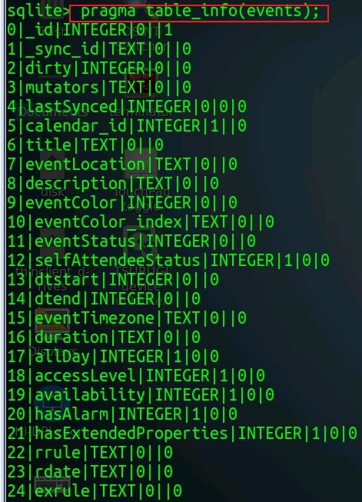
Column | Type | Description
_id | INTEGER | Primary key for the event.
calendar_id | INTEGER | Foreign key linking to Calendars._id.
title | TEXT | Event title.
description | TEXT | Event description.
eventLocation | TEXT | Location of the event.
eventStatus | INTEGER | Status (e.g., tentative=0, confirmed=1, canceled=2).
dtstart | INTEGER | Start time in UTC (milliseconds since epoch).
dtend | INTEGER | End time in UTC (milliseconds since epoch).
duration | TEXT | Duration if dtend is not set (e.g., “PT1H”).
eventTimezone | TEXT | Time zone for the event start.
eventEndTimezone | TEXT | Time zone for the event end (Android ≥7.0).
allDay | INTEGER | 1 if all-day event, else 0.
rrule | TEXT | Recurrence rule (RFC 5545 format, e.g., “FREQ=WEEKLY;COUNT=10”).
rdate | TEXT | Recurrence dates.
exrule | TEXT | Exclusion rule.
exdate | TEXT | Exclusion dates.
original_id | INTEGER | _id of the original recurring event (for exceptions).
original_sync_id | TEXT | Legacy sync ID for recurring exceptions.
originalInstanceTime | INTEGER | Start time of the original recurring instance.
originalAllDay | INTEGER | Whether the original event was all-day.
lastDate | INTEGER | Last date this event repeats on (UTC ms).
hasAlarm | INTEGER | 1 if event has a reminder.
hasExtendedProperties | INTEGER | 1 if event has extended properties.
accessLevel | INTEGER | Access level (default=0, owner=700, etc.).
availability | INTEGER | Availability (busy=0, free=1, tentative=2).
guestsCanModify | INTEGER | Whether guests can modify the event.
guestsCanInviteOthers | INTEGER | Whether guests can invite others.
guestsCanSeeGuests | INTEGER | Whether guests can see other guests.
organizer | TEXT | Organizer’s email or identifier.
isOrganizer | INTEGER | 1 if the user is the organizer.
selfAttendeeStatus | INTEGER | Attendance status for the current user.
sync_data1–sync_data5 | TEXT | Reserved for sync adapters.
customAppPackage | TEXT | Custom app package that created the event.
customAppUri | TEXT | URI for the custom app.
uid2445 | TEXT | Globally unique ID (iCalendar UID).
lastSynced | INTEGER | Last sync timestamp (ms).
dirty | INTEGER | Whether record has unsynced local changes (1=yes).
deleted | INTEGER | Whether event is deleted (soft delete flag).

Slide 12
Relevance of the Events Table in Digital Forensics
Establish Timelines: Events with timestamps (dtstart, dtend) can help reconstruct a suspect’s or victim’s activities at specific times.
Identify Locations: The eventLocation field can reveal where a person was or intended to be, which is crucial for alibi verification or tracking movements.
Uncover Relationships: Fields like organizer, guestsCanSeeGuests, and links to the Attendees table can reveal who the user was interacting with.
Reveal Intentions or Plans: Event titles, descriptions, and recurrence rules (rrule) can indicate planned activities, such as meetings, travel, or recurring behaviors.
Corroborate or Contradict Statements: Calendar events can be cross-referenced with other evidence (e.g., GPS data, call logs, or messages) to confirm or challenge a person’s claims.

Slide 13
Hypothetical Scenario
Imagine a digital forensics investigation involving a suspect, Alice Johnson, who is under investigation for a financial fraud scheme. Investigators have obtained her Android phone and extracted the calendar.db database. They are particularly interested in a meeting that might be related to the fraud, which occurred around March 10, 2025. They find an event in the Events table and analyze its associations with people to uncover potential accomplices or witnesses.

Slide 14
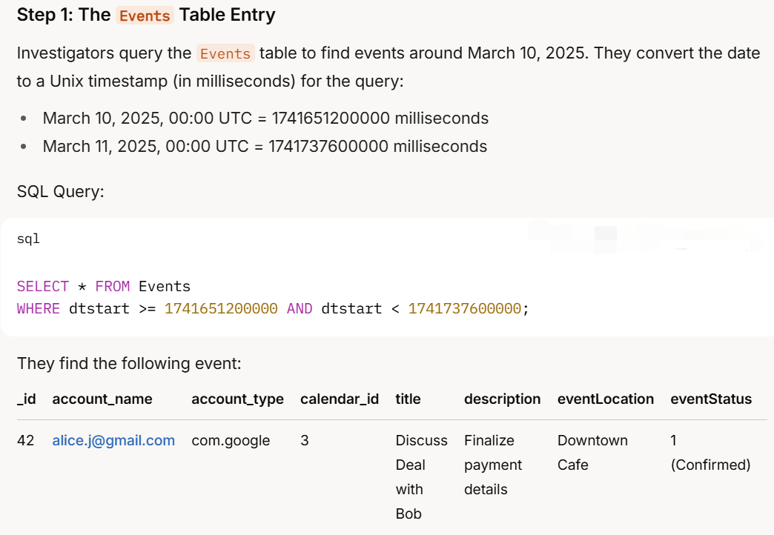
in calendars table

Slide 15
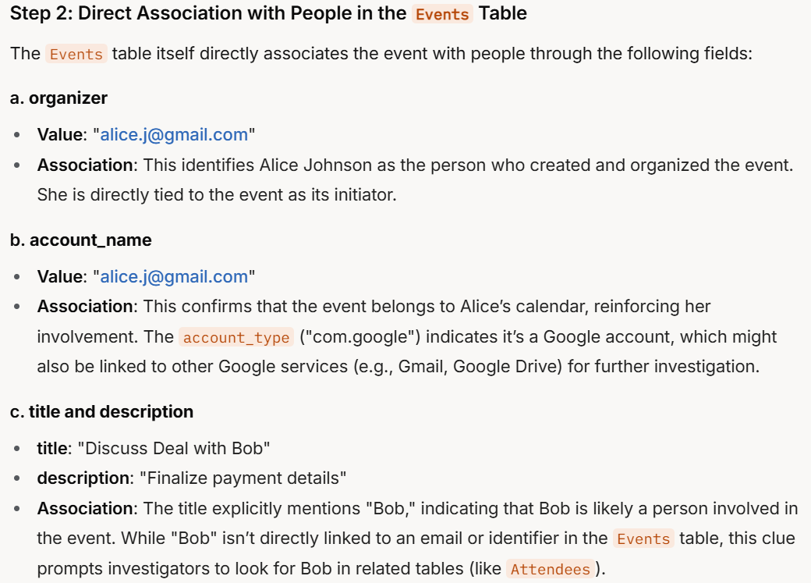

Slide 16
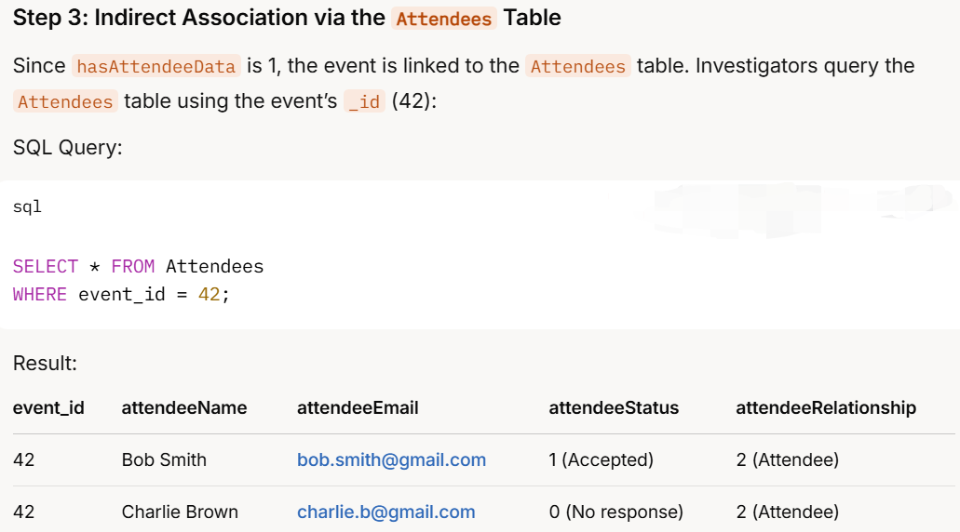

Slide 17
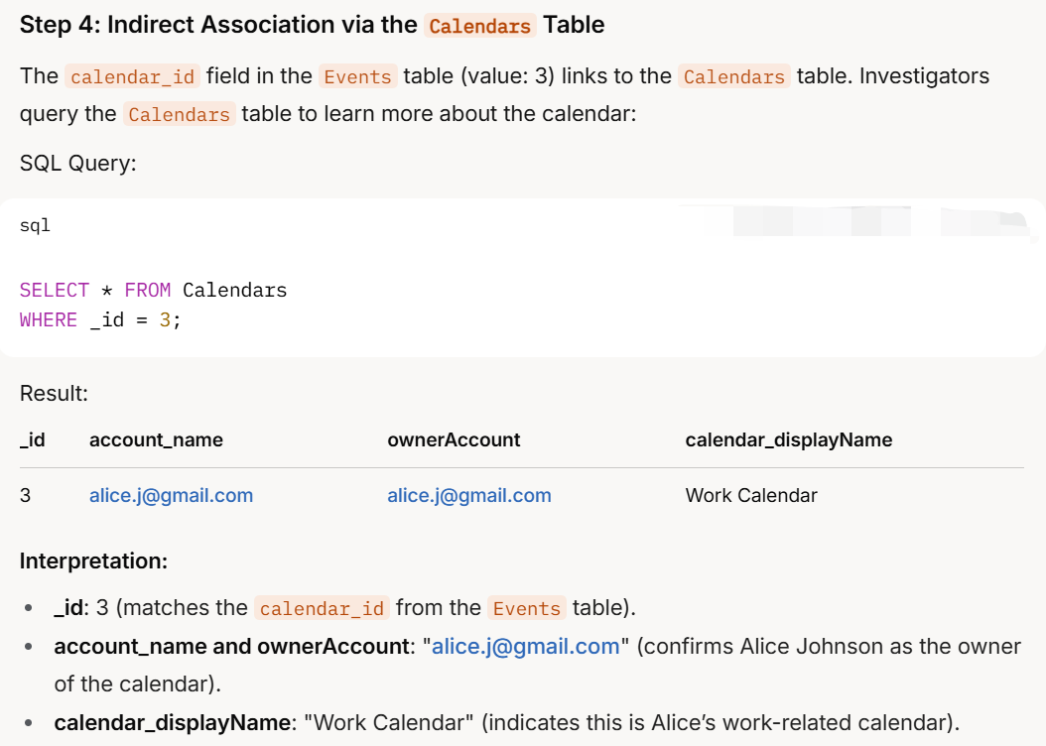

Slide 18
Summary
Events
When is the event (start/end date–time)?
What/where is it (title, description, location)?
Whose event is it (organizer / linked calendar)?
Calendars
Which account owns the event (account name/type)?
Is this calendar active/syncing on the device?
Attendees
Who are the attendees (names/emails)?
What is each attendee’s response status (accepted/declined/tentative)?

