Slide 1
AOSP Apps Investigations
Part 2: Investigating contacts management service
Notes:
https://android.googlesource.com/platform/packages/providers/ContactsProvider/+/b0f94c82189fdbe30037fbda532576043cbb067e/src/com/android/providers/contacts/ContactsProvider.java

Slide 2
Overview
Background
Investigating Contacts information
Investigating Call logs information
Investigating Voicemails (part of call logs)

Slide 3
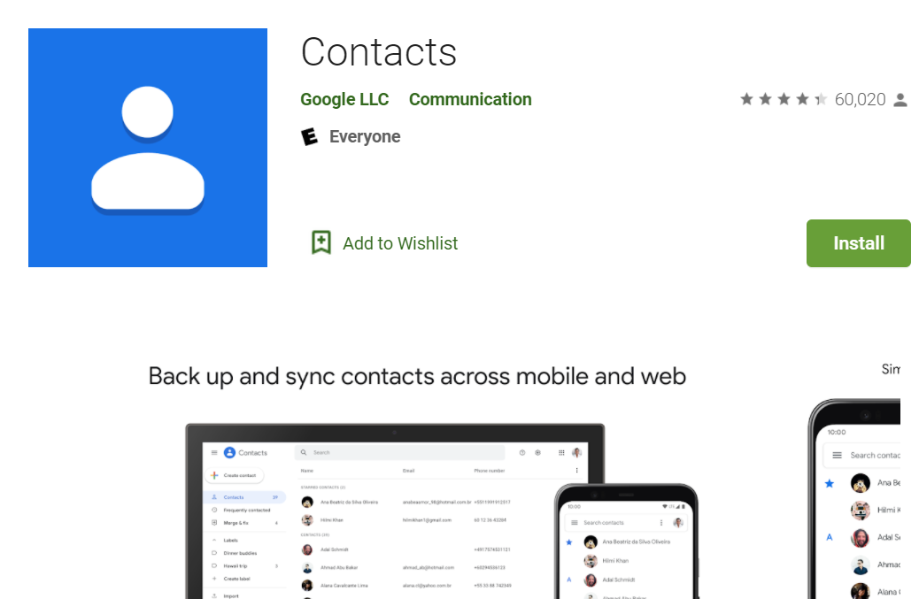
What is contacts management service?
Keep your contacts organized and up to date
View your contacts by account (e.g., work vs. personal)
Easily add contacts and edit information like phone numbers, emails, and photos
Get suggestions for adding new contacts, merging duplicates, and more
Back up your contacts and sync them across all your devices
Safely back up the contacts in your Google Account to the cloud
Access the contacts in your Google Account from any device
Record calling logs
Provides content providers which the third-party app can use to manipulate android contacts,
Evidence types
Contact info, groups, call logs, voicemails

Slide 4
Why it's important to investigate contacts management service?
Contacts: Understand the device owner’s social network
Contact profile
groups information
Call logs: Understand owner’s calling history
Who made the call
Was it received or not
Duration of the call
Voicemails: Know who contacted the owners and the conversation
can retrieve the stored message through phone, desktop, email and other communications devices

Slide 5
Investigating contacts information

Slide 6
What information does a contact consist of?
Phone,
Mobile, work phone,
Display name
nickname
company
department, title, Website, etc.
Email
email type (home, work, mobile, other)
Instant message
qq, icq, skype etc
Organization
company, department, title, job description, office location
Address
address type ( home, work, other)
Postal Address
country, city, region, street, postcode
Identity
namespace(SSN, passport)
Photo
Group
contact belongs group id.
Website
url, website type
Note

Slide 7
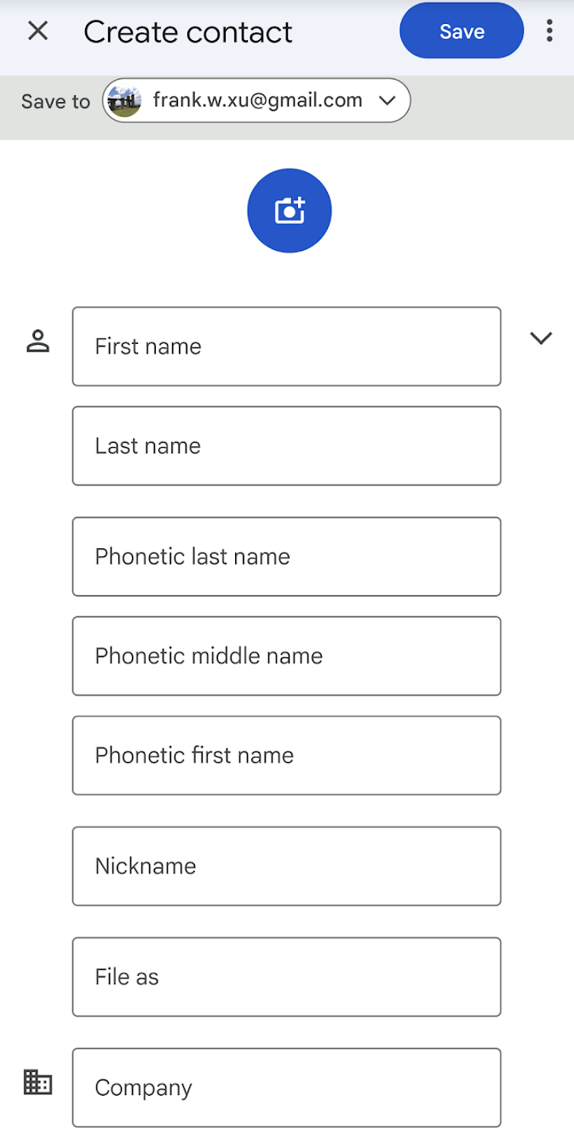
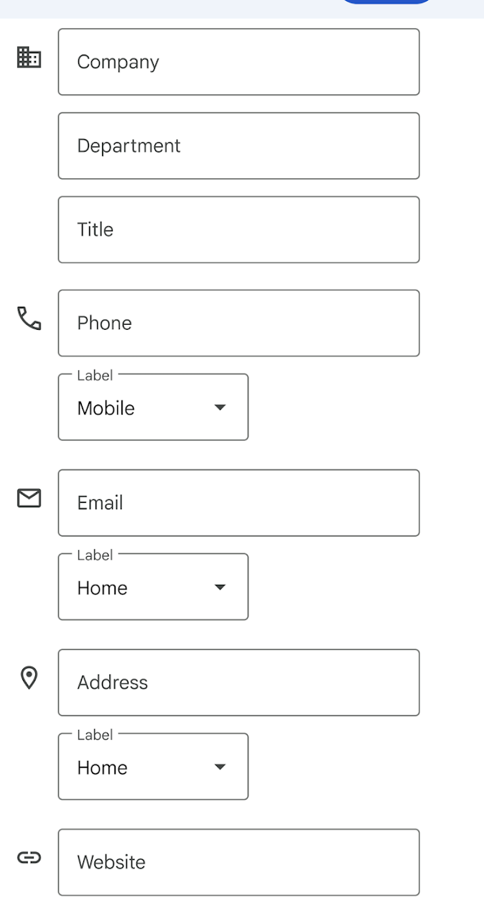
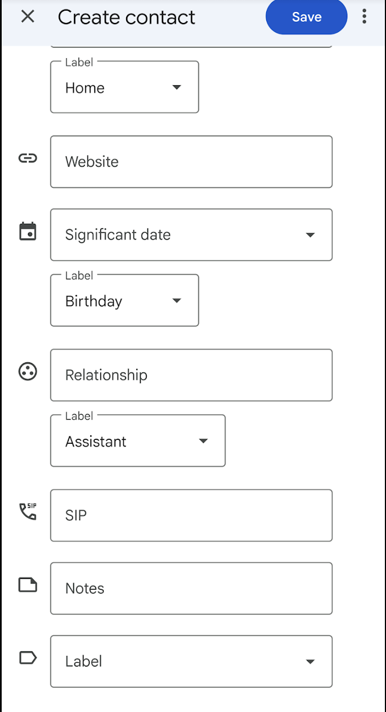
Notes:
https://www.dev2qa.com/android-contacts-database-structure/

Slide 8
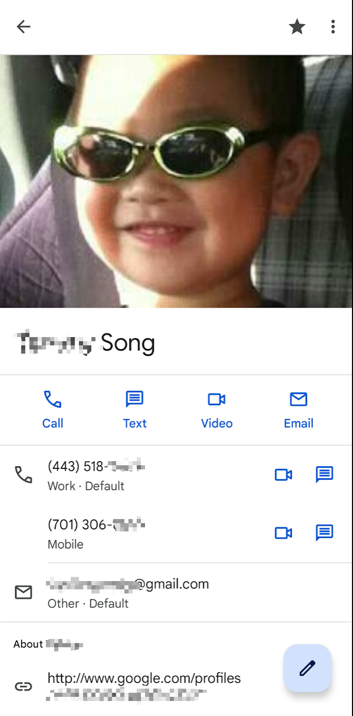
A simple scenario
Assume the device owner saved some of his contact details
Questions need to be answered during the investigation
Owner contacts
How many contacts does the owner saved?
What are the names of the groups?
Are there any groups marked as favourite?
Is there any description of any group?
Deleted contact
If the owner deleted some contacts, can we retrieve them?

Slide 9
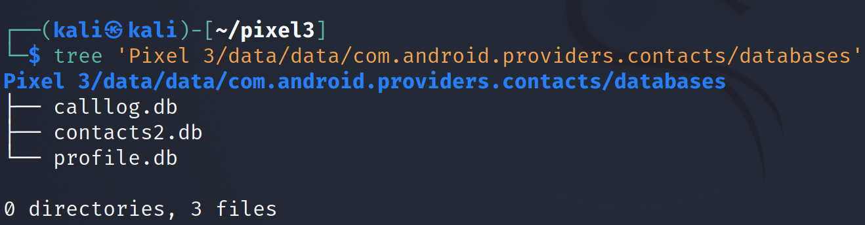
Understand contacts database and tables (contacts2.db )
Notes:
Cmd: sqlitebrowser 'Pixel 3/data/data/com.android.providers.contacts/databases/contacts2.db’
https://www.dev2qa.com/android-contacts-database-structure/

Slide 10
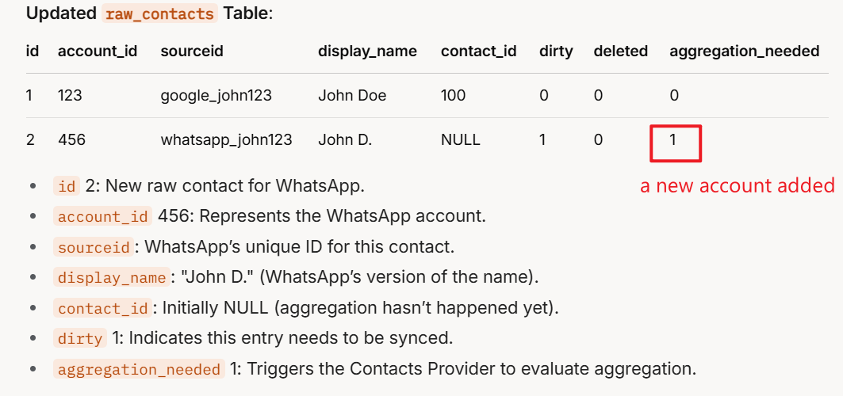
raw_contacts, data, contacts tables
Note: It will be updated after aggregated

Slide 11
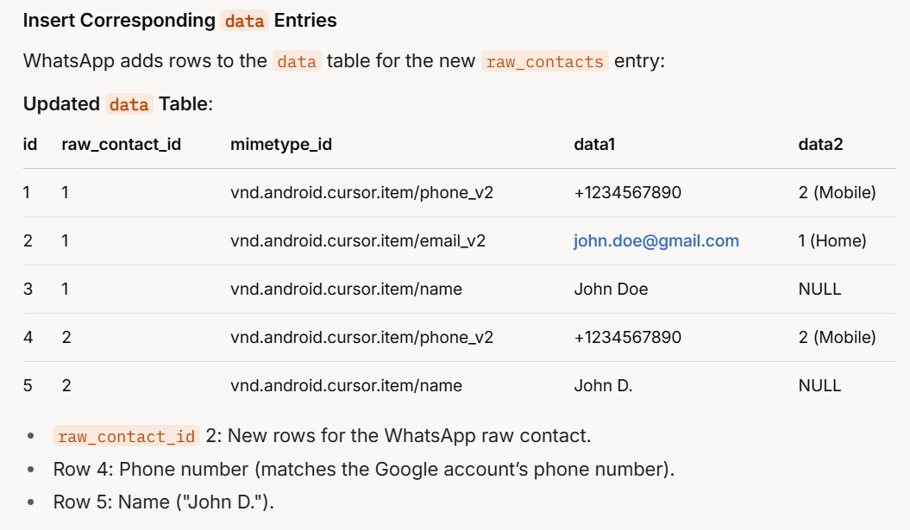
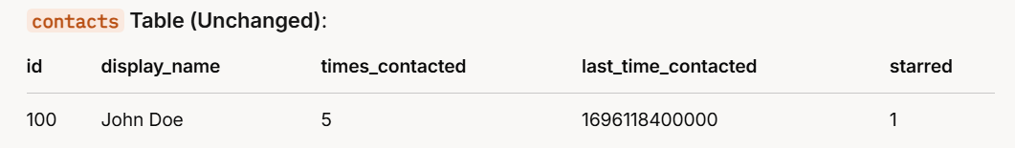




Slide 12
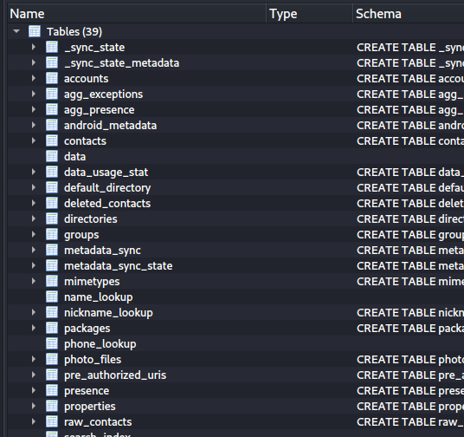
metadata of each contacts info, e.g., times contacted, last time contacted
contacts info
fields of contacts
contact group information, e.g., family, friends
raw data is unprocessed data, which contains contacts and data tables
Notes:
Cmd: sqlitebrowser 'Pixel 3/data/data/com.android.providers.contacts/databases/contacts2.db’
https://www.dev2qa.com/android-contacts-database-structure/

Slide 13
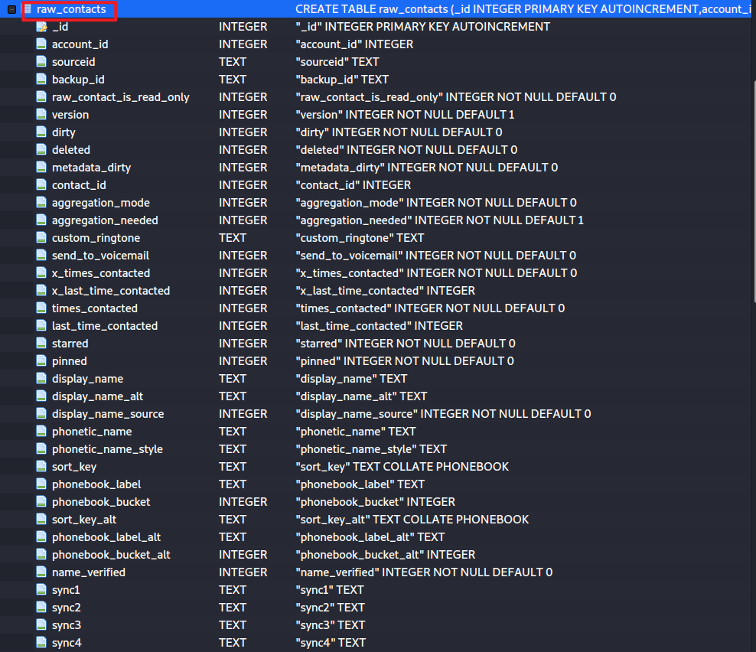
raw_contacts table
Raw Contacts vs. Contacts:
The raw_contacts table stores individual contact entries from different accounts.
The contacts table (not shown here) aggregates these raw contacts into unified contacts that the user sees in the Contacts app.
For example, if "John Doe" has a Google contact and a WhatsApp contact, there will be two rows in raw_contacts, but they might be merged into one entry in the contacts table.

Slide 14
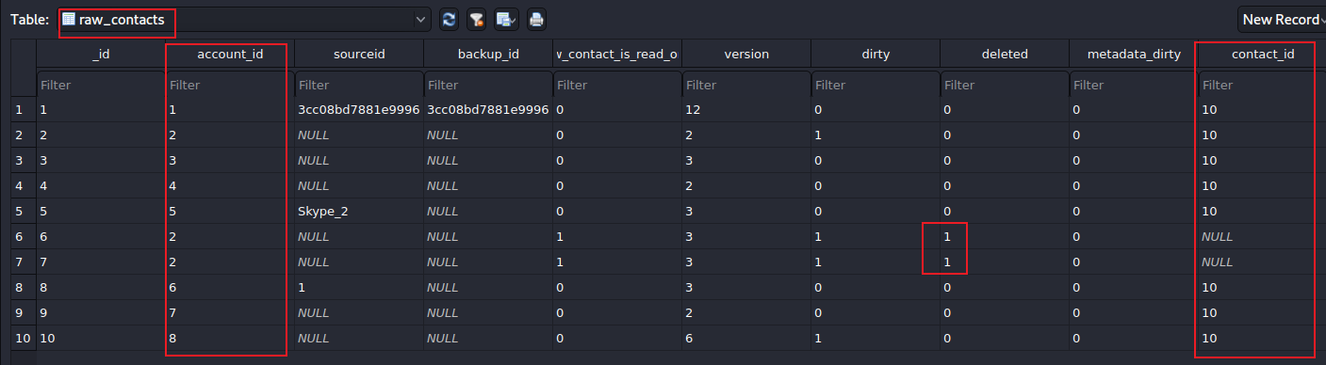
Find the number of contact_id
Notes: The table shows ONE contact (aggregated) information used in 8 different app accounts. 2 accounts were deleted.

Slide 15
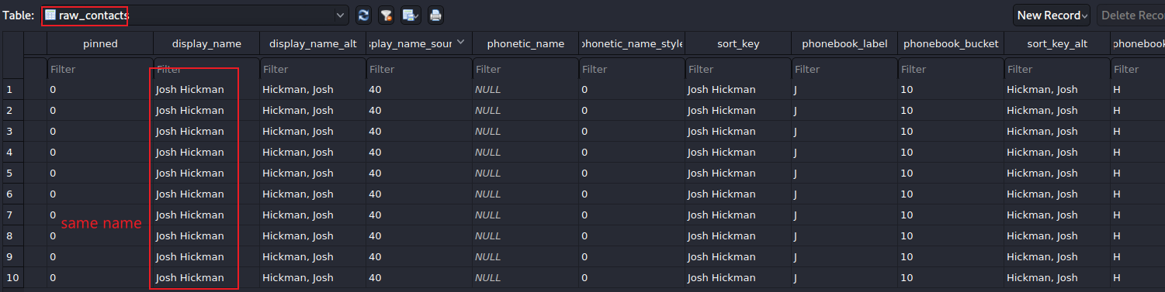
Show the names of all accounts

Slide 16
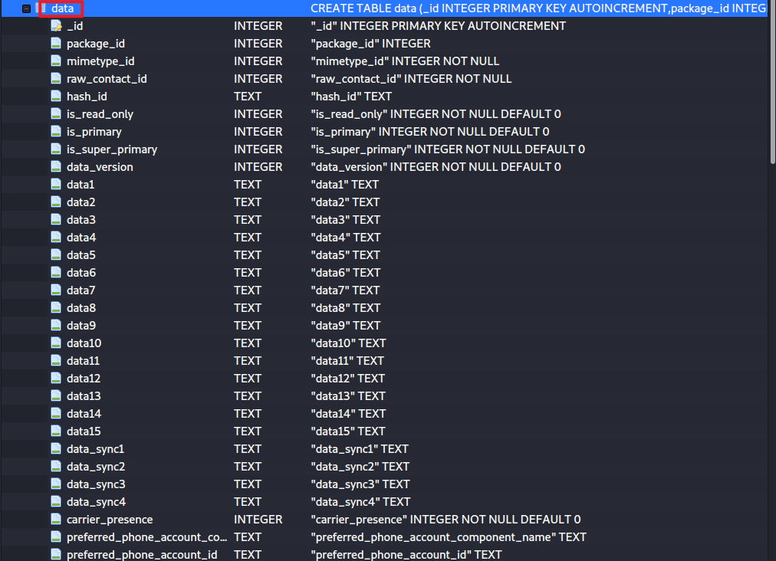
What are the details of the contact with ID 10?
Show data table structure
contact details are saved in data table

Slide 17
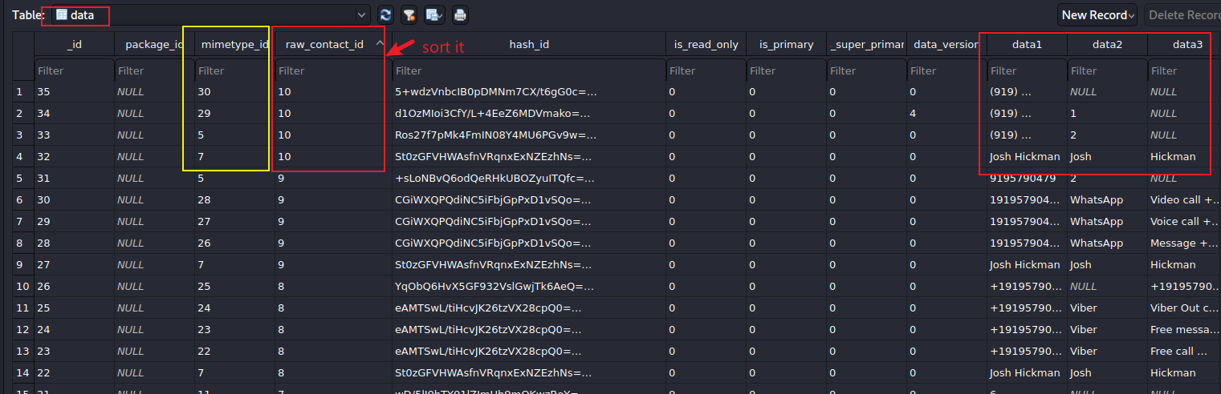
indicate what data type is stored in this row.
See mimetypes Table
indicate the data for the data type
contact 10 (has four fields, each field has a different value type based on minetypes)
Show content of data table

Slide 18
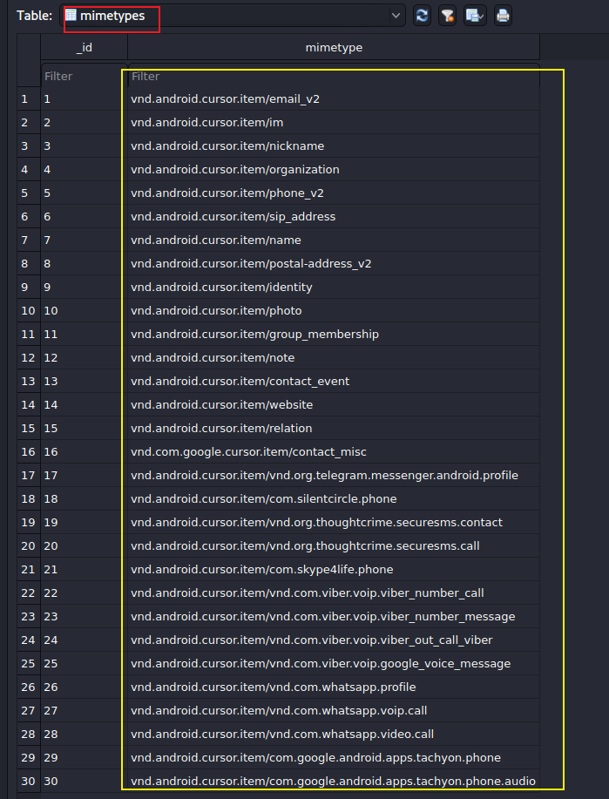
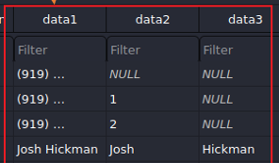
Show structure of minetypes
Used to define android contact filed mime type. For example, for the contact information email field, it’s mimetype is vnd.android.cursor.item/email_v2.
The contact includes phone number, name, …, ….
google FI

Slide 19
When was the contact (id=10) updated?
Exam contacts table

Slide 20
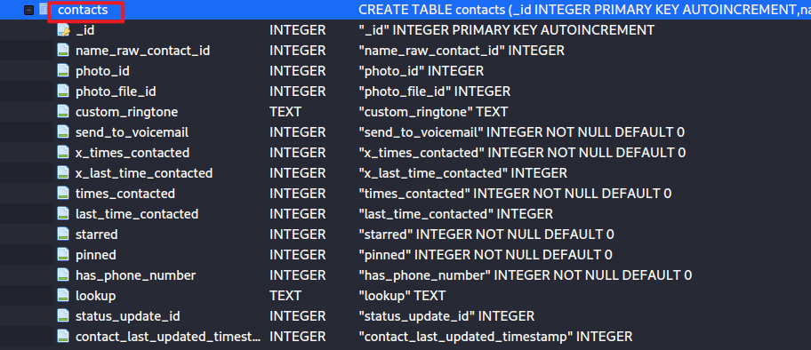
The last time this contact is contacted. The format is in milliseconds.
contact id
The timestamp this contact is updated for the last time.
Show the structure of contacts table

Slide 21
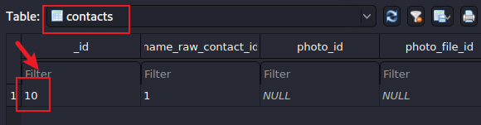
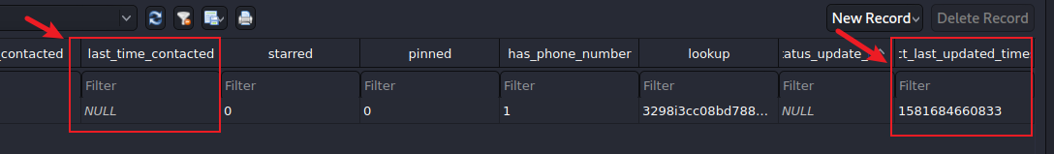

Show the contact_last_updated_time
Notes:
date -d '@1581684660' -u

Slide 22
How many groups have the device owner create?
Before adding any contact in android, you can create a new group or select an existing contact group.
Exam contact group information, e.g., family, friends

Slide 23
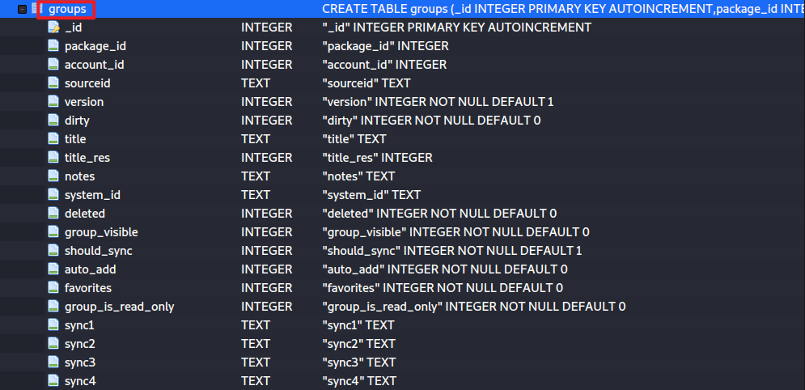
Show group table schema
group description info.

Slide 24
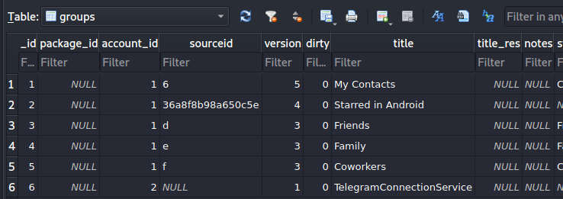
Show 6 groups and the names of the groups
Can you list all contacts in each group?

Slide 25
Investigating call logs

Slide 26
A simple calling scenario
A call from +19195121037 was made to the device owner on Feb 12, 2020
Questions need to be answered during the investigation
What is the approximate time the call was made?
Did the receiver answer the call?
What was the duration of the call if answered?

Slide 27
Find the database location
Notes:
Cmd: tree 'Pixel 3/data/data/com.android.providers.contacts/databases'

Slide 28
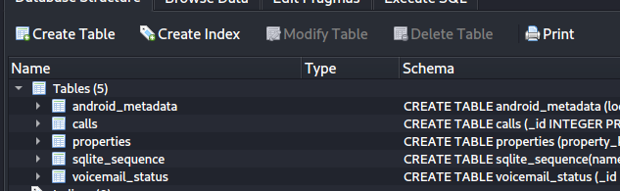
Show all tables in the database
calls: call log
Contains made/received calls along with timestamp and duration

Slide 29
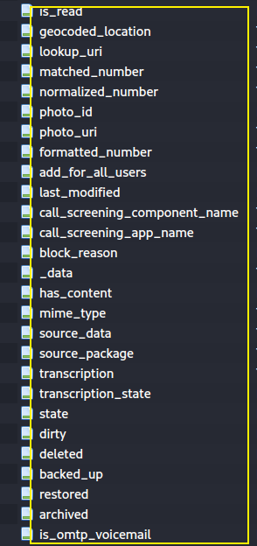
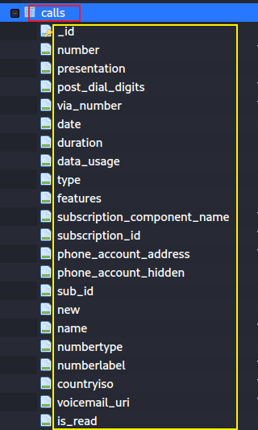
incoming/ outgoing number
if show phone number
Date/time when call was made/received
INCOMING_TYPE
OUTGOING_TYPE
MISSED_TYPE
VOICEMAIL_TYPE
REJECTED_TYPE
BLOCKED_TYPE
ANSWERED_EXTERNALLY_TYPE
phone account id
If it left voicemail, then url to the voice

Slide 30
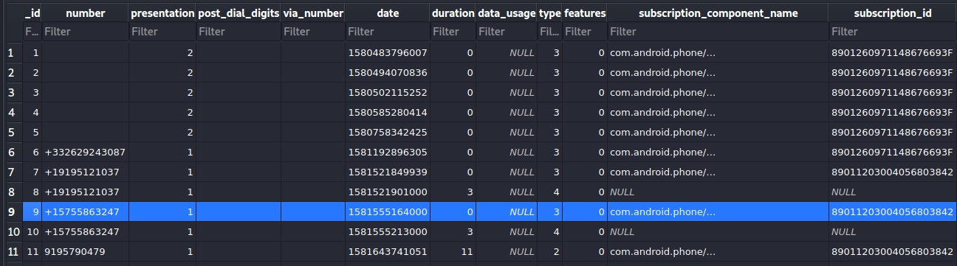
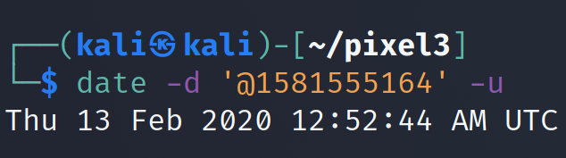
Exam calls table
incoming/ outgoing number
Date/time when call was made/received
missed call
record _id=10 are voicemail type after missed the call (record 9)
Duration of the call
Notes:
https://developer.android.com/reference/android/provider/CallLog.Calls

Slide 31
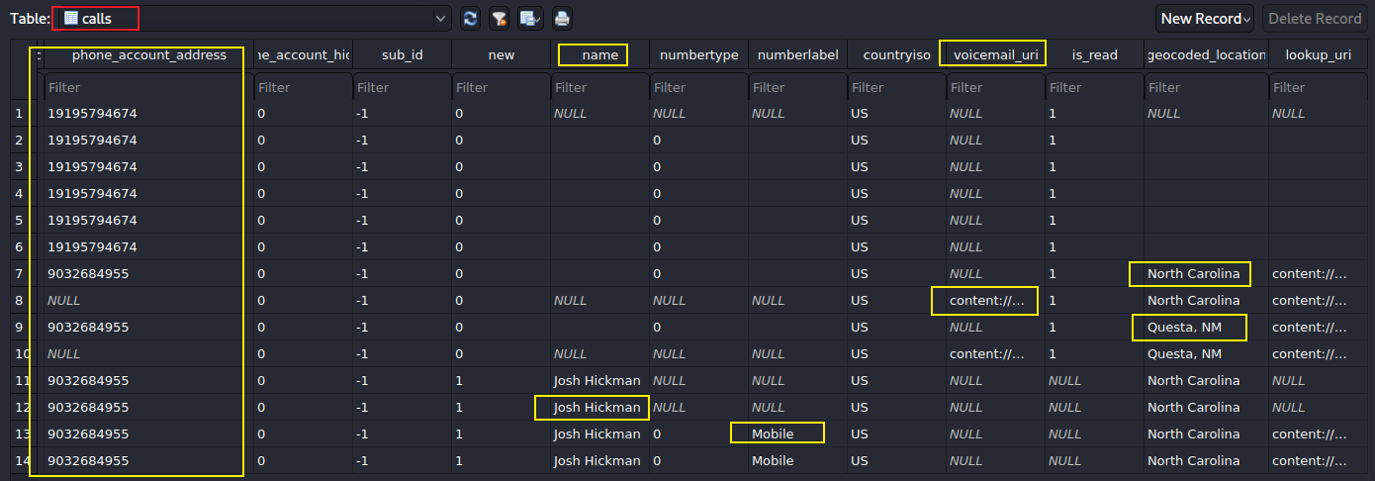

Slide 32
Calling logs investigation solutions
What is the exact time the call was made?
The call was made on Feb 12, 2020 around 04:00:00 pm
Did the receiver answer the call?
No, because it is a missed call.
If the call was answered, how long the conversation last?
A missed call, 0 second
Where is the caller located?
Questa, MN

Slide 33
Investigating Voicemails (part of call logs)

Slide 34
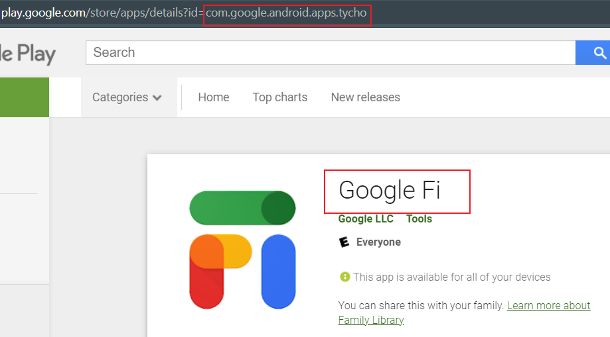
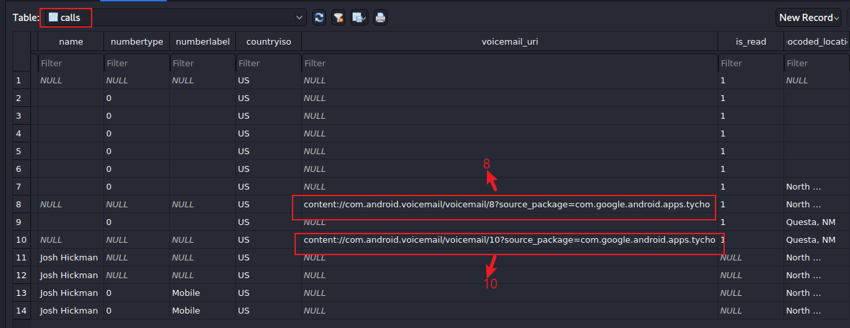
What is the saved voicemail url?
the owner use Google FI and it provides voicemail
Find which service provides voicemail

Slide 35
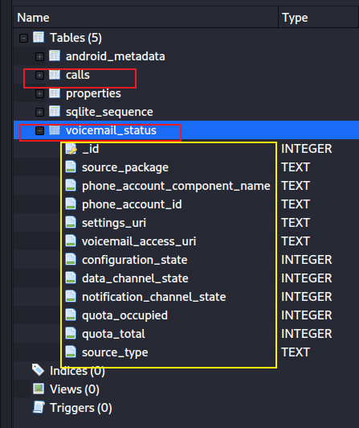
How to access voicemail?
App used by caller, Google dialer
voicemail_access_url

Slide 36
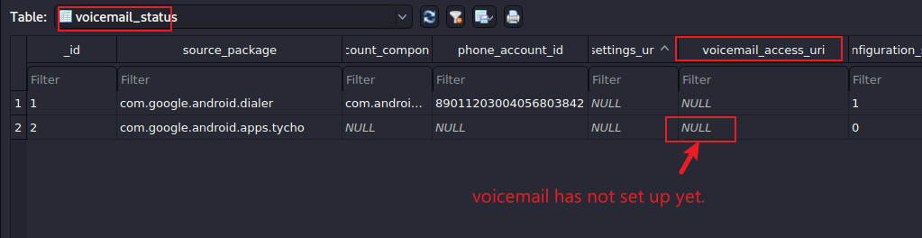
Find voicemail access url

