Slide 1
Understand Number Systems and Timestamps
Frank Xu
wxu@ubalt.edu

Slide 2
Overview
Number systems
American Standard Code for Information Interchange (ASCII code)
Epoch time and timestamps
Data stored in memory

Slide 3
Number systems

Slide 4
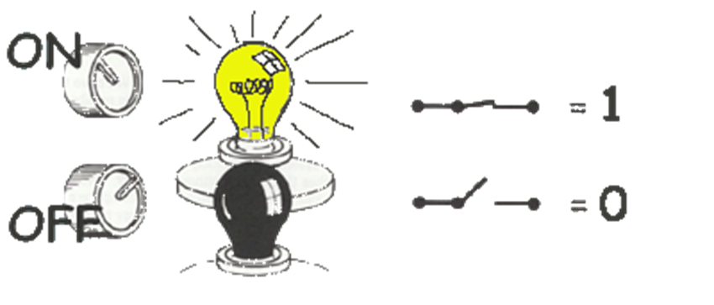

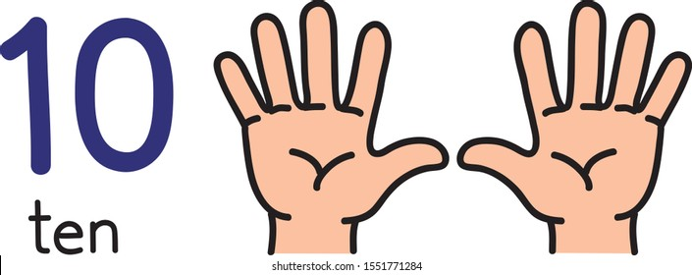
System | Base | Symbols | Used by humans? | Used by CPU? | Used by Forensic Professionals?
Decimal | 10 | 0, 1, … 9 | Yes | No | Yes
Binary | 2 | 0, 1 | No | Yes | Yes
Hexa- decimal | 16 | 0, 1, … 9, A, B, … F | No | No | Yes

Slide 5
Conversion among number systems
Decimal
Binary
Hexadecimal

Slide 6

Conversion table
Decimal | Binary | Hexa- decimal
0 | 0 | 0
1 | 1 | 1
2 | 10 | 2
3 | 11 | 3
4 | 100 | 4
5 | 101 | 5
6 | 110 | 6
7 | 111 | 7
Decimal | Binary | Hexa- decimal
8 | 1000 | 8
9 | 1001 | 9
10 | 1010 | A
11 | 1011 | B
12 | 1100 | C
13 | 1101 | D
14 | 1110 | E
15 | 1111 | F

Slide 7
Binary Addition
A | B | A + B
0 | 0 | 0
0 | 1 | 1
1 | 0 | 1
1 | 1 | 10
1
1
10101 21 + 11001 + 25 101110 46
carry bit

Slide 8
Decimal to Decimal
placeholder
Weight
126₁₀ => 6 x 10⁰ = 6 2 x 10¹ = 20 1 x 10² = 100 126
Decimal
Base

Slide 9

Binary to Decimal
placeholder
Weight
Multiply each bit by 2^{n}, where n is the “weight” of the bit
The weight is the position of the bit, starting from 0 on the right
Add the results
101010₂ => 0 x 2⁰ = 0 1 x 2¹ = 2 0 x 2² = 0 1 x 2³ = 8 0 x 2⁴ = 0 1 x 2⁵ = 32
42₁₀
Base
$(()): Shell Arithmetic
2# base 2

Slide 10
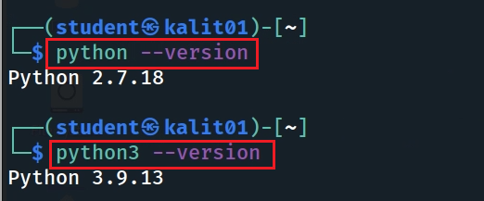
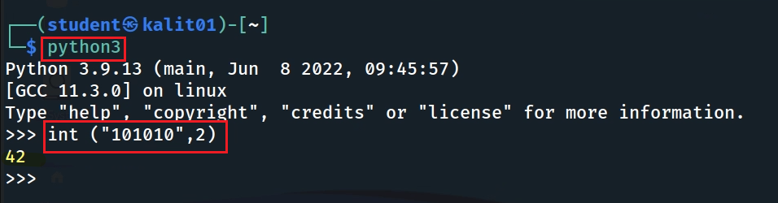
Binary to Decimal (Python code)
Check Python version
I use Python version 3.9
# hex to int
int ("800", 16)
Notes:
python:
int("0101", 2)

Slide 11

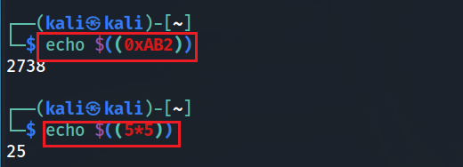
Hexadecimal to Decimal
Multiply each bit by 16^{n}, where n is the “weight” of the bit
The weight is the position of the bit, starting from 0 on the right
Add the results
AB2₁₆ => (?)₁₀
2 x 16⁰ = 2 x 1 = 2 B x 16¹ = 11 x 16 = 176 A x 16² = 10 x 256 = 2560
2738₁₀
$(()): Shell Arithmetic
python code: int("ab2", 16)
Notes:
https://www.gnu.org/software/bash/manual/html_node/Shell-Arithmetic.html
python code: int("ab2", 16)

Slide 12


Decimal to Binary
126₁₀ = (?)₂
2 126 63 0
Divide by 2, keep track of the remainder
First remainder is bit 0 (LSB, least-significant bit)
Second remainder is bit 1
Etc.
2 31 1
2 15 1
2 7 1
2 3 1
2 1 1
2 0 1
stop
126₁₀ = 1111110₂
basic calculator
Notes:
echo "obase=2;126" | bc

Slide 13


Decimal to Hexadecimal
2738₁₀ = (?)₁₆
Divide by 16
Keep track of the remainder
16 2738
171 2
16
10 11 = B
16
0 10 = A
2738₁₀ = AB2₁₆
controls the output as in C printf %d - Print the argument as a signed decimal integer.
%x - Print the argument as an unsigned hexadecimal integer.
%s - Print the argument as a string.
Notes:
https://linuxize.com/post/bash-printf-command/

Slide 14


Decimal to Binary and Hex (Python code)
Decimal to Binary
Decimal to Hex

Slide 15




Binary to Hexadecimal
101010110010₂ = ?₁₆
Group bits in fours, starting on right
Convert to hexadecimal digits
1010 1011 0010
10 11 2
A B 2
101010110010₂ = AB2₁₆

Slide 16
American Standard Code for Information Interchange
ASCII Code

Slide 17




Bit, Byte
A ‘bit’ (from Binary + digIT)
is the smallest unit of memory,
the unit of measurement of data information.
Byte 8-bit collections
A single bit holds so little information.
A byte holds one ASCII

Slide 18
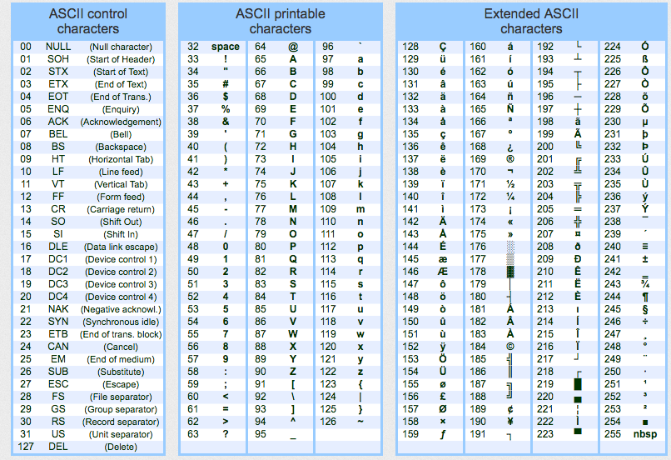
ASCII - American Standard Code for Information Interchange
ASCII codes represent text in computing devices.

Slide 19
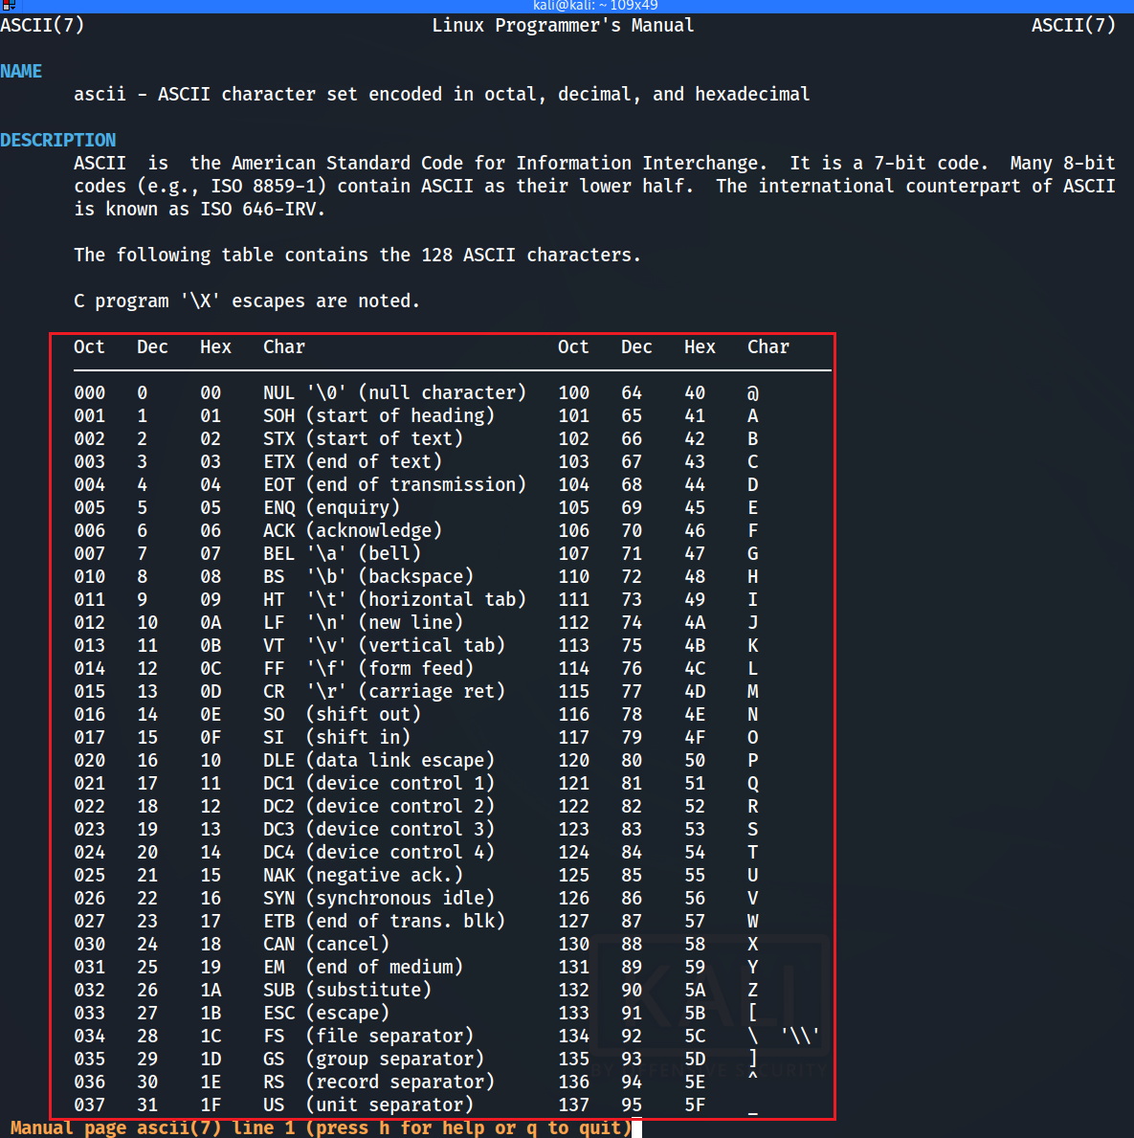


Slide 20
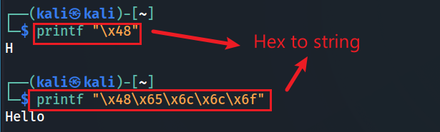

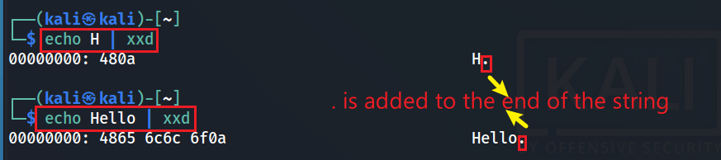
Number and ASCII conversion (CLI)
Hex to ASCII string
Decimal to ASCII string
ASCII to Hex
“0a” represents a newline character (\n)
The newline character (\n, or 0A in hexadecimal) is not a printable ASCII character. Therefore, xxd represents it with a dot (.).
Notes:
printf "\x48\x65\x6c\x6c\x6f“
echo -n Hello | xxd

Slide 21
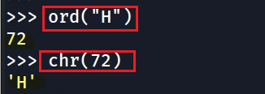
Decimal and ASCII char conversion (Python version)
Decimal to an ASCII char
ord()
ASCII
Dec
chr()

Slide 22

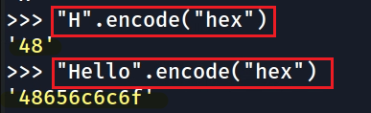

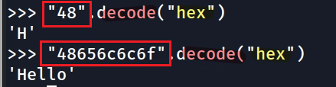
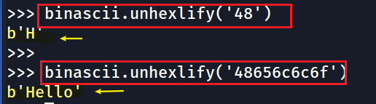
Hex and ASCII conversion (Python version)
Python 2
Python 3
ASCII to Hex
ASCII to Hex
Hex to ASCII string
Hex to ASCII
hexlify()
encode(“hex”)
ASCII
Hex
ASCII
Hex
unhexlify()
decode(“hex”)
Notes:
>>> import binascii
>>> binascii.hexlify(b'H')
b'48'
>>>
>>> binascii.hexlify(b'Hello')
b'48656c6c6f'
>>> import codecs
>>> hex_encoder=codecs.getencoder('hex')
>>> hex_encoder(b'H')
(b'48', 1)
>>> hex_encoder(b'H')[0]
b'48'
>>> hex_encoder(b'Hello')
(b'48656c6c6f', 5)
>>> hex_encoder(b'Hello')[0]
b'48656c6c6f

Slide 23
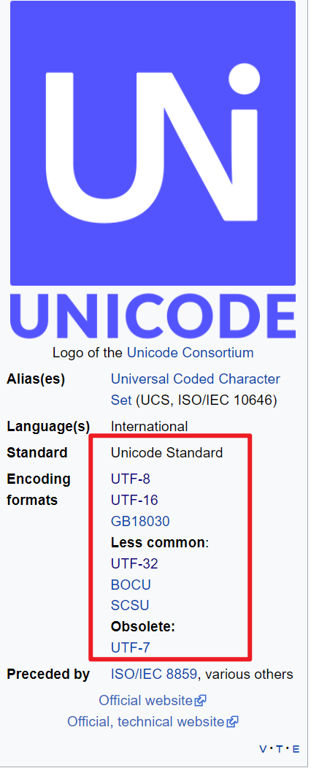
Unicode
Unicode, formally The Unicode Standard is an information technology standard for the consistent encoding, representation, and handling of text expressed in most of the world's writing systems.
https://en.wikipedia.org/wiki/Unicode

Slide 24
What's the difference between ASCII and UTF-8 Unicode?
Both are character encoding standards used for representing characters
letters, numbers, symbols, etc.
use a series of bits (1s and 0s).
Length difference
ASCII uses 7 bits (128 characters)
UTF-8 uses variable-length encoding (1,112,064 characters)
UTF-8 is a superset of ASCII
all ASCII characters have the same representation in UTF-8.
UTF-8 can represent a wider range of characters, including non-English characters

Slide 25
Epoch time and timestamps
-different timestamp formats

Slide 26
Epoch time
Epoch time is a way to represent time as the number of seconds or milliseconds that have passed since a specific starting point, known as the epoch
1 second = 1,000 milliseconds (ms)
1 second = 1,000,000 microseconds (µs)
Types of epoch time
Unix Epoch Time (POSIX Time) - 1970
Mac Time: Mac OS X Time/ Cocoa Core Date – 2001; HFS+/APFS - 1904
WebKit time - 1601
Windows Filetime - 1601
Understand epoch time is important for digital forensics

Slide 27
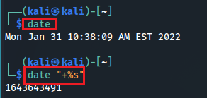
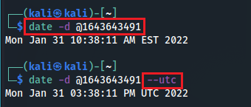
Unix time
Unix time, or POSIX time, is a system for describing points in time.
It is the number of seconds that have elapsed since the Unix epoch,
The Unix epoch is 00:00:00 UTC on 1 January 1970
Current time to Unix time
Unix time to readable time
-d: Specifies a string to be interpreted as a date (instead of using the current time)
Notes:
1643643491

Slide 28

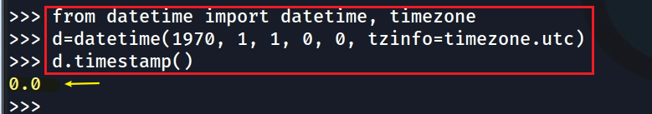
Unix time (Python version)
0 second => UTC Jan 1st, 1970
A Python module is a .py file that contains Python code.
A Python module contains multiple functions
Use keyword from and import if you only want to import a few functions,
timestamp is an integer, representing a time in second
from [module] import [function1, function2]
UTC Jan, 1st, 1970 => 0 second
Notes:
from datetime import datetime, timezone
d=datetime(1970, 1, 1, 0, 0, tzinfo=timezone.utc)
d.timestamp()

Slide 29
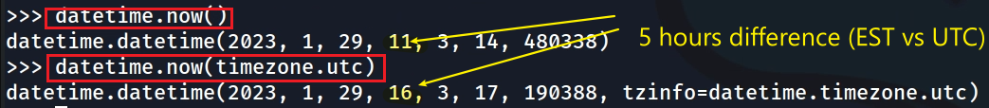

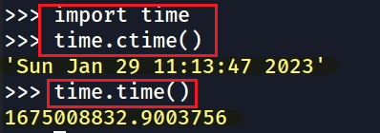
datetime(year, month, day, hour, minute, second, microsecond)
format
Get current time (datetime Module)
Get current time (time Module)
Get the current time in a human-readable format
Get the current time in seconds. It returns the number of seconds since Jan 1, 1970, 00:00:00.
Notes:
datetime.timezone was added in Python 3.2. So it is normal to get an import error in e.g. Python 2.7.
In Python 2.7, you can use the pytz library.
from datetime import datetime, timezone

Slide 30
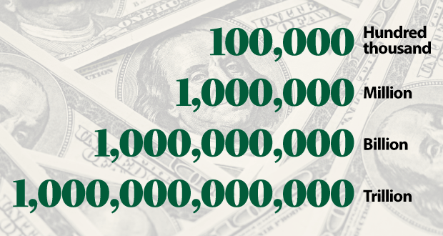
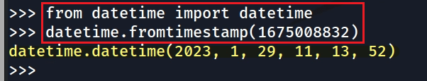

1.67 billion = 1,670,000,000
Covert seconds to a readable time (datetime Module)
our default time zone is EST. Pay attention to the 5 hours difference
If the timestamps are in UTC timezone (a common way to store dates) you should use
Notes:
from datetime import datetime
datetime.fromtimestamp(1675008832)

Slide 31
Mac "epoch time" - Cocoa Core Date
Mac uses a different "epoch time" than the UNIX epoch time.
Cocoa Core Date
Mac OS epoch date is Midnight January 1, 2001, UTC
Cocoa Core Data time is the number of seconds elapsed since January 1, 2001, 00:00:00 UTC,
Different is 31 years (978,307,200 seconds)
Example: 0,700,000,000 (0.7 billion)
Notes:
date - d ‘1970-01-01 00:00:00 UTC’ +%s
date - - date=20010101 +$s
expr 1657166400 - 1609390800
datediff 1970-01-01 2001-01-01 –f %Ss

Slide 32
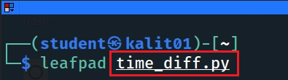
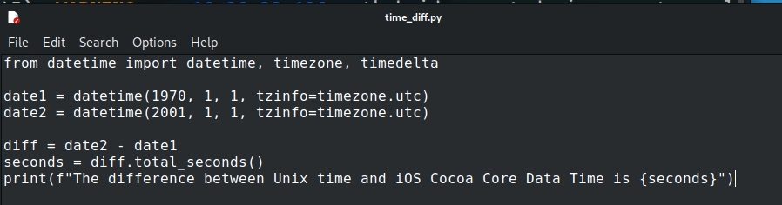
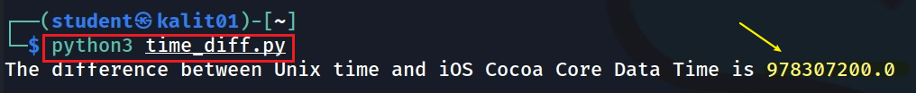
Write a function to compute the difference between Unix time and iOS time
Notes:
from datetime import datetime, timezone, timedelta
date1 = datetime(1970, 1, 1, tzinfo=timezone.utc)
date2 = datetime(2001, 1, 1, tzinfo=timezone.utc)
diff = date2 - date1
seconds = diff.total_seconds()
print(f"The difference between Unix time and iOS Cocoa Core Data Time is {seconds}")

Slide 33
WebKit time
WebKit (Chrome) is a popular open-source rendering engine used by many web browsers
Safari and Google Chrome.
The time it takes for the WebKit rendering engine to render and display a webpage.
webkit microsecond since 01/01/1601
Example: 13,402,068,765, 000,000

Slide 34
Hash code

Slide 35
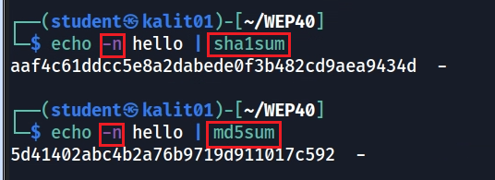
Linux commands
echo appends a \n
Use the -n argument to omit the trailing linebreak
Notes:
https://stackoverflow.com/questions/5693360/why-is-an-md5-hash-created-by-python-different-from-one-created-using-echo-and-m

Slide 36
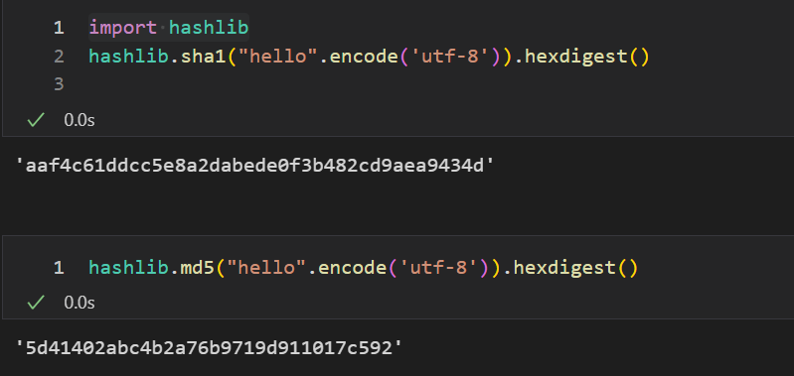
Python

Slide 37
Data stored in memory

Slide 38
Endianness
Endianness is a term that describe the order in which a sequence of bytes (byte order) is stored in memory.
Little-endian
is an order in which the "little end" (least significant value in the sequence) is stored first.
Big-endian
is an order in which the "big end" (most significant value in the sequence) is stored first (at the lowest storage address).

Slide 39
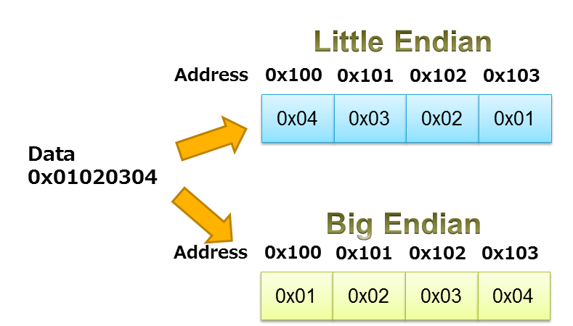




Least significant value
https://www.iar.com/knowledge/learn/programming/migration-techniques-for-different-endianness/
Notes:
Least significant is stored in low address

Slide 40
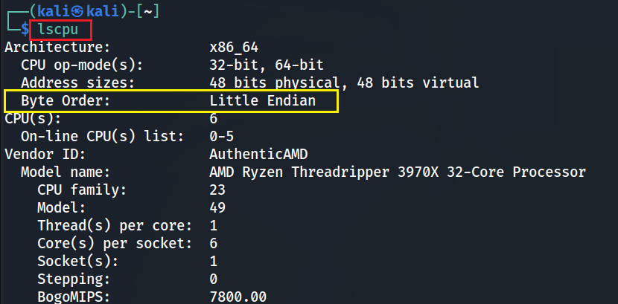
Check Byte order

