Slide 1
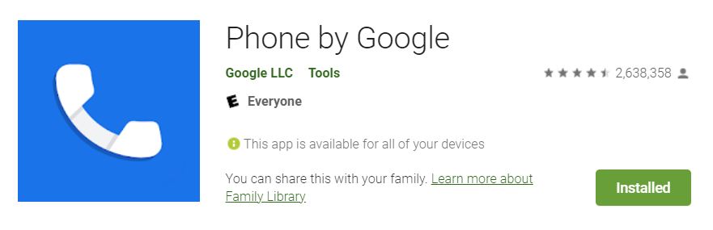
GMS Apps Investigations
Part 2: GMS Google Phone Dialer App

Slide 2
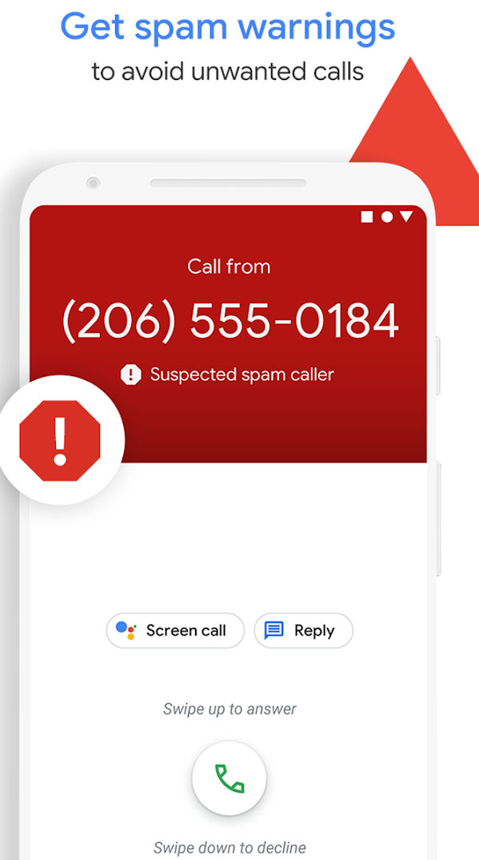
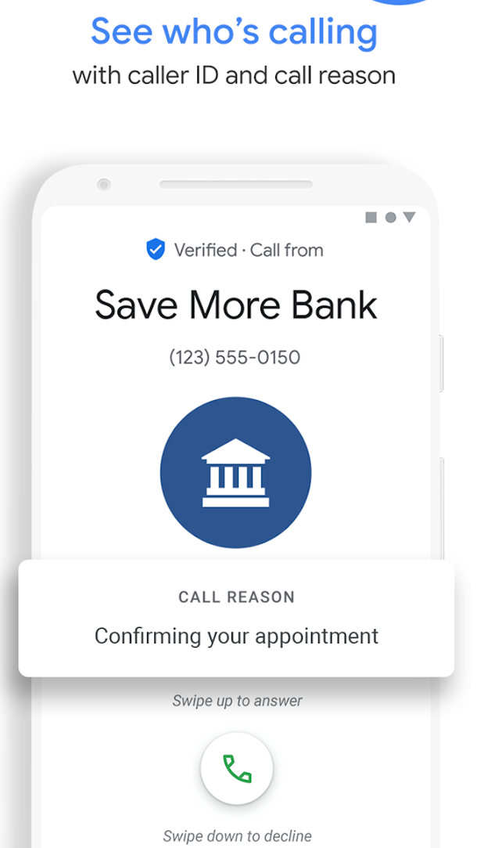
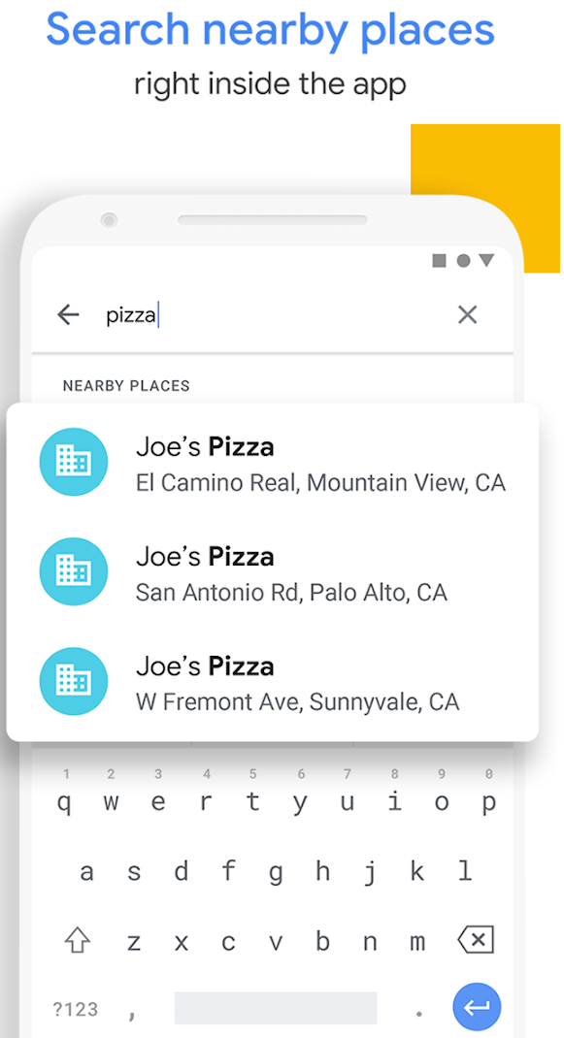
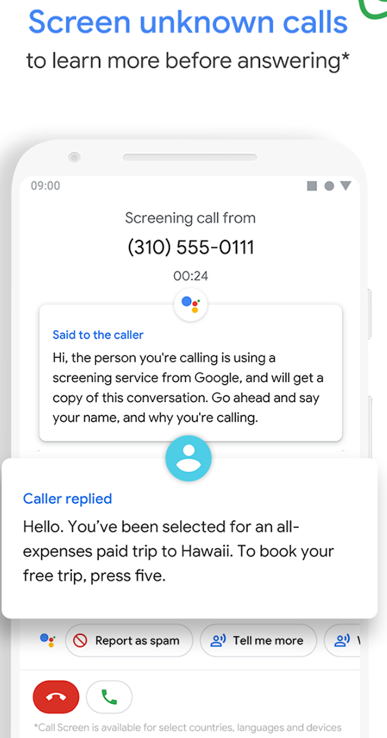
Phone App by Google id=com.google.android.dialer

Slide 3
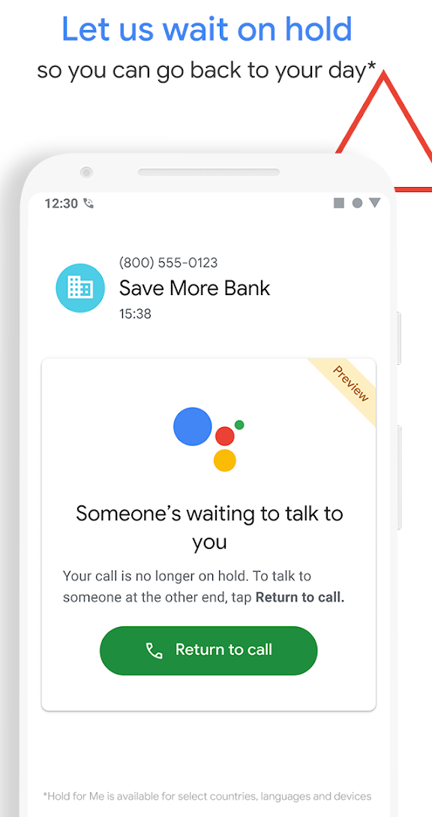
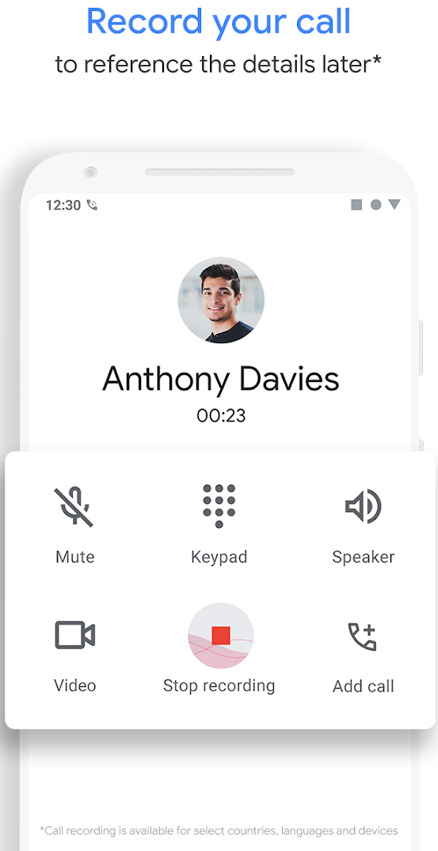
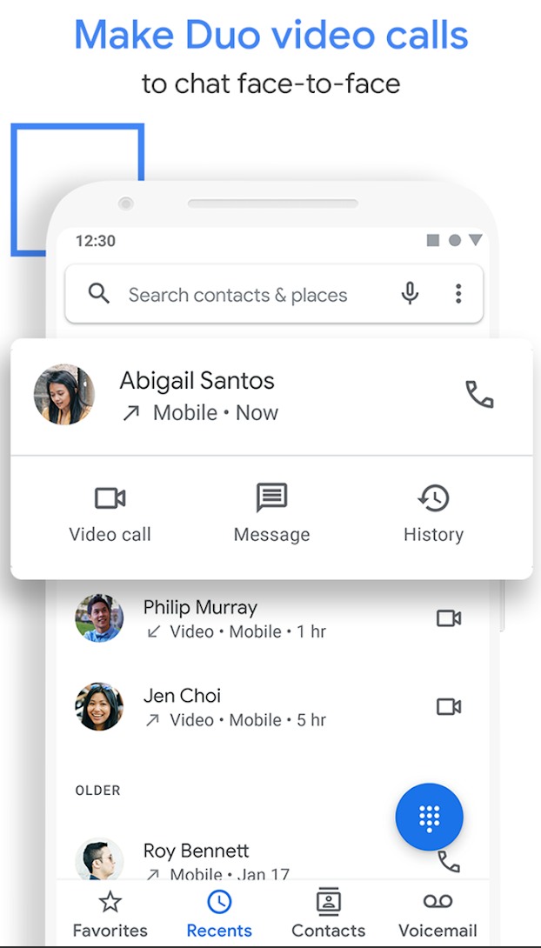
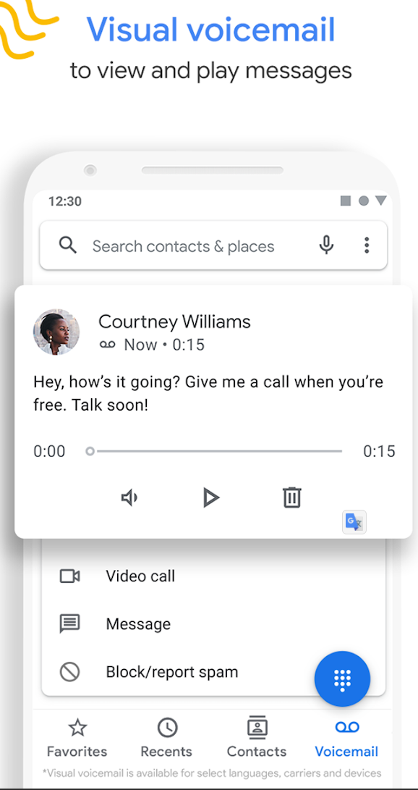

Slide 4
Questions
List all incoming calls
Did any callers leave voice mails?

Slide 5
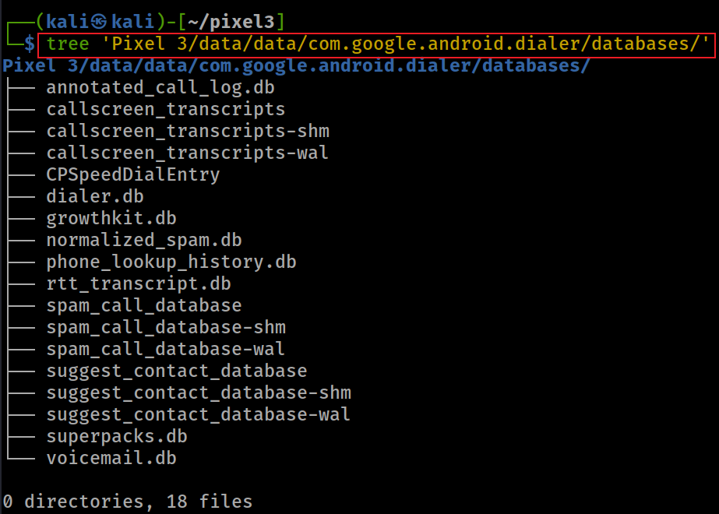
Notes:
tree 'Pixel 3/data/data/com.google.android.dialer/databases/'

Slide 6
Most Valuable Tables for Investigation (1)
dialer.db
Why? containing contact information, smart dial data, and filtered number data. It’s a primary source for understanding contact associations and some usage patterns but does not contain detailed call logs.
Use Case: Investigating frequently contacted numbers, mapping phone numbers to contacts, and identifying blocked or filtered numbers.
annotated_call_log.db
Why? includes enriched call log data, such as whether a call was flagged as spam, marked as a favorite, or associated with a specific contact. It might also include user annotations or app-generated labels.
Use Case: Identifying suspicious calls (e.g., flagged as spam) or understanding user interactions with specific numbers.

Slide 7
Most Valuable Tables for Investigation (2)
suggest_contact_database
Why? store data for suggesting contacts, likely across a broader range of interactions beyond just dialing.
Suggesting contacts to call based on recent interactions (calls, messages, emails).
Suggesting contacts for sharing content (e.g., via the share sheet).
Suggesting contacts in other contexts, like when composing a message or email.
Use Case:
Useful for understanding a broader range of the user’s interactions with contacts, not just dialing.
Could reveal contacts the user frequently interacts with across different apps or contexts (e.g., messaging, email), which might not show up in smartdial_table if they weren’t dialed.

Slide 8
Most Valuable Tables for Investigation (3)
voicemail.db
Why? Voicemails can contain critical information, such as audio recordings, transcriptions, and metadata about the caller. This could reveal important conversations or evidence.
Use Case: Extracting voicemail content for evidence of threats, plans, or other relevant communications.
phone_lookup_history.db
Why? This database tracks phone number lookups, which could reveal attempts to identify unknown callers, reverse lookups, or spam detection queries. It might also show if the user or app queried a number against a known database.
Use Case: Investigating whether the user was dealing with unknown or suspicious numbers.

Slide 9
Most Valuable Tables for Investigation (4)
rtt_transcript.db
Why? If the user used RTT (Real-Time Text) for communication, this database could contain transcripts of text-based conversations during calls, which might be relevant for accessibility users or specific investigations.
Use Case: Extracting text communications that occurred during calls.
callscreen_transcripts
Why? contains transcriptions of call screening interactions (e.g., Google’s Call Screen feature, which answers calls and transcribes responses). It could reveal interactions with unknown callers.
Use Case: Investigating interactions with unknown or suspicious callers through call screening.

Slide 10
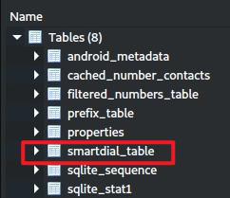
Smart dial information in dialer.db
"smart dial" functionality
Allows users to quickly find contacts by typing a portion of a name or number, with the app suggesting matches as they type.
Provides detailed information about frequently dialed or interacted-with contacts
including usage patterns (last_time_used, times_used).
contact_id and lookup_key can link to the Android Contacts database,
starred or is_primary can indicate important contacts.

Slide 11
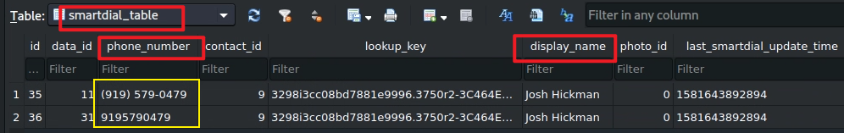
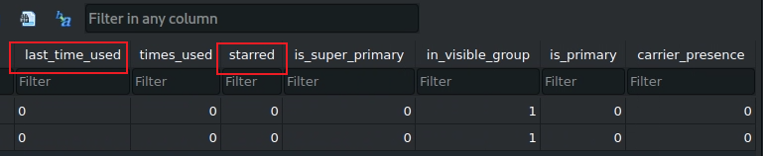
Two phone numbers are found

Slide 12
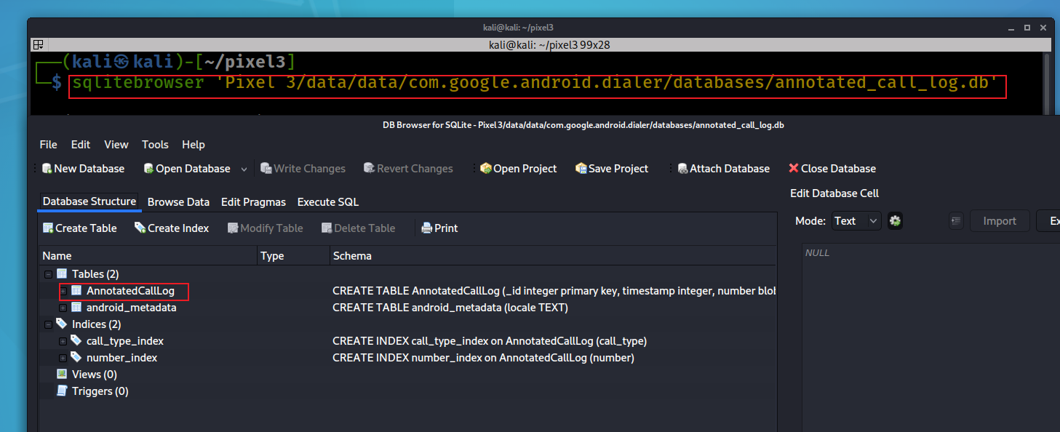
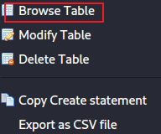
Call log in annotated_call_log.db
Notes:
sqlitebrowser 'Pixel 3/data/data/com.google.android.dialer/databases/annotated_call_log.db'

Slide 13
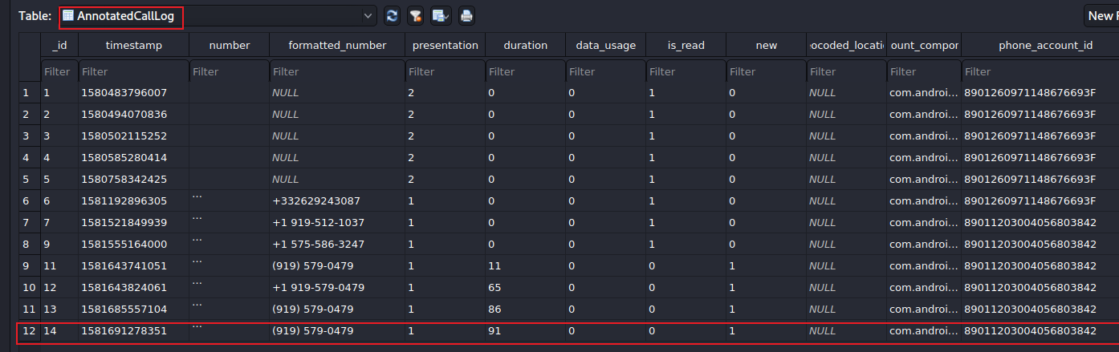

phone_account_component_name
com.android.phone/com.android.services.telephony.TelephonyConnectionService
calling/
received number
91 seconds
0: took the call
1: missed
The identifier for the account used to place or receive the call.
The phone has two accounts
calling/received time
Number is allowed to display for caller id.
1: number # showed
2: private #
The component name of the account used to place or receive the call
Notes:
date -d '@1581691278’ –u
https://developer.android.com/reference/android/provider/CallLog.Calls

Slide 14
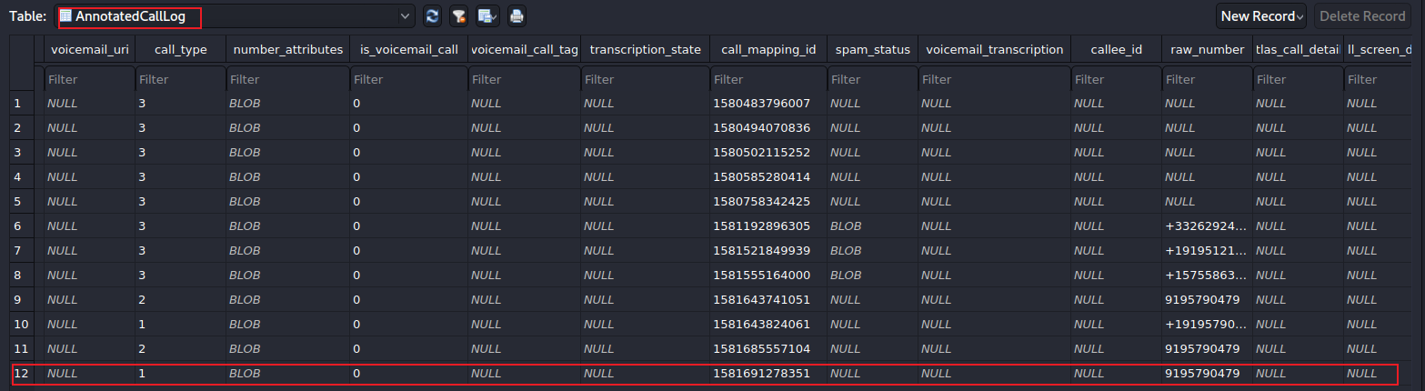
url to voicemail
1: incoming
2: outgoing
3: missed
left voice mail?
Voicemail transcription state, ie. in-progress, failed
Notes:
https://developer.android.com/reference/android/provider/CallLog.Calls.html#TYPE
https://android.googlesource.com/platform/packages/apps/Dialer/+/5d01ebb84a25c097a58ea8a3e1b4a521456e6f17/java/com/android/dialer/calllogutils/PhoneCallDetails.java

Slide 15

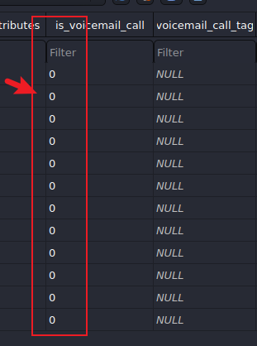
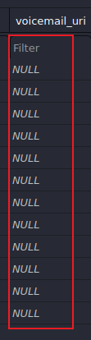
Answer
List all incoming calls
2
Did any callers leave voice mails?
none

Slide 16
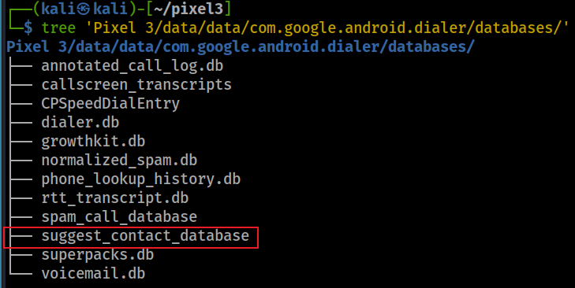
Understand user’s interactions with contacts, not just dialing (suggest_contact_database)
When you try and share photos or anything from Google pixel, you will see suggested contacts pops up with several frequently contacted people in the phone

Slide 17
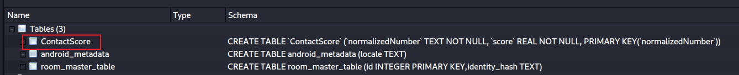
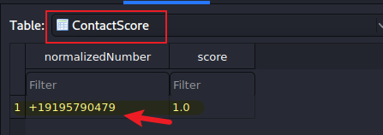
Open suggest_contact_database
Find thefrequently contacted phone numbers

Slide 18
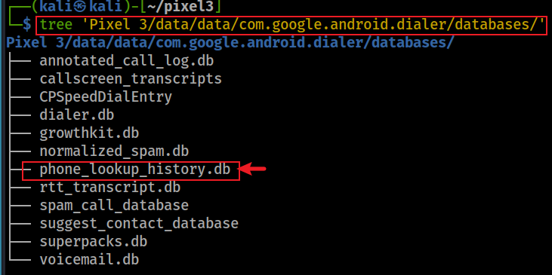
List phone lookup (caller ID) history
When the Google Dialer app performs a caller ID lookup
it may query Google’s servers or another external database to identify the caller.
done either manually by the user or automatically for caller ID
Storing these results locally in phone_lookup_history.db
allows the app to quickly retrieve the same information if the same number calls again, reducing the need for repeated server queries and improving performance.

Slide 19
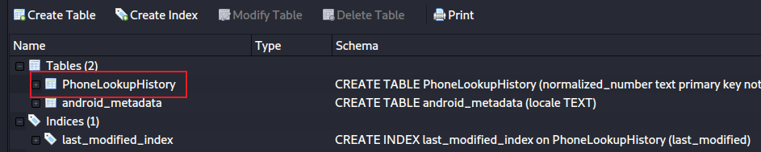
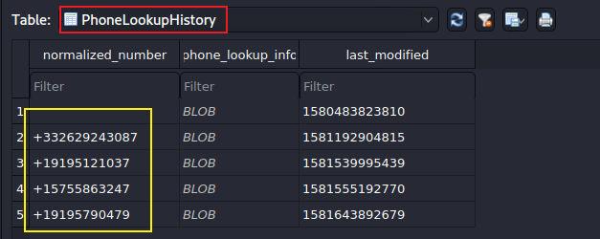
Open phone_lookup_history.db
Two contacts are saved

Slide 20
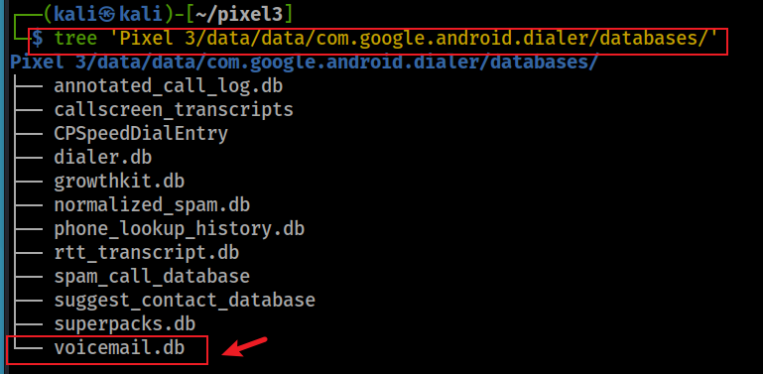
What is the greeting message?
The owner often provides greeting message. Did the owner use a greeting message?

Slide 21
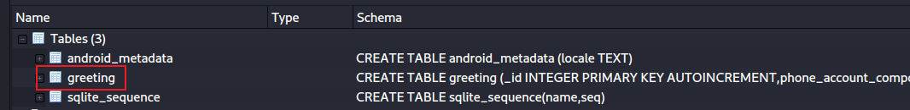
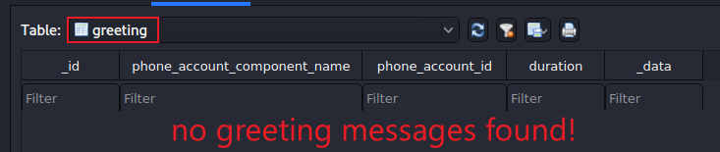
Open voicemail.db
Find thefrequently contacted phone numbers

Slide 22
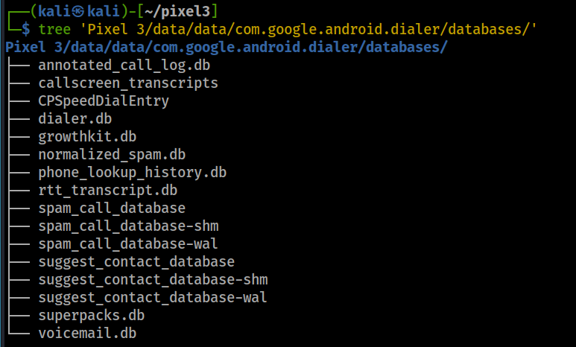
Other valuable information in databases
speed dial entry
spam call database

