Slide 1
AOSP Apps Investigations
Part 3: Investigating calendar services
Notes:
https://digitalcorpora.s3.amazonaws.com/corpora/mobile/android_10/Non-Cellebrite%20Extraction/Pixel%203.zip

Slide 2
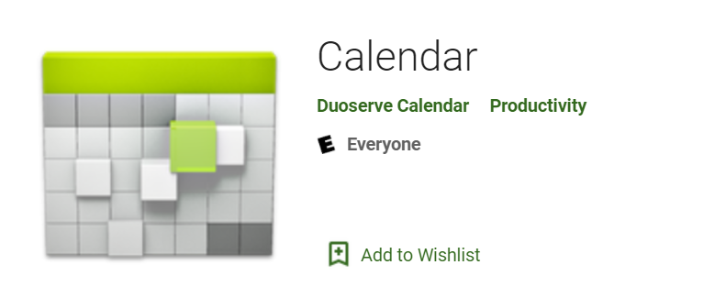
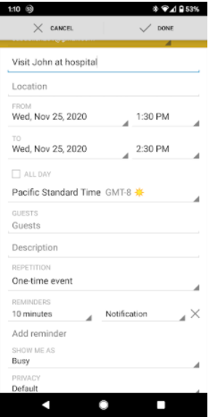
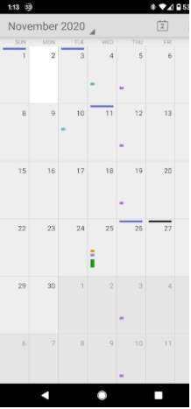
What are calendar services?
Service for calendar apps
Calendar is a tool to keep track of:
Appointments
Events
Birthdays
Evidence types:
Events
Reminders

Slide 3
Why it's important to investigate calendar evidence?
Calendar saves the information about the appointments, events etc.
It can give the information about:
Date/time of appointments
Place of appointment
Events created
Attendees

Slide 4
Note
Calendar app can be very useful in an investigation but in this case there isn't any data to look at in any of the tables
In future, you may use this approach to look through the suspect's calendar data

Slide 5
Calendar scenario
Assume that suspect added an event along with the attendees for any date and added a reminder about that event
Questions
What is the date of the scheduled event?
Who are the attendees?
For which date is the reminder set?
Are there any other events saved by the suspect?

Slide 6
Strategies to find the message evidence
Understand how events/reminders are stored in disks
often organized and stored in centralized locations such as database, xml, text file.
Steps
Remember the list of questions to be answered
for each question, repeat
find potential locations of evidence, e.g., folder
find database/files
examine database/file

Slide 7
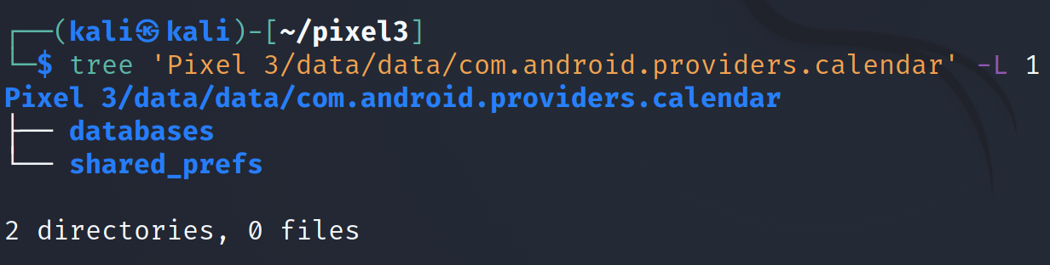
Step 1: find the location of the evidence
Notes:
Cmd: tree 'Pixel 3/data/data/com.android.providers.calendar' -L 1

Slide 8
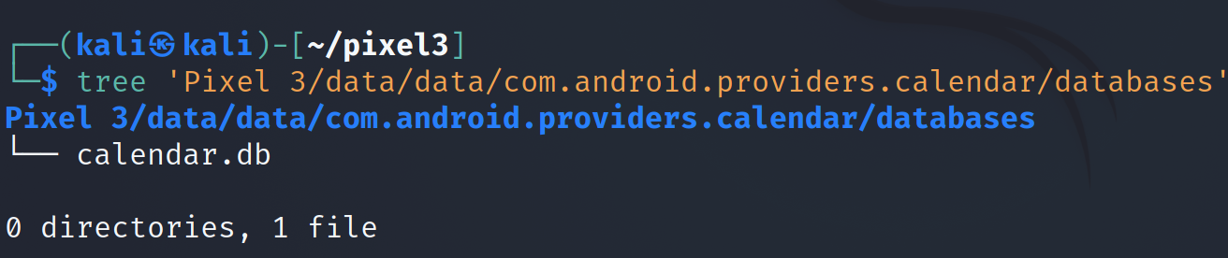
Step 2: Find the database
Notes:
Cmd: tree 'Pixel 3/data/data/com.android.providers.calendar/databases'

Slide 9
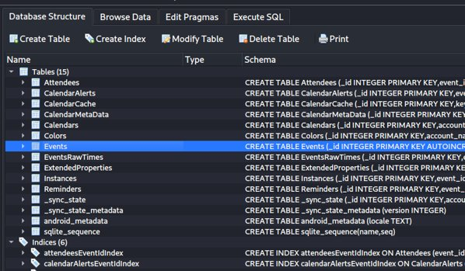
Step 3: examine the database
Tables in database
Tables to focus on: attendees, events, reminders
In this case there isn't any data to look at in any of the tables
Notes:
Cmd: sqlitebrowser 'Pixel 3/data/data/com.android.providers.calendar/databases/calendar.db'

Slide 10
Relevance of the Events Table in Digital Forensics
Establish Timelines: Events with timestamps (dtstart, dtend) can help reconstruct a suspect’s or victim’s activities at specific times.
Identify Locations: The eventLocation field can reveal where a person was or intended to be, which is crucial for alibi verification or tracking movements.
Uncover Relationships: Fields like organizer, guestsCanSeeGuests, and links to the Attendees table can reveal who the user was interacting with.
Reveal Intentions or Plans: Event titles, descriptions, and recurrence rules (rrule) can indicate planned activities, such as meetings, travel, or recurring behaviors.
Corroborate or Contradict Statements: Calendar events can be cross-referenced with other evidence (e.g., GPS data, call logs, or messages) to confirm or challenge a person’s claims.

Slide 11
Hypothetical Scenario
Imagine a digital forensics investigation involving a suspect, Alice Johnson, who is under investigation for a financial fraud scheme. Investigators have obtained her Android phone and extracted the calendar.db database. They are particularly interested in a meeting that might be related to the fraud, which occurred around March 10, 2025. They find an event in the Events table and analyze its associations with people to uncover potential accomplices or witnesses.

Slide 12
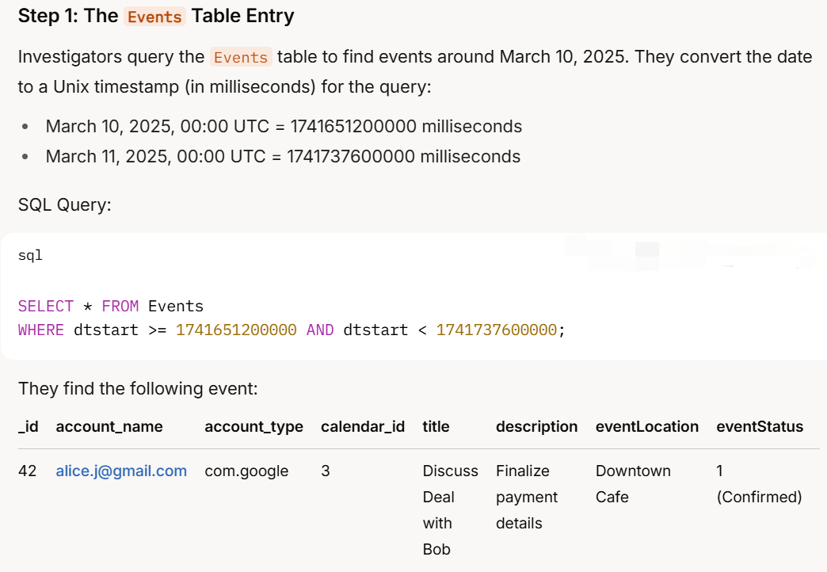

Slide 13
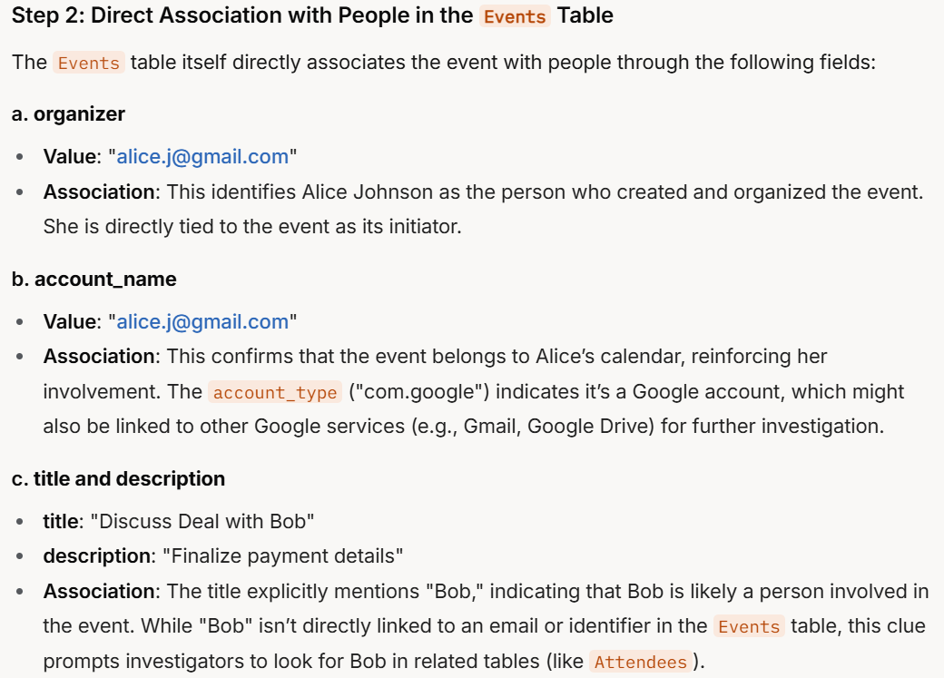

Slide 14
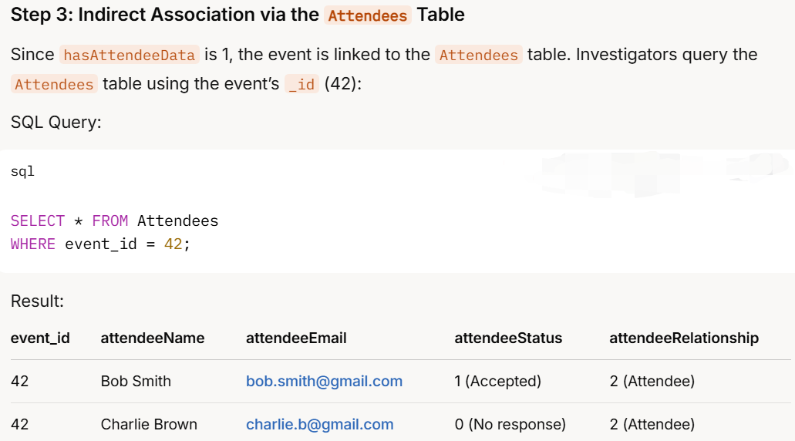

Slide 15
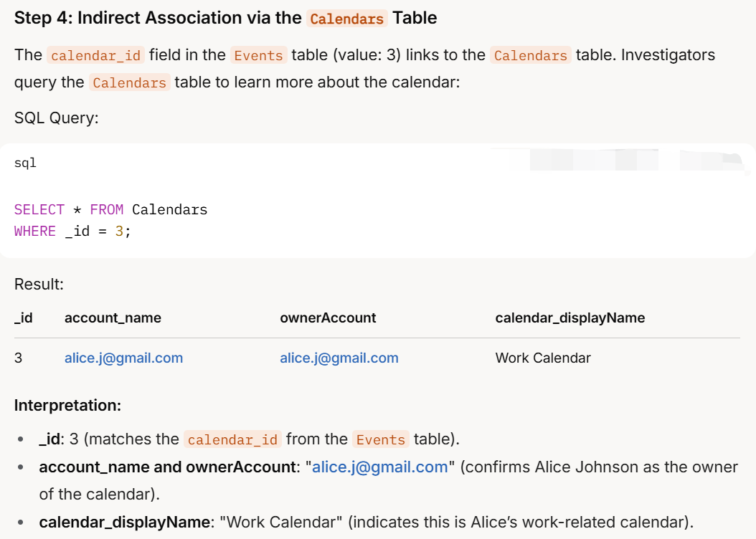

Slide 16
Solutions
What is the date of the scheduled event?
Events table
Who are the attendees ?
Attendees table
For which date is the reminder set?
Reminders table
Are there any other events saved by the suspect?
Events table

Slide 17
To summarize
Understand the application
Locate the calendar package
Look at the application directories
Go to the "databases" directory
Open calendar.db
Explore these tables: events, reminders

