Slide 1


FRONT END WORKSHOP
ACHS IT CLUB
INTRODUCTION
X
h1 img br header nav a footer div p h2 section
class id input button type /**/ text password email number
src link rel stylesheet script h3 radio checkbox option
select ul li disc circle square body head html
<> <!-- > </> title h4 href h5 aside table
css * margin padding rem em % vh vw px keyframe media background cover contain
height width before after // hover font-size transition
all unset max-width min-width {} . # []
FRONTEND WORKSHOP
AADARSHA AACHARYA
Pemba Sherpa
Mukesh Chaudhary DIKSHYA LAMMICHHANE
PART 1
ACHS IT CLUB
8th February, 2020
SPEAKER: SUPARTH NARAYAN GHIMIRE

Slide 2
FRONT END WORKSHOP
ACHS IT CLUB
CHAPTER 1
X
UNDERSTANDING WEB

Slide 3

FRONT END WORKSHOP
ACHS IT CLUB
CHAPTER 1
X
WEB SERVERS
HTML CSS JS
www.google.com
X
RESPONSE
WEB BROWSER
<html>
…
<html>
.abc{…}
Console.log(1)
<?php
…
?>
INSERT INTO TABLE () VALUES ()
APPLICATION SERVERS
Protocolled REQUEST
Compile Server Side Language
To HTML
FILES DIRECTLY FROM WEB SERVER
CLIENT
FILES COMPILED FROM APPLICATION SERVER
GOOGLE SERVERS
(WEB + APPLICATION SERVERS)

Slide 4
FRONT END WORKSHOP
ACHS IT CLUB
CHAPTER 1
X
EXAMPLE
<html>
.....
.....
<?php
.....
?>
....
</html>
COMPILED BY BROWSER
COMPILED BY BROWSER
COMPILED BY BROWSER
COMPILED BY SERVER AND SENT TO BROWSER
COMPILED BY SERVER AND SENT TO BROWSER
COMPILED BY SERVER AND SENT TO BROWSER
COMPILED BY BROWSER
COMPILED BY BROWSER

Slide 5
FRONT END WORKSHOP
ACHS IT CLUB
CHAPTER 1
X
TYPES OF WEBPAGES
STATIC
DYNAMIC

Slide 6
FRONT END WORKSHOP
ACHS IT CLUB
CHAPTER 1
X
STATIC
HTML CSS JS

Slide 7
FRONT END WORKSHOP
ACHS IT CLUB
CHAPTER 1
X
HTML
MARKUP LANGUAGE
SKELETON OF A WEB PAGE

Slide 8
FRONT END WORKSHOP
ACHS IT CLUB
CHAPTER 1
X
CSS
CASCADING STYLESLEET
SKIN AND MUSCLE OF WEBPAGE

Slide 9
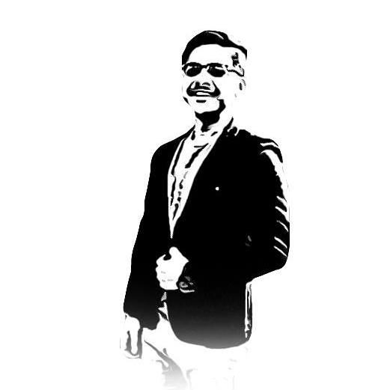
FRONT END WORKSHOP
ACHS IT CLUB
HTML ONLY
X
SUPARTH
HOME
ABOUT
WELCOMR TO MY WEBSITE
MY NAME IS SUPARTH NARAYAN GHIMRIE
I AM A WEB DEVELOPER!
THIS IS A BOOOOORING LOOKING WEBPAGE THAT USES ONLY HTML

Slide 10
FRONT END WORKSHOP
ACHS IT CLUB
HTML AND CSS
X
SUPARTH
HOME
ABOUT
WELCOME TO MY WEBSITE
MY NAME IS SUPARTH NARAYAN GHIMRIE
I AM A WEB DEVELOPER!
THIS LOOKS COOL THO!

Slide 11
FRONT END WORKSHOP
ACHS IT CLUB
LETS CODE
X
LETS CODE! TURN ON YOUR LAPTOPS AND OPEN VS CODE!!!!!!!!!

