Slide 1
Python Programming
DICTIONARY

Slide 2
What is a dictionary in Python?
Python dictionary is an unordered collection of items.
While other compound data types have only value as an element, a dictionary has a key: value pair.

Slide 3
How to create a dictionary?
Creating a dictionary is as simple as placing items inside curly braces {} separated by comma.
An item has a key and the corresponding value expressed as a pair, key: value.
Code:
# empty dictionary
>>> my_dict = {}
# dictionary with integer keys
>>> my_dict = {1: 'apple', 2: 'ball'}
# dictionary with mixed keys
>>> my_dict = {'name': 'John', 1: [2, 4, 3]}
# using dict()
>>> my_dict = dict({1:'apple', 2:'ball'})
# from sequence having each item as a pair
>>> my_dict = dict([(1,'apple'), (2,'ball')])

Slide 4
How to access elements from a dictionary?
While indexing is used with other container types to access values, dictionary uses keys.
Key can be used either inside square brackets or with the get() method.
Code:
>>>my_dict = {'name':'Jack', 'age': 26}
# Output: Jack
>>>print(my_dict['name'])
# Output: 26
>>>print(my_dict.get('age'))
# Trying to access keys which doesn't exist throws error
# my_dict.get('address')
# my_dict['address']

Slide 5
How to change or add elements in a dictionary?
Dictionary are mutable. We can add new items or change the value of existing items using assignment operator.
If the key is already present, value gets updated, else a new key: value pair is added to the dictionary.
Code:
>>> my_dict = {'name':'Jack', 'age': 26}
# update value
>>> my_dict['age'] = 27
#Output: {'age': 27, 'name': 'Jack’}
>>> print(my_dict)
# add item
>>> my_dict['address'] = 'Downtown'
# Output: {'address': 'Downtown', 'age': 27, 'name': 'Jack’}
>>> print(my_dict)

Slide 6
How to delete or remove elements from a dictionary?
Python pop() method removes as item with the provided key and returns the value.
Python popitem() method can be used to remove and return an arbitrary item (key, value) form the dictionary.
Code:
# create a dictionary
>>> squares = {1:1, 2:4, 3:9, 4:16, 5:25}
# remove a particular item
# Output: 16
>>> print(squares.pop(4))
# Output: {1: 1, 2: 4, 3: 9, 5: 25}
>>> print(squares)
Code:
# remove an arbitrary item
# Output: (1, 1)
>>> print(squares.popitem())
# Output: {2: 4, 3: 9, 5: 25}
>>> print(squares)

Slide 7
Cont.…..
All the items can be removed at once using the clear() method.
We can also use the del keyword to remove individual items or the entire dictionary itself.
Code:
# delete a particular item
>>> del squares[5]
# Output: {2: 4, 3: 9}
>>> print(squares)
# remove all items
>>> squares.clear()
# Output: {}
>>> print(squares)
# delete the dictionary itself
>>> del squares
# Throws Error
# print(squares)

Slide 8
Python Dictionary Methods
Method | Description
copy() | Return a shallow copy of the dictionary.
fromkeys(seq[, v]) | Return a new dictionary with keys from seq and value equal to v(defaults to None).
keys() | Return a new view of the dictionary's keys.
setdefault(key[,d]) | If key is in the dictionary, return its value. If not, insert key with a value of d and return d (defaults to None).
update([other]) | Update the dictionary with the key/value pairs from other, overwriting existing keys.
values() | Return a new view of the dictionary's values

Slide 9

Python copy()
How copy works for dictionaries?
Code:
>>>original = {1:'one', 2:'two’}
>>>new = original.copy()
>>>print('Orignal: ', original)
>>>print('New: ', new)

Slide 10
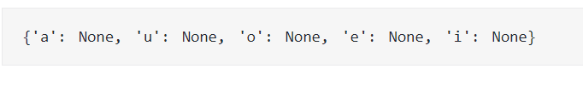
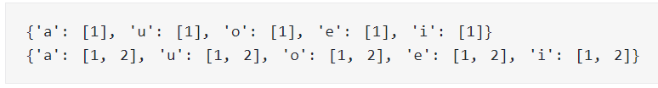
Python Dictionary fromkeys()
Create a dictionary from a sequence of keys
# vowels keys
>>> keys = {'a', 'e', 'i', 'o', 'u' }
>>> vowels = dict.fromkeys(keys)
>>> print(vowels)
Create a dictionary from a sequence of keys with value
# vowels keys
>>> keys = {'a', 'e', 'i', 'o', 'u’ }
>>> value = 'vowel’
>>> vowels = dict.fromkeys(keys, value)
>>> print(vowels)
Create a dictionary from mutable object list
# vowels keys
>>> keys = {'a', 'e', 'i', 'o', 'u’ }
>>> value = [1]
>>> vowels = dict.fromkeys(keys, value)
>>> print(vowels)
# updating the value
>>> value.append(2)
>>> print(vowels)

Slide 11

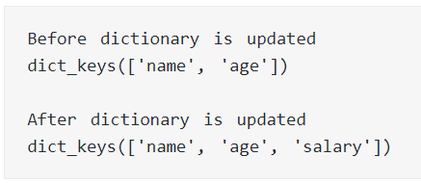
Python Dictionary keys()
How keys() works?
>>> person = {'name': 'Phill', 'age': 22, 'salary': 3500.0}
>>> print(person.keys())
>>> empty_dict = {}
>>> print(empty_dict.keys())
How keys() works when dictionary is updated?
>>> person = {'name': 'Phill', 'age': 22, }
>>> print('Before dictionary is updated’)
>>> keys = person.keys()
>>> print(keys)
# adding an element to the dictionary
>>> person.update({'salary': 3500.0})
>>> print('\nAfter dictionary is updated’)
>>> print(keys)

Slide 12
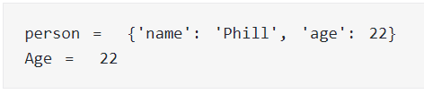
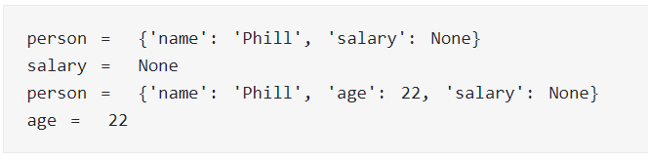
Python Dictionary setdefault()
How setdefault() works when key is in the dictionary?
>>> person = {'name': 'Phill', 'age': 22}
>>> age = person.setdefault('age’)
>>> print('person = ',person)
>>> print('Age = ',age)
How setdefault() works when key is not in the dictionary?
>>> person = {'name': 'Phill'}
# key is not in the dictionary
>>> salary = person.setdefault('salary’)
>>> print('person = ',person)
>>> print('salary = ',salary)
# key is not in the dictionary
# default_value is provided
>>> age = person.setdefault('age', 22)
>>> print('person = ',person)
>>> print('age = ',age)

Slide 13
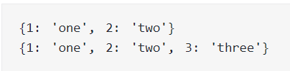

Python Dictionary update()
How update() works in Python?
>>> d = {1: "one", 2: "three"}
>>> d1 = {2: "two"}
# updates the value of key 2
>>> d.update(d1)
>>> print(d)
>>> d1 = {3: "three"}
# adds element with key 3
>>> d.update(d1)
>>> print(d)
How update() Works With an Iterable?
>>> d = {'x': 2}
>>> d.update(y = 3, z = 0)
>>> print(d)

Slide 14

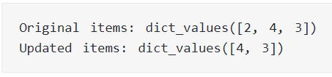
Python Dictionary values()
Get all values from the dictionary
# random sales dictionary
>>> sales = { 'apple': 2, 'orange': 3, 'grapes': 4 }
>>> print(sales.values())
How values() works when dictionary is modified?
# random sales dictionary
>>> sales = { 'apple': 2, 'orange': 3, 'grapes': 4 }
>>> values = sales.values()
>>> print('Original items:', values)
# delete an item from dictionary
>>> del[sales['apple’]]
>>> print('Updated items:', values)

Slide 15
Python Dictionary Comprehension
Dictionary comprehension is an elegant and concise way to create new dictionary from an iterable in Python.
Dictionary comprehension consists of an expression pair (key: value) followed by for statement inside curly braces {}.
Code:
>>> squares = {x: x*x for x in range(6)}
# Output: {0: 0, 1: 1, 2: 4, 3: 9, 4: 16, 5: 25}
>>>print(squares)
Code:
squares = {}
for x in range(6):
squares[x] = x*x
>>> odd_squares = {x: x*x for x in range(11) if x%2 == 1}
# Output: {1: 1, 3: 9, 5: 25, 7: 49, 9: 81}
>>>print(odd_squares)

Slide 16
Built-in Functions with Dictionary
Function | Description
all() | Return True if all keys of the dictionary are true (or if the dictionary is empty).
any() | Return True if any key of the dictionary is true. If the dictionary is empty, return False.
len() | Return the length (the number of items) in the dictionary.
cmp() | Compares items of two dictionaries.
sorted() | Return a new sorted list of keys in the dictionary.

Slide 17
What is Nested Dictionary in Python?
In Python, a nested dictionary is a dictionary inside a dictionary. It's a collection of dictionaries into one single dictionary.
nested_dict = { 'dictA': {'key_1': 'value_1'},
'dictB': {'key_2': 'value_2'}}

Slide 18
Create a Nested Dictionary
How to create a nested dictionary
Code:
>>> people = {1: {'name': 'John', 'age': '27', 'sex': 'Male'},
2: {'name': 'Marie', 'age': '22', 'sex': 'Female'}}
>>> print(people)
Access the elements using the [] syntax
Code:
>>> people = {1: {'name': 'John', 'age': '27', 'sex': 'Male'},
2: {'name': 'Marie', 'age': '22', 'sex': 'Female'}}
>>> print(people[1]['name’])
>>> print(people[1]['age’])
>>> print(people[1]['sex'])

Slide 19
How to change or add elements in a nested dictionary?
Code:
>>> people = {1: {'name': 'John', 'age': '27', 'sex': 'Male'},
2: {'name': 'Marie', 'age': '22', 'sex': 'Female'}}
>>> people[3] = {}
>>> people[3]['name'] = 'Luna’
>>> people[3]['age'] = '24’
>>> people[3]['sex'] = 'Female’
>>> people[3]['married'] = 'No’
>>> print(people[3])
Add another dictionary to the nested dictionary
Code:
>>> people = {1: {'name': 'John', 'age': '27', 'sex': 'Male'},
2: {'name': 'Marie', 'age': '22', 'sex': 'Female'},
3: {'name': 'Luna', 'age': '24', 'sex': 'Female', 'married': 'No'}}
>>> people[4] = {'name': 'Peter', 'age': '29', 'sex': 'Male', 'married': 'Yes’}
>>> print(people[4])

Slide 20
How to delete elements from a nested dictionary?
Code:
>>> people = {1: {'name': 'John', 'age': '27', 'sex': 'Male'},
2: {'name': 'Marie', 'age': '22', 'sex': 'Female'},
3: {'name': 'Luna', 'age': '24', 'sex': 'Female', 'married': 'No'},
4: {'name': 'Peter', 'age': '29', 'sex': 'Male', 'married': 'Yes'}}
>>> del people[3]['married’]
>>> del people[4]['married’]
>>> print(people[3])
>>> print(people[4])
How to delete dictionary from a nested dictionary?
Code:
>>> people = {1: {'name': 'John', 'age': '27', 'sex': 'Male'},
2: {'name': 'Marie', 'age': '22', 'sex': 'Female'},
3: {'name': 'Luna', 'age': '24', 'sex': 'Female'},
4: {'name': 'Peter', 'age': '29', 'sex': 'Male'}}
>>> del people[3], people[4]
>>> print(people)

Slide 21
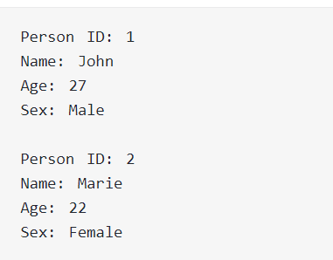
How to iterate through a Nested dictionary?
Code:
>>> people = {1: {'Name': 'John', 'Age': '27', 'Sex': 'Male'},
2: {'Name': 'Marie', 'Age': '22', 'Sex': 'Female'}}
>>> for p_id, p_info in people.items():
print("\nPerson ID:", p_id)
for key in p_info:
print(key + ':', p_info[key])

Slide 22
Check out these examples
Write a Python script to concatenate following dictionaries to create a new one.
Sample Dictionary : dic1={1:10, 2:20} dic2={3:30, 4:40} dic3={5:50,6:60} Expected Result : {1: 10, 2: 20, 3: 30, 4: 40, 5: 50, 6: 60}
Write a Python script to check if a given key already exists in a dictionary.
Write a Python program to find the highest 3 values in a dictionary.

Slide 23
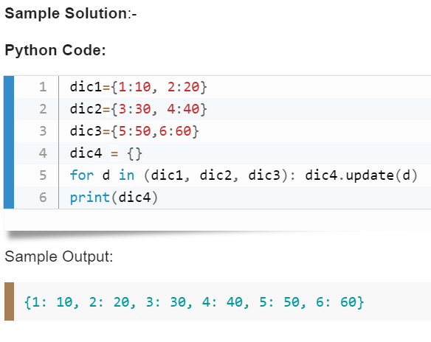

Slide 24
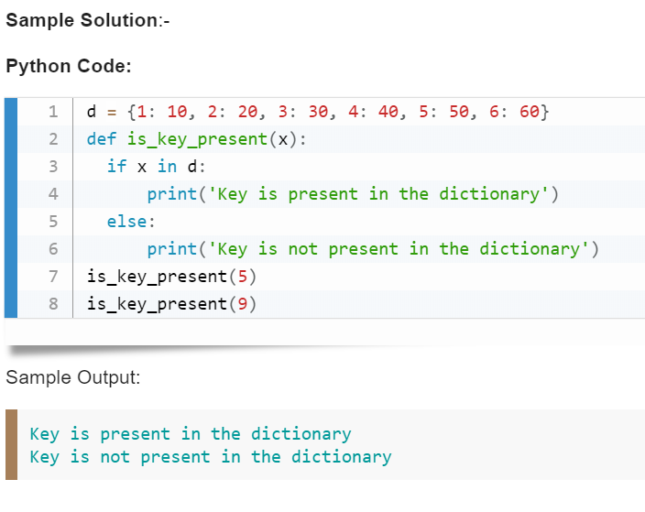

Slide 25
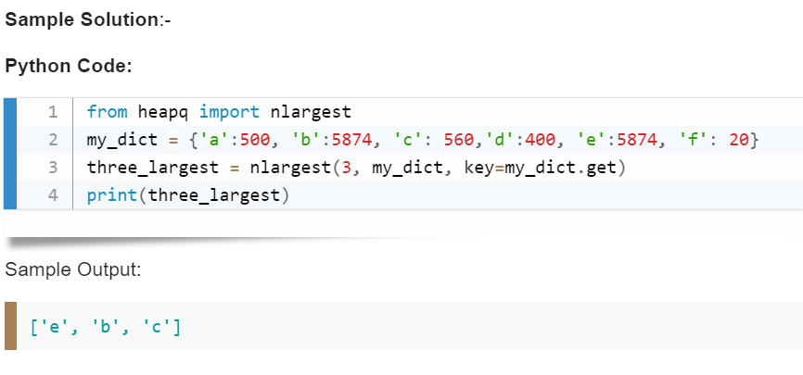

Slide 26
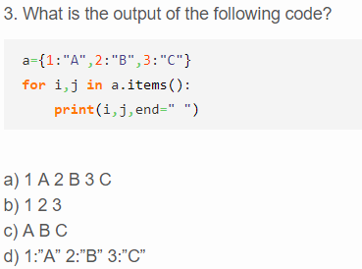
Quiz

Slide 27
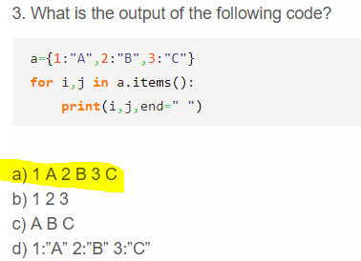

Slide 28
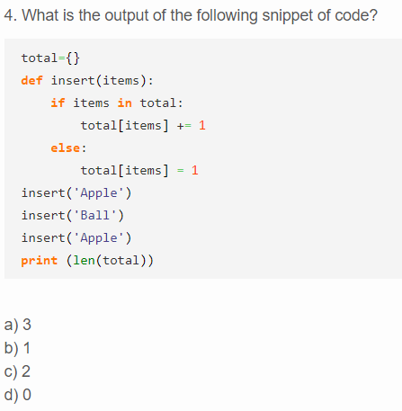
Quiz

Slide 29
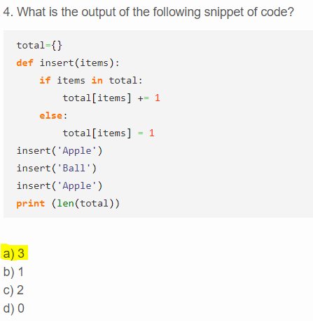

Slide 30
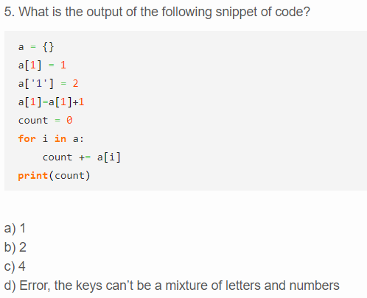
Quiz

Slide 31
