Slide 1

Programming in Python

Slide 2
Evolution of Python
13
Guido Van Rossum developed Python in early 1990s at National Research Institute for Mathematics and Computer Science, Netherlands.
Named after a circus show Monty Python show.
Derives its features from many languages like Java, C++, ABC, C, Modula-3, Smalltalk, Algol-68, Unix shell and other scripting languages.
Available under the GNU General Public License (GPL) – Free and open-source software.

Slide 3



Slide 4
WWW
What is Python?
Where we using Python?
Why Python?

Slide 5
What is Python?
Python is an object-oriented, high level language, interpreted, dynamic and multipurpose programming language.

Slide 6
Worldwide Python Users
12
Web Development
Yahoo Groups, Google, Shopzilla
Games
Battelefield2, The Temple of Elemental Evil, Vampire
Graphics
Walt Disney feature Animation, Blender 3D
Science
National Weather Service
NASA
Robotics
Environmental Systems Research Institute

Slide 7
Introduction Why Python for beginners?
10
Easy – to - learn
Code is 3-5 times shorter than Java
5-10 times shorter than C++
Stepping Stone to Programming universe
Python’s methodologies can be used in a broad range of applications
Bridging the Gap between abstract computing and real world applications
Python is used as main programming language to do projects using Raspberry Pi
Rising Demand for Python Programmers
Google, Nokia, Disney, Yahoo, IBM use Python
Open- Source, Object – Oriented, procedural and functional
Not only a Scripting language, also supports Web Development and Database Connectivity

Slide 8
Python v/s C
11
A simple Program to print “Hello World”
C Code | Python Code
#include<stdio.h> #include<conio.h> void main() { printf (“Hello World!”) } | print (“Hello World!”)

Slide 9
Python Versions
14
Python v0.9.0 - February, 1991
Features: Exception Handling, Functions and core data types like List, Dictionary, String and others. It was object oriented and had module system
Python v1.0 - January 1994
Features: Functional Programming tools lambda, map, filter and reduce
Python v2.0 - October 2000
Features: List comprehensions, Garbage Collector and support for Unicode.
• Python v3.0 - 2008
Known as “Python 3000” and “Py3k”. It is not backward compatible with v2.0 and its other variants. Emphasizes more on removal of duplicate programming constructs and modules

Slide 10
Python Features
15
Python is a High - Level, Interpreted, Interactive and Object - Oriented Programming Language
Features include:
Beginners Language
Extensive Standard Library
Cross Platform Compatibility
Interactive Mode
Portable and Extendable
Databases and GUI Programming
Scalable and Dynamic Semantics
Automatic Garbage Collection

Slide 11
Configuration
16
Download and Install Python 3.6: https://www.python.org/downloads/
Download PyDev_3.8.0 or higher version: http://www.pydev.org/download.html
Download Eclipse neon or higher version: https://www.eclipse.org/downloads/index.php
Install Python on your machine
Note: You need eclipse locally installed in your machine Procedure:
Copy paste the contents of the plugin folder of PyDev into plugin folder of Eclipse
In Eclipse open PyDev perspective (Window -> Open Perspective -> Other -> Pydev)
Create a PyDev Project
Select Grammar as 3.x
Configure interpreter by choosing the .exe file of Python installed in your machine

Slide 12
Commenting Style in Python!
18
Types of Comments:
A single line comment starts with hash symbol ‘#’ and end as the line ends.
These lines are never executed and are ignored by the interpreter.
Single # This is a single line comment
Multi-line comments starts and ends with triple single quotes ‘’’ or triple “””
double quotes
Used for documentation
Triple ‘’’ or “””
“””
Contents here can be used for documentation
“””
‘’’
An example for multi-line comments with single quotes ‘’’

Slide 13
Multiline statements
19
Python statements always end up with a new line, but it also allows multiline statement using “\” character at the end of line as shown below:
result = (8+5)*\
2+\
9/5
Statements which have (), [], {} brackets and comma, do not need any multiline character to go to next line.
customer_details = [101, ‘kevin’,
‘165’, 498.24]

Slide 14
Print Statement
20
Displays the output on the screen of user
Python has its own String Format Operator as %
print('The value of PI is %5.3f' % 3.1417)
print('The value of PI is approximately %5.2f.' % 3.1417) print( "Latest Python Version is: %d" % 3.5)
print ("%20s : %d" % ('Python', 3000.34 ))
Output:
The value of PI is 3.142
The value of PI is approximately 3.14. Latest Python Version is: 3
Python : 3000
User Input in Python
name = input("Enter your name")
print("Welcome to session on Programming in Python,", name)

Slide 15
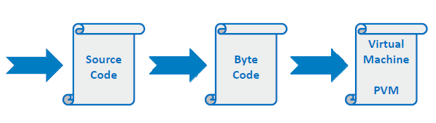
Execute a Python Script
21
Execution of python program means execution of the byte code on Python Virtual Machine
print(“Hello World!”)
print("My first sample python script")
#prints Hello World!
#prints My first sample python script

Slide 16
Python Data Variables

Slide 17
Programming Constructs in Python
23
Given a real world problem, to solve the problem using a program, we need:
Logic
High level programming language
Programming Fundamentals
Identifiers
Variables
Data types
Operators etc

Slide 18
Identifiers
24
Are names given to anything that you want to identify in a program
Helps to refer to that item from any place in the program
Can start with an underscore (_) or a upper or lower case alphabet
Can have digits
Identifiers cannot match any of Python's reserved words
Are case-sensitive
Identify the identifiers needed to solve the
problem discussed as part of previous guided activity?
bill_id customer_id bill_amount

Slide 19
Variables
25
An identifier for the data and it holds data in your program
Is a location (or set of locations) in memory where a value can be stored
A quantity that can change during program execution
No declaration of variables
Data type of a variable can change during program execution compared to other strongly typed languages such as Java, C++, C
customer_id = 101 customer_name = "John" bill_amount = 675.45
x = 5.3 + 0.9j
print(customer_id, customer_name, bill_amount) print(x.real)
print(x.imag + 3)
# Integer
# String
# Floating-point
# complex number
#prints 101 John 675.45
#prints 5.3
#prints 3.9

Slide 20
Data Types in Python
26
Category | Data Type | Example
Integer Type | int | 675
 | long | 9669737712
 | complex | 2 + 5i
Floating Type | float | 642.43
Textual | char | C
 | String | Python
Logical | boolean | True, False

Slide 21
Python Operators

Slide 22
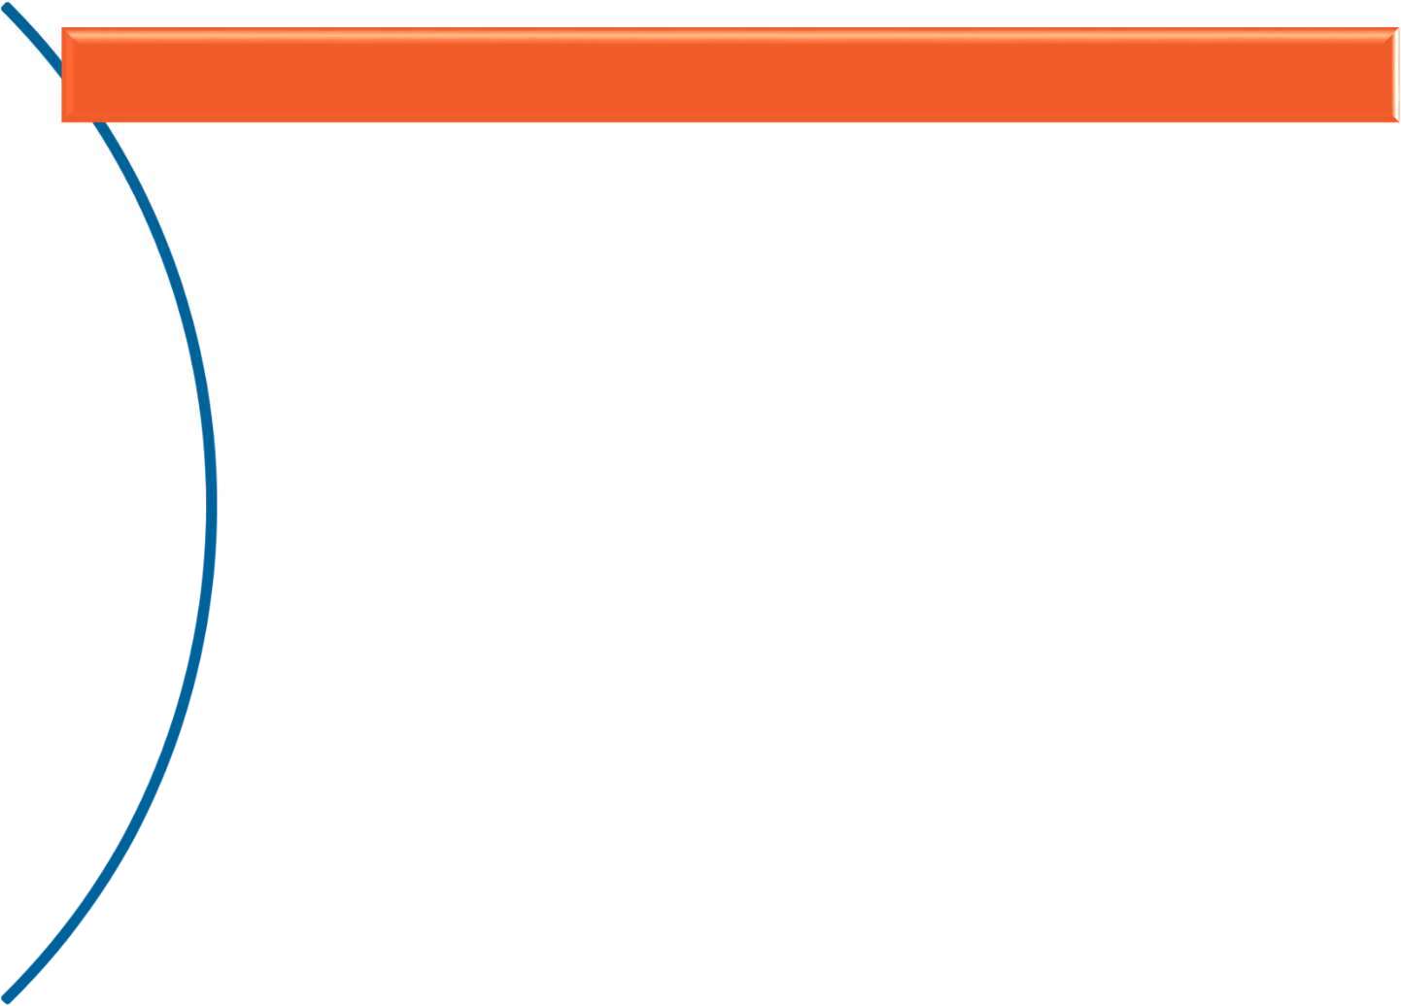







Operators (1 of 7)
28
Used to perform specific operations on one or more operands (or variables) and provide a result
Arithmetic Operators Relational Operators
Assignment Operators Bitwise Operators
Logical Operators Membership Operators
Identity Operators

Slide 23
Operators (2 of 7)
29
Arithmetic Operators
– Used for performing arithmetic operations
Operators | Description | Example
+ | Additive operator (also used for String concatenation) | 2 + 3 = 5
- | Subtraction operator | 5 – 3 = 2
* | Multiplication operator | 5 * 3 = 15
/ | Division operator | 6 / 2 = 3
% | Modulus operator | 7 % 2 = 1
// | Truncation division (also known as floor division) | 10 // 3 = 3 10.0 // 3 = 3.0
** | Exponentiation | 10 ** 3 = 1000

Slide 24
Operators (3 of 7)
30
Relational Operators
Also known as Comparison operators
Used in conditional statements to compare values and take action depending on the result
Operators | Description
== | Equal to
< | Less than
> | Greater than
<= | Lesser than or equal to
>= | Greater than or equal to
!= | Not equal to
<> | Similar to Not equal to

Slide 25
Operators (4 of 7)
31
Assignment Operators
Operators | Description | Example | Equivalent
= | Assignment from right side operand to left side | c = 50; c = a;
+= | Add & assigns result to left operand | c += a | c = c + a
-= | Subtract & assigns result to left operand | c -= a | c = c – a
*= | Multiply & assigns result to left operand | c *= a | c = c * a
/= | Divide & assigns result to left operand | c /= a | c = c / a
%= | Calculates remainder & assigns result to left operand | c %= a | c = c % a
//= | Performs floor division & assigns result to left operand | c //= a | c = c // a
**= | Performs exponential calculation & assigns result to left operand | c **= a | c = c ** a
Multiple Assignments – Same value can be assigned to more than one variable
Ex.1: Students Ram, Sham, John belong to semester 6 Ram = Sham = John = 6
Ex.2: a, b, c = 10, 20, 30 is same as a = 10, b = 20, c = 30

Slide 26
Operators (5 of 7)
32
Bitwise Operators
– performs bit by bit operation on bits
Operators | Description
& | Binary AND
| | Binary OR
^ | Binary XOR
~ | Binary Ones Complement
<< | Binary Left Shift
>> | Binary Right Shift

Slide 27
Operators (6 of 7)
33
Logical Operators
Are based on Boolean Algebra
Returns result as either True or False
Operator | Meaning
and | Short Circuit-AND
or | Short Circuit-OR
not | Unary NOT

Slide 28
Operators (7 of 7)
34
Membership Operators
– Checks for membership in a sequence of Strings, Lists, Dictionaries or Tuples
Operators | Description
in | Returns to true if it finds a variable in given sequence else false
not in | Returns to true if it does not find a variable in given sequence else false
Identity Operators
– Are used to compare memory locations of 2 objects
Operators | Description
is | Returns to true if variables on either side of operator are referring to same object else false
is not | Returns to false if variables on either side of operator are referring to same object else true

Slide 29

Built-in function: id()
35
Id(object)
Returns identity of an object. It is the address of object in memory
It will be unique and constant throughout the lifetime of an object
Example:
Output
a = 10
b = a
print("Value of a and b before increment") print("id of a: ",id(a))
print("id of b: ",id(b)) b = a + 1
print("Value of a and b after increment") print("id of a: ",id(a))
print("id of b: ",id(b))
Value of a and b before increment
id of a: 1815592664 id of b: 1815592664
Value of a and b after increment id of a: 1815592664
id of b: 1815592680
Note the change in address of variable ‘b’ after increment

Slide 30
Built-in function: type()
36
Used to identify the type of object
Example:
int_a = 10
print("Type of 'int_a':", type(int_a))
str_b = "Hello"
print("Type of 'str_b':", type(str_b))
list_c = []
print("Type of 'list_c':", type(list_c))
Output:
Type of 'int_a': <class 'int'>
Type of 'str_b': <class 'str'> Type of 'list_c': <class 'list'>
Note: Every variable in Python is a object

Slide 31
Coding Standards in Python
37
Set of guidelines
To Enhance the readability and Clarity of the program
Make it easy to debug and maintain the program
All the letters in a variable name should be in lowercase
When there are more than two words in variable name, underscore can be used between internal words
Use meaningful names for variables
Limit all lines to a maximum of 79 characters
A function and class should be separated by 2 blank lines
Methods within classes should be separated by single blank line
Always surround binary operators with a space on either side:
Ex: a = a + 1;

Slide 32
Coding Standards in Python
38
Bad Code | Good Code
a = 10 b = 23 C = 24 ^{sum = a + b + c} Usage of keyw ‘sum’ as varia ^{avg = sum/3} name will lea warning print(“Average: “, avg) | marks1 = 10 marks2 = 23 marks3 = 24 _{o}sum_of_marks = marks1 + marks2 + marks3 ble _{d t}avg_of_marks = sum_of_marks / 3 print (“Average: “, avg_of_marks)

Slide 33
Type Conversion
119
Conversion of data type of a variable from one to other
Following are few built-in types available to convert between types
Function | Description
int(a) | Converts ‘a’ to an integer
long(a) | Converts ‘a’ to a long integer
float(a) | Converts ‘a’ to a floating – point number
complex (real [,imag]) | Creates a complex number
str(a) | Converts object ‘a’ to a string representation
eval(a) | Evaluates a string and returns an object
tuple(a) | Converts ‘a’ to a tuple
list(a) | Converts ‘a’ to a list.
set(a) | Converts ‘a’ to a set.
dict(a) | Creates a dictionary. ‘a’ must be a sequence of (key, value) tuples.
Copyright © 2015 - 2016, KCE Limited

Slide 34
Thank You

