Slide 1
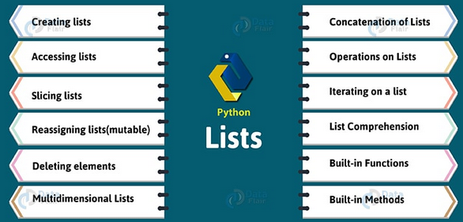
List
List is an ordered sequence of items. It is one of the most used data type in Python and is very flexible.

Slide 2
Creating List
To create python lists of items, you need to mention the items, separated by commas, in square brackets [ ].
All the items in a list need not be of the same type.
An empty list can be created using the method list()
Example :
>>> a=list()
>>> a
[] an empty list created
Example :
>>> days=['Monday','Tuesday','Wednesday',4,5,6,7.0]
>>>print(days)
['Monday', 'Tuesday', 'Wednesday', 4, 5, 6, 7.0]

Slide 3

Accessing List
To access a single element, use its index in square brackets after the list’s name. Indexing begins at 0.
Trying to access an element other that this will raise an IndexError.
Example :
>>>print(days[2])
'Wednesday'
>>>print(days[-2])
6
Slicing lists:
To slice a list use [start:stop]
>>>days[1:4]
['Tuesday', 'Wednesday', 4]

Slide 4
>>> indices=['zero','one','two','three','four','five']
>>> indices[2:4]
[‘two’, ‘three’]
>>> indices[:]
[‘zero’, ‘one’, ‘two’, ‘three’, ‘four’, ‘five’]
Negative indices
Python allows negative indexing for its sequences. The index of -1 refers to the last item, -2 to the second last item and so on.
>>> indices[:-2]
[‘zero’, ‘one’, ‘two’, ‘three’]
>> indices[-2:-1]
[‘four’]

Slide 5
List - Mutable
List are mutable, meaning, their elements can be changed unlike string or tuple.
We can use assignment operator (=) to change an item or a range of items.
>>> colors=['caramel','gold','silver','occur']
>>>colors[2:]=['bronze','silver']
[‘caramel’, ‘gold’, ‘bronze’, ‘silver’]
We can add one item to a list using append() method or add several items using extend() method.
>>>odd = [1, 3, 5]
>>>odd.append(7)
>>> print(odd)
[1, 3, 5, 7]
>>>odd.extend([9, 11, 13])
>>>print(odd)
[1, 3, 5, 7, 9, 11, 13]

Slide 6
Deleting elements
We can delete one or more items from a list using the keyword del. It can even delete the list entirely.
a. Deleting the entire list
>>> del colors
>>> colors
Traceback (most recent call last):
File "<pyshell#51>", line 1, in <module>
NameError: name ‘colors’ is not defined
b. Deleting a few elements : Use the slicing operator in python to delete a slice
>>> colors=['caramel','gold','silver','bronze','holographic']
>>> del colors[2:4]
>>> colors
[‘caramel’, ‘gold’, ‘holographic’]
c. Deleting a single element :To delete a single element from a list, use its index.
>>> del colors[0]
>>> colors
[‘gold’, ‘holographic’]

Slide 7
We can use remove() method to remove the given item or pop() method to remove an item at the given index.
The pop() method removes and returns the last item if index is not provided. This helps us implement lists as stacks (first in, last out data structure).
We can also use the clear() method to empty a list.
>>>my_list = ['p','r','o','b','l','e','m']
>>>my_list.remove('p')
['r', 'o', 'b', 'l', 'e', 'm']
>>>print(my_list.pop(1))
O
>>>print(my_list.pop())
['r', 'b', 'l', 'e']
>>>print(my_list)
my_list.clear()
[]

Slide 8
Multidimensional Lists
You can also put a list in a list. Let’s look at a multidimensional list.
>>> grocery_list=[['caramel','P&B','Jelly'],['onions','potatoes'],['flour','oil']]
>>> grocery_list
[[‘caramel’, ‘P&B’, ‘Jelly’], [‘onions’, ‘potatoes’], [‘flour’, ‘oil’]]
>>> grocery_list[1][1]
'potatoes‘
>>> a=[[[1,2],[3,4],5],[6,7]]
>>> a
[[[1, 2], [3, 4], 5], [6, 7]]
To access the element 4 here, we type the following code into the shell.
>>> a[0][1][1]
4

Slide 9
Concatenation of Python Lists
The concatenation operator works for lists as well. It lets us join two lists, with their orders preserved.
>>> a,b=[3,1,2],[5,4,6]
>>> a+b
[3, 1, 2, 5, 4, 6]
Operations on Lists in Python
a. Multiplication
This is an arithmetic operation. Multiplying a list by an integer makes copies of its items that number of times, while preserving the order.
>>> a*=3
>>> a
[3, 1, 2, 3, 1, 2, 3, 1, 2]

Slide 10
b. Membership
You can apply the ‘in’ and ‘not in’ operators on a list.
>>> 1 in a
True
>>> 2 not in a
False
Iterating on a list
A list can be traversed with a for loop in python.
>>> for i in [1,2,3]:
if i%2==0:
print(f"{i} is composite\n")
2 is composite

Slide 11
List Comprehension
List comprehension is an elegant and concise way to create new list from an existing list in Python.
List comprehension consists of an expression followed by for statement inside square brackets.
Example :
>>> even=[2*i for i in range(1,11)]
>>> even
[2, 4, 6, 8, 10, 12, 14, 16, 18, 20]
Example :
>>> even=[2*i for i in range(1,11) if i%3==0]
>>> even
[6, 12, 18]
l=[i*i if i%2==0 else 'false' for i in range(1,11) ]
[(i,j) for i in range(1,4) for j in range(1,4)]

Slide 12
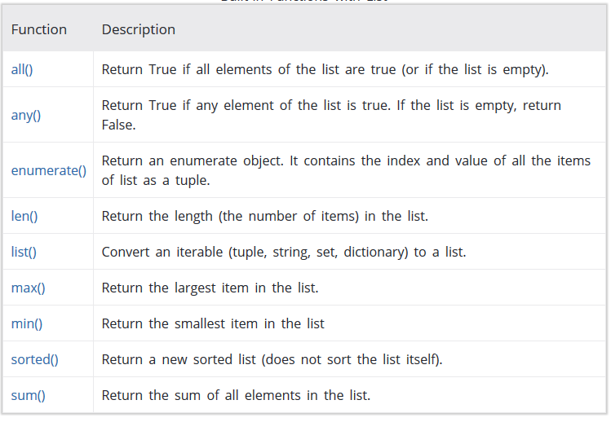
Built-in List Functions

Slide 13
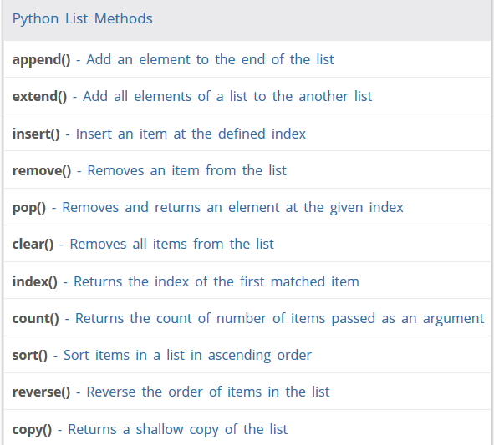
List Methods

Slide 14
Example 1:
How enumerate() works in Python?
>>>grocery = ['bread', 'milk', 'butter']
>>>enumerateGrocery = enumerate(grocery)
>>>print(type(enumerateGrocery))
<class 'enumerate'>
>>>print(list(enumerateGrocery))
[(0, 'bread'), (1, 'milk'), (2, 'butter')]
>>>enumerateGrocery = enumerate(grocery, 10)
>>>print(list(enumerateGrocery))
[(10, 'bread'), (11, 'milk'), (12, 'butter')]

Slide 15
Using Lists as Stacks
The list methods make it very easy to use a list as a stack, where the last element added is the first element retrieved (“last-in, first-out”). To add an item to the top of the stack, use append(). To retrieve an item from the top of the stack, use pop() without an explicit index.
Example:
>>> stack = [3, 4, 5]
>>> stack.append(6)
>>> stack.append(7)
>>> stack
[3, 4, 5, 6, 7]
>>> stack.pop()
7
>>> stack
[3, 4, 5, 6]
>>> stack.pop()
6

Slide 16
Using Lists as Queues
To implement a queue, use collections.deque which was designed to have fast appends and pops from both ends.
>>> from collections import deque
>>> queue = deque(["Eric", "John", "Michael"])
>>> queue.append("Terry")
>>> queue.append("Graham")
>>> queue.popleft()
>>> queue.popleft()
>>> queue
deque(['Michael', 'Terry', 'Graham'])

Slide 17
Write a python code for the following
1. Matrix Addition using Nested Loop
2. Matrix Addition using Nested List Comprehension

Slide 18
Solution
X = [[12,7,3],
[4 ,5,6],
[7 ,8,9]]
Y = [[5,8,1],
[6,7,3],
[4,5,9]]
result = [[0,0,0],
[0,0,0],
[0,0,0]]
# iterate through rows
for i in range(len(X)):
# iterate through columns
for j in range(len(X[0])):
result[i][j] = X[i][j] + Y[i][j]
for r in result:
print(r)

Slide 19
X = [[12,7,3],
[4 ,5,6],
[7 ,8,9]]
Y = [[5,8,1],
[6,7,3],
[4,5,9]]
result = [[X[i][j] + Y[i][j] for j in range(len(X[0]))] for i in range(len(X))]
for r in result:
print(r)
Output
[17, 15, 4]
[10, 12, 9]
[11, 13, 18]

Slide 20
List unpacking
Although we can use the slice operator to access items in a list, in some situations we want to take two or more pieces of a list in one go.
This can be done by sequence unpacking.
Any iterable (lists, tuples, etc.) can be unpacked using the sequence unpacking operator, an asterisk or star(*)
.When used with two or more variables on the left-hand side of an assignment, one of which is preceded by * , items are assigned to the variables, with all those left over assigned to the starred variable.
Here are some examples:
>>> first, *rest = [9, 2, -4, 8, 7]
>>> first
9
>>> rest
[2, -4, 8, 7]

Slide 21
List Quiz
What will be the output of the following code snippet?
1.a=[1,2,3,4,5,6,7,8,9]
print(a[::2])
A. [1,2] B. [8,9] C. [1,3,5,7,9] D. [1,2,3]
2. a=[1,2,3,4,5,6,7,8,9]
a[::2]=10,20,30,40,50,60
print(a)
A. ValueError: attempt to assign sequence of size 6 to extended slice of size 5 B. [10, 2, 20, 4, 30, 6, 40, 8, 50, 60] C. [1, 2, 10, 20, 30, 40, 50, 60] D. [1, 10, 3, 20, 5, 30, 7, 40, 9, 50, 60]

Slide 22
3. a=[1,2,3,4,5]
print(a[3:0:-1])
A. Syntax error B. [4, 3, 2] C. [4, 3] D. [4, 3, 2, 1]
4. arr = [[1, 2, 3, 4], [4, 5, 6, 7], [8, 9, 10, 11], [12, 13, 14, 15]]
for i in range(0, 4):
print(arr[i].pop())
A. 1 2 3 4 B. 1 4 8 12 C. 4 7 11 15 D. 12,13,14,15

Slide 23
Solutions
1→ C. [1,3,5,7,9]
2→A.ValueError: attempt to assign sequence of size 6 to extended slice of size 5
3→ B. [4, 3, 2]
4→ C. 4 7 11 15

