Slide 1
Python Programming
Modules & Packages

Slide 2
What are modules in Python?
Modules refer to a file containing Python statements and definitions.
A file containing Python code, for e.g.: example.py, is called a module and its module name would be example.
We use modules to break down large programs into small manageable and organized files. Furthermore, modules provide reusability of code.
We can define our most used functions in a module and import it, instead of copying their definitions into different programs.

Slide 3
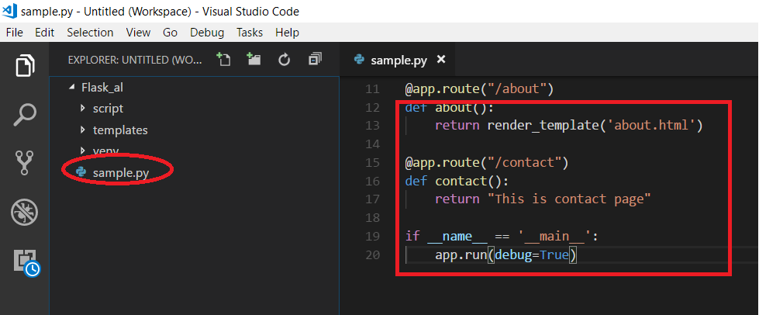
Module
It have references and statements

Slide 4
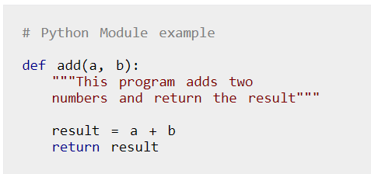

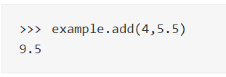
How to import modules in Python?
example.py

Slide 5
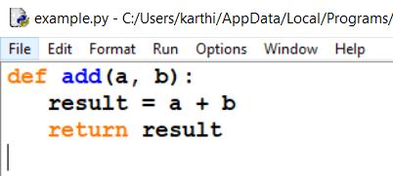

Import with renaming
Note:
That the name example is not recognized in our scope. Hence, example.add i is invalid, sum.add is the correct implementation.

Slide 6
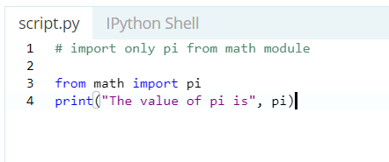
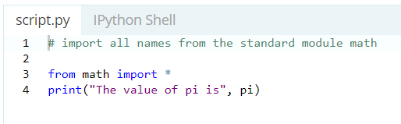
Python from...import statement
We can import specific names from a module without importing the module as a whole.
Import all names

Slide 7
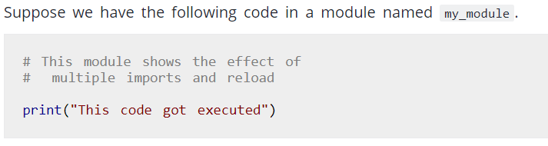
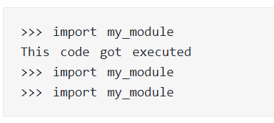
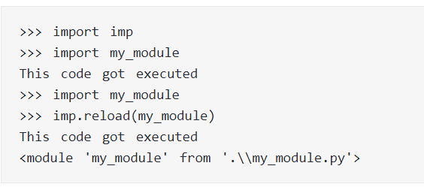
Reloading a module
The Python interpreter imports a module only once during a session. This makes things more efficient.

Slide 8
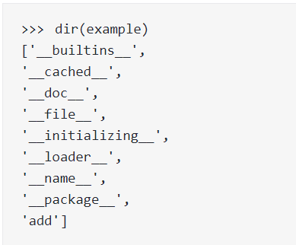
The dir() built-in function
We can use the dir() function to find out names that are defined inside a module.

Slide 9
Random Module
Python defines a set of functions that are used to generate or manipulate random numbers.

Slide 10
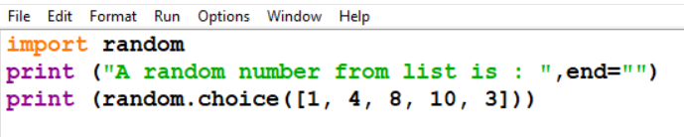

Method choice()
choice() :- This function is used to generate 1 random number from a container.

Slide 11
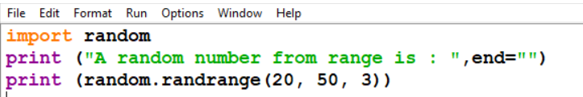

Method randrange()
randrange(beg, end, step) :-
This function is also used to generate random number but within a range specified in its arguments.
This function takes 3 arguments, beginning number (included in generation), last number (excluded in generation) and step ( to skip numbers in range while selecting).

Slide 12
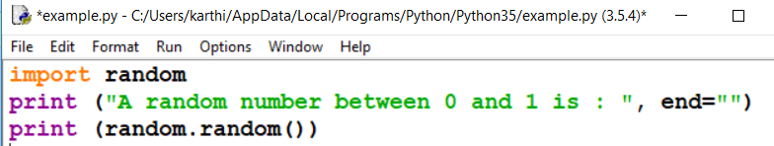

Method random()
random() :- This number is used to generate a float random number less than 1 and greater or equal to 0.

Slide 13
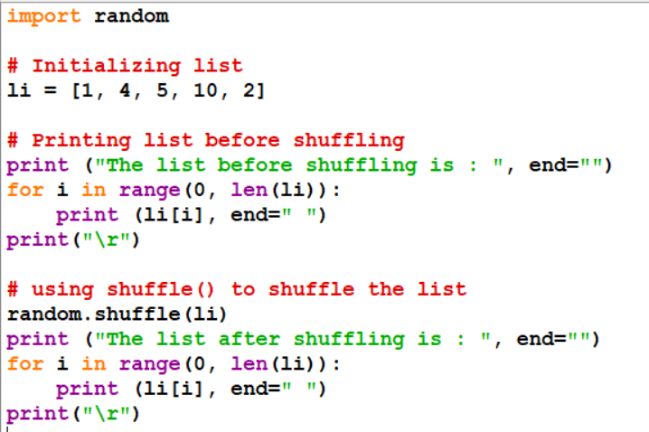
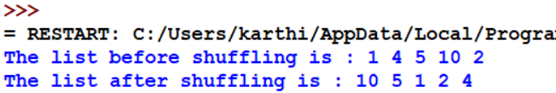
Method shuffle()
shuffle() :- This function is used to shuffle the entire list to randomly arrange them.

Slide 14
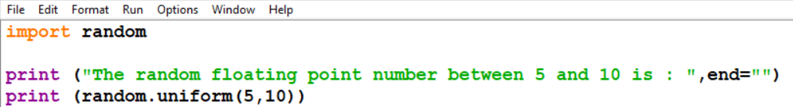
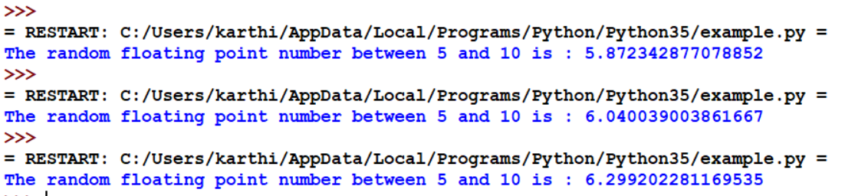
Method uniform()
uniform(a, b) :-
This function is used to generate a floating point random number between the numbersmentioned in its arguments.
It takes two arguments, lower limit(included in generation) and upper limit(not included in generation).

Slide 15
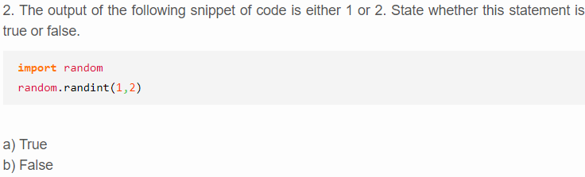
Quiz

Slide 16
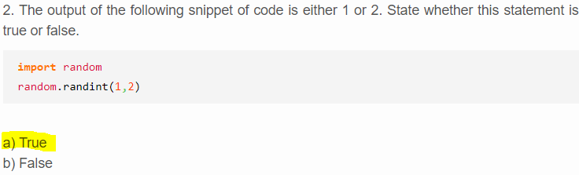
Answer

Slide 17
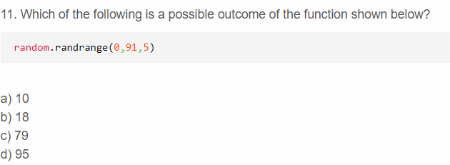
Quiz

Slide 18
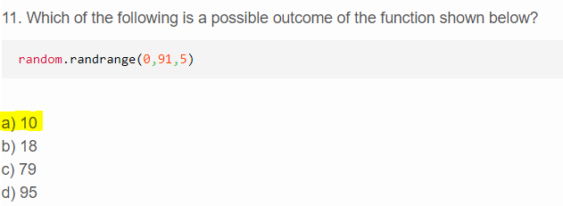
Answer

Slide 19
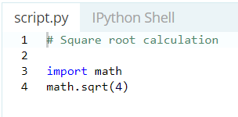
Math Module
The math module is a standard module in Python and is always available.
To use mathematical functions under this module, you have to import the module using import math.

Slide 20
Functions in Python Math Module
Function | Description
ceil(x) | Returns the smallest integer greater than or equal to x.
factorial(x) | Returns the factorial of x
floor(x) | Returns the largest integer less than or equal to x
exp(x) | Returns e**x
expm1(x) | Returns e**x - 1
log(x[, base]) | Returns the logarithm of x to the base (defaults to e)
pow(x, y) | Returns x raised to the power y
sqrt(x) | Returns the square root of x
cos(x) | Returns the cosine of x
sin(x) | Returns the sine of x
tan(x) | Returns the tangent of x
degrees(x) | Converts angle x from radians to degrees
radians(x) | Converts angle x from degrees to radians
pi | Mathematical constant, the ratio of circumference of a circle to it's diameter (3.14159...)

Slide 21
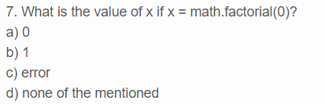
Quiz

Slide 22
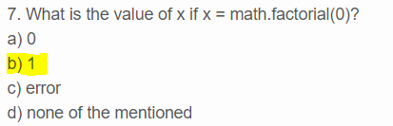
Answer

Slide 23
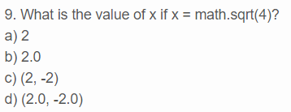
Quiz

Slide 24
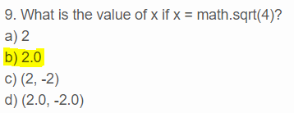
Answer

Slide 25
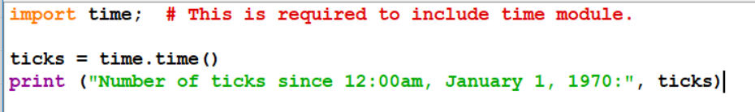
Date & Time Module
Converting between date formats is a common chore for computers. Python's time and calendar modules help track dates and times.

Slide 26

What is TimeTuple?
Index | Field | Values
0 | 4-digit year | 2016
1 | Month | 1 to 12
2 | Day | 1 to 31
3 | Hour | 0 to 23
4 | Minute | 0 to 59
5 | Second | 0 to 61 (60 or 61 are leap-seconds)
6 | Day of Week | 0 to 6 (0 is Monday)
7 | Day of year | 1 to 366 (Julian day)
8 | Daylight savings | -1, 0, 1, -1 means library determines DST

Slide 27
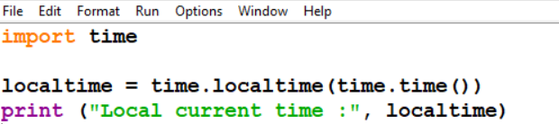
Getting current time
To translate a time instant from seconds since the epoch floating-point value into a timetuple, pass the floating-point value to a function (e.g., localtime) that returns a time-tuple with all valid nine items.

Slide 28
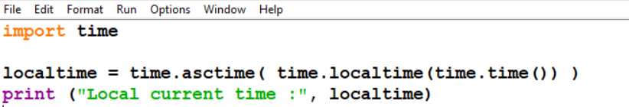

Getting formatted time

Slide 29
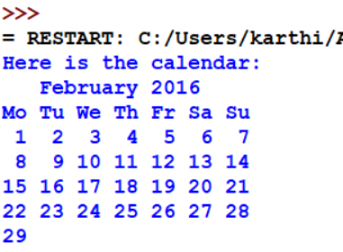
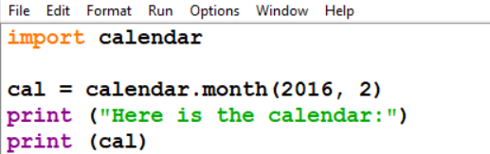
Getting calendar for a month
Calendar module gives a wide range of methods to play with yearly and monthly calendars.

Slide 30
Function | Description
time.altzone | The offset of the local DST timezone, in seconds west of UTC, if one is defined. This is negative if the local DST timezone is east of UTC
time.asctime([tupletime]) | Accepts a time-tuple and returns a readable 24-character string such as 'Tue Dec 11 18:07:14 2008'.
time.clock( ) | Returns the current CPU time as a floating-point number of seconds. To measure computational costs of different approaches, the value of time.clock is more useful than that of time.time().
time.ctime([secs]) | Like asctime(localtime(secs)) and without arguments is like asctime( )
time.gmtime([secs]) | Accepts an instant expressed in seconds since the epoch and returns a time-tuple t with the UTC time. Note − t.tm_isdst is always 0
time.localtime([secs]) | Accepts an instant expressed in seconds since the epoch and returns a time-tuple t with the local time (t.tm_isdst is 0 or 1, depending on whether DST applies to instant secs by local rules).
time.mktime(tupletime) | Accepts an instant expressed as a time-tuple in local time and returns a floating-point value with the instant expressed in seconds since the epoch.
time.sleep(secs) | Suspends the calling thread for secs seconds.
time.strftime(fmt[,tupletime]) | Accepts an instant expressed as a time-tuple in local time and returns a string representing the instant as specified by string fmt.
time.strptime(str,fmt = '%a %b %d %H:%M:%S %Y') | Parses str according to format string fmt and returns the instant in time-tuple format.
time.time( ) | Returns the current time instant, a floating-point number of seconds since the epoch.
time.tzset() | Resets the time conversion rules used by the library routines. The environment variable TZ specifies how this is done.

Slide 31
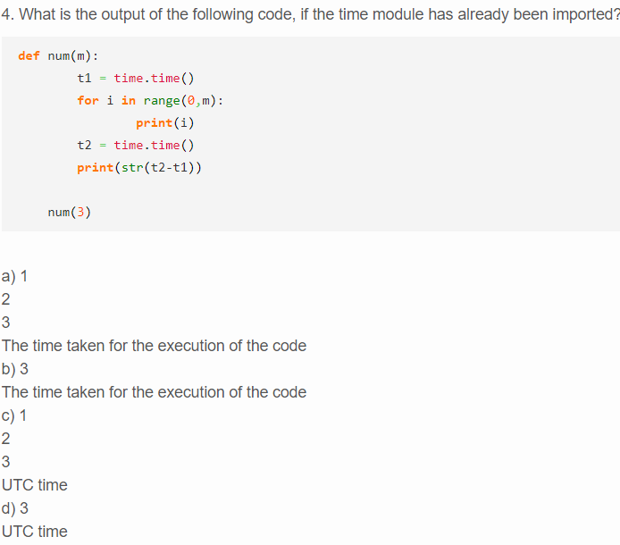
Quiz

Slide 32
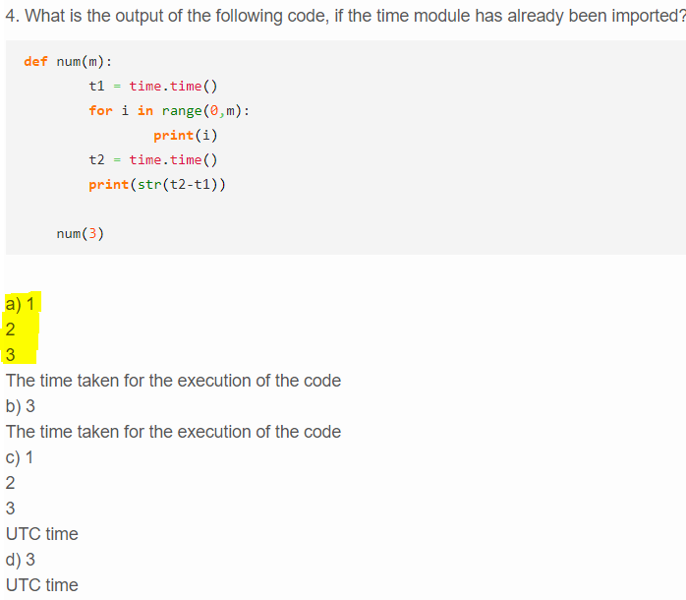
Answer

Slide 33
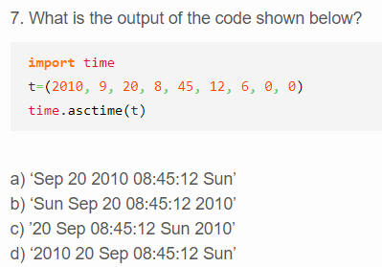
Quiz

Slide 34
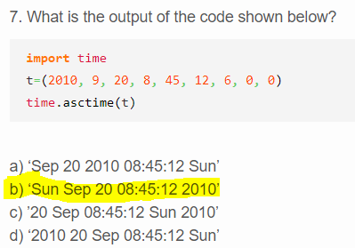
Answer

Slide 35
Regular Expression
A regular expression is a special sequence of characters that helps you match or find other strings or sets of strings.
It is defined in module re.
There are three main functions defined.
match Function
search Function
Search and Replace(sub)
Split
Findall
Finditer

Slide 36
Patterns
Pattern | Description
\w | Matches word characters.(Numbers and characters)
\W | Matches nonword characters.
\s | Matches whitespace. Equivalent to [\t\n\r\f].
\S | Matches nonwhitespace.
\d | Matches digits. Equivalent to [0-9].
\D | Matches nondigits.

Slide 37
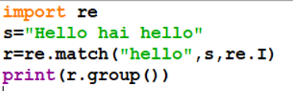

Method match()
match()-This function matches only the first occurrence of RE pattern within string with optional flags.
syntax : re.match(pattern, string, flags=0)
Modifier | Description
re.I | Performs case-insensitive matching.
re.M | Makes $ match the end of a line (not just the end of the string) and makes ^ match the start of any line (not just the start of the string).

Slide 38
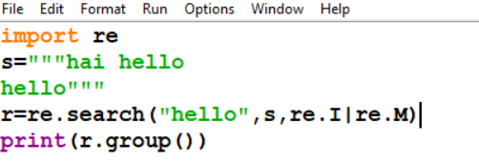
Method search()
search (): This function searches for first occurrence of RE pattern within string with optional flags.
Syntax : re.search(pattern, string, flags=0)
returns hello because it checks value throughout string

Slide 39
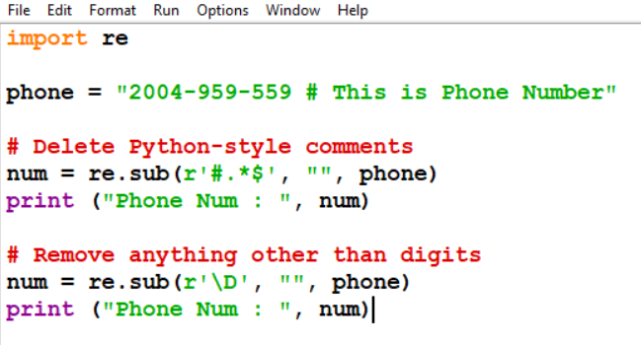
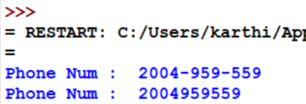
Search and Replace
One of the most important re methods that use regular expressions is sub.
Syntax: re.sub(pattern, repl, string, max=0)

Slide 40
Character classes
Example | Description
[Pp]ython | Match "Python" or "python"
rub[ye] | Match "ruby" or "rube"
[aeiou] | Match any one lowercase vowel
[0-9] | Match any digit; same as [0123456789]
[a-z] | Match any lowercase ASCII letter
[A-Z] | Match any uppercase ASCII letter
[a-zA-Z0-9] | Match any of the above
[^aeiou] | Match anything other than a lowercase vowel
[^0-9] | Match anything other than a digit

Slide 41
Repetition Case
Example | Description
ruby? | Match "rub" or "ruby": the y is optional
ruby* | Match "rub" plus 0 or more ys
ruby+ | Match "rub" plus 1 or more ys
\d{3} | Match exactly 3 digits
\d{3,} | Match 3 or more digits
\d{3,5} | Match 3, 4, or 5 digits

Slide 42
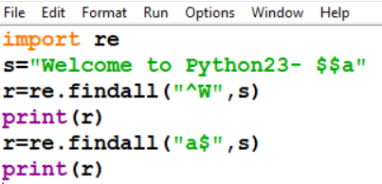
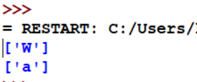
Method findall()
Findall()-This function checks the occurance of the match string throughout the main string and return in list.
Syntax: re.findall(pattern,mainstring,flag)

Slide 43
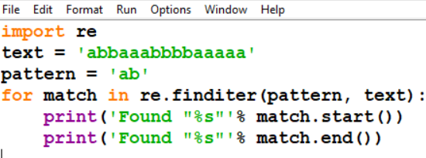
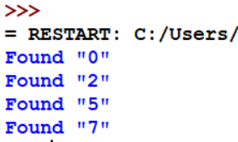
Method finditer()
Finditer()-This function checks the occurance of the match string throughout the main string and return as object.
Syntax: re.finditer(pattern,mainstring,flag)
Note:
Match.start()-it will display the starting number from which the matching string starts.
Match.end()-it will display the ending number from which the matching string ends.

Slide 44
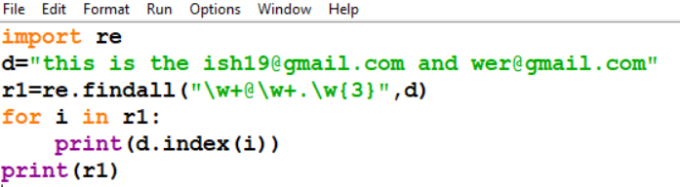
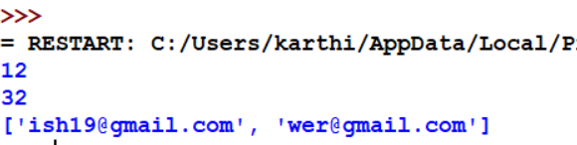
To extract the E-Mail ID
Code:

Slide 45
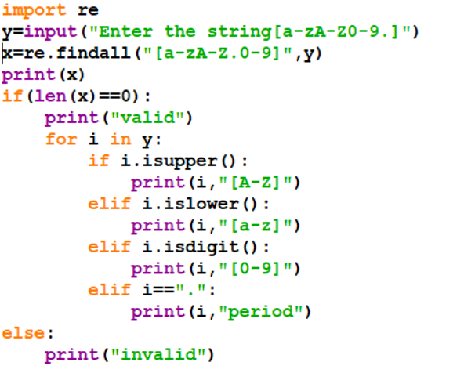
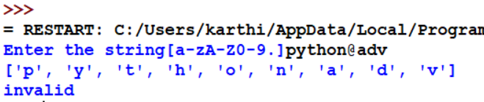
To ignore special character

Slide 47
Check out these examples
Python Program to Shuffle Deck of Cards

Slide 48
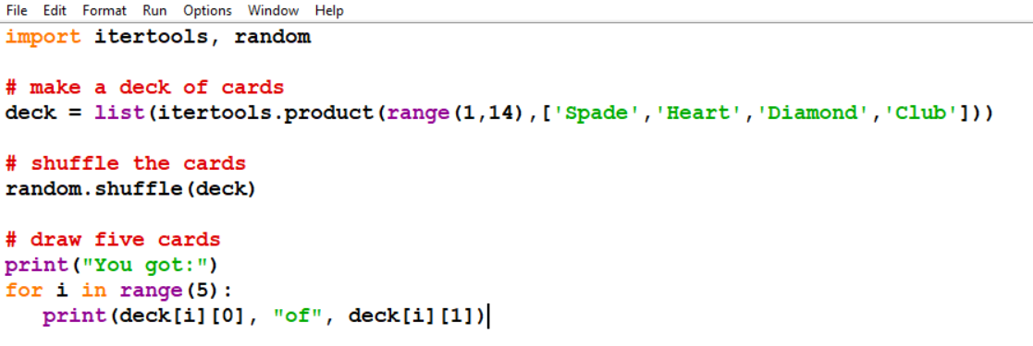

Slide 49
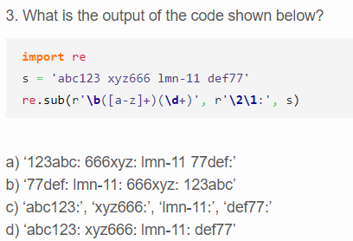
Quiz

Slide 50
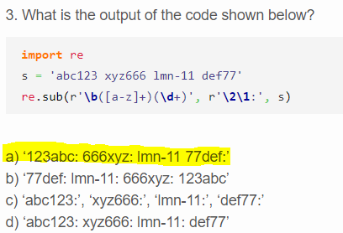
Answer

Slide 51

Python Package
A package is a hierarchical file directory structure that defines a single Python application environment that consists of modules and subpackages and sub-subpackages, and so on.
Packages

Slide 52

What are packages?
A directory must contain a file named __init__.py in order for Python to consider it as a package.
This file can be left empty but we generally place the initialization code for that package in this file.

Slide 53
Importing module from a package
if want to import the start module in the above example
→import Game.Level.start
Now if this module contains a function named select_difficulty(), we must use the full name to reference it.
→Game.Level.start.select_difficulty(2)
If this construct seems lengthy, we can import the module without the package prefix as follows.
→from Game.Level import start
We can now call the function simply as follows.
→start.select_difficulty(2)

