Slide 1
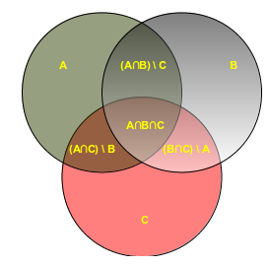
Sets
A set Is an unordered collection data type with no duplicate elements. A Python set is similar to this mathematical definition with below additional conditions.
The elements in the set cannot be duplicates.
The elements in the set are immutable(cannot be modified) but the set as a whole is mutable.
There is no index attached to any element in a python set.
So they do not support any indexing or slicing operation.

Slide 2
Creating a Python Set
A set is created by placing all the items (elements) inside curly braces {}, separated by comma or by
using the built-in function set().
Every element is unique (no duplicates) and must be immutable (which cannot be changed).
However, the set itself is mutable. We can add or remove items from it.
>>> setA = set()
>>> print(setA)
set() → empty set
>>> setA = set("HackerEarth")
>>> print(setA)
{'h', 'H', 't', 'k', 'e', 'c', 'E', 'a', 'r'}
>>>my_set = {1.0, "Hello", (1, 2, 3)}
>>>print(my_set)
{1.0, 'Hello', (1, 2, 3)} → set with different data type

Slide 3
It can have any number of items and they may be of different types (integer, float, tuple, string etc.). But
a set cannot have a mutable element, like list, set or dictionary, as its element.
>>> my_set = {1, 2, [3, 4]}
Traceback (most recent call last):
File "<pyshell#6>", line 1, in <module> → [3,4] is a mutable element where set does not support
my_set = {1, 2, [3, 4]}
TypeError: unhashable type: 'list‘
Creating an empty set is tricky
>>> a={}
>>>a
{ }
>>>type(a)
<class 'dict'> → Empty curly braces {} will make an empty dictionary in Python.

Slide 4
Sets - Mutable
Sets are mutable. But since they are unordered, indexing have no meaning.
We can add single element using the add() method and multiple elements using the update() method.
The update() method can take tuples, lists, strings or other sets as its argument.
Example:
>>>my_set = {1,3}
>>>my_set.add(2)
>>>print(my_set)
{1, 2, 3}
>>>my_set.update([21,3,4])
{1, 2, 3, 4, 21}

Slide 5
Deleting a Set
A particular item can be removed from set using methods, discard() and remove()
Similarly, we can remove and return an item using the pop() method.
user can also remove all items from a set using clear().
>>> numbers={3,2,1,4,6,5}
>>> numbers
{1, 2, 3, 4, 5, 6}
1. discard() :This method takes the item to delete as an argument.
>>> numbers.discard(3)
>>> numbers
{1, 2, 4, 5, 6} → item 3 has been removed.
2. remove()
>>> numbers.remove(5)
>>> numbers
{1, 2, 4, 6} → item 5 has been removed.

Slide 6
discard() vs remove ()
If user try to delete an item that doesn’t exist in the set, discard() ignores it, but remove() raises a KeyError.
>>> numbers.discard(7)
>>> numbers
{1, 2, 4, 6}
>>> numbers.remove(7)
Traceback (most recent call last):
File "<pyshell#37>", line 1, in <module>
numbers.remove(7)
KeyError: 7
3. pop()
>>> numbers.pop()
1
4. clear()
>>> numbers.clear()
>>> numbers
set()

Slide 7
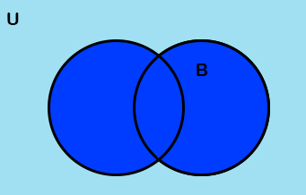
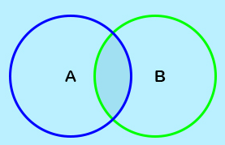
Set Operations
Let us consider the following three sets for the following operations.
>>> set1={1,2,3}, set2={3,4,5}, set3={5,6,7}
union() → Union is performed using | operator.
it returns all the items that are in any of those sets.
>>> set1.union(set2,set3) →it did not alter set1
{1, 2, 3, 4, 5, 6, 7}
>>> set1
{1, 2, 3}
2. intersection() →Intersection is performed using & operator.
It returns the common items in all the sets.
>>> set2.intersection(set1)
{3}

Slide 8
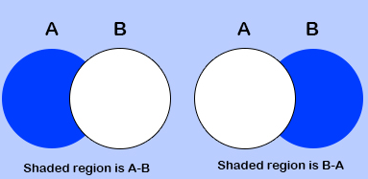
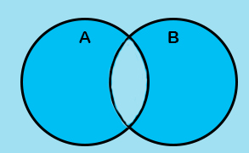
3. difference() → returns the difference of two or more sets. It returns as a set.
Difference is performed using – operator
>>> set1.difference(set2)
{1, 2}
This returns the items that are in set1, but not in set2.
>>> set1.difference(set2,set3)
{1, 2}
4. symmetric_difference() →This method returns all the items that are unique to each set.
Symmetric difference is performed using ^ operator
>>> set1.symmetric_difference(set2)
{1, 2, 4, 5}

Slide 9
5.intersection_update()
As we discussed in intersection(), it does not update the set on which it is called. For this, we have the intersection_update() method.
>>> set1.intersection_update(set2)
>>> set1
{3}
It stored 3 in set1, because only that was common in set1 and set2.
6. difference_update()
Like intersection-update(), this method updates the Python set with the difference.
>>> set1={1,2,3}
>>> set2={3,4,5}
>>> set1.difference_update(set2)
>>> set1
{1, 2}

Slide 10
7. symmetric_difference_update()
Like the two methods we discussed before this, it updates the set on which it is called with the symmetric difference.
>>> set1={1,2,3}
>>> set2={3,4,5}
>>> set1.symmetric_difference_update(set2)
>>> set1
{1, 2, 4, 5}
8. issubset()
This method returns true if the set in the argument contains this set.
>>> {1,2}.issubset({1,2,3})
True
>>> {1,2}.issubset({1,2})
True
{1,2} is a proper subset of {1,2,3} and an improper subset of {1,2}.

Slide 11
9. issuperset()
Like the issubset() method, this one returns True if the set contains the set in the argument.
>>> {1,3,4}.issuperset({1,2})
False
>>> {1,3,4}.issuperset({1})
True
10.isdisjoint()
This method returns True if two sets have a null intersection.
>>> {1,3,2}.isdisjoint({4,5,6})
True
>>> {1,3,2}.isdisjoint({3,4,5},{6,7,8})
TypeError: isdisjoint() takes exactly one argument (2 given)

Slide 12
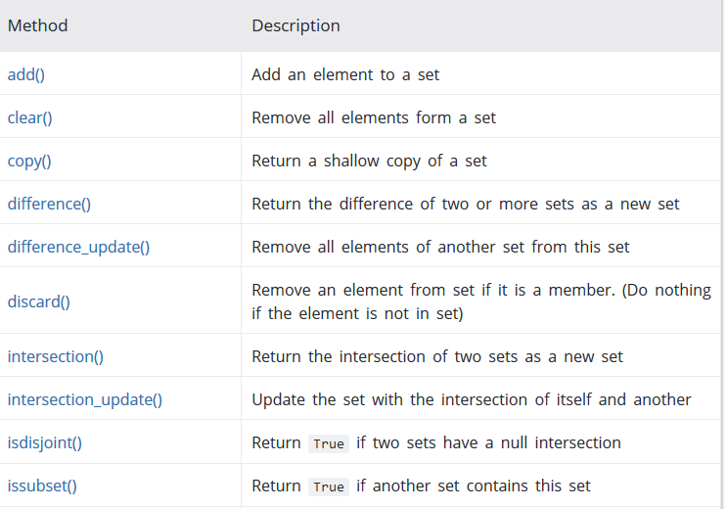
Set Methods

Slide 13
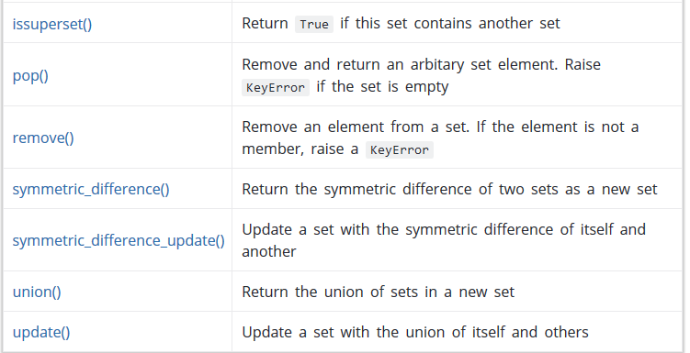

Slide 14
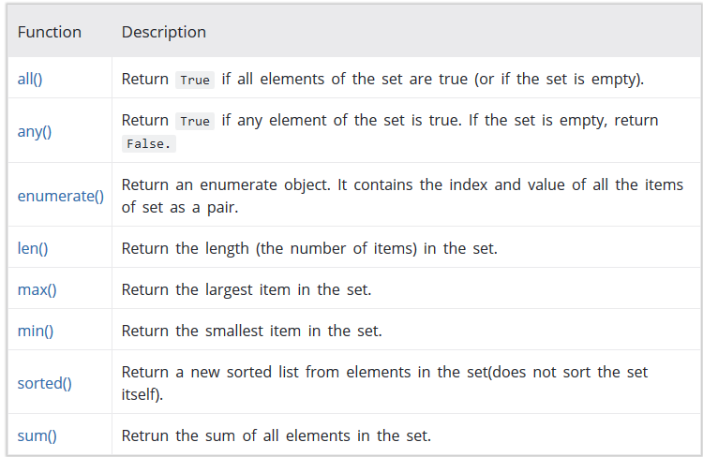
Built-in Functions with Set

Slide 15
Iterating on a Set
Using a for loop, we can iterate though each item in a set.
>>> for letter in set("apple"):
print(letter)
a p e l
{} set comprehension
Returns a set based on existing iterables.
Syntax : {expression(variable) for variable in input_set [predicate][, …]}
>>> {s**2 for s in [1, 2, 1, 0]}
set([0, 1, 4])

Slide 16
Python Frozenset
Frozenset is a new class that has the characteristics of a set, but its elements cannot be changed once assigned. While tuples are immutable lists, frozensets are immutable sets.
Sets being mutable are unhashable, so they can't be used as dictionary keys. On the other hand, frozensets are hashable and can be used as keys to a dictionary.
Frozensets can be created using the function frozenset().
Example :
A = frozenset([1, 2, 3, 4])
B = frozenset([3,
>>> A.isdisjoint(B)
False
>>> A.difference(B)
frozenset({1, 2})
>>> A | B
frozenset({1, 2, 3, 4, 5, 6})
>>> A.add(3)
AttributeError: 'frozenset' object has no attribute 'add'4, 5, 6])

Slide 17
Predict the output :
# define three sets
E = {0, 2, 4, 6, 8};
N = {1, 2, 3, 4, 5};
>>>print("Union of E and N is",E | N)
>>>print("Intersection of E and N is",E & N)
>>>print("Difference of E and N is",E - N)
>>>print("Symmetric difference of E and N is",E ^ N)

Slide 18
Solutions
Union of E and N is {0, 1, 2, 3, 4, 5, 6, 8}
Intersection of E and N is {2, 4}
Difference of E and N is {8, 0, 6}
Symmetric difference of E and N is {0, 1, 3, 5, 6, 8}

Slide 19
Quiz
1.Which of these about a set is not true? a) Mutable data type b) Allows duplicate values c) Data type with unordered values d) Immutable data type
2.What is the output of the following code?
nums = set([1,1,2,3,3,3,4,4]) print(len(nums))
a) 7 b) Error, invalid syntax for formation of set c) 4 d) 8

Slide 20
Solutions
Answer: d Explanation: A set is a mutable data type with non-duplicate, unordered values, providing the usual mathematical set operations.
Answer: c Explanation: A set doesn’t have duplicate items.

