Slide 1


Strings
A string is a sequence of characters that are enclosed in single quotes ‘’ or double quotes “ ”.
We can access the string by using indexing operator[]
Example:
>>> fruit = “banana”
-6 -5 -4 -3 -2 -1 Negative Indexing
>>> print(fruit[1],fruit[-6])
a b

Slide 2
Strings are immutable
If user try to change a single character in string , it
Example:
>>> greeting = 'Hello, world!'
>>> greeting[0] = 'J'
Type Error: object does not support item assignment
The reason for the error is that strings are immutable, which means you can't change an existing string.
By using string operation like slicing it is possible to do the same
Example:
>>> greeting = 'Hello, world!'
>>> new_greeting = 'J' + greeting[1:]
>>> print (new_greeting)
Jello, world!

Slide 3
String Operations
SLICING
We can slice the particular character/substring by using slicing operator [start:stop].
start-It is the starting value of string and it is included.
stop-It is the ending value of string and it is excluded.
>>>>name=”python”
>>>name[0:3]
pyth
2. STRIDING
The optional, third number in a slice specifies the stride.
If omitted, the default is 1: return every character in the requested range. To return every kth letter, set the stride to k. Negative values of k reverse the string
Syntax:
[start :stop :step]
>>> s="python"
>>> s[::-1]
'nohtyp'

Slide 4
Find it….
SLICING
STRIDING
s=‘python programming’
1.s[0:6]
2.s[:9]
3.s[-6:]
4.s[3:9]
5.s[-6:-1]
6.s[:-6]
s=‘python programming’
1.s[::-1]
2. s[::2]
3. s[:3:]
4. s[-6:-1:2]
5. s[-4::-1]
6. s[-4:-1:1]

Slide 5
Solutions
SLICING
1.‘python’
2.‘python pr’
3.‘amming’
4.‘hon pr’
5. ‘ammin’
6.‘python progr’
STRIDING
'gnimmargorp nohtyp‘
'pto rgamn‘
'pyt'
'amn‘
'mmargorp nohtyp'
'min'

Slide 6
String Operators
Concatenation (+)
Adds values on either side of the operator
>>>a=‘karpagam’
>>>b=‘college’
>>> a+b
‘karpagam college’
Repetition (*)
Creates new strings , concatenating multiple copies of the same string
>>>a=hello
>>>a*3
‘hellohellohello’
Membership (in)
Returns true if a character exists in the given string
>>> a=“Hackathon”
>>> ‘k’ in a
True
Membership (not in)
Returns true if a character does not exist in the given string
>>>a=“Hackathon”
>>> ‘k’ not in a
False

Slide 7
String functions
Python has quite a few methods that string objects can call to perform frequency occurring task (related to string).
1.Capitalize() :
It returns a copy of the string with only its first character capitalized.
Example:
>>> s=“java Programming"
>>>print("capitalize",s.capitalize())
Capitalize Java Programming
2.Centre() :
The center() method returns a string which is padded with the specified character.
The center() method takes two arguments:
width - length of the string with padded characters
fillchar (optional) - padding character
Example:
center java Programming

Slide 8
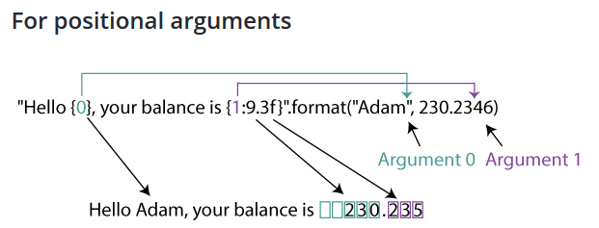
String functions cont..
center() Method With * fillchar
>>> print("center",s.center(60,'*'))
center **********************java Programming**********************
3. format()
The string format() method formats the given string into a nicer output in Python.
Here, Argument 0 is a string "Adam" and Argument 1 is a floating number 230.2346.

Slide 9
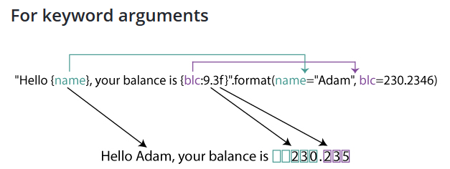
String functions cont..
Here, instead of just the parameters, we've used a key-value for the parameters. Namely, name="Adam" and blc=230.2346
4. join()
The join() is a string method which returns a string concatenated with the elements of an iterable.
Example:
>>>s1 = 'abc‘
>>>s2 = '123
>>>print('s1.join(s2):', s1.join(s2))
s1.join(s2): 1abc2abc3

Slide 10
String functions cont..
5.strip():
The strip() method returns a copy of the string with both leading and trailing characters removed (based on the string argument passed).
Example:
>>>str = “*******this is string example....wow!!!*******";
>>>print str.strip( ‘*' )
this is string example....wow!!!
6. split() :
The split() method breaks up a string at the specified separator and returns a list of strings.
Example:
>>>text= ‘kit kat choco’
>>>print(text.split())
[‘kit', ‘kat', ‘choco']

Slide 11
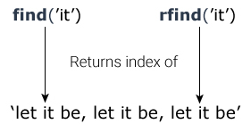
String functions cont..
7. splitlines()
The splitlines() method splits the string at line breaks and returns a list of lines in the string.
Example:
>>>grocery = 'Milk\nChicken\nBread\nButter‘
>>> print(grocery.splitlines())
['Milk', 'Chicken', 'Bread', 'Butter']
8.find()
The find() method returns the lowest index of the substring (if found). If not found, it returns -1.
Example:
>>>quote = 'Let it be, let it be, let it be‘
>>>result = quote.find('let it')
>>>print("Substring 'let it':", result)
Substring 'let it': 11

Slide 12
String functions cont..
find() with start and end Arguments
>>> print(quote.find('with ', 10, -1))
>>>quote = 'Do small things with great love‘
16
9. index():
The index() method returns the index of a substring inside the string (if found). If the substring is not found, it raises an exception.
The only difference is that find() method returns -1 if the substring is not found, whereas index() throws an exception.
Example:
>>>sentence = 'Python programming is fun.‘
>>>result = sentence.index('is fun')
>>>print("Substring 'is fun':", result)
Substring 'is fun': 19

Slide 13
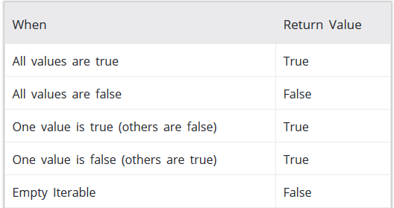
String functions cont..
index() With start and end Arguments
Example:
sentence = 'Python programming is fun.‘
print(sentence.index('g is', 10, -4))
17
10. any() :
The any() method returns True if any element of an iterable is true. If not, this method returns False.

Slide 14
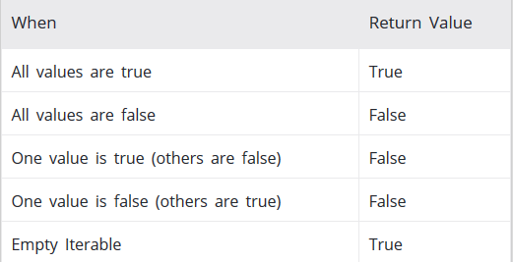
Example:
>>>s = "This is good“
>>>print(any(s))
True
11.all() :
The all() method returns True when all elements in the given iterable are true. If not, it returns False.
Example:
>>>s = “ ”
print(all(s))
True
12. compile() :
The compile() method returns a Python code object from the source (normal string, a byte string, or an AST object).

Slide 15
compile(source, filename, mode, flags=0)
source - a normal string, a byte string, or an AST object
filename - file from which the code was read. If it wasn't read from a file, you can give a name yourself
mode - Either exec or eval or single.
eval - accepts only a single expression.
exec - It can take a code block that has Python statements, class and functions and so on.
Example:
>>>codeInString = 'a = 5\nb=6\nsum=a+b\nprint("sum =",sum)‘
>>>codeObejct = compile(codeInString, 'sumstring', 'exec')
>>>exe
sum = 11
13.enumerate():
The enumerate() method adds counter to an iterable and returns it (the enumerate object).
Example:
>>>rocery = ['bread', 'milk', 'butter']
>>>enumerateGrocery = enumerate(grocery)
>>>print(list(enumerateGrocery))
[(0, 'bread'), (1, 'milk'), (2, 'butter')]

Slide 16
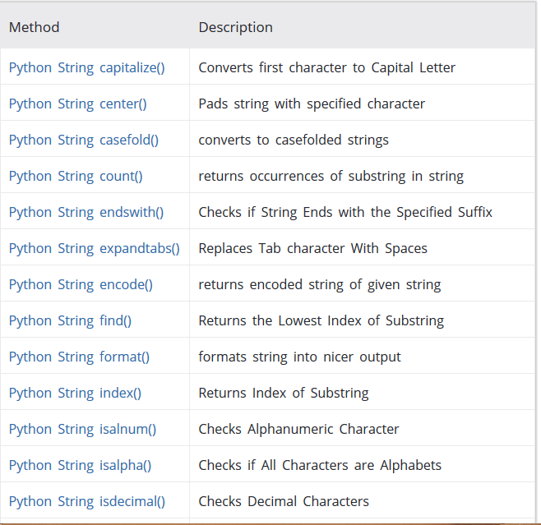

Slide 17
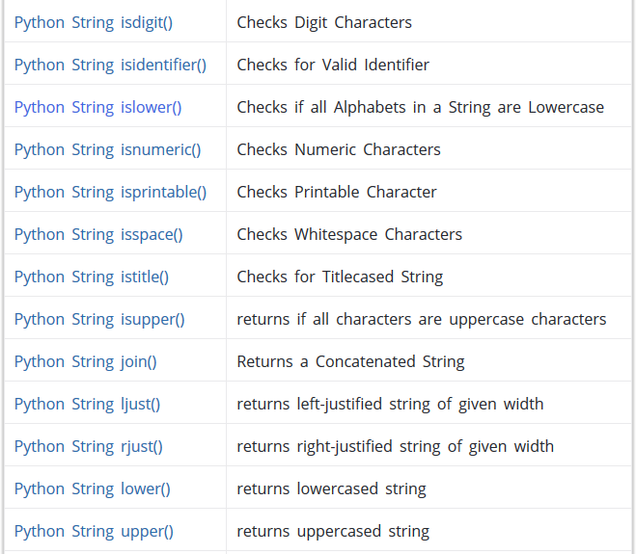

Slide 18
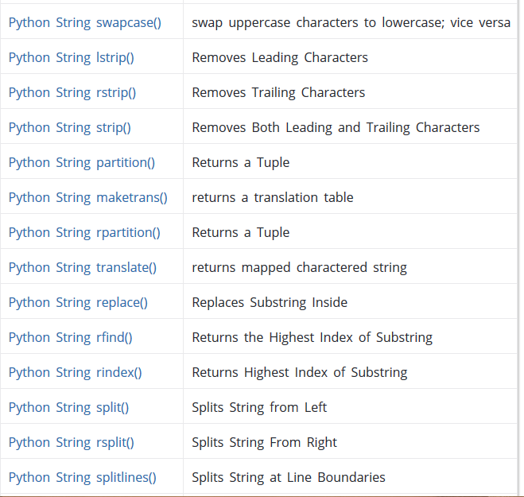

Slide 19
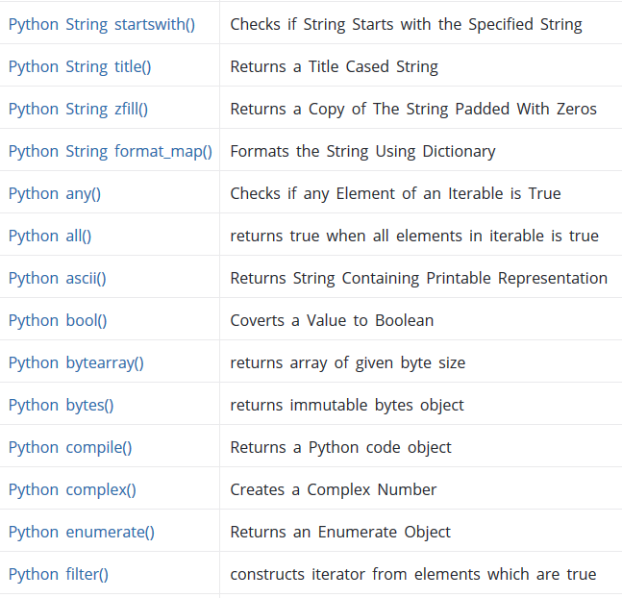

Slide 20
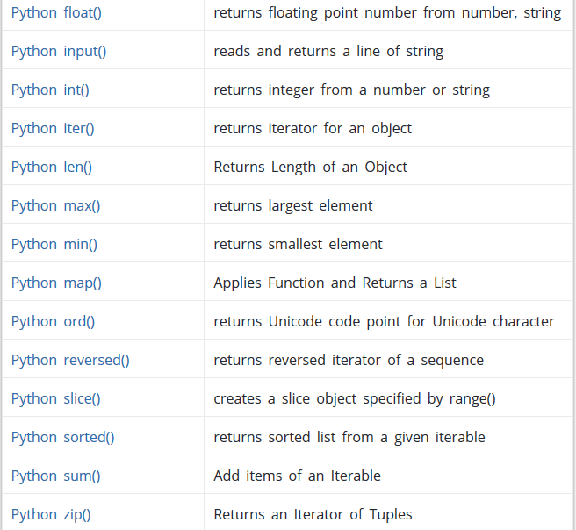

Slide 21
Using quotes inside a Python string
>>> a="Dogs are “cute”“
SyntaxError: invalid syntax
If you need to use double quotes or single quotes inside a string, delimit the string with single quotes/Double Quotes.
>>> a='Dogs are “love”'
>>> print(a)
Dogs are “love”

Slide 22
Python Escape Sequences
In a string, you may want to put a tab, a linefeed, or other such things. Python supports the following sequences.
\n – linefeed
\t – tab
>>> print("hell\to")
hell o
\\ – backslash-Since a backslash may be a part of an escape sequence, so, a backslash must be escaped by a backslash too.
\’ – A single quote can be escaped by a backslash. This lets you use single quotes freely in a string.
\” – Like the single quote, the double quote can be escaped too.

Slide 23
Strings with Loop
for i in "karpagam":
print(i)
k
a
r
p
a
g
a
m

Slide 24
Design a code
Python Program to Count Number of Lowercase Characters in a String

Slide 25
Solution
string=input("Enter string:")
count=0
for i in string:
if(i.islower()):
count=count+1
print("The number of lowercase characters is:")
print(count)

