Slide 1
Python Programming
TUPLES

Slide 2
What is a tuple?
A tuple is a sequence of immutable Python objects. Tuples are sequences, just like lists.
The main difference between the tuples and the lists is that the tuples cannot be changed unlike lists.
Tuples use parentheses, whereas lists use square brackets.
Creating a tuple is as simple as putting different comma-separated values.

Slide 3
Advantages of Tuple over List
Since tuple are immutable, iterating through tuple is faster than with list. So there is a slight performance boost.
Tuples that contain immutable elements can be used as key for a dictionary. With list, this is not possible.
If you have data that doesn't change, implementing it as tuple will guarantee that it remains write-protected.

Slide 4
Creating a Tuple
>>> tup=()
>>> tup1 = ('physics', 'chemistry', 1997, 2000)
>>> tup2 = (1, 2, 3, 4, 5 )
>>> tup3 = "a", "b", "c", "d“
>>> type(tup1)
>>>t1,t2,t3,t4=tup3

Slide 5
Cont.….
Creating a tuple with one element is a bit tricky
# Output: <class 'str'>
my_tuple = ("hello")
print(type(my_tuple))
# need a comma at the end
# Output: <class 'tuple'>
my_tuple = ("hello",)
print(type(my_tuple))
# parentheses is optional
# Output: <class 'tuple'>
my_tuple = "hello",
print(type(my_tuple))

Slide 6
Accessing Elements in a Tuple
Changing a Tuple
Unlike lists, tuples are immutable.
This means that elements of a tuple cannot be changed once it has been assigned. But, if the element is itself a mutable datatype like list, its nested items can be changed.
>>>tup1 = (12, 34.56)
>>>tup2 = ('abc', 'xyz')
# Following action is not valid for tuples
>>> tup1[0] = 100;
# So let's create a new tuple as follows
>>>tup3 = tup1 + tup2
>>>print (tup3)

Slide 7
Accessing Elements in a Tuple
Deleting a Tuple
Removing individual tuple elements is not possible.
>>> tup = ('physics', 'chemistry', 1997, 2000);
>>> print (tup)
>>> del tup
>>> print ("After deleting tup : “)
>>> print (tup)

Slide 8
Basic Tuples Operations
Python Expression | Results | Description
len((1, 2, 3)) | 3 | Length
(1, 2, 3) + (4, 5, 6) | (1, 2, 3, 4, 5, 6) | Concatenation
('Hi!',) * 4 | ('Hi!', 'Hi!', 'Hi!', 'Hi!') | Repetition
3 in (1, 2, 3) | True | Membership
for x in (1,2,3) : print (x, end = ' ') | 1 2 3 | Iteration

Slide 9
Indexing, Slicing, and Matrixes
>>>T=('C++', 'Java', 'Python')
Python Expression | Results | Description
T[2] | 'Python' | Offsets start at zero
T[-2] | 'Java' | Negative: count from the right
T[1:] | ('Java', 'Python') | Slicing fetches sections

Slide 10
Python Tuple Methods
Method | Description | Code
count(x) | Return the number of items that is equal to x | >>> my_tuple = ('a','p','p','l','e’,) >>> print(my_tuple.count('p'))
index(x) | Return index of first item that is equal to x | >>> my_tuple = ('a','p','p','l','e’,) >>> print(my_tuple.index('l'))

Slide 11
Built-in Functions with Tuple
Function | Description
all() | Return True if all elements of the tuple are true (or if the tuple is empty).
any() | Return True if any element of the tuple is true. If the tuple is empty, return False.
enumerate() | Return an enumerate object. It contains the index and value of all the items of tuple as pairs.
len() | Return the length (the number of items) in the tuple.
max() | Return the largest item in the tuple.
min() | Return the smallest item in the tuple
sorted() | Take elements in the tuple and return a new sorted list (does not sort the tuple itself).
sum() | Retrun the sum of all elements in the tuple.
tuple() | Convert an iterable (list, string, set, dictionary) to a tuple.

Slide 12
Method all()
Code:
>>>tup = ('physics', 'chemistry', 1997, 2000)
# all values true
>>>l = [1, 3, 4, 5]
>>>print(all(l))
# all values false
>>>l = [0, False]
>>>print(all(l))
# one false value
>>>l = [1, 3, 4, 0]
>>>print(all(l))
# one true value
>>>l = [0, False, 5]
>>>print(all(l))
# empty iterable
>>>l = []
>>>print(all(l))
all() Parameters
The all() method takes a single parameter:
iterable - any iterable (list, tuple, dictionary, etc.) which contains the elements
>>> all(iterable)
Truth table for all()
When | Return Value
All values are true | True
All values are false | False
One value is true (others are false) | False
One value is false (others are true) | False
Empty Iterable | True

Slide 13
Method any()
They any() method takes an iterable (list, string, dictionary etc.) in Python.
Return Value from any()
The any method returns:
True if at least one element of an iterable is true
False if all elements are false or if an iterable is empty
Code:
>>> l = [1, 3, 4, 0]
>>> print(any(l))
>>> l = [0, False]
>>> print(any(l))
>>> l = [0, False, 5]
>>> print(any(l))
>>> l = []
>>> print(any(l))
When | Return Value
All values are true | True
All values are false | False
One value is true (others are false) | True
One value is false (others are true) | True
Empty Iterable | False

Slide 14
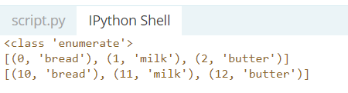
Python enumerate()
Method adds counter to an iterable and returns it (the enumerate object).
The syntax of enumerate() is:
enumerate(iterable, start=0)
Code:
>>>grocery = ['bread', 'milk', 'butter’]
>>>enumerateGrocery = enumerate(grocery)
>>>print(type(enumerateGrocery))
# converting to list
>>>print(list(enumerateGrocery))
# changing the default counter
>>>enumerateGrocery = enumerate(grocery, 10)
>>>print(list(enumerateGrocery))

Slide 15
Check out these examples
Write a Python program to create a tuple with numbers and print one item.
Write a Python program to replace last value of tuples in a list.
Sample list: [(10, 20, 40), (40, 50, 60), (70, 80, 90)] Expected Output: [(10, 20, 100), (40, 50, 100), (70, 80, 100)]

Slide 16
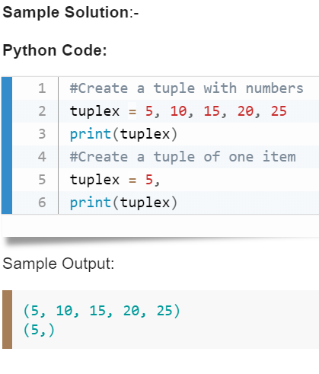

Slide 17
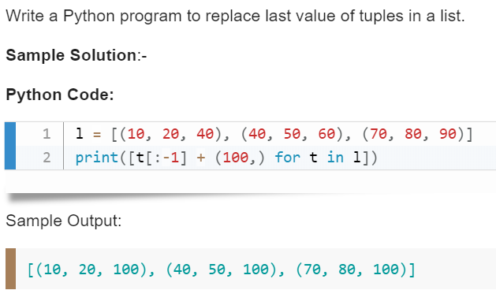

Slide 18
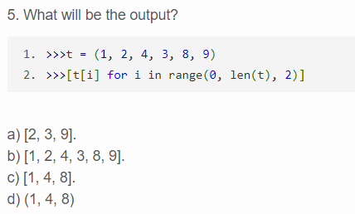
Quiz

Slide 19
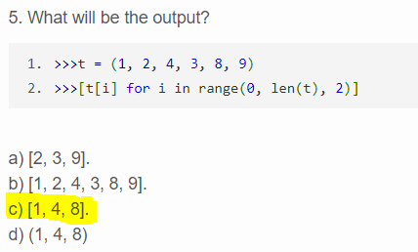
Answer

Slide 20
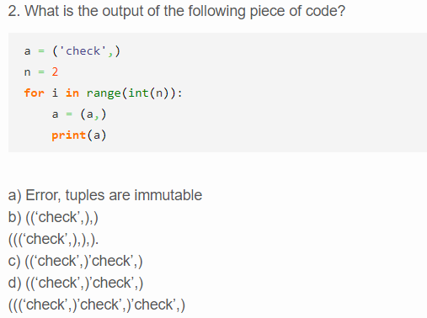
Quiz

Slide 21
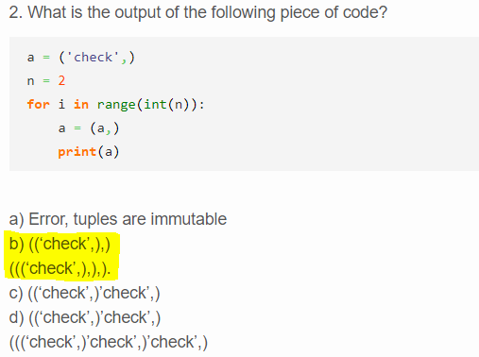
Answer

