Slide 1
File Handling
File
A file or a computer file is a chunk of logically related data or information which can be used by computer programs.
File is categorized as either text or binary.
Text File- Text files are structured as a sequence of lines, where each line includes a sequence of characters
Binary File- A binary file is any type of file that is not a text file.
Hence, in Python, a file operation takes place in the following order.
Open a file
Read or write (perform operation)
Close the file

Slide 2
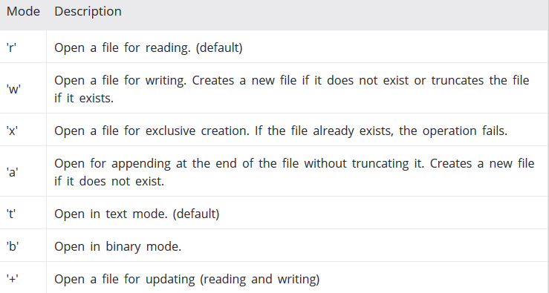
The open Function
Python's built-in open() function is used to open the file.
Syntax: fileobject=open(“filename”,”mode”,”buffering”)
File name: The file name argument is a string value
Access mode: The access mode determines the mode in which the file has to be opened. The modes are
Buffering: If the buffering value is set to 0, no buffering takes place. If the buffering value is 1, line buffering is performed while accessing a file.

Slide 3
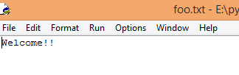

Write to file
Example: main.py
Write () Method:- The write() method writes any string to an open file.
fo = open("foo.txt", "w")
fo.write("Welcome!!")
fo.close()
Writelines() Method:- Writes a sequence of strings to the file.
fo = open("foo.txt", "w")
lines=["hi all ","good morning"," bye"]
fo.writelines(lines)
fo.write("\n KCE")
fo.close()

Slide 4



Read From file
Example: main.py
Read () Method:-It is used to read the data from the file.
fo = open("foo.txt", "r")
print(fo.read())
fo.close()
Readline() Method:-It is used to read a single line from the file.
fo = open("foo.txt", "r")
print(fo.readline())
fo.close()
Readlines() Method:-It is used to read many number of lines from the file.
fo = open("foo.txt", "r")
print(fo.readlines())
fo.close()

Slide 5
The file Object Attributes
Once a file is opened and you have one file object, We can get various information related to that file.
>>>fo = open("foo.txt", "w")
>>>print("Name of the file: ", fo.name)
>>>print("Closed or not : ", fo.closed)
>>>print("Opening mode : ", fo.mode)
Name of the file: foo.txt
Closed or not : False
Opening mode : w
Attribute | Description
file.closed | Returns true if file is closed, false otherwise.
file.mode | Returns access mode with which file was opened.
file.name | Returns name of the file.
file.softspace | Returns false if space explicitly required with print, true otherwise.

Slide 6

With Statement
user can also work with file objects using the with statement.
One bonus of using this method is that any files opened will be closed automatically after you are done.
Syntax: - with open(“filename”) as file:
Example:
with open("hello.txt", "w") as f:
f.write("Hello World")

Slide 7

Looping over a file object
When you want to read – or return – all the lines from a file in a more memory efficient, and fast manner,
you can use the loop over method.
Example:
f = open("foo.txt", "r")
for line in f:
print(line)

Slide 8

File Positions
tell() :- The tell() method tells the current position within the file.
Syntax: fileobject.tell()
fo = open("foo.txt", "w")
fo.write("Welcome to the world of jumangi \n mayajal")
fo.close()
fo=open("foo.txt",'r')
print(fo.tell())
print(fo.read(6))
print(fo.tell())

Slide 9
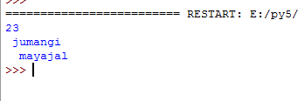
File Positions cont..
seek() :- The seek(offset[, from]) method changes the current file position.
The offset argument indicates the number of bytes to be moved.
The from argument specifies the reference position from where the bytes are to be moved.
Syntax:fileobject.seek(offset,[from])
fo = open("foo.txt", "w")
fo.write("Welcome to the world of jumangi \n mayajal")
fo.close()
fo=open("foo.txt",'r')
print(fo.seek(23))
print(fo.read())

Slide 10
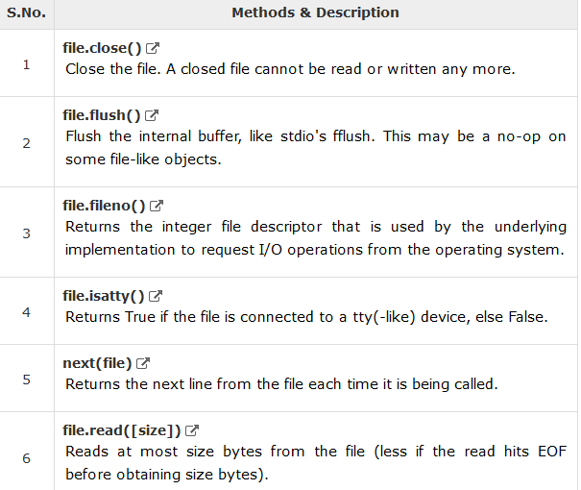
File methods
A file object is created using open function and here is a list of functions which can be called on this object

Slide 11
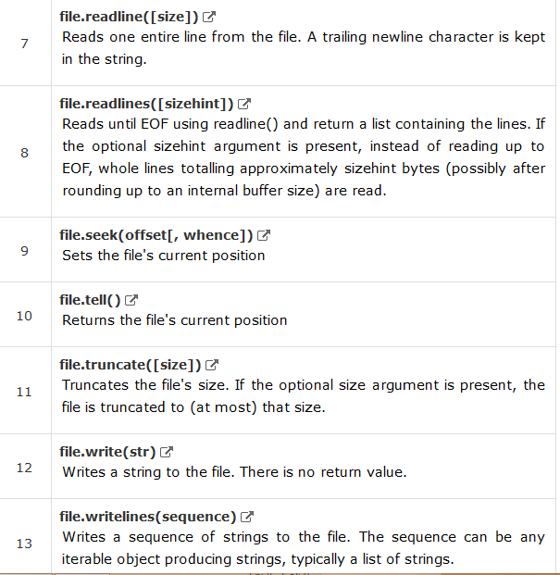
File methods cont…

Slide 12


Example :
Fileno ( ):-
fo = open("foo.txt", "wb")
print ("Name of the file: ", fo.name)
fid = fo.fileno()
print ("File Descriptor: ", fid)
fo.close()
Next() , isatty()
fd=open("foo.txt","r")
for index in range(2):
line=next(fd,-1)
print(index,line)
print(fd.isatty())#checks for the link with any terminal linked files
fd.close()

Slide 13
Pickle
It is used for serializing and de-serializing a Python object structure.
Pickling is a way to convert a python object (list, dict, etc.) into a character stream import the module through this command:
import pickle has two main methods: dump() and load().
Dump()-Used to dumps an object to a file object
Load()-Used to loads an object from a file object.
Syntax:pickle.dump(value,fileobject)Variable=pickle.load(fileobject)

Slide 14

Example
import pickle
f1=open("f1.txt","wb")
l1=[10,20,30]
l2=[40,50]
l_obj=(l1,l2)
pickle.dump(l_obj,f1)
f1.close()
f2=open("f1.txt","rb")
#(list1,list2)=pickle.load(f2)
#print("in list",list1,list2)
liste=pickle.load(f2)
print("in tuple",liste)
f2.close()

Slide 15

Shelve
It is used for serializing and de-serializing a Python object structure.
In pickle random access of an object is not possible where as it is possible using shelve.
Example :
import shelve
s=shelve.open("file1.txt","c")
l1=[10,20]
l2=[30,40]
s["lis1"]=l1
s["lis2"]=l2
for i,j in s.items():
print (i,j)

Slide 16
Programs
Write a python code to write multiple lines to a file

Slide 17
Quiz
1.Which of the following command is used to open a file “c:\temp.txt” in read-mode only?
A. infile = open(“c:\temp.txt”, “r”) B. infile = open(“c:\\temp.txt”, “r”) C. infile = open(file = “c:\temp.txt”, “r+”) D. infile = open(file = “c:\\temp.txt”, “r+”)

Slide 18
2.What will be the output of the following code snippet?
fo = open("myfile.txt", "w+")
print ("Name of the file: ", fo.name)
# Assuming that the file contains these lines
# TechBeamers
# Hello Viewers!!
seq="TechBeamers\nHello Viewers!!"
fo.writelines(seq )
fo.seek(0,0)
for line in fo:
print (line)
fo.close()
A. TechBeamers Hello viewers!! B. Name of the file: myfile.txt TechBeamers Hello Viewers!! C. TechBeamers Hello viewers!! D. Syntax Error

Slide 19
Solutions
fh = open(“hello.txt”,”w”)
lines_of_text = [“One line of text here”, “and another line here”, “and yet another here”, “and so on and so forth”]
fh.writelines(lines_of_text)
fh.close()
Answer. B
Answer. B

