Slide 1
Function
A function is a block of code which only runs when it is called.
You can pass data, known as parameters, into a function.
Provide better modularity and high degree of re usability
Creating a Function
A function in Python is defined by a def statement. The general syntax looks like this:
def function-name(Parameter list):
statements, i.e. the function body
Keyword def marks the start of function header.
A function name to uniquely identify it.
Parameters (arguments) through which we pass values to a function. They are optional.
A colon (:) to mark the end of function header.

Slide 2
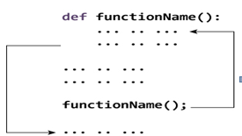
Example :
def my_function(): print("Hello from a function")
Calling a Function :
To call a function, use the function name followed by parenthesis
def my_function(): function definition
print("Hello from a function")
my_function() function call

Slide 3
Docstring
The first string after the function header is called the docstring and is short for documentation string.
def printme( str ):
"This prints a passed string into this function“ document string
print(printme.__doc__)
This prints a passed string into this function
Scope and Lifetime of variables
Lifetime of a variable is the period throughout which the variable exits in the memory
The lifetime of variables inside a function is as long as the function executes.
Parameters and variables defined inside a function is not visible from outside ,hence they have a local scope.
In order to modify the value of variables outside the function, they must be declared as global variables using the keyword global.

Slide 4
def my_func():
x = 10 local scope
print("Value inside function:",x)
x = 20 global scope
my_func()
print("Value outside function:",x)
Value inside function: 10
Value outside function: 20
In order to modify the value of variables outside the function, they must be declared as global variables using the keyword global.

Slide 5
Types of Function
Python supports:
– Built-in functions like print(),math functions,type conversion functions etc..
– User - defined functions
Python Built-in Function
The Python interpreter has a number of functions that are always available for use.
These functions are called built-in functions.
For example, print() function prints the given object to the standard output device (screen) or to the text stream file.

Slide 6
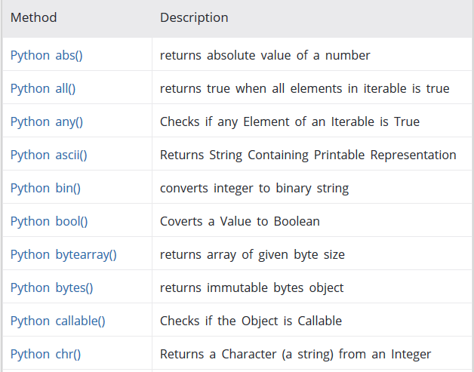
Built-in Functions

Slide 7
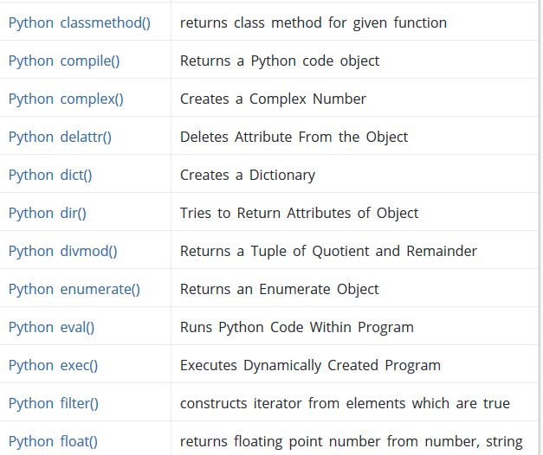
Built-in Functions cont…

Slide 8
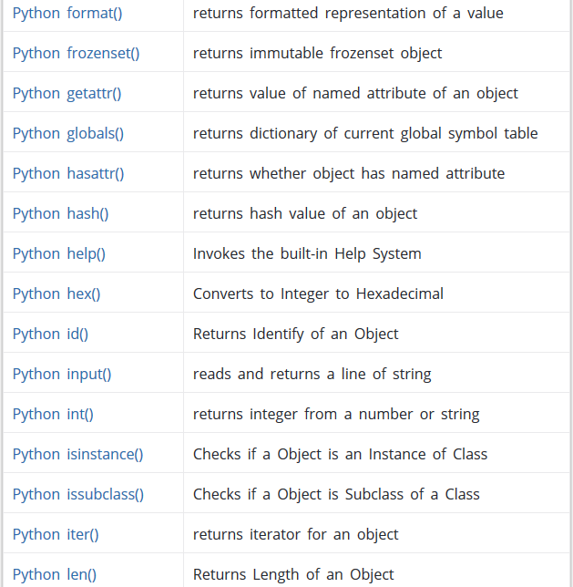
Built-in Functions cont…

Slide 9
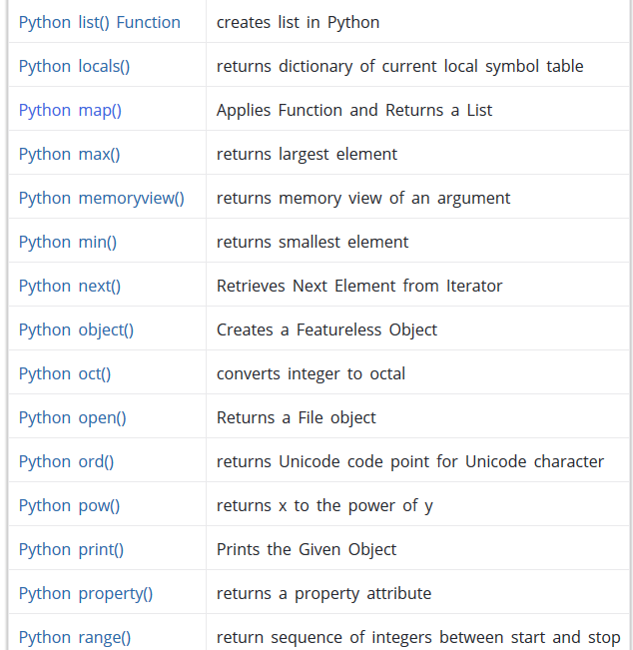
Built-in Functions cont…

Slide 10
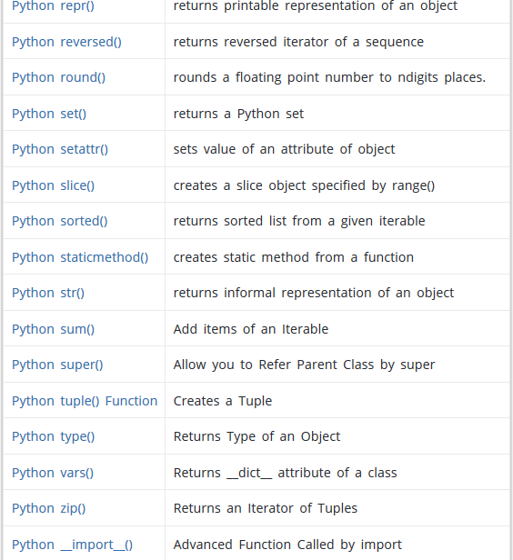
Built-in Functions cont…

Slide 11
User-defined Functions
Functions that we define ourselves to do certain specific task are referred as user-defined functions.
Parameters
Parameters are specified after the function name, inside the parentheses.
You can add as many parameters as you want, just separate them with a comma.
Example
def print_str(str1): # Defining function print_str(str1)
print("This function prints string passed as an argument")
print(str1)
print_str("Calling the user defined function”)
This function prints string passed as an argument
Calling the user defined function print_str(str1)

Slide 12
Function Arguments
You can call a function by using the following types of formal arguments
Required arguments
Keyword arguments
Default arguments
Variable-length arguments
1.Required arguments
Arguments follow positional order
No. of arguments and the order of arguments in the function call should be exactly same as that in function definition
def add_numbers(x,y): # Function Definition
sum = x + y
return sum
num1 = 5
num2 = 6
print("The sum is", add_numbers(num1, num2)) # Function Invocation without required arguments
The sum is 11

Slide 13
2.Keyword arguments
when used in function call, the calling function identifies the argument by parameter name
Allows you to skip arguments or place them out of order
Python Interpreter uses the keyword provided to match the values with parameters
Once the value for keyword is provided in argument ,all value to its right side must hold the value for defined keyword
Example 1:
def customer_details (cust_id, cust_name): # Function Definition
print("This function prints Customer details")
print("Customer Id: ",cust_id)
print("Customer Name: ",cust_name)
return
customer_details(cust_name = "John", cust_id = 101) # Function Invocation with Keyword arg
Customer Id: 101
Customer Name: John

Slide 14
3. Default arguments
Default arguments are those that take a default value if no argument value is passed during the function call.
You can assign this default value by with the assignment operator =
Example 1:
def plus(a, b = 2): # b is default parameter
return a + b
plus(a=1)
plus(a=1, b=3) # default values of b get updated as 3 if provided
3
4

Slide 15
4.Variable-length arguments
In cases where you don’t know the exact number of arguments that you want to pass to a function, you can use the following syntax with *args
The asterisk (*) is placed before the variable name that holds the values of all nonkeyword variable arguments.
Example 1:
def plus(*args):
total = 0
for i in args:
total += i
return total # Calculate the sum
plus(20,30,40,50)
140

Slide 16
The Anonymous Functions
These functions are called anonymous because they are not declared in the standard manner by using the
def keyword.
Lambda forms can take any number of arguments but return just one value in the form of an expression. They cannot contain commands or multiple expressions.
Lambda functions have their own local namespace and cannot access variables other than those in their parameter list and those in the global namespace
Syntax : lambda [arg1 [,arg2,.....argn]]:expression
Example 1:
Using Function Using lamda Function
def f(x): f = lambda x : x*2 #function definition
return x*2
f(3) f(3) # function call
6 6

Slide 17
The Anonymous Functions cont….
Example 2:
Using Function Using lamda Function
def f(x,y): f = lambda x,y : x*y #function definition
return x*y
f(3,6) f(3,6) # function call
18 18
This is a lambda function that accomplishes the same thing as the normal function above it.
Note the abbreviated syntax here: there are no parentheses around the argument list, and the return keyword is missing (it is implied, since the entire function can only be one expression).
Also, the function has no name, but it can be called through the variable it is assigned to.
In the above example the values of x,y is passed from the function call f(3,6) in both cases

Slide 18
The Anonymous Functions cont….
You can use a lambda function without even assigning it to a variable.
This may not be the most useful thing in the world, but it just goes to show that a lambda is just an in-line function.
Example 2:
>>>(lambda x: x*2)(3)
6
You use anonymous functions when you require a nameless function for a short period of time and that is created at runtime.
Lambda with filter(), map() and reduce()
map( )
map functions expects a function object and any number of iterables like list, dictionary, etc. It executes the function_object for each element in the sequence and returns a list of the elements modified by the function object.
Syntax : map(function_object, iterable1, iterable2,...)

Slide 19
The Anonymous Functions cont….
Example :
def multiply2(x):
return x * 2
map(multiply2, [1, 2, 3, 4])
[2, 4, 6, 8]
In the above example, map executes multiply2 function for each element in the list i.e. 1, 2, 3, 4 and returns [2, 4
, 6, 8].
Let’s see how we can write the above code using map and lambda.
Example 1:
map(lambda x : x*2, [1, 2, 3, 4])
[2, 4, 6, 8]
Example 2:
my list = [1,2,3,4,5,6,7,8,9,10]
mapped_list = list(map(lambda x: x*2, my_list)) # Use lambda function with `map()`
print(mapped_list)
[2, 4, 6, 8, 10, 12, 14, 16, 18, 20]

Slide 20
The Anonymous Functions cont….
Filter ( )
filter function expects two arguments, function_object and an iterable. function_object returns a boolean value.
function_object is called for each element of the iterable and filter returns only those element for which the function_object returns true.
Like map function, filter function also returns a list of element. Unlike map function filter function can only have one iterable as input.
Example 1:
my list = [1,2,3,4,5,6,7,8,9,10]
filtered_list = list(filter(lambda x: (x*2 > 10), my_list)) # Use lambda function with `filter()`
print(filtered_list)
[6, 7, 8, 9, 10]

Slide 21
The Anonymous Functions cont…
Reduce ( )
Reduce is a really useful function for performing some computation on a list and returning the result. It applies a rolling computation to sequential pairs of values in a list. For example, if you wanted to compute the product of a list of integers.
So the normal way you might go about doing this task in python is using a basic for loop:
Example1 :
product = 1
list = [1, 2, 3, 4]
for num in list:
product = product * num
24
Let’s see how we can write the above code using reduce and lambda.
from functools import reduce
product = reduce((lambda x, y: x * y), [1, 2, 3, 4])
24

Slide 22
Example2 :
my list = [1,2,3,4,5,6,7,8,9,10]
from functools import reduce
reduced_list = reduce(lambda x, y: x+y, my_list) # Use lambda function with `reduce()`
print(reduced_list)
55
Example3:
number_list = range(-5, 5)
less_than_zero = list(filter(lambda x: x < 0, number_list))
print(less_than_zero)
[-5, -4, -3, -2, -1]

Slide 23
Program
1. Write a Python function to find the Max of three numbers.
2.Write a Python function to sum all the numbers in a list.

Slide 24
Solution
1.def max_of_two( x, y ):
if x > y:
return x
return y
def max_of_three( x, y, z ):
return max_of_two( x, max_of_two( y, z ) )
print(max_of_three(3, 6, -5))
2.def sum(numbers):
total = 0
for x in numbers:
total += x
return total
print(sum((8, 2, 3, 0, 7)))

Slide 25
Quiz
1.Which of the following statements correctly represent the function body in the given code snippet?
def f(number):
# Missing function body
print(f(5))
A. return “number” B. print(number) C. print(“number”) D. return number
2. def myfunc(text, num):
while num > 0:
print(text) num = num – 1
myfunc('Hello', 4)
A. HelloHelloHelloHelloHello B. HelloHelloHelloHello C. invalid call D. infinite loop

Slide 26
solution
1. D. return number
2. D. infinite loop

