Slide 1
Logo
B
User Profile
Logout

Slide 2




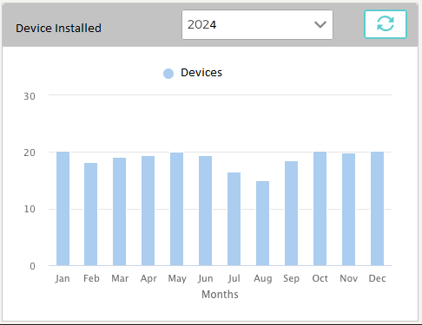
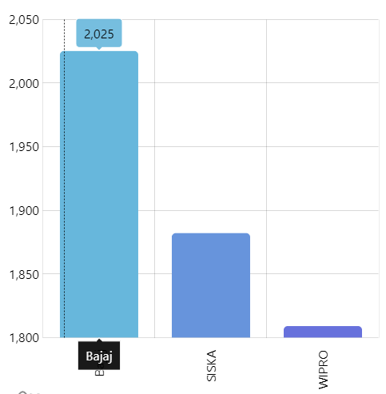
Logo
B
Dashboard
All Devices
----------------
1000
Comunicating
----------------
900
Comunicated before 24 hours
----------------
20
Not communicating
----------------
80
Top 5 Customers

Slide 3



Logo
B
Users
User id
Submit
Add
Sl no | User id | name | Email Id | User Roles | customers | Action
1 | bala | Bala krishna | abc@email.com | Admin role,test role | Abc, xyz

Slide 4
Logo
B
Add User
User id
Name
Email Id
Roles
Customers
Submit

Slide 5
Logo
B
Customers
Customer Name
Submit
Add
Sl no | name | Email Id | Action
1 | Abc | abc@email.com

Slide 6
Logo
B
Customers
Customer Name
Email Id
Customer Logo
Submit

Slide 7
Logo
B
Roles
Role Name
Submit
Add
Sl no | name | Action
1 | Abc

Slide 8
Logo
B
Roles
Roles Name
List
Selected List
Dashboard
Reports
Customers
Users
Submit

Slide 9
Logo
B
Device details location wise
State dropdown
District dropdown
Village dropdown
Submit
Add
Sl no | IMEI no | Location | Last communicated Time | Action
1 | 123456789 | xyz | 12/02/2024 10:12:00

Slide 10
Logo
B
Add Device
State dropdown
District dropdown
Village dropdown
IMEI no
Submit

Slide 11
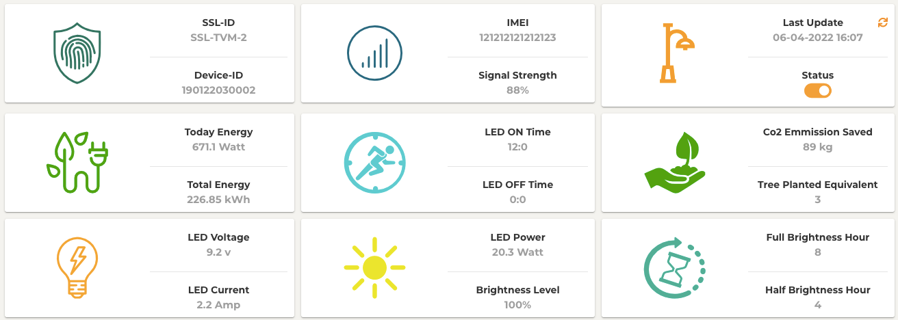
Logo
B
Device Status
IMEI no
Submit

