Slide 1
Performance Analysis of MPI Over Cluster
Presented by:
Achuth P V, Aniruddh Rao K, Avishkar P

Slide 2
Introduction
Cluster: Widely used in HPC to scale computing
MPI: Message Passing Interface (Standard)
OPENMPI
MVAPICH
MPICH
Communication methods
Ethernet
InfiniBand
Shared Memory
RDMA
CUDA and CUDA aware MPI
CPU-GPU
GPU-GPU (GPU Direct)

Slide 3
Tools and Methods for MPI
Cluster of 2 machines each with 16 CPU cores connected by
IP over InfiniBand
Ethernet
MPI Implementations used:
OPENMPI v 1.8.4
MVAPICH2 v 2.1
Modes of communication:
InfiniBand
Ethernet
Shared Memory
Matrix Multiplication test code
Matrix size from 2000x2000 to 10000x10000
With number of processes ranging from 8 to 32

Slide 4
Tools and Methods for CUDA aware MPI
Setup cluster of 2 machines each with 4 CPU cores, GT 640 NVIDIA CUDA card
CUDA Aware MPI
CUDA Over MPI
MPI Implementations used:
OPENMPI v 1.8.8
MVAPICH2 v 2.1
Modes of communication:
Ethernet
Shared Memory
Test code
Message sending code and Matrix multiplication
Message size varying from 1 Byte to 4MB

Slide 5
Code flow and Plots for MPI
Code flow : At Each Node
Broadcast B
Transfer part of A from PE 0 to others
Compute part of C
Transfer part of C from all processes to PE 0
Plotting : (with fixed number of processes: 8, 16 and 32 for matrix size from 2000x2000 to 10000x10000 and different modes of communication Viz InfiniBand, Ethernet and Shared Memory)
Plot for Full timing of code
Plot for time taken to transfer A
Plot for time taken to broadcast B
Plot for time taken to transfer C

Slide 6
Plots for full timing of Code

Slide 7
Plots for time taken to transfer A

Slide 8
Plots for time taken to Broadcast B

Slide 9
Plots for time taken to transfer C

Slide 10
Observations and Inference
InfiniBand Communication faster than Ethernet
Clear in OpenMPI
Not so clear in MVAPICH2
Intra process Communication faster than both InfiniBand and Ethernet
For Small N (matrix size), InfiniBand comparable to Intra Process
With increased np, computation time per node decreases, but communication time remains almost same
Each node gets lesser number of computations
Time to Bcast B is largest among all communications and remains same
OpenMPI has better performance than MVAPICH
May be due to configuration of MVAPICH (was setup by us –without much knowledge of configuration)
Non Blocking vs Blocking
Non-blocking is faster
But Non-blocking is inconsistent

Slide 11
Code flow and Plots for CUDA over MPI
Code Flow of matrix multiplication
Send Parts of A and B to other processes
Use GPU to compute
Send back Computed part of C to main process
Plotting (Done for 4 processes: with 2 machines having GPU or only one machine)
Plots for BW measurement for CUDA over MPI and CUDA aware MPI
Plots for time taken to transfer A and B
Plots for time taken to transfer C
Plots for time taken for complete code execution

Slide 12
Bandwidth vs Data transferred for CUDA Over and Aware MPI

Slide 13
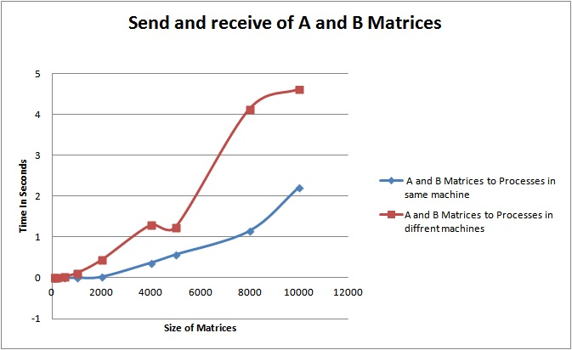
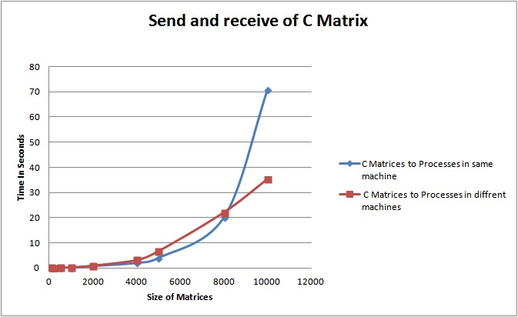
Plots for time taken to transfer A and B, time taken to transfer C

Slide 14
Plot for complete execution time

Slide 15
Observations and Inference
Communication was over GbE network
Bandwidth in CUDA-Aware-MPI is relatively higher than CUDA-over-MPI for same node.
Bandwidth was same for small matrices and then CUDA-over-MPI Bandwidth got deteriorated for big matrices for different nodes
Transfer over network is slower compared to intra node inter process transfer
For larger matrices inter node transfer is getting slower – may be due to shared memory/virtual memory access

