Slide 1


MUSIC INSTRUMENT CLASSIFICATION BASED ON SPECTROGRAMS
Group - 1
Notes:
1

Slide 2
Team Composition
Achyuth S.S | PES1UG21EC010
Akshay Angadi | PES1UG21EC030
Ananya Belavadi S | PES1UG21EC035
Guide : Prof Ashwini Bhat (ECE)
2

Slide 3
Contents
Introduction
Problem Statement
AST Architecture
ViT Model
Results and Comparison
References
3

Slide 4
PROBLEM STATEMENT
The spectrogram is a representation of the audio recording that shows the energy of the recording at different frequencies and times. This representation can be used to identify the different instruments that are being played in the recording.
To solve this problem, we are using ViT Classifier, Audio spectrogram transformer Architectures that is trained on a dataset of spectrograms and their corresponding instrument labels. The model can then be used to classify new spectrograms.

Slide 5
Audio Spectrogram Transformer Architecture
Music instrument classification is an exciting challenge in the
field of audio processing and machine learning. The goal is to
build a system that can automatically identify different musical
instruments from audio recordings.
One effective approach to this task involves using spectrograms,
which provide a visual representation of the audio signal’s
frequency content over time. Another crucial component is the
use of the AST (Audio Spectrogram Transformer) architecture,
which is a neural network architecture designed specifically for
audio-related tasks.

Slide 6
METHODOLOGY
1. Data Collection and Preprocessing:
Gather a diverse dataset of audio recordings containing various musical instruments playing different notes and phrases. Preprocess the audio data by normalizing, resampling, and removing background noise to improve data quality.
2. Spectrogram Generation:
Convert the preprocessed audio data into spectrogram representations using the Short-Time Fourier Transform (STFT) or other time-frequency analysis techniques.
4. Deployment of Model
Done after checking accuracy, F1 scores etc
3. Train / Validation / Test Split (Cross-Validation):
Split the dataset into training, validation, and testing sets.

Slide 7
Audio Preprocessing
Cros-Validation
Denoising corrupted music samples
AST Model
Mel Spectrograms
Measure accuracy, F1 scores
Training Audio Input
Testing Audio Input

Slide 8
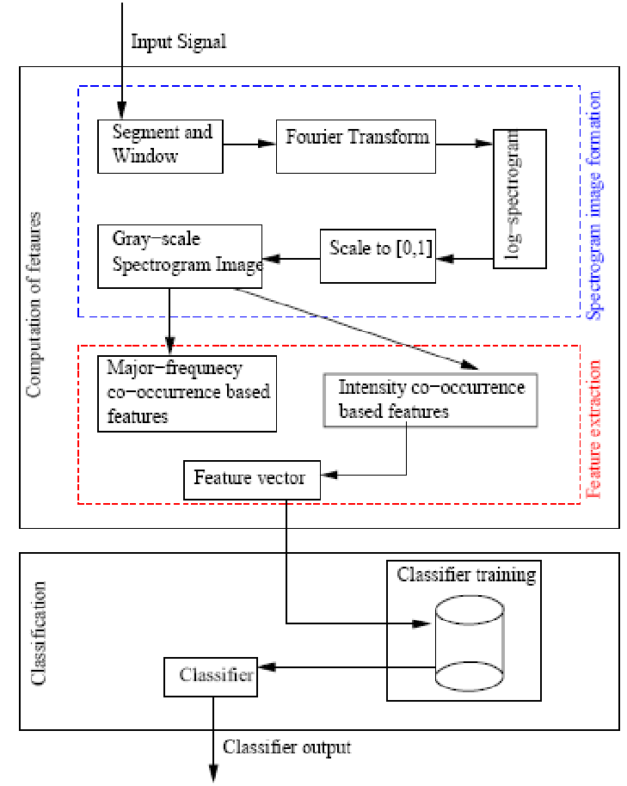
BLOCK DIAGRAM

Slide 9
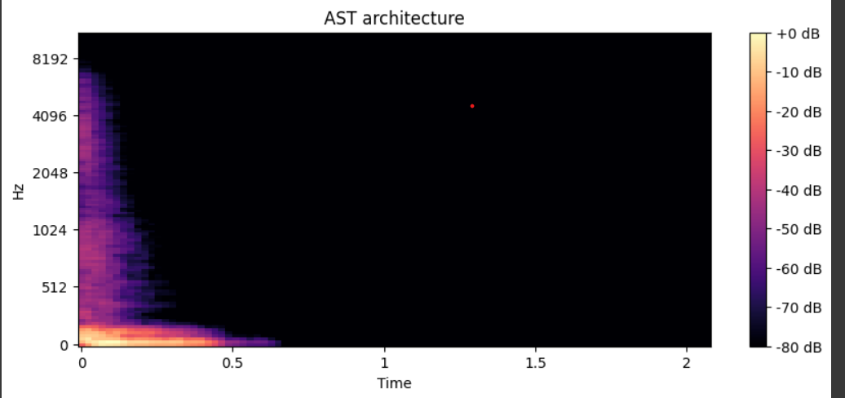
An instance of spectrogram generated using AST model for Saxophone

Slide 10
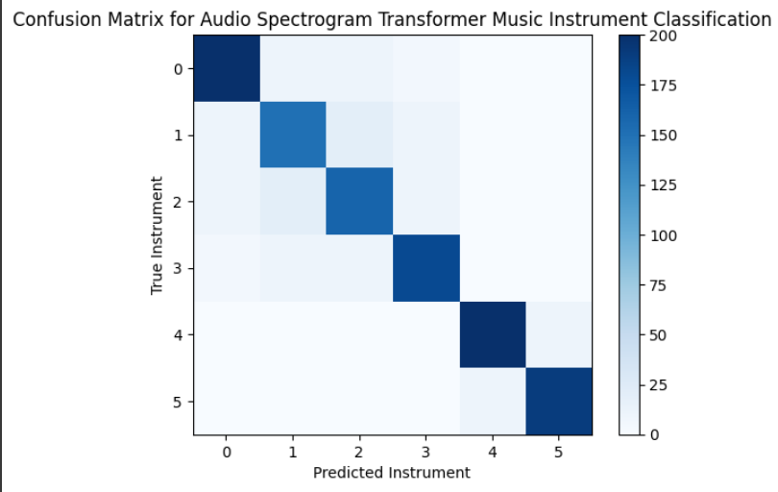
CONFUSION MATRIX

Slide 11
VISION-TRANSFORMERS CLASSIFIER
Music instrument classification is a fascinating task in the field of audio processing and machine learning. The goal is to develop an automated system that can accurately identify different musical instruments from audio recordings. One of the most common approaches for this task is to use the spectrogram, a visual representation of the audio signal's frequency content over time. The spectrogram provides valuable information about the timbre and harmonic characteristics of each instrument, making it a suitable input for machine learning models.
In recent years, Vision Transformer (ViT) models have gained popularity in computer vision tasks due to their impressive performance in image recognition and object detection. The ViT model utilizes the transformer architecture, originally designed for natural language processing, to process image patches and learn global contextual information from the entire image.

Slide 12
Input: Music Instrument Audio samples
Mel Spectrogram Extraction:
* Convert the audio clip to a time-domain signal.
* Apply a short-time Fourier transform (STFT) to the time-domain signal.
* Compute the mel spectrogram from the STFT coefficients.
Vision Transformer Model:
* The mel spectrogram is fed into a vision transformer model.
* The vision transformer model learns to extract the features of the mel spectrogram that are relevant for music instrument classification.
Classification:
* The output of the vision transformer model is passed through a ViT classifier.
* The classifier predicts the dominant instruments present in the audio clip as integers.

Slide 13
Vision transformer model: A vision transformer is a type of deep learning model that is used for image recognition. Vision transformers have been shown to be very effective for a variety of tasks, including music instrument classification.
Classification: The classifier is a machine learning model that is used to predict the class label of an input. In the case of music instrument classification, the classifier predicts the dominant instruments present in the audio clip.

Slide 14
Data Collection and Preprocessing:
Gather a diverse dataset of audio recordings containing various musical instruments. The dataset should cover different playing styles, pitches, and recording conditions.
Preprocess the audio data to create spectrogram representations. Divide the audio signals into short overlapping segments and apply a Fourier transform to each segment to obtain the magnitude of the frequency-domain representation. This results in a 2D image-like representation, where time is on the x-axis, and frequency is on the y-axis.
Split the Dataset:
Divide the dataset into training, validation, and testing sets. The training set is used to train the model, the validation set is used to tune hyperparameters and monitor performance, and the testing set is used to evaluate the final model.

Slide 15
Vision Transformer Model Architecture:
Adapt the Vision Transformer (ViT) architecture for music instrument classification. The ViT model processes 2D image-like data through self-attention layers, capturing global contextual information effectively.
Modify the input patch size and model dimensions to accommodate the spectrogram images. Consider the number of instruments you want to classify and adjust the output layer accordingly.
Evaluation:
Calculate metrics such as accuracy, precision, recall, F1 score, and confusion matrix to assess the model's effectiveness in instrument classification.

Slide 16
Audio Preprocessing
Cross-Validation
Mel Spectrograms
ViT Model
Measure accuracy, F1 scores
Instrument identification
Training Audio Input
Testing Audio Input

Slide 17
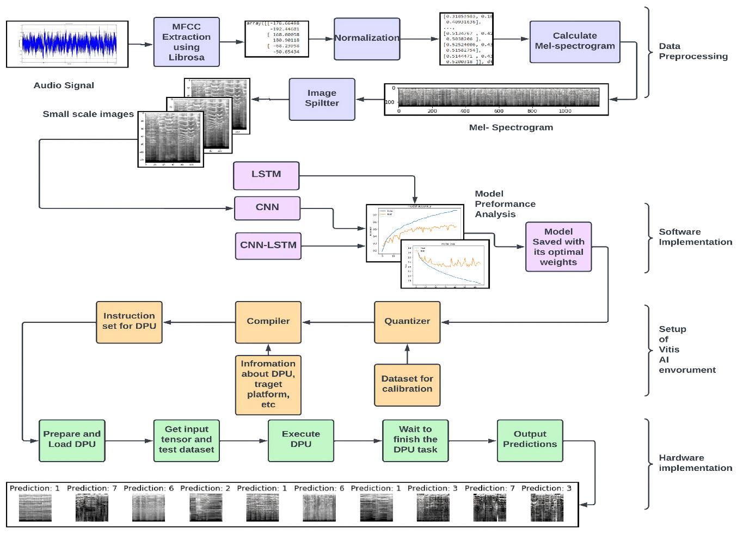
BLOCK DIAGRAM

Slide 18
IMPLEMENTATION
from sklearn.metrics import confusion_matrix
import numpy as np
import pandas as pd
import matplotlib.pyplot as plt
from sklearn import metrics
true_labels = ['trumpet', 'cello', 'flute', 'sax', 'viola', 'oboe']
predicted_labels = [1, 3, 5, 2, 4, 0]
# Create a mapping between string labels and integer representations
label_map = {'trumpet': 1, 'cello': 3, 'flute' : 5, 'sax' : 2, 'viola' : 4, 'oboe' : 0}
# Convert the true and predicted labels to integer representations
true_labels_int = [label_map[label] for label in true_labels]
predicted_labels_int = [label_map[label] if isinstance(label, str) else label for label in predicted_labels]
# Get the unique classes (integer labels) from both sets of labels
classes = np.unique(true_labels_int + predicted_labels_int)

Slide 19
# Generate the confusion matrix
cm = confusion_matrix(true_labels_int, predicted_labels_int, labels=classes)
#print(cm)
cm_display = metrics.ConfusionMatrixDisplay(confusion_matrix = cm)
cm_display.plot()
plt.show()

Slide 20
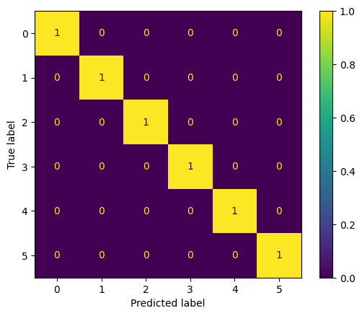
CONFUSION MATRIX

Slide 21
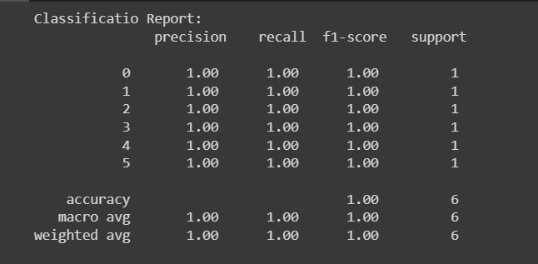

from sklearn.metrics import classification_report
#tn, fp, fn, tp = confusion_matrix().ravel()
#(tn, fp, fn, tp)
#Confusion Matrix metrics
matrix = classification_report(true_labels_int, predicted_labels_int)
print("Classificatio Report: \n", matrix)
Accuracy = metrics.accuracy_score(true_labels_int, predicted_labels_int)
print(Accuracy)

Slide 22
Applications
Automatic music transcription: This is the process of automatically converting an audio recording of music into a musical score. One of the steps in automatic music transcription is to identify the different instruments that are being played in the recording. This can be done using spectrogram classification.
Music information retrieval: This is the process of retrieving information about music, such as the title, artist, and lyrics of a song. One of the tasks in music information retrieval is to identify the different instruments that are being played in a song. This can be done using spectrogram classification.
Music recommendation: This is the process of recommending music to users based on their listening history and preferences. One of the factors that can be used to recommend music is the type of instruments that are being played in the music. This can be done using spectrogram classification.
Music generation: This is the process of creating new music, such as by generating new melodies, chords, or rhythms. One of the steps in music generation is to identify the type of instruments that should be used in the music. This can be done using spectrogram classification.
Music education: This is the process of teaching people about music. One of the ways that music can be taught is by using spectrograms to illustrate the different sounds that are produced by different instruments.

Slide 23
References
1. Birajdar, G.K., Patil, M.D. Speech and music classification using spectrogram based statistical descriptors and extreme learning machine. Multimed Tools Appl 78, 15141–15168 (2019).
https://doi.org/10.1007/s11042-018-6899-z
2. Arijit Ghosal, R. Chakraborty, Bibhas Chandra Dhara, and Sanjoy Kumar Saha, “Song/instrumental classification using spectrogram based contextual features,” Sep. 2012, doi: https://doi.org/10.1145/2381716.2381722

Slide 24
THANK YOU

