Slide 1
Image Classification Using Graph Convolutional Networks
Team Elite:
Achyuth Pothuganti
Phanindra Chowdary Borra
Venkata Sai Veyyagandla
Surya Prakash Bandam

Slide 2
Project Overview
About the Project: This project focuses on classifying natural scene images using Graph Neural Networks (GNNs). Two approaches were implemented to convert images into graph-based representations for classification.
About the Dataset:
Context: Image data of natural scenes from around the world.
Content:
Size: 24,000 images of 150x150 resolution.
Categories: Buildings (0), Forest (1), Glacier (2), Mountain (3), Sea (4), Street (5).
Splits: 14,000 images for training, 3,000 for testing, and 7,000 for prediction. Originally published on the Intel Image Classification Challenge.

Slide 3
Approaches for Graph-Based Image Classification
Approach 1: Delaunay Triangulation
Steps:
Images are resized to 32x32 pixels.
Each pixel is treated as a node in the graph.
Nodes are connected using Delaunay Triangulation, forming edges between neighboring pixels.
Features for each node include pixel color values.
GCNs are trained using the graph representations for classification.
Approach 2: SLIC Segmentation
Steps:
Images are segmented into superpixels using SLIC.
Superpixels serve as graph nodes with features such as color, eccentricity, solidity, etc.
Region Adjacency Graphs (RAGs) are created, connecting adjacent superpixels.
Graph Convolutional Networks (GCNs) are trained for classification.

Slide 4
Delaunay Preprocessing
Steps:
Resized images to 32x32 for efficiency.
Extracted pixel RGB values as node features.
Applied Delaunay Triangulation for edges between neighboring pixels.
Graphs prepared using PyTorch Geometric.
Output: Graphs with pixel-level features for GNN training.

Slide 5
Model 1 - Delaunay Triangulation
Model Architecture:
Graph Convolutional Layers:
Layer 1: Input (3 RGB features) → Hidden (256 features).
Layer 2: Hidden (256 features) → Hidden (128 features).
Layer 3: Hidden (128 features) → Hidden (64 features).
ReLU activation applied for non-linearity after each layer.
Batch Normalization applied after the 2nd and 3rd layers for stabilization.
Global Mean Pooling: Aggregates node-level features into a graph-level representation.
Fully Connected Layer: Maps graph-level features to 6 output classes (e.g., buildings, forest).
Training:
Optimizer: Adam
Learning Rate: 0.001
Loss: CrossEntropy.
Epochs: 10
Batch size 32

Slide 6
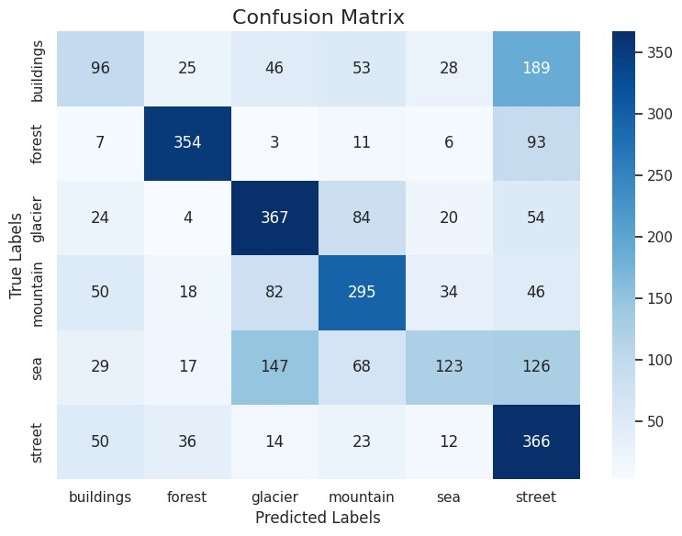
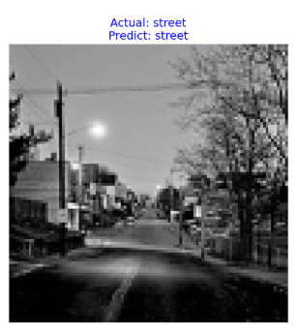
Results - Delaunay Triangulation
Performance:
Test Accuracy: 55.57%.
Strong Classes: Glacier (367 correct), Street (366 correct).
Misclassifications: Buildings as Street, Sea as Glacier.
Insights:
Effective for pixel-level representation.
Challenges with visually similar classes.

Slide 7
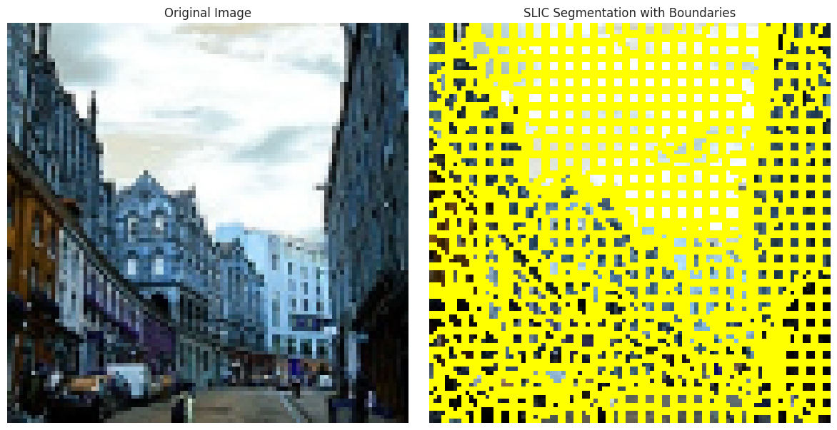
SLIC Preprocessing
Parameters Used:
n_segments: 400
sigma: 1
compactness: 1
Steps:
Segmented images into 400 superpixels using SLIC.
Extracted node features: Mean color, eccentricity, solidity,Centroid, perimeter.
Created Region Adjacency Graphs (RAGs) connecting adjacent superpixels.
Converted RAGs to PyTorch Geometric graphs for classification.
Output: Graphs with superpixel-level features.

Slide 8
Model 2 - SLIC Segmentation
Model Architecture:
Graph Convolutional Layers:
3 GCN layers with BatchNorm and ReLU activations.
Input: 9 features per superpixel (e.g., mean color, eccentricity, solidity).
Hidden Dimensions: 512 → 256 → 128.
Fully Connected Layers:
Hidden Layer: 128 → 64.
Output Layer: 64 → 6 classes (categories).
Dropout: 30% to prevent overfitting.
Global Mean Pooling: Aggregates graph-level information.
Training:
Optimizer: Adam
Batch size:32
Learning Rate: 0.001
Loss: CrossEntropy.
Epochs: 100

Slide 9
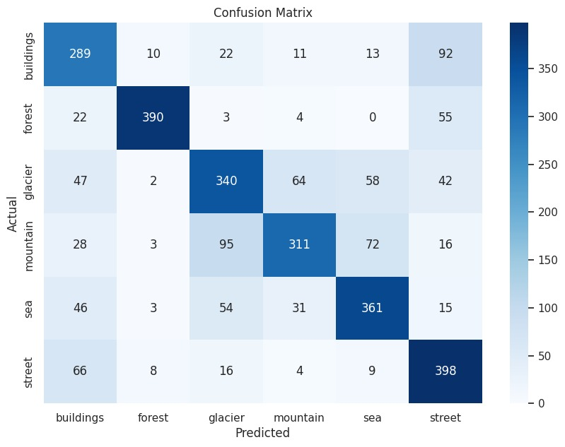
Results - SLIC Segmentation
Performance:
Test Accuracy: 73.0%.
Strong Classes: Forest (390 correct), Street (398 correct).
Misclassifications: Glacier as Mountain, Sea as Glacier.
Insights:
Superior for capturing regional features.

Slide 10
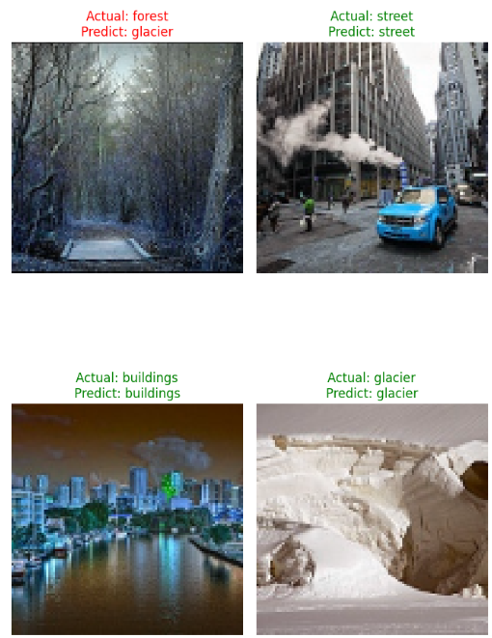
Results - SLIC Segmentation

Slide 11
Conclusion
Key Insights:
Delaunay Triangulation:
Graph Generation: Faster, as pixel-level graphs are straightforward to generate.
Model Training: Takes longer due to the higher complexity of pixel-level graph representations.
SLIC Method:
Graph Conversion and Feature Extraction: More time-consuming due to superpixel segmentation and feature computation.
Model Training: Faster due to the reduced complexity of superpixel-level graphs.
Performance Comparison:
SLIC Model:
Provides better results with higher accuracy, especially for distinct classes.
Demonstrates the effectiveness of regional feature-based graph representations.

