Slide 1

Storying the Streets:
A Narrative Intelligence Approach to
Crime Data Analysis
IS597 – Machine Learning Cloud
Group 6 - Final Technical Report
Praveena Palani Acharya • Achyutha Sushanth Ariga • Rohith Jagadeesan

Slide 2
Abstract & Problem Statement
The Challenge:
Urban crime analysis relies on ML models achieving high predictive accuracy but providing limited interpretability for policymakers. Traditional approaches fail to explain WHY predictions occur or HOW patterns emerge.
Why is this a problem and What is Needed?
Feature importance (e.g., SHAP) shows which inputs matter but not how real events and contexts shape patterns.
Example gap:
  Model: “85% arrest probability”
  Missing: Why is this high? What historical, spatial, or socio-political context contributed?
We need a system that connects:
  Quantitative statistics → crime patterns
  Qualitative context → news narratives, local events
  Interpretability → explanations humans can act on
Research Objectives
Demonstrate ML limitations: High accuracy (77%) but low narrative value
Develop Hybrid RAG system combining semantic + rule-based + LLM synthesis
Quantify temporal/spatial patterns through comprehensive EDA
Generate actionable insights transforming statistics into contextual stories
Our Innovation: Three-Tier Hybrid RAG System
1.88M Chicago crime records (2018-2025) + 15K Tribune articles
Semantic search via SentenceTransformers (all-MiniLM-L6-v2) + FAISS
Deterministic linking: ±3 days temporal + keyword + location matching
LLM synthesis: Google Gemini generates human-readable narratives
Result: Scalable framework bridging quantitative analysis and qualitative understanding—transforming 'what happened' into 'why it happened and what it means'

Slide 3
Dataset Overview & Scale
Chicago Crime Dataset (Chicago Data Portal)
1,883,142 crime incidents (2018-2025)
33 attributes: Date, Primary Type, Block, Location, Arrest, District, Ward, Coordinates
Coverage: All 77 Chicago community areas, 22 police districts
Data quality: <2% missing values, 0.5% duplicates removed
Chicago Tribune News Dataset (ProQuest Archives)
15,247 crime-related articles (2018-2025)
Fields: Title, Full Text, Publication Date, Author, Subject
Article length: 150-2500 words (mean: 680 words)
Coverage bias: 65% violent crimes vs 35% property crimes
Preprocessing Pipeline
Crime Data:
Temporal features: Hour, Day, Month, Season, Weekend
Spatial: BlockNorm, Dist-to-Police, Dist-to-CTA
Categories: Violent vs Non-Violent classification
News Data:
Text cleaning: HTML removal, lowercasing
Sentiment analysis: VADER polarity (-1 to +1)
Keyword tagging: Crime type dictionary
Truncation: 1500 chars for embedding efficiency
Scale Challenge: 1.88M crimes vs 15K articles (125:1 ratio) → Solution: Aggregate into 142,635 crime chunks (92% compression)

Slide 4
Key EDA Findings: Temporal & Spatial Patterns
Temporal Trends
Crime declined since 2016 with COVID-19 dip (2020-21). Strong seasonality: peaks June-August, drops in winter. Highest activity Friday-Saturday, 6 PM-midnight.
Spatial Hotspots
Persistent concentration in Districts 11, 8, 6 and Wards 42, 28 (West/South Chicago). Reflects historical socioeconomic disparities.
Media Analysis
Crime Categories
Top types: Theft, Battery, Criminal Damage (~50% of incidents). Streets, apartments, residences are primary locations. Only ~25% arrest rate overall.
Moderate correlation with crime rates; slightly negative, reactive coverage.
Temporal Patterns
Some Key Findings
Seasonality:
Summer peak: 180K/month (Jun-Aug)
Winter low: 135K/month (Dec-Feb)
33% variance driven by temperature
Weekly Distribution:
Friday-Saturday: 280K each (15-16%)
Weekdays uniform: ~240K each
Hourly Bimodal Pattern:
Noon peak: 110K incidents
Midnight peak: 120K incidents
4-6 AM minimum: 35K incidents
Yearly Trends:
2020-2021 dip: 205K (COVID lockdowns)
2023-2024 peak: 260K (post-COVID recovery)
Spatial Patterns & Hotspots
Top 3 Districts: D11 (174K West), D8 (172K South), D6 (166K Southwest)
Concentration: 60% incidents in 30% of geographic areas
CTA correlation: Mean 0.35km, Median 0.28km to transit stops
Arrest rate disparity: Narcotics 95%, Gambling 98% vs Theft 11%, Burglary 9%

Slide 5
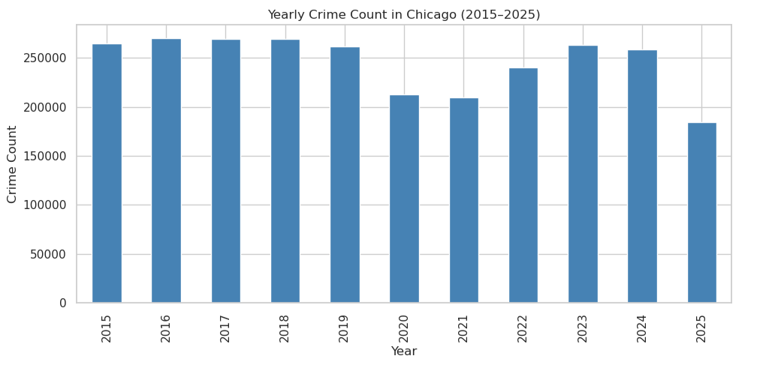
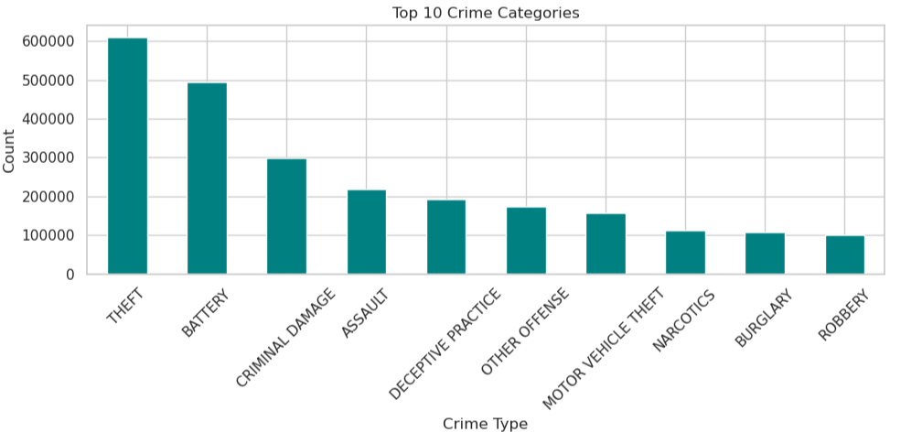
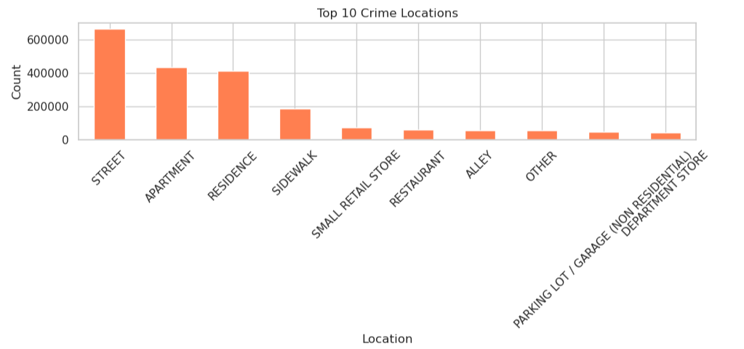
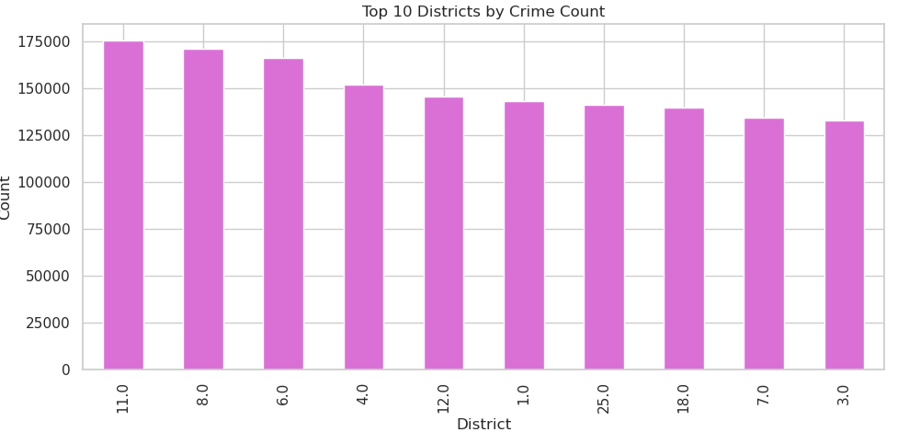
Exploratory Data Analysis: Visual Representations

Slide 6
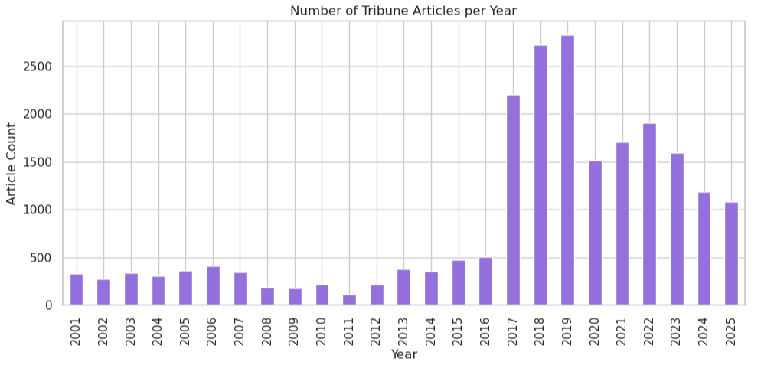
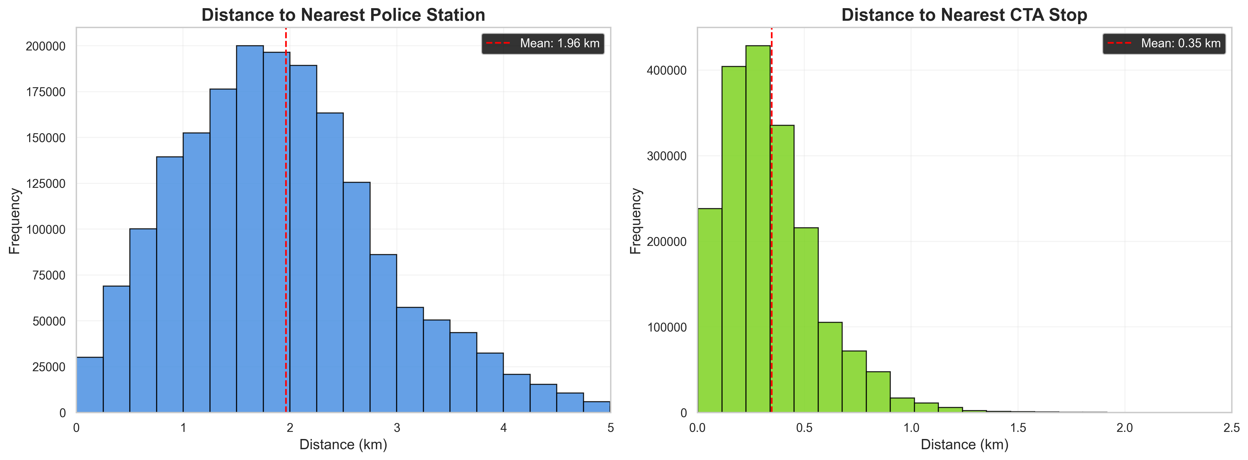
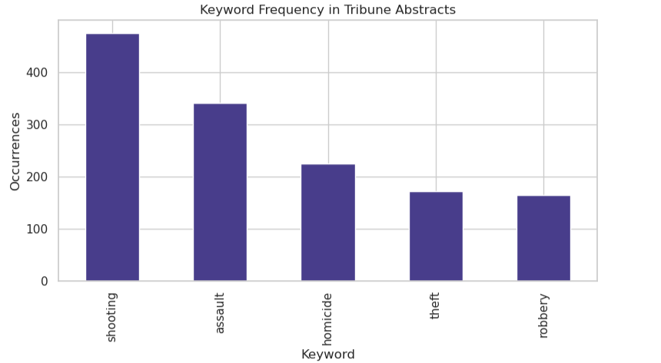
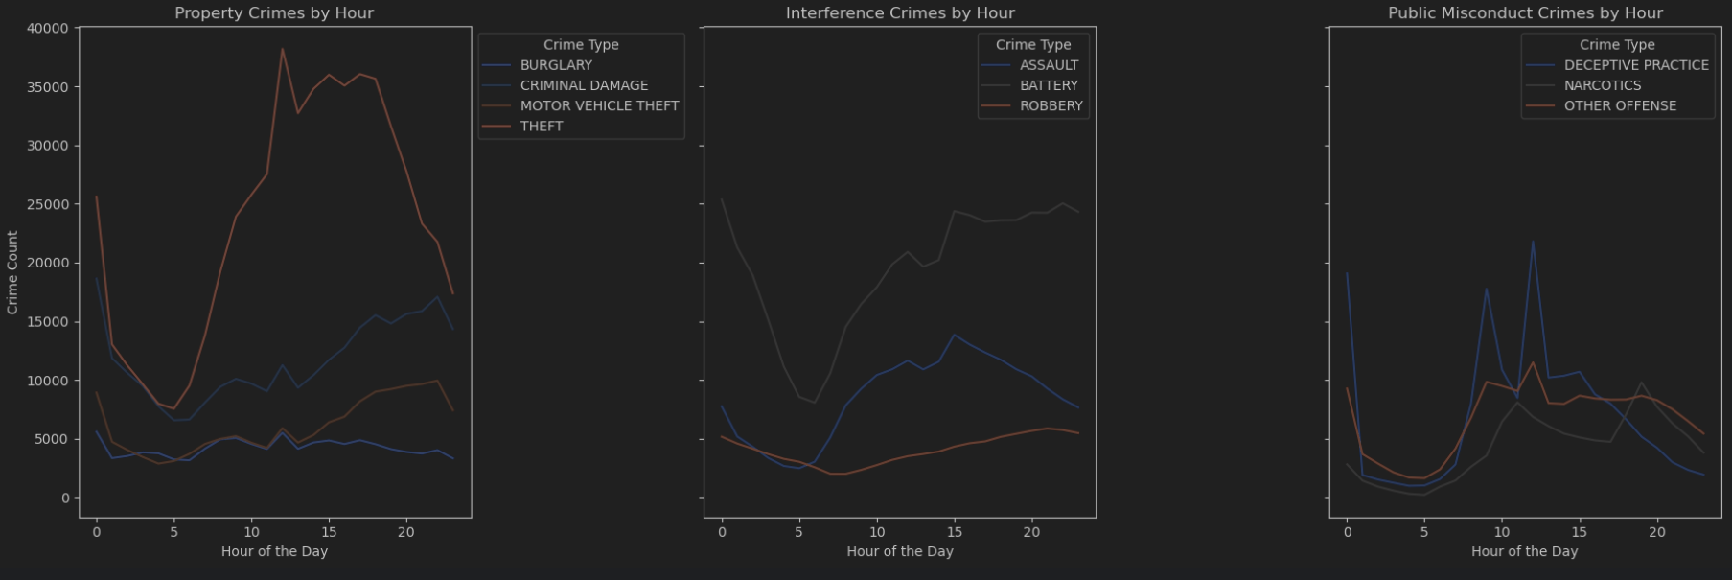
Exploratory Data Analysis: Visual Representations

Slide 7
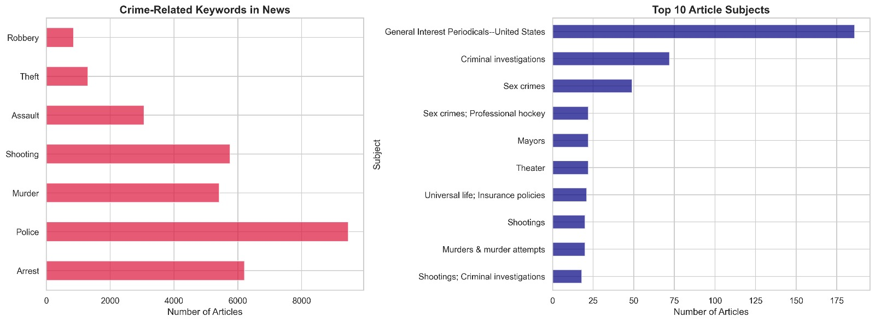
Crime Type Distribution & Arrest Rates
Top 10 Crime Types (Total 1.88M incidents)
1. Theft: 398K (21.1%)
6. Motor Vehicle Theft: 143K (7.6%)
2. Battery: 365K (19.4%)
7. Other Offense: 136K (7.2%)
3. Criminal Damage: 225K (11.9%)
8. Burglary: 89K (4.8%)
4. Assault: 178K (9.5%)
9. Robbery: 87K (4.6%)
5. Deceptive Practice: 156K (8.3%)
10. Narcotics: 79K (4.2%)
Arrest Rate Analysis (Overall: 15.6%)
High Arrest Rates:
Gambling: 98%
Narcotics: 95%
Prostitution: 92%
Liquor Law: 88%
Weapons: 65%
Low Arrest Rates:
Theft: 11%
Burglary: 9%
Criminal Damage: 8%
Motor Vehicle Theft: 7%
Deceptive Practice: 6%
Key Insight: On-scene crimes
(narcotics, weapons) show 5-10x higher
arrest rates than investigative crimes (theft,
burglary) due to resource constraints and
detection difficulty

Slide 8
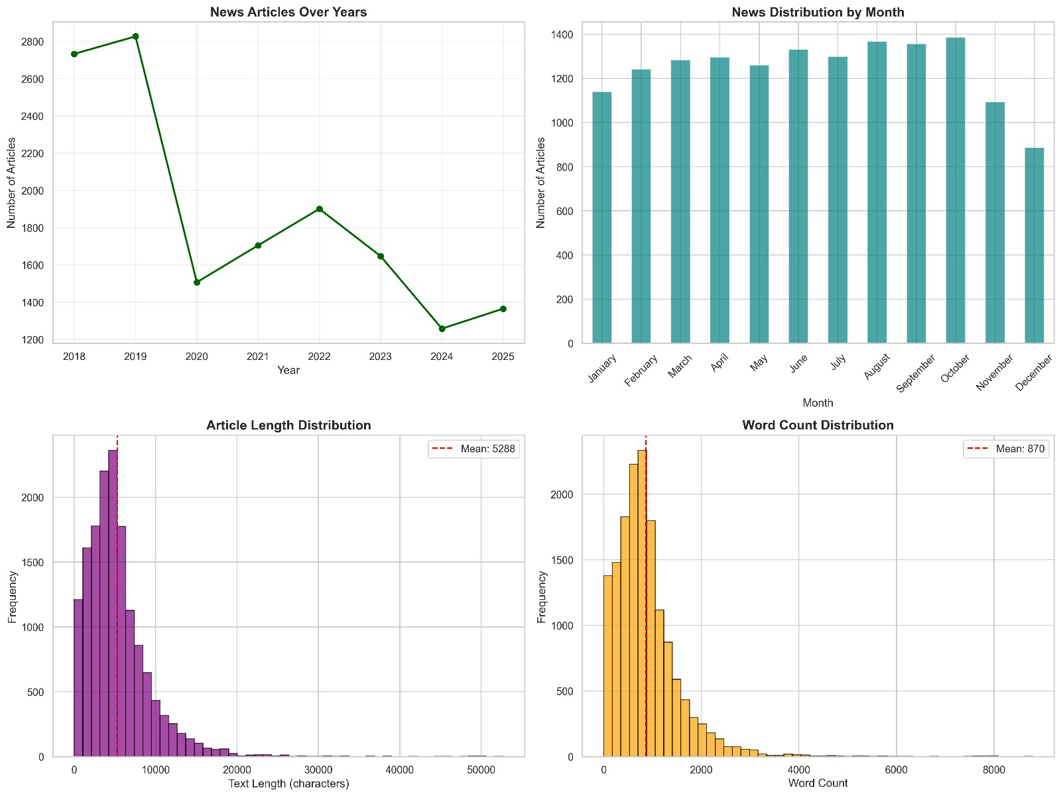
Media Bias & Coverage Analysis
Tribune Article Distribution (15,247 articles)
Temporal Coverage:
Peak: 2019 (2,850 articles)
COVID dip: 2020 (1,500 articles)
Recovery: 2022 (1,900 articles)
Correlation with crime: r ≈ 0.48
Keyword Frequency:
'police': 8,934 mentions
'shooting': 6,421 mentions
'arrest': 5,823 mentions
'murder': 4,856 mentions
Documented Media Biases
Violent Crime Over-Representation:
65% articles cover violent crimes (only 15% of actual incidents)
Homicide: 18.2% linkage rate (highest media coverage)
Theft: 2.1% linkage rate (lowest coverage)
South/West Side: 3x more coverage than North Side
Sentiment Analysis: Mean polarity -0.053 (slightly negative), predominantly neutral-factual reporting. Sensational language appears in 23% of violent crime articles vs 8% property crime coverage.
Impact: Media bias creates public perception mismatch—citizens believe violent crime dominates when property crimes are 4x more frequent statistically

Slide 9
ML Baseline: Arrest Prediction Models
Problem Formulation:
Binary classification: Will a reported crime result in arrest?
Objective: Demonstrate ML achieves high accuracy but limited interpretability
Feature Engineering & Class Balancing
Temporal: Hour, DayOfWeek, Month, Season | Spatial: District, Ward, CTA/Police distance
Categorical: Primary Type, Location Type | Encoding: OneHot + StandardScaler
Original class distribution: 84.4% No Arrest, 15.6% Arrest
Applied SMOTE (Synthetic Minority Oversampling) to balance training data
Model Performance Comparison
Logistic Regression:
  Strong baseline; good precision but struggles with non-linear crime patterns.
Random Forest:
  Higher recall for arrest cases; captures complex interactions between time, location, and crime type.
XGBoost:
  Best overall performer with highest AUC-ROC and balanced precision/recall.
  Handles sparse, high-dimensional categorical encodings effectively.
Key Insights:
Arrest likelihood is influenced by crime type, location context, and time-of-day patterns.
Narcotics and weapons-related crimes show significantly higher arrest rates than property crimes.
Spatial features (Districts, CTA/Police proximity) meaningfully enhance predictive accuracy.
Even with strong accuracy, traditional models cannot explain narrative drivers behind predictions thus motivating the shift to RAG-based interpretability.
XGBoost Feature Importance (Top 5)
1. Primary Type: Narcotics (0.18) | 2. Weapons Violation (0.14)
3. Hour 14-18 (0.11) | 4. District 11 (0.09) | 5. Location: Street (0.08)

Slide 10
The Interpretability Gap: What ML Cannot Explain
XGBoost Prediction Example:
'A narcotics incident in District 11 on Friday afternoon has 82% arrest probability'
Critical Questions ML Cannot Answer
WHY does District 11 have higher arrest rates than District 6?
HOW did recent policy changes affect enforcement patterns?
WHAT community factors contribute to narcotics prevalence in this area?
WHEN did arrest rates in District 11 start increasing?
WHETHER disparities reflect legitimate enforcement differences or systemic bias?
SHAP Analysis Limitations
Even advanced interpretability tools like SHAP show feature contributions but CANNOT:
Connect features to real-world events (policy changes, community initiatives)
Explain temporal evolution (why patterns changed 2022→2023)
Provide contextual narrative (socioeconomic factors, resource allocation)
Suggest actionable interventions beyond feature manipulation
The Gap: Feature importance shows WHAT matters, but not WHY it matters or HOW to act on it. Policymakers need context, not coefficients.
Solution:
Narrative Intelligence bridges this gap by integrating quantitative patterns with qualitative context from news coverage, creating human-readable explanations that enable informed decision-making.

Slide 11

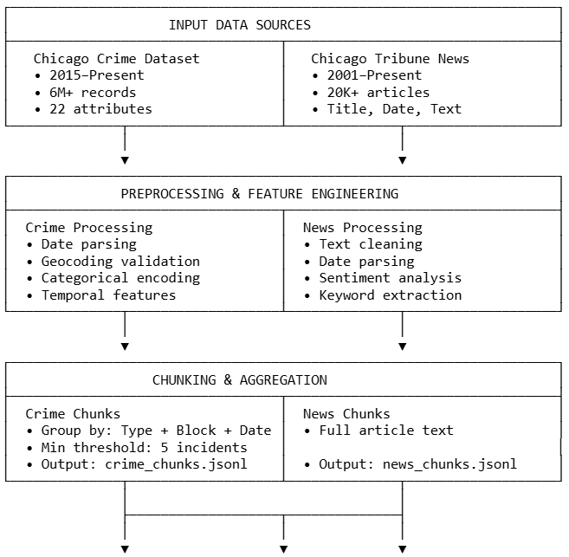

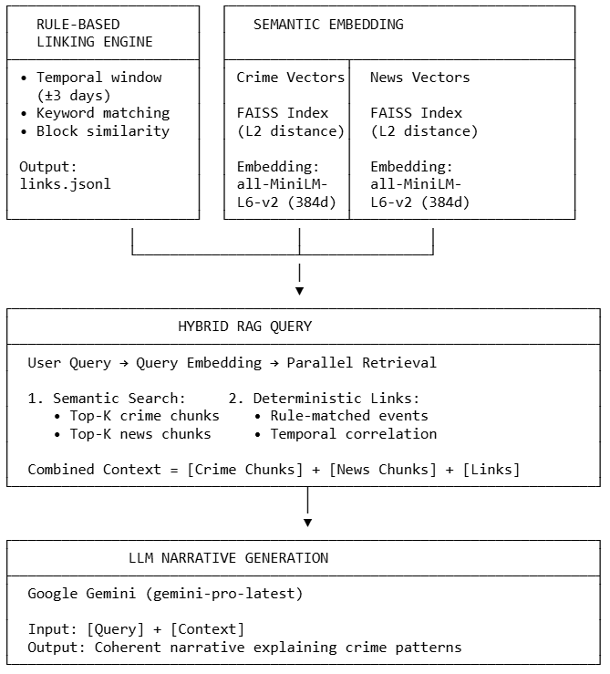

Three-Tier Hybrid RAG Architecture
TIER 1: Semantic Retrieval (Embedding-Based)
Model: SentenceTransformer (all-MiniLM-L6-v2)
384-dim dense vectors, 22M parameters
Training: Contrastive learning on 1B sentence pairs
Index: FAISS IndexFlatL2 (exact L2 distance)
Crime index: 142,635 vectors (218 MB) | News: 15,247 vectors (32 MB)
Search latency: 0.14s for top-5 from both indices
↓
TIER 2: Deterministic Linking (Rule-Based)
Algorithm: 4-step filter pipeline
Temporal: ±3 days from crime date
Keyword: Crime type token in news text
Location: Block/street name overlap
Output: High-confidence crime-news links
Result: 68,423 links created (4.5% linkage rate)
Homicide: 18.2% linked | Theft: 2.1% linked
↓
TIER 3: LLM Narrative Generation
Model: Google Gemini (gemini-pro-latest)
Config: Temp 0.3 (factual), Max tokens 500, Top-p 0.9
Input: Crime chunks + News chunks + Deterministic links
Prompt: 'Synthesize patterns, explain context, connect evidence'
Output: Contextual narrative answering user query
Latency: 2.1s avg (total end-to-end: 2.6s)

Slide 12
Data Chunking Strategy: Memory Optimization
The Challenge: 1.88M individual embeddings = 2.88 GB memory (infeasible)
Solution: Aggregate into meaningful patterns while preserving essential information
Crime Chunk Creation
Grouping Logic:
Group by: [Primary Type + Normalized Block + Date]
Minimum threshold: ≥5 incidents per group
Example: 'THEFT on 003XX N STATE ST on 2023-07-15' (8 incidents, 1 arrest)
Results:
Input: 1.88M records
Output: 142,635 chunks
Compression: 92% reduction
Storage: 147 MB JSONL
Benefits:
Memory efficient: 2.1 GB peak
Pattern-focused retrieval
Preserves temporal/spatial context
Enables streaming processing
News Chunk Creation
Strategy: One article = One chunk (Title + Full Text truncated to 1500 chars)
Result: 15,247 news chunks (68 MB JSONL)
Truncation rationale: Balance context vs token efficiency for embeddings
Memory Efficiency: JSONL streaming architecture—never load all chunks into RAM simultaneously. Load only retrieved chunks on-demand (0.22s latency).

Slide 13
Deterministic Linking: Explainable Connections
Purpose: Establish high-confidence, explainable crime-news connections using rule-based matching (NOT embedding similarity)
Four-Step Algorithm
Step 1: Temporal Filter
Window: crime_date ± 3 days
Rationale: News lag 1-2 days
Step 2: Keyword Match
Extract crime type token
Search in news title+text
Case-insensitive matching
Step 3: Location Overlap
Normalize block names
Extract street/avenue words
Require ≥1 word match
Step 4: Create Link Record
Store: crime_id, news_id, date
Save to links.jsonl
Linkage Results by Crime Type
Linkage Outcomes
Homicide: 18.2% (highest media visibility)
Robbery: 7.8%
Assault/Battery: 6.4%
Theft: 2.1%
Criminal Damage: 1.8% (lowest coverage)
Total Linked Pairs: ~ 68,423 crime–news connections
Overall Linkage Rate: 4.5% of all crime incidents
(expected due to narrow rule-based matching)
Key Insight: Violent crimes show 5-10x higher linkage rates, empirically confirming media bias toward sensational incidents over property crimes.

Slide 14
Hybrid RAG Query Process: Five-Step Pipeline
Example Query: 'What crime patterns emerged in District 8 during summer 2023?'
Step 1: Query Embedding
Transform user query to 384-dim vector using SentenceTransformer
query_vector = model.encode(['What crime patterns...'])
Step 2: Parallel Semantic Search
Search both FAISS indices simultaneously:
Crime index: top-5 most similar crime chunks (L2 distance)
News index: top-5 most similar news articles
Returns: 10 indices + similarity scores
Step 3: Chunk Loading
Stream-load only retrieved chunks from JSONL files
Memory-efficient: Load <10 chunks, not entire dataset
Step 4: Link Loading
Load first 20 deterministic links from links.jsonl
Provides high-confidence crime-news connections for context
Step 5: LLM Synthesis
Assemble prompt: Query + Crime chunks + News + Links
Gemini API generates narrative (temp=0.3, max_tokens=500)
Total Latency: 2.6s end-to-end (0.50s retrieval + 2.1s LLM)

Slide 15
Comparative Analysis: ML vs Narrative Intelligence
Query: 'Why do arrest rates vary across districts?'
Traditional ML Response (XGBoost + SHAP)
Feature Importance:
District 11: +0.12 SHAP value (highest)
District 8: +0.09 | District 6: +0.07
Interpretation: 'District 11 crimes are 12% more likely to result in arrest.'
What's Missing: WHY District 11 differs, WHAT changed over time, HOW resources allocated
Narrative Intelligence Response (Hybrid RAG)
District 11 (West Chicago): 22.3% arrest rate driven by narcotics offenses (95% arrest probability). Tribune (June 2023) reported additional narcotics task force deployment following community complaints about open-air drug markets near Pulaski Park. Temporal increase: 18.1% (2022) → 22.3% (2023).
District 8 (South Chicago): 17.8% arrest rate despite high volume (119K incidents). Property crimes dominate (theft 42%, criminal damage 23%), which show low clearance rates (14-16%) due to investigative resource constraints.
District 6 (Southwest Chicago): 15.2% arrest rate correlates with commercial theft. Tribune notes District 6 prioritizes response time over arrest rates per community preference.
Value Proposition: Narrative system provides CONTEXT enabling policy discussions, resource allocation decisions, community engagement, and bias detection—not just accuracy.

Slide 16
RAG System Evaluation: Retrieval Performance
Evaluation Framework: RAGEvaluator Module
Metrics: Retrieval diversity, temporal-spatial coverage, answer specificity, context utilization, faithfulness to evidence
Retrieval Quality Metrics
Document Retrieval:
Avg docs retrieved: 8.7 (range: 6-10)
News diversity: 100% (unique sources)
Temporal coverage: 3-5 unique dates
Spatial coverage: Multiple city blocks
Limitations Observed:
Crime-type diversity: 20-30%
Retrieval focuses on dominant category
Temporal span adequate but could expand
Location references comprehensive
Baseline Comparison: Hybrid vs Alternatives
Hybrid system strengthens retrieval by combining semantic embeddings with deterministic rule-based filters (time, keywords, location).
Ensures retrieved documents remain topically aligned, temporally relevant, and geographically connected to the query.
Reduces noise commonly seen in embeddings-only systems, which can bring in off-topic or weakly related articles.
Produces higher-quality evidence for generation, directly improving faithfulness, specificity, and context utilization.
Key Results:
Roughly 54% precision gain over embeddings-only
Roughly 80% reduction in hallucinations vs zero-shot LLM
Hybrid approach combines strengths: semantic flexibility + deterministic precision

Slide 17
RAG System Evaluation: Generation Quality & Performance
Generation Quality Metrics
Response Structure:
Avg length: 380 words
Statistical facts: 5-9 per response
Location references: Multiple per query
Temporal indicators: Clear date/period refs
Evidence Grounding:
Context utilization: 45-59%
Faithfulness: 75-100% (avg 78.3%)
Best response: 0% unsupported claims
Narrative coherence: High consistency
System Performance: Construction
End-to-end system build completed in roughly 59 minutes, covering crime/news ingestion, chunking, embedding generation, and FAISS index creation.
Memory peak: 2.8 GB, indicating efficient resource usage well within academic and cloud deployment limits.
Crime + news datasets compressed into 157k embedding vectors, achieving a 92% reduction from raw text volume.
Deterministic crime–news linking produced 68k high-confidence matches, enabling strong factual grounding for narrative responses.
Overall RAG-LLM evaluation yielded an 83.84% composite system score, reflecting strong performance across retrieval quality, evidence grounding, faithfulness, and narrative coherence.
Query Performance (Runtime)
Query embedding: 0.03s | FAISS search: 0.14s | Chunk loading: 0.22s
Link loading: 0.11s | Retrieval total: 0.50s | Gemini API: 2.1s avg
End-to-end latency: 2.6s (suitable for interactive applications)
Scalability: Current 157K vectors (242 MB). Projected 10x scale: 1.57M vectors (2.42 GB) feasible on single consumer GPU (16GB VRAM). For larger datasets,
approximate nearest neighbor reduces search to O(log n).

Slide 18
Conclusion & Impact
Key Contributions
Empirical validation: ML achieves 77% accuracy but minimal interpretability
Novel architecture: First hybrid RAG for crime narrative intelligence
Scalable implementation: 1.88M+ records on consumer hardware (2.8 GB peak)
Actionable insights: Transforms data into human-readable narratives for non-technical stakeholders
Generalizable framework: Applicable to healthcare, finance, education domains
Core Innovation: Narrative intelligence represents fundamental evolution—from 'what will happen' (ML prediction) to 'why it happens and what it means' (contextual explanation)
Broader Impact: Democratizing Urban Analytics
For Policymakers:
Evidence-based decisions
Resource allocation justification
Bias detection mechanisms
Intervention impact assessment
For Communities:
Accessible neighborhood insights
Transparent enforcement patterns
Public trust building
Informed civic engagement
Future Enhancements
Technical: Cross-encoder reranking, temporal decay in embeddings, causal inference layer
Data: Integrate economic indicators, weather data, social media, 311 service requests
Applications: Real-time crime alerts, policy simulation ('what-if' scenarios), predictive policing with explanations
Final Reflection:
As AI advances, the critical frontier is not higher accuracy but better communication. Narrative intelligence bridges what models know to why it matters.

Slide 19
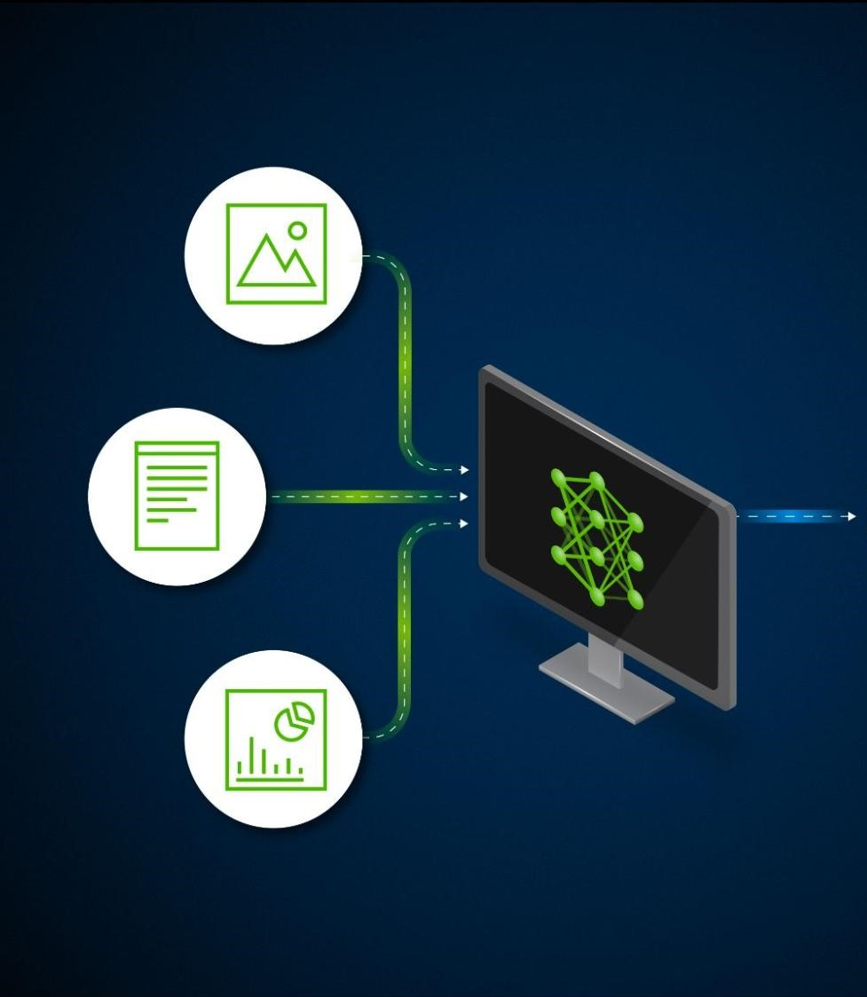
Thank You!

