Slide 1
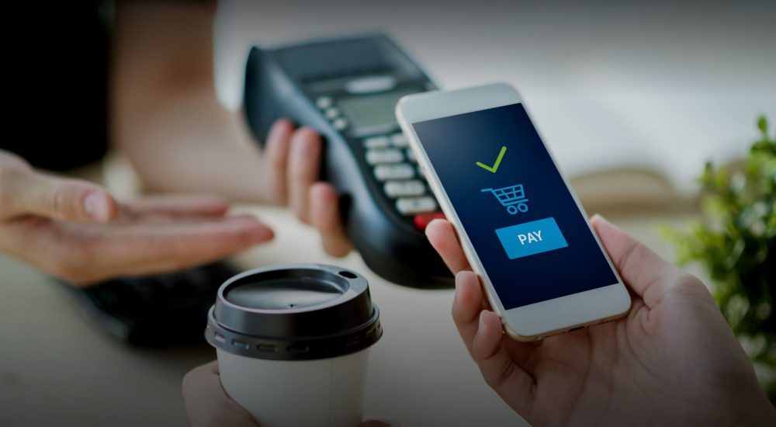
BLAZIN’ CODERS
APPLICATION PAYMENT UNITED
PRESENTED BY:
UNIVERSITY OF ALABAMA AT BIRMINGHAM

Slide 2
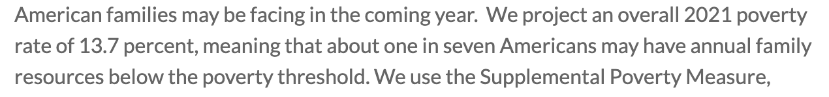
BACKGROUND:
those with lower household incomes have fewer resources
struggle to access the finance they need.
lack access to financing
due to wealth disparities.
Due to covid-19 the Need for financial innovative solutions has never been greater
Accessibility
Affordability
education
https://www.urban.org/research/publication/2021-poverty-projections

Slide 3
PROBLEM:
Today mobile payments APPLICATIONS have become so popular therefore creating a SURPLUS of apps.
Many users have trouble organizing their payments and finances.
Transfers to Bank take 3-5 business days

Slide 4
MARKET/TARGET:
INDIVIDUALS UNDER 35YRS OLD
COLLEGE STUDENTS
GROCERIES, UTILITIES, LABOR, UBER, ETC

Slide 5
SOLUTION:
We present to you a PAYMENT CONSOLIDATION APPLICATION for mobile payment.
ONE app that pulls in data from all mobile payment applications and makes it easier for user to organize their payments and finances.

Slide 6
WHY OUR APPLICATION:
Loaded with AWS security, trust, and convenience
Simple and well designed

Slide 7
TECHNOLOGIES USED
LANGUAGES USED: PYTHON, HTML
AWS EC2 – TO HOST THE SITE
AWS RDS – TO STORE DATABASES
PYTHON FLASK

Slide 8

THANK YOU

