Slide 1
Recommending System for Prepaid Mobile Recharging using APIs
By
-Achyuth K.P.
-Shreyas Narayanan Kutty
Guided by: Dr.Bharathi

Slide 2
Objective
To create a mobile application for Firefox OS, that monitors the number of calls, messages and data usage for any specific period of time.
To recommend a prepaid plan available from the service provider based on the data collected.
To collect data on users’ selection of the plan which can provide a business model for service providers.

Slide 3
Modules
Firefox OS Application -Data collection from the user’s side, Recommending a prepaid plan
Rating for the App developers - Ratings can be given by the user based on their satisfaction with the optimal plans suggested by the application. This will help in the improvement of the application.

Slide 4
Existing Methodology
Existing applications in the market provide a list of available prepaid plans, but they do not give an optimized list based on the user’s requirement.
Originally, the process of selecting a prepaid plan for talk time, SMS boosters or Internet packs is usually done manually by the user/customer.
The user decides the prepaid plan based on previous experiences, feedback from other users, popularity of the plan etc.

Slide 5
Proposed Application
The application monitors the number of calls and its duration, number of messages sent and data transferred for a period of time which is set by the user.
Based on the customer’s usage, the top 3 most preferable prepaid plans are displayed.
For Advanced Users, this application would also have a manual option so that user can directly enter the number of calls, SMS and Data usage for a period of time(which can also be set by the user). Certain calculations are done by the application and an optimized recharge plan is suggested to the user.

Slide 6
Proposed Application(contd.)
Generally, data is never sent back to the Service Provider for their use. In this application, data regarding users’ plan preferences is collected in a database for Service Providers.
This data collected can be used to provide business models for Service Providers based on behaviour analysis of user’s age group/ region/ financial conditions
This analysis can help the Service Provider in updating or creating new prepaid plans for users in the future.

Slide 7
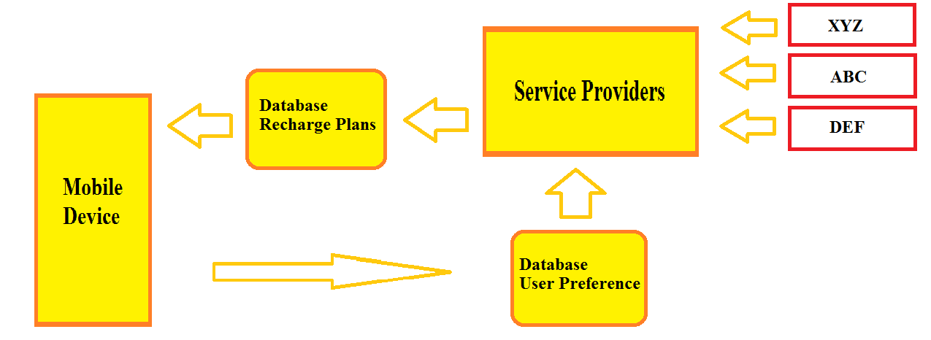
Proposed Design Methodology

Slide 8
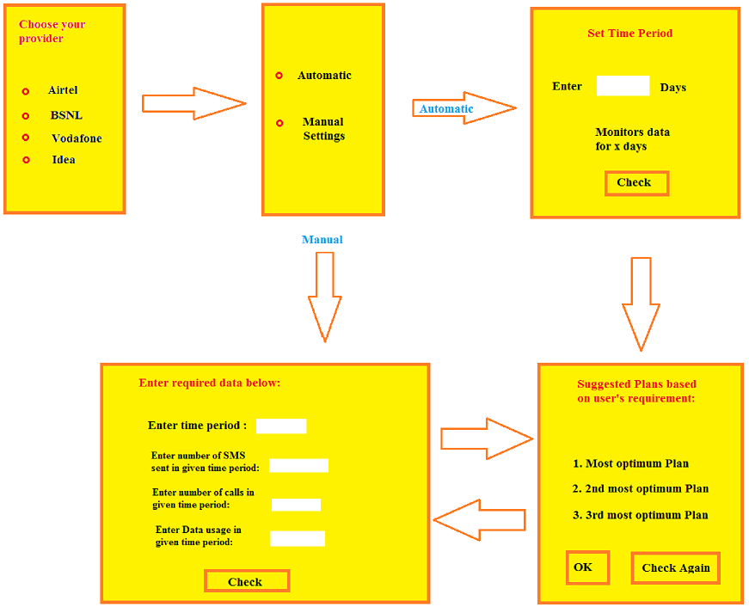
User Interface Design

Slide 9
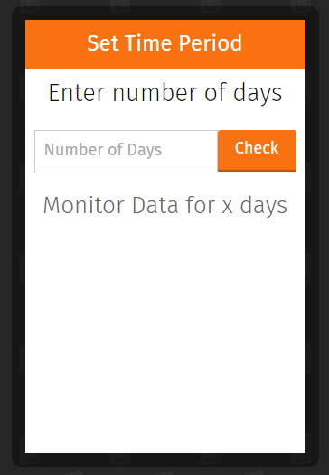
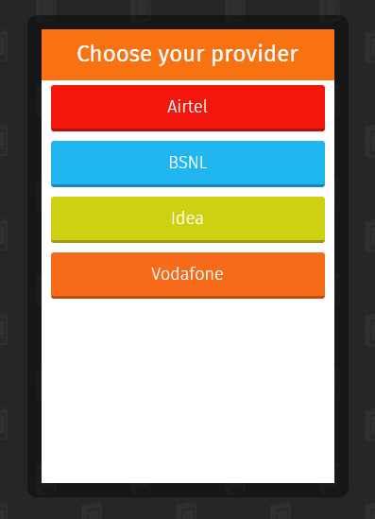
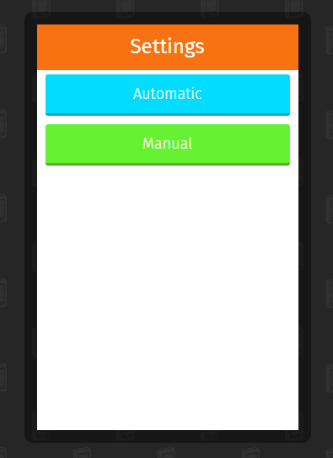
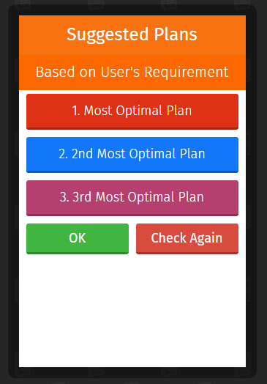
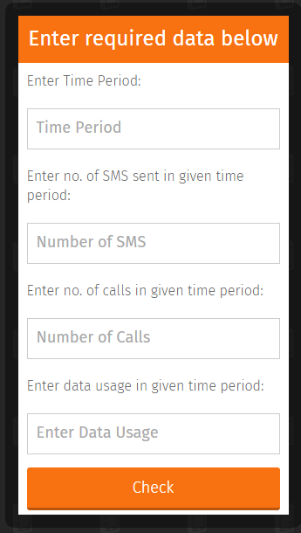
Sample Prototype

Slide 10
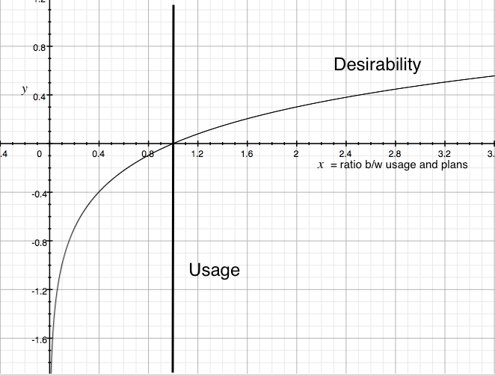
Desirability Quotient
Desirability quotient is a factor that determines the desirability of a plan based on a user’s usage.
To calculate the desirability quotient, both the benefit and risk must be assessed. The benefits refer to the SMS, calls, data provided by each of the plans while the risk here refers to the cost of the plans.
The benefit value for each plan will increase quickly when the values of the plans are just greater than the user’s usage values but as the values of the plans increase away from the usage values, the increment of the benefit value of the plans will become gradual. The risk value is calculated based on the cost of each plan, the higher the cost, the less desirable the plan becomes.
The logarithmic value of the summation of the benefit value for the plan is divided by the cost of the certain plan to give the desirability of the said plan.

Slide 11
Function Implementation
Function planSatisfiesUsage(plan, usage) is used to return the set of plans which have values of sms, calls and data greater than that of the user’s usage.
Function desirabilityOf(plan, usage) returns the desirability quotient d after implementing the logic behind the application.
Function findBestNPlans(plans, usage, n) filters the plans which are returned by the planSatisfiesUsage(plan, usage) function, then sorts the plans based on the desirabilityOf(plan, usage) function and returns the best n plans by using slice function.
As the application focuses on the best 3 plans, the n value is set as 3, to provide 3 most preferable plans for the user.

Slide 12
Function planSatisfiesUsage()
Begin Procedure planSatisfiesUsage(plan, usage) do if (plan.sms >= usage.sms && plan.call>= usage.call && plan.data>= usage.data) then return true; end else return false; end end planSatisfiesUsage()
Function planSatisfiesUsage(plan, usage) is used to return the set of plans which
have values of SMS, calls and data greater than that of the user’s usage.
Only these set of plans are considered when calculating the best n plans from the database of the service provider.
In this case, usage is an argument that is used as a filter to select the plans initially.
The users’ input within the application includes SMS, calls and data usage for 30 days duration.

Slide 13
Function desirabilityOf()
Begin Procedure desirabilityOf(plan, usage) do Initialise variable d = ( Math.log(usage.sms/plan.sms) + Math.log(usage.call/plan.call) + Math.log(usage.data/plan.data) ) / plan.cost; return d end desirabilityOf()
Function desirabilityOf(plan, usage) returns the desirability quotient d after implementing the logic behind the application.
Desirability quotient is a factor that determines the desirability of a plan based on a user’s usage.
The cost is also calculated as one of the factors that determine the desirability of a plan, considering users’ budget.
If two plans have similar features like number of SMS, Calls made and SMS sent, then the plan with lesser cost is more desirable.
The logarithmic value of the summation of the benefit value for the plan is divided by the cost of the certain plan to give the desirability of the said plan.

Slide 14
Function findBestNPlans()
Begin Procedure findBestNPlans(plans, usage, n) do return plans.filter() Begin Procedure slice(0,n) do Begin Procedure plan.filter(function(plan)) do return planSatisfiesUsage(plan, usage) end plan.filter(function(plan)) Begin Procedure sort(function (planA, planB)) do return desirabilityOf(planB, usage) – desirabilityOf(planA, usage) end sort(function (planA, PlanB)) end Procedure slice(0, n) end findBestNPlans(plans,usage,n)

Slide 15
Function findBestNPlans() (contd.)
Function findBestNPlans(plans, usage, n) filters the plans which are returned by the planSatisfiesUsage(plan, usage) function.
It then sorts the plans based on the desirabilityOf(plan, usage) function and returns the best n plans by using slice function.
The value of n could be defined so that the application retrieves the best n plans from the list of plans available that are most suitable for the user depending upon the usage.
In this application, n = 3 and therefore this function would retrieve the 3 most optimal plans.

Slide 16
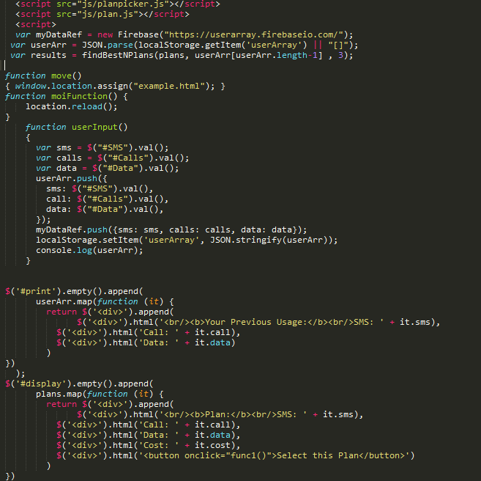
Code implementation

Slide 17
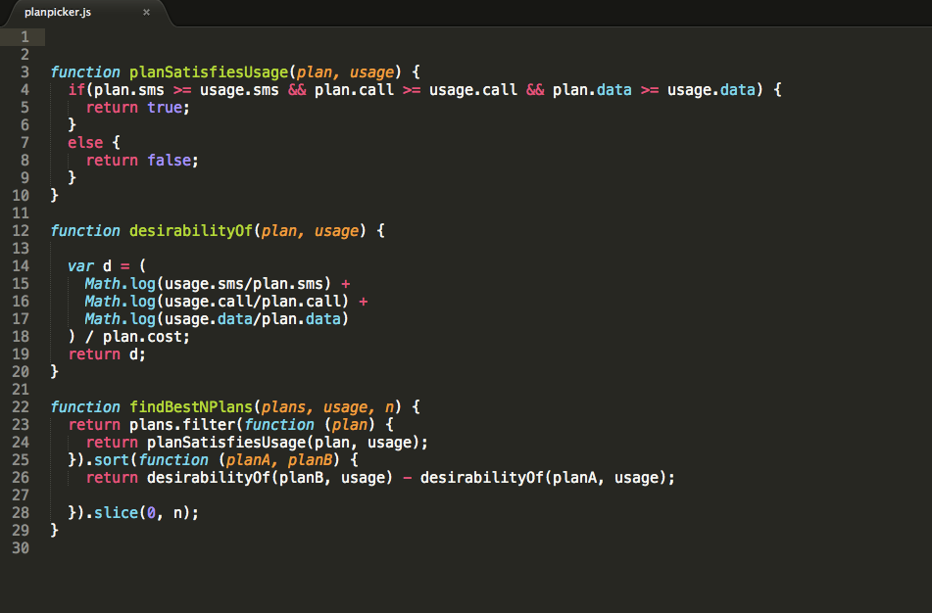
Code Implementation (contd.)

Slide 18
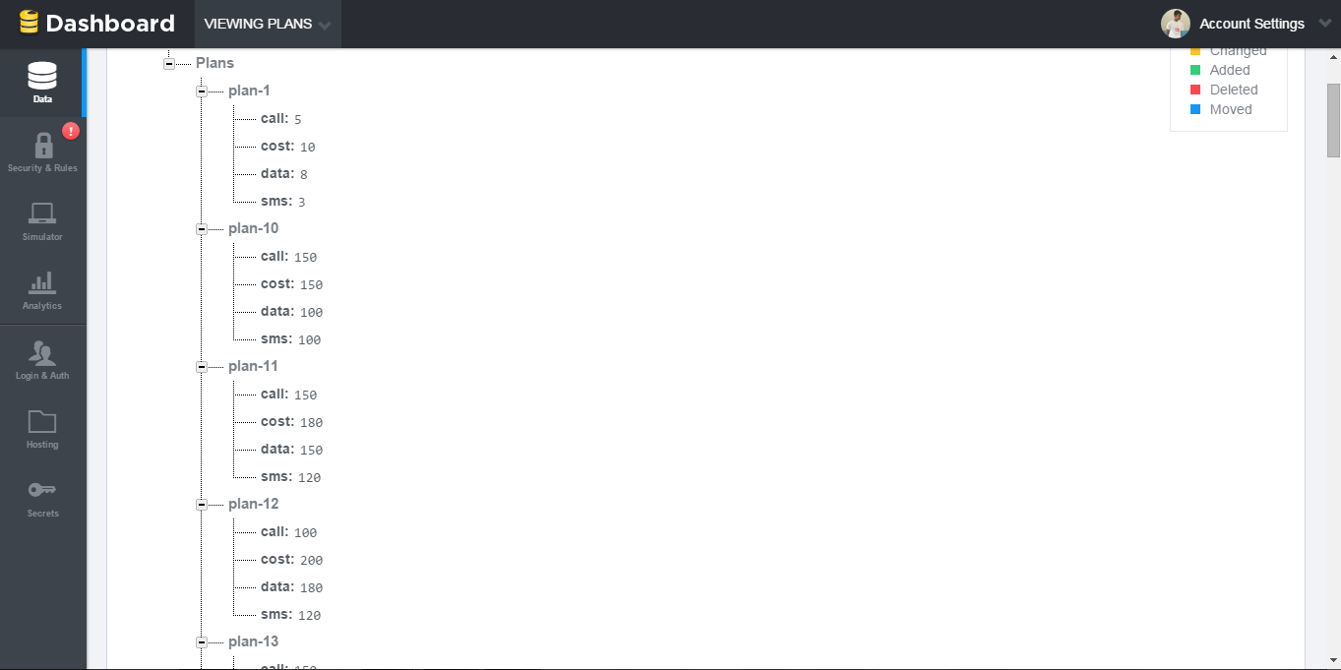
Firebase - Plans database

Slide 19
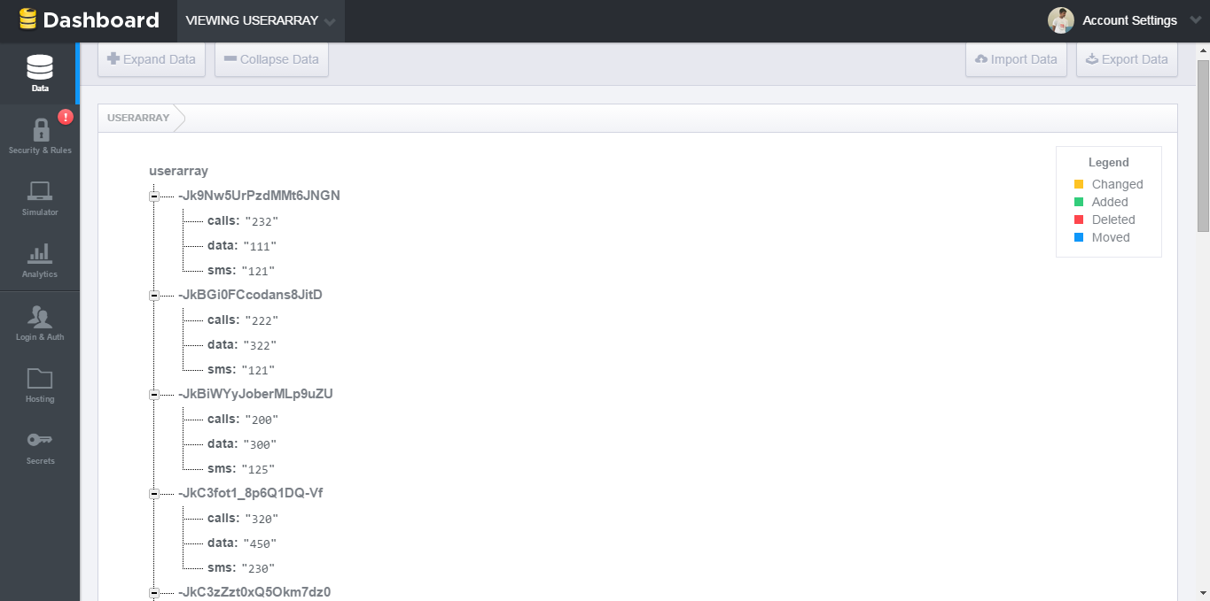
Firebase - User Input database

Slide 20
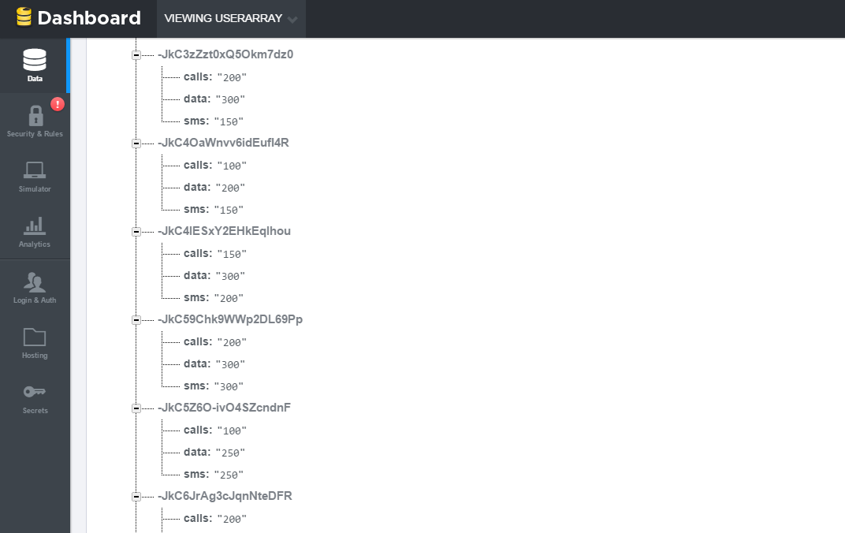
Firebase – User Input database (contd.)
Each time a user manually sends in the user’s usage – SMS, calls and data, the data is automatically stored in the Firebase database.
The major advantage of using a Mobile Backend as a Service like Firebase is that it synchronises immediately with all the apps in various devices and stores each of the user’s data with randomly number generated keys so as to avoid overlapping of different users’ data.

Slide 21
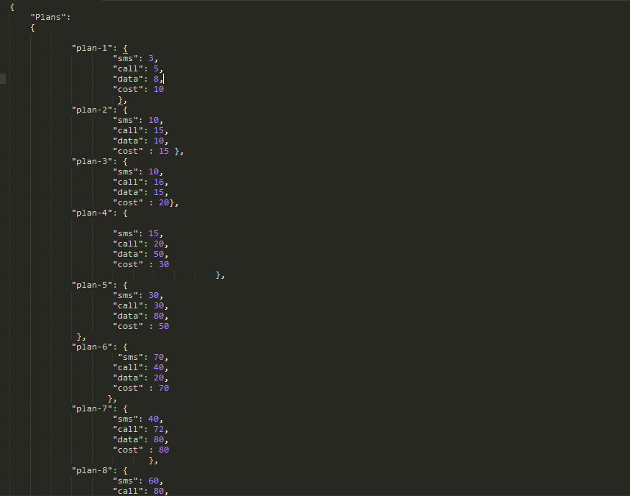
Plans.json

Slide 22
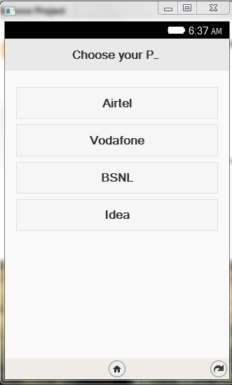
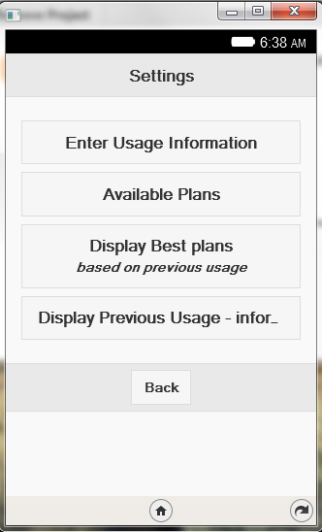
Screenshots of Output

Slide 23
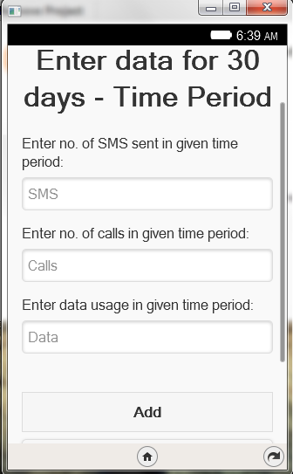
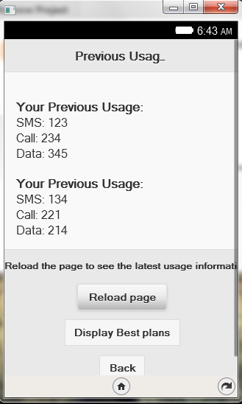
Screenshots of Output (contd.)

Slide 24
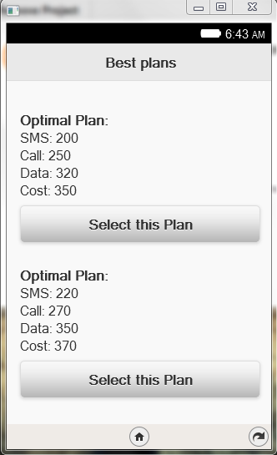
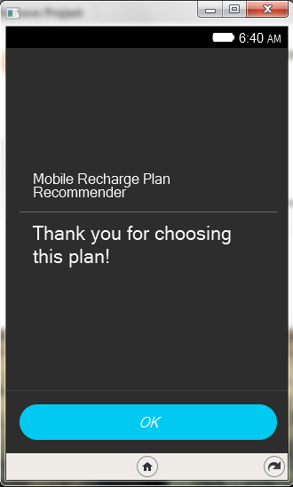
Screenshots of Output(contd.)

Slide 25
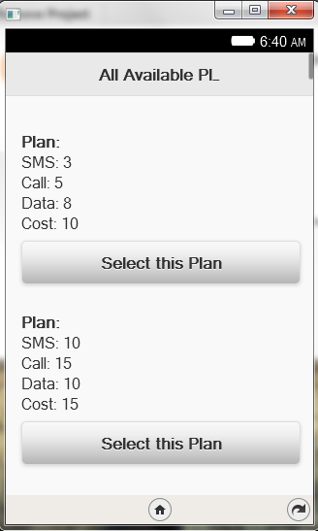
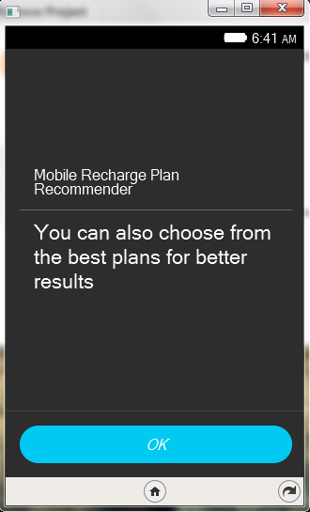
Screenshots of Output(contd.)

Slide 26
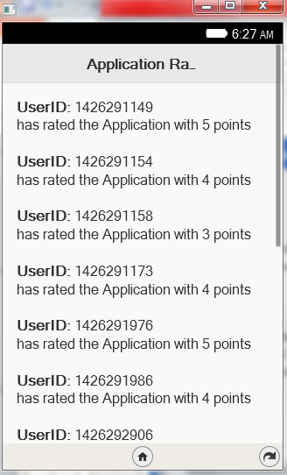
App Ratings
Every time a user rates the application, the data is sent to the Firebase database.
Which in turn, transfers it to the App Rating application through which the App developers can see the ratings given by the user.
The page does not need to be refreshed as it is completely dynamic.

Slide 27
User Plan Selection
Sl. No. | Input SMS | Input calls | Input data | Plan suggested by application | Plan chosen by user
1 | 121 | 200 | 300 | 18,19,20 | 19
2 | 230 | 320 | 450 | 25,33 | 25
3 | 150 | 100 | 200 | 17,31,18 | 17
4 | 200 | 150 | 300 | 19,20,21 | 18
5 | 300 | 200 | 300 | 24,25,34 | 34
6 | 250 | 100 | 250 | 23,24,25 | 22
7 | 350 | 200 | 400 | 33,34 | 34
8 | 170 | 150 | 200 | 17,18,19 | 18
9 | 200 | 100 | 400 | 23,24,25 | 23
10 | 100 | 100 | 300 | 18,19,23 | 20

Slide 28
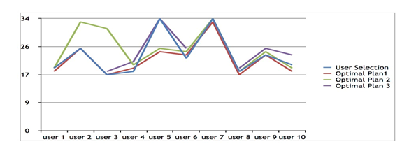
Performance Analysis
This graph describes the comparison between the user selection and the set of n optimal plans (in this case, three).
The x axis denotes the users and the y axis denotes the existing plans.
The blue line depicts the user selection based on the plans provided by the service provider.
The red, purple and green lines depict the three most recommended plans based on each user’s usage.

Slide 29
Performance Analysis (contd.)
As per the testing process, most of the users chose one of the three most preferable plans available.
But under certain circumstances, such as user 4’s, user 6’s and user 10’s plan selection slightly defer from the most preferable plans provided by the application.
The variation between the plans selection is fairly small, as it varies only by few plans.

Slide 30
Conclusion
This project describes a Firefox OS mobile application which provides optimised prepaid recharge preferences based on user’s data usage.
Users can rate the application based on how well the optimal plans suggested by the application satisfies them.
The application developers can view all the ratings by different users in their ratings application.
This project can be further upgraded to have a payment gateway or wallet to recharge directly from the application.
Hence the problem of finding optimal plans for users is solved by this application.

Slide 31
References
[1] Inoue A., Iwashita M., Kurosawa T. and Nishimatsu K., 2013,“Mobile-Carrier Choice Behavior Analysis Around Smart Phone Market”, Software Engineering, Artificial Intelligence, Networking and Parallel/Distributed Computing (SNPD), 14th ACIS International Conference, pp 63-22
[2] Julia Cutler and Market Probe, “User preferences and revenue drivers for smartphone services”, HP -Business White Paper –Review the highlights
[3] John Aogon and Patrick J. Ogao, “A Visualization Framework For Discovering Prepaid Mobile Subscriber Usage Patterns” – Project Report submitted to school of Graduate Studies, Makerere University
[4] Kumar A. and Dr. Thambidurai P.(2010), “Collaborative Web Recommendation Systems -A Survey Approach”, Global Journal of Computer Science and Technology Vol. 9 Issue 5 (Ver 2.0)
[5] Nasreen B. and Safiya Parvin A.(2014), “Mining Suggestions for Recommender Systems”, Nasreen B. et al, / (IJCSIT), International Journal of Computer Science and Information Technologies, Vol. 5 (1) , pp: 459-461
[6] Rifon L.E.A., Canas Rodriguez A., RorisV.M.A., Gago J.M.S. and Iglesias M.J.F.,2013, "A recommender system for educational resources in specific learning contexts", Computer Science & Education (ICCSE), 8th International Conference on, On page(s): 371 –376
[7] Robin Burke, “Hybrid Web Recommender Systems”,2007, Lecture Notes in Computer Science, Springer-Verlag, Berlin, Germany, Lecture Notes in Computer pp. 377-408
[8] Shu Chuan Liao, Kuo Fong Kao, I En Liao, Hui Lin Chen and Shu O Huang, (2009) "PORE: a personal ontology recommender system for digital libraries", The Electronic Library, Vol. 27 Iss: 3, pp.496 - 508
[9] Mozilla Developer Network – MDN (Web APIs) - https://developer.mozilla.org/en/docs/Web/API

