Slide 1
MPCA LAB MINI PROJECT
PROJECT TITLE: Building security system using Arduino
SECTION: A
STUDENTS NAME: Achyut Jagini PES2UG19CS013
Amar S Sanjayshetty PES2UG19CS032
Akshay B K PES2UG19CS030
Amit PES2UG19CS033

Slide 2
PROBLEM STATEMENT :
How to build security system using Arduino

Slide 3
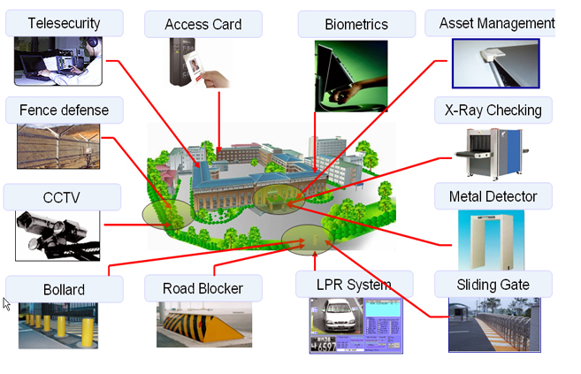

Slide 4
Materials required:
1) Arduino board.
2)LCD screen
3)Buzzer
4)Servo motors.
5) Number Keypad
6)Gas sensor
7)Led lights
8)Bread boards.
9)Wires.

Slide 5
Introduction.
Our project helps to maintain security of the building. 
We have used 2 Arduino boards to implement the security system. First arduino board is connected with number keypad, servo motor (Main door), buzzer. The second Arduino board is connected with leds (indicator), pair of servo motors (emergency exit doors), gas sensors etc 
We have installed keypad with LCD screen to prompt the user to type his password to enter into the building. If the user fails to enter the correct password multiple times, the system will lock and the door remains closed.

Slide 6
If any intruder tries to enter into the building and types incorrect password multiple times, then the system buzzer starts to make a emergency sound.
If the building catches fire accidently or by terrorists (manually) the gas sensor will sense the smoke from the building and this will automatically opens the exit door, so that people who were residing in the building can escape out of the building and save there lives

Slide 7
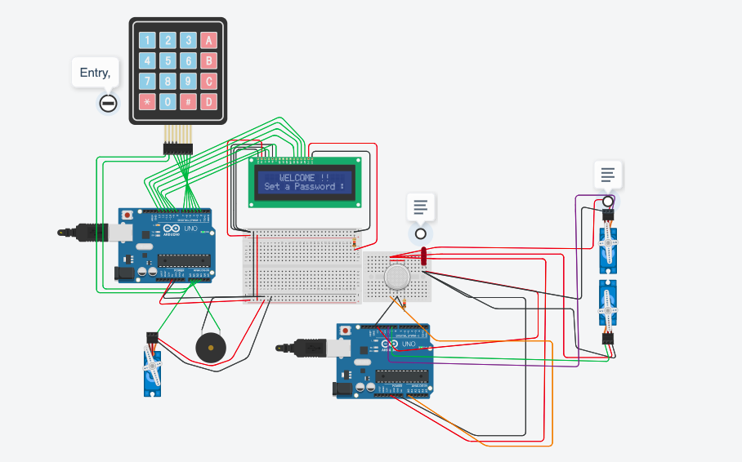
BLOCK DIAGRAM

Slide 8
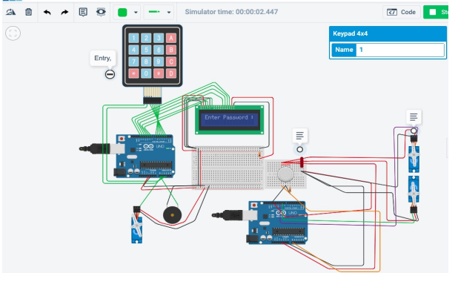
To set the password.

Slide 9
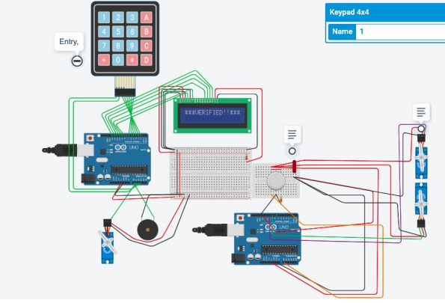
Verified Password.

Slide 10
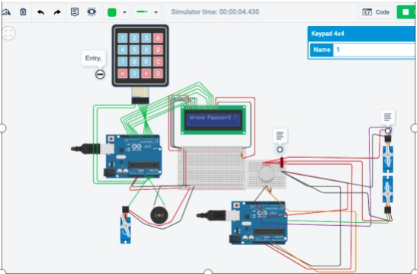
If password typed is wrong then the door will get locked automatically buzzer wil start making noise.

Slide 11
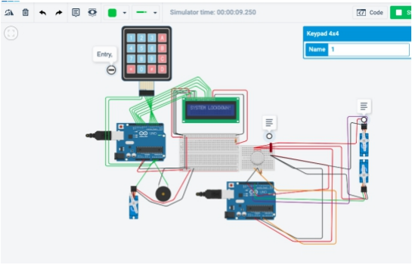
If the user/ intruder types the password incorrectly for 3 times continuously then the system get locked.

Slide 12
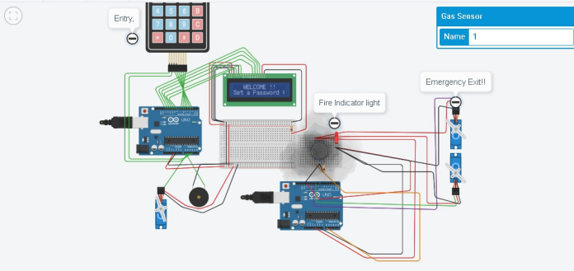
Fire alarm system. When the building catches fire. The emergency doors will open automatically

Slide 13
APPLICATIONS
Home Security.
Offices.
Data centers.
Jails
Defence base
Laboratories
etc.

Slide 14
REFERENCES(Website links, Books etc.
TEXT BOOK :
Building a home security system with Adruino

Slide 15
THANK YOU

