Slide 1
AI-Powered Resume Screening System
Automated Candidate Ranking & Semantic Fit Analysis
Achyut Shreyas
Soumya Prasad
AI Resume Screening System | Internship Project Presentation
Slide 1 of 11

Slide 2
The Core Problem in Candidate Screening
• High Resume Volume: HR managers receive hundreds of resumes per job opening. Sorting them manually takes days, causing massive hiring bottlenecks.
• ATS Keyword Limitations: Traditional Applicant Tracking Systems (ATS) rely on exact keyword matches. They fail to identify synonyms (e.g., rejecting an expert in 'ETL pipelines' because they didn't write 'data engineering' in their resume).
• Inconsistency & Fatigue: Human screening is subjective, prone to unconscious bias, and highly inconsistent when reviewing dozens of documents in a single sitting.
THE RECRUITER'S DILEMMA
Time Spent per Resume: Average of 6 to 8 seconds by human recruiters, leading to critical screening errors.
Missed Talent: Up to 75% of qualified candidates are filtered out by rigid, keyword-based legacy ATS systems because of formatting or exact term mismatches.
The Goal: Transition from rigid string matching to intelligent semantic matching that understands candidate capability, context, and quality.
AI Resume Screening System | Internship Project Presentation
Slide 2 of 11

Slide 3
Our Solution: AI Resume Screening System
• Semantic Matching: Uses pre-trained Transformer models (Sentence-BERT) to understand the semantic intent of both the JD and the resumes, matching synonyms and related domains.
• Explainable AI: Instead of a simple black-box score, the system generates a tailored textual summary explaining the recommendation (e.g. matched/missing skills, project presence).
• Interactive HR Interface: Provides recruiters with a full dashboard, from secure sign-up/login to screening forms and interactive charts displaying candidate statistics.
🧠 Deep Semantic Core
Transends keyword limits using advanced SBERT sentence embeddings.
💡 Explainable AI Match summaries
Auto-generates transparent rationale detailing candidate strengths/weaknesses.
📊 Interactive Analytics Dashboard
Visualizes candidate pools, score distributions, and top skills automatically.
AI Resume Screening System | Internship Project Presentation
Slide 3 of 11

Slide 4
System Architecture & Tech Stack
FRONTEND ARCHITECTURE
• React 18: Component-driven structure for clean, modular, and high-performance UI rendering.
• Tailwind CSS: Responsive layouts, sleek slate theme styling, and clean spacing systems.
• Recharts Library: Visual SVG charts mapping candidate status distributions and scores in real-time.
• Framer Motion: Micro-animations, smooth transition effects, and dashboard fade-ins.
• Axios Services: Centralized API communication layer with JWT authentication interceptors.
BACKEND ARCHITECTURE
• FastAPI: Modern, high-performance async framework for routing and auto-generated OpenAPI docs.
• SentenceTransformers: Deep learning inference using SBERT (MiniLM) and Cross-Encoders for re-ranking.
• spaCy NLP Engine: Tokenization, name/entity extraction, and rule-based text cleaning filters.
• pdfplumber + Docx: Engineered text extractions from PDF and Word files, keeping layouts intact.
• Bcrypt + JWT JWT: Auth backend hashing passwords and issuing secure tokens expiring in 8 hours.
AI Resume Screening System | Internship Project Presentation
Slide 4 of 11

Slide 5
End-to-End AI Matching Pipeline
• Layout Preserving Parsers: Raw documents (PDF, DOCX, TXT) are read. Cleaners fix merged words and strip garbage characters.
• spaCy NER & Sections: Extracts details like Name, Email, and Phone, while parsing sections (Experience, Projects, Education) separately.
• Dual Encoder Matching: SBERT handles fast cosine similarity search. Then, the Cross-Encoder re-evaluates top-10 candidates with multi-attention.
• AI Explanation Engine: Constructs customized candidate fit text based on scoring vectors, detailing exactly why they matched.
PIPELINE EXECUTION FLOW
1. Document Upload (JD + Resumes)
↓
2. Text Extraction & Cleanup
↓
3. Section Parsing & Skill Matching (spaCy)
↓
4. SBERT Vector Embeddings Mapping
↓
5. 7-Factor Weighted Scoring Logic
↓
6. Cross-Encoder Re-Ranking (ms-marco)
↓
7. AI Explanation Summary & Final Ranking Output
AI Resume Screening System | Internship Project Presentation
Slide 5 of 11

Slide 6
7-Factor Weighted Scoring Mechanism
Evaluation Factor | Weight | Computational Description
Semantic Similarity | 40% | SBERT embeddings utility computing cosine similarity between JD & resume text.
Skills Match | 25% | Regex-based matching of extracted JD skills from universal 200+ list.
Projects & Achievements | 15% | Scored on action verbs (0.4), metrics/numbers (0.3), hackathons/awards (0.15), and project section length (0.15).
Experience Relevance | 10% | Overlap coefficient of words (>4 chars) in resume experience section vs. full JD text.
Education Level | 5% | Degree hierarchy scoring: PhD (1.0), Masters (0.9), Bachelors (0.8), Diploma (0.6), college name (0.5).
Certifications | 3% | Continuous learning metrics scanning keywords like AWS, Coursera, Udemy, NPTEL (0.25 per cert, max 1.0).
Resume Quality | 2% | Completeness scoring: checks for email (0.25), phone (0.20), education (0.20), projects (0.20), text length (0.15).
AI Resume Screening System | Internship Project Presentation
Slide 6 of 11

Slide 7
Dual-Model Deep Learning Architecture
BI-ENCODER (SENTENCE-BERT)
• Model: 'all-MiniLM-L6-v2' — Lightweight, 384-dimensional vector space mapped for high speed.
• Method: Encodes JD and Resume separately. Calculates Cosine Similarity between vectors.
• Use Case: Acts as the initial pipeline filter. Highly scalable, handles bulk candidate scoring in seconds.
• Semantic Scope: Understands conceptual overlap (e.g. associates 'React Native' with 'mobile development').
CROSS-ENCODER (RE-RANKER)
• Model: 'cross-encoder/ms-marco-MiniLM-L-6-v2' — High accuracy, fine-tuned on search relevance.
• Method: Inputs JD and Resume simultaneously, utilizing self-attention across both sequences.
• Use Case: Re-ranks the top 10 candidates. Compensates for bi-encoder limitations to resolve nuances.
• Weighted Blend: Combines final scores: 70% weighted factor pipeline + 30% Cross-Encoder predict score.
AI Resume Screening System | Internship Project Presentation
Slide 7 of 11

Slide 8
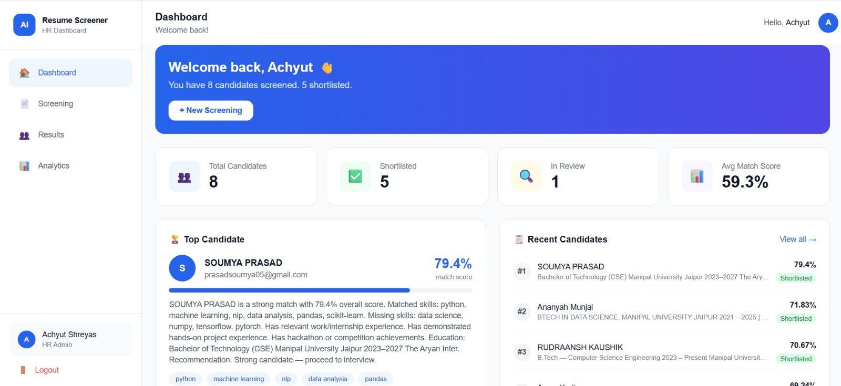
HR Dashboard: Resume Upload & Analytics
• HR Access Portal: Secure user registration and login endpoints utilizing encrypted credentials (bcrypt) and JWT credentials.
• Multi-Format Upload Zone: Intuitive, animated drop-zone accepting JD file and batch resume files (.pdf, .docx, .txt).
• Candidate History: Fetches recently screened pools automatically from local storage memory to maintain screening sessions.
AI Resume Screening System | Internship Project Presentation
Slide 8 of 11

Slide 9
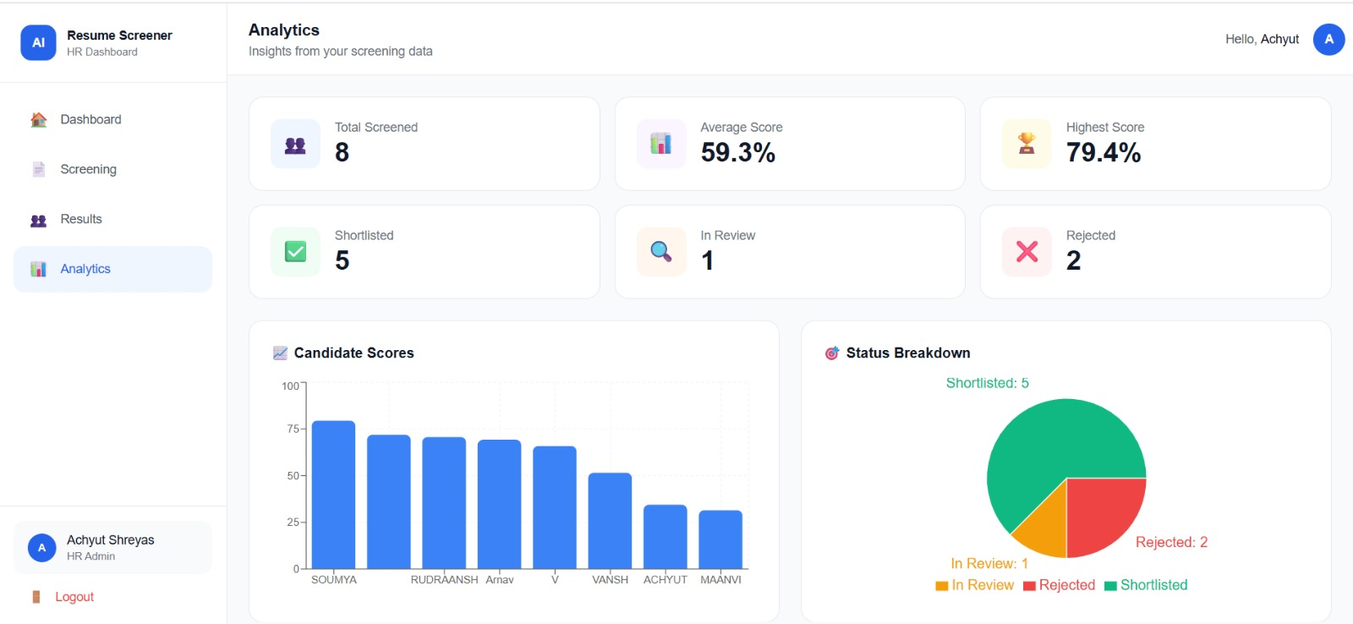
Candidate Results & AI-Generated Explanations
• Status Thresholds: Sorts candidate statuses based on score boundaries: Shortlisted (>=60%), In Review (40-59%), and Rejected (<40%).
• Skills Match Checklist: Explicitly lists matched vs. missing skills, helping recruiters rapidly assess talent gaps.
• AI Explanations: Textual breakdown explaining recommendations. Highlights key certifications, project volume, and contact completeness.
AI Resume Screening System | Internship Project Presentation
Slide 9 of 11

Slide 10
Key Strengths & Engineering Best Practices
• Domain Agnostic Design: The entire pipeline (SBERT, spaCy parse, scoring) handles any business domain — Tech, Finance, Marketing, HR, or Healthcare. It adapts dynamically based solely on the uploaded Job Description.
• Word-Boundary Regex Skill Extraction: Rather than loose string searches, skills are matched using strict regex word boundaries (e.g. won't match language 'Scala' inside 'scalable' or 'Go' in 'Google'). This dramatically reduces false positives.
• Secure Session Handshake: Features password hashing on registration with bcrypt, and subsequent endpoint security via temporary JWT bearer tokens with expiration limits.
• Performance Minded Scoring: SBERT handles high-speed vector embeddings for all candidates, while the slower Cross-Encoder only re-ranks the top candidate subset, ensuring fast system response.
AI Resume Screening System | Internship Project Presentation
Slide 10 of 11

Slide 11
Conclusion & Future Roadmap
• Automated Screening Standard: Successfully designed a production-grade 7-factor screening pipeline that shortlists resumes in seconds instead of hours.
• Explainability and Transparency: The AI explanation engine removes black-box skepticism for managers and provides recruiters with actionable fit insights.
• Future: LLM Interview Generative UI: Plan to integrate local LLMs to generate custom, resume-specific technical questions for the HR team to use in interview stages.
• Future: Database Persistence: Transition from local memory/JSON storage to a relational DB (PostgreSQL) or document DB (MongoDB) for scalability and security.
AI Resume Screening System | Internship Project Presentation
Slide 11 of 11

