Slide 1
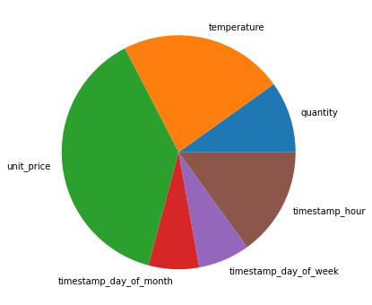
Relative Importance of features
Price is the most important feature
More data or features are required for
better model results

