Slide 1
Microsoft’s TypeScript
Introduction
Installation
Why TypeScript?
Features
Comparison With TypeScript Alternatives
Conclusion

Slide 2
Introduction - What is TypeScript
TypeScript lets you write JavaScript the way you really want to. TypeScript is a typed superset of JavaScript that compiles to plain JavaScript. Any browser. Any host. Any OS. Open Source.

Slide 3
Installation
npm install –g typescript
If you don’t have nodejs…

Slide 4
Introduction – Why we need it
To answer why we need typescript, we need to understand what's wrong with vanilla JavaScript

Slide 5
What is the problem
Why do people hate working in JavaScript?

Slide 6
What is the problem
Javascript | Typescript
It is a scripting language. | It is an object oriented programming language(not pure).
There is no static typing. ex: var num. | Here it is static typing (We can declare a variable in multiple ways). ex: var num : number.
It doesn't have interfaces . | It has interfaces.
It has no optional parameter feature. | It has optional parameter feature.
It has no inheritance | It has inheritance
No modules support. Number, string etc. are the objects. | Supports Modules . Number, string etc. are the interfaces.
Notes:
Who is using lots of JavaScript in their project now?
What libraries are you using?
JavaScript is designed as a scripting language to do small things on a browser document.
We now use it as a full programming language to do all sort of things, a "page" can be the application, and all logic runs in JavaScript.
AJAX and REST end points allow us to communicate to the server without refreshing the page.
But JavaScript is not suited for large applications
As JavaScript code gets complex, it is extremely unwieldy.

Slide 7
Feature
Data Types Supported
Optional Static Type Annotation
Classes
Interface
Modules
Arrow Expressions
Type Assertions
Ambient Declarations
Source File Dependencies
Notes:
Who is using lots of JavaScript in their project now?
What libraries are you using?
JavaScript is designed as a scripting language to do small things on a browser document.
We now use it as a full programming language to do all sort of things, a "page" can be the application, and all logic runs in JavaScript.
AJAX and REST end points allow us to communicate to the server without refreshing the page.
But JavaScript is not suited for large applications
As JavaScript code gets complex, it is extremely unwieldy.

Slide 8
Data Types Supported
Any
Primitive
Number
Boolean
String
Void
Null
Undefined
Same as JS
Array
Enum
Notes:
Who is using lots of JavaScript in their project now?
What libraries are you using?
JavaScript is designed as a scripting language to do small things on a browser document.
We now use it as a full programming language to do all sort of things, a "page" can be the application, and all logic runs in JavaScript.
AJAX and REST end points allow us to communicate to the server without refreshing the page.
But JavaScript is not suited for large applications
As JavaScript code gets complex, it is extremely unwieldy.

Slide 9
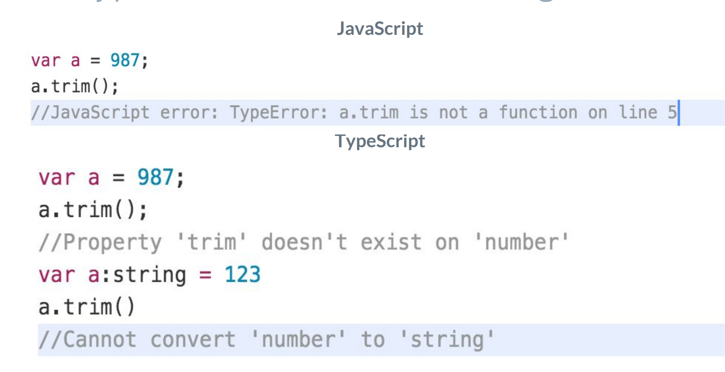
Type Annotations/Checking
Notes:
Who is using lots of JavaScript in their project now?
What libraries are you using?
JavaScript is designed as a scripting language to do small things on a browser document.
We now use it as a full programming language to do all sort of things, a "page" can be the application, and all logic runs in JavaScript.
AJAX and REST end points allow us to communicate to the server without refreshing the page.
But JavaScript is not suited for large applications
As JavaScript code gets complex, it is extremely unwieldy.

Slide 10
Classes
TypeScript Classes
Can implement interfaces
Inheritance
Instance methods/members
Static methods/members
Single constructor
Default/Optional parameter
ES6 class syntax
Notes:
Who is using lots of JavaScript in their project now?
What libraries are you using?
JavaScript is designed as a scripting language to do small things on a browser document.
We now use it as a full programming language to do all sort of things, a "page" can be the application, and all logic runs in JavaScript.
AJAX and REST end points allow us to communicate to the server without refreshing the page.
But JavaScript is not suited for large applications
As JavaScript code gets complex, it is extremely unwieldy.

Slide 11
Interface
TypeScript Interfaces Example
Notes:
Who is using lots of JavaScript in their project now?
What libraries are you using?
JavaScript is designed as a scripting language to do small things on a browser document.
We now use it as a full programming language to do all sort of things, a "page" can be the application, and all logic runs in JavaScript.
AJAX and REST end points allow us to communicate to the server without refreshing the page.
But JavaScript is not suited for large applications
As JavaScript code gets complex, it is extremely unwieldy.

Slide 12
Questions?
Comments?
More info

Slide 13
Thanks for listening

