Slide 1

Grammar from Oxford
Conditionals
For FCE-level practice see Oxford Practice Grammar Intermediate

Slide 2
Find examples of conditionals
‘I’m in the school football team, but I hate having to go to training. The problem is that if you don’t go, the coach threatens to throw you out of the team. I’m a good player, and I know it’s necessary to train. But if I went every week, I wouldn’t be able to do band practice, which is on the same day – today! If I go to training tonight, the coach will probably pick me to play in the match on Saturday. He said that if I hadn’t turned up for training last week, he wouldn’t have given me another chance.’
For FCE-level practice see
Oxford
Practice
Grammar

Slide 3
Examples of conditionals
‘I’m in the school football team, but I hate having to go to training. The problem is that if you don’t go, the coach threatens to throw you out of the team. I’m a good player, and I know it’s necessary to train. But if I went every week, I wouldn’t be able to do band practice, which is on the same day – today! If I go to training tonight, the coach will probably pick me to play in the match on Saturday. He said that if I hadn’t turned up for training last week, he wouldn’t have given me another chance.’
For FCE-level practice see
Oxford
Practice
Grammar

Slide 4

conditionals
There are four main types of conditional sentences: types 0, 1, 2 and 3.
Each consists of an if-clause and a main clause. Either clause can come first, but an if-clause in first position is always followed by a comma.
If I go to football
training, I can’t go to
band practice.
For FCE-level practice see
Oxford
Practice
Grammar

Slide 5
conditionals
Look at the sentences below. Which type of conditional is each one?
‘If you don’t go, the coach threatens to throw you out of the team.’
‘If I went every week, I wouldn’t be able to do band practice.’
‘If I go to training tonight, the coach will probably pick me to play in the match.’
‘If I hadn’t turned up for training last week, he wouldn’t have given me another chance.’
0
2
1
3
For FCE-level practice see
Oxford
Practice
Grammar

Slide 6
conditionals: type 0
Form:
If you turn off lights, it helps the environment.
We use this type of conditional to show that one thing is a natural or logical consequence of another.
We can use can / can’t in the main clause.
“If you haven’t got any money, you can’t go out.”
if-clause main clause
= if + present simple / present simple
For FCE-level practice see
Oxford
Practice
Grammar

Slide 7
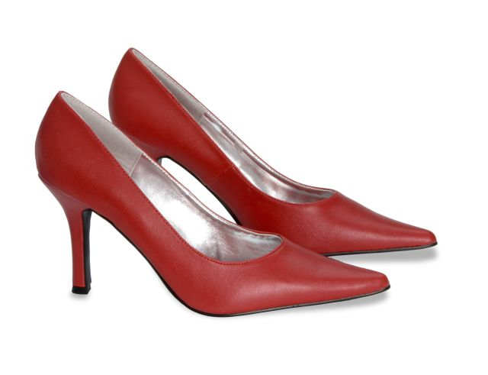
conditionals: type 1
Form:
If you try to walk in those shoes, you will fall.
NOT If you will try to walk …
We use this type of conditional to predict the likely outcome of an action.
if-clause main clause
= if + present simple / will + infinitive
For FCE-level practice see
Oxford
Practice
Grammar

Slide 8
conditionals: type 1
Other modals can be used in the main clause instead of will, e.g. might or should.
‘If you want to lose weight, you should eat fewer cakes.’
We can also use either the present continuous or
present perfect simple in the if-clause.
‘If you’re going walking, you’ll need to buy some good boots.’
‘If you haven’t decided which shoes to buy, I’ll help you.’
For FCE-level practice see
Oxford
Practice
Grammar

Slide 9

conditionals: type 1
This type of conditional clause is often used in offers and suggestions, warnings and threats.
‘If you start to feel hungry, we’ll look for somewhere
to eat.’
If you don’t clear this up, you won’t get your pocket money!
For FCE-level practice see
Oxford
Practice
Grammar

Slide 10
conditionals: type 2
conditionals: type 2
Form:
If we wanted to join in the game, we would ask.
NOT If we would want to play …
We use this type of conditional to talk about the probable outcome of a hypothetical situation.
We can use the past continuous in the if-clause.
‘If you were staying longer, we’d show you all the sights.’
In this type of conditional we can use were instead of was, especially in the expression If I were you …
if-clause main clause
= if + past simple / would + infinitive without to
For FCE-level practice see
Oxford
Practice
Grammar

Slide 11
conditionals: type 2
Other modals can be used in the main clause instead of would, such as could or might.
‘If they wanted to go into town, they could take the bus.’
We use this type of conditional to speculate about the outcome of a hypothetical situation.
This type of conditional clause is often used in requests.
In this case, we use would in the if-clause.
‘If you would all like to sit down, we’ll serve dinner shortly.’
For FCE-level practice see
Oxford
Practice
Grammar

Slide 12
conditionals: type 3
Form:
If his exam had gone well, he would have told us.
NOT If his exam would have been easy …
We use this type of conditional to speculate on the outcome of a different course of action to the one that actually occurred.
Other modals can be used in the main clause instead of would have, such as could have or might have.
We use this type of conditional to show that one thing is a natural or logical consequence of another.
We can use can / can’t in the main clause.
“If you haven’t got any money, you can’t go out.”
if-clause main clause
= if + past perfect simple / would have + past participle
For FCE-level practice see
Oxford
Practice
Grammar

Slide 13

conditionals: type 3
This type of conditional clause is often used to express regret or to criticize someone.
Note that the short form ’d is the contracted form of both had and would.
If you hadn’t
turned right,
we’d be there
by now!
If you’d read the map properly, I wouldn’t have gone in the wrong direction!
For FCE-level practice see
Oxford
Practice
Grammar

Slide 14
Correct or incorrect?
You could of come if you’d saved up enough money for the trip.
If you want to contribute to mum’s birthday, you can buy her a cake.
If you would been here sooner, you could have helped us clean the house.
I’d buy this model if I were looking for a new mobile phone.




For FCE-level practice see
Oxford
Practice
Grammar

Slide 15
mixed conditionals
Unreal conditional clauses can be mixed in a variety of
Combinations, where the if-clause is different from
the time in the main clause. We can do this in order
to show:-
how an unreal past affects an unreal present
EXAMPLE
‘If I hadn’t lost my ticket, I’d be at the concert now.’
(= but I did lose my ticket, so I’m not at the concert)
For FCE-level practice see
Oxford
Practice
Grammar

Slide 16
mixed conditionals
We can also mix unreal conditional clauses to show:
how an unreal present affects an unreal past
‘If he was still alive, he’d have advised you to travel the world while you can.’ (= but he isn’t still alive, so he couldn’t advise you to see the world)
As in non-conditional sentences, might (have) can be used to sound less certain about the future.
‘If you had left on time, you might be there by now.’
For FCE-level practice see
Oxford
Practice
Grammar

Slide 17
introductory conditional expressions
Find examples of expressions used to introduce conditions
‘I’ve told everyone that my French pen friend is coming to visit. Everyone’s really looking forward to meeting you. This time tomorrow, you’ll have touched down in England, unless your flight’s delayed, of course. My mum is driving me to the airport, so as long as our car doesn’t break down (again!), we’ll be there in the Arrivals hall to greet you. I think you’ll be comfortable at our house – provided that you don’t mind sharing a bedroom with me!’
For FCE-level practice see
Oxford
Practice
Grammar

Slide 18
introductory conditional expressions
‘I’ve told everyone that my French pen friend is coming to visit. Everyone’s really looking forward to meeting you. This time tomorrow, you’ll have touched down in England, unless your flight’s delayed, of course. My mum is driving me to the airport, so as long as our car doesn’t break down (again!), we’ll be there in the Arrivals hall to greet you. I think you’ll be comfortable at our house – provided that you don’t mind sharing a bedroom with me!’
For FCE-level practice see
Oxford
Practice
Grammar

Slide 19
introductory conditional expressions
Conditionals can be introduced by expressions other than if, that have a similar meaning and use.
provided / providing (that) and as / so long as are used in the same way as if, and are followed by similar structures:
EXAMPLES:
‘You can borrow my CDs provided / providing (that) you bring them
back in good condition.’
‘I’d be happy for them to come as / so long as they pay their share of the petrol.’
For FCE-level practice see
Oxford
Practice
Grammar

Slide 20
introductory conditional expressions
Another expression used to introduce a conditional clause is unless meaning ‘if ... not’.
It is never followed by will.
EXAMPLES:-
‘I’ll see you on Friday unless I see you before then.’
(= I’ll see you on Friday if I don’t see you before then)
‘Unless you wanted anything else, I’ll bring the bill with the coffee.’
(= if you don’t want anything else …)
For FCE-level practice see
Oxford
Practice
Grammar

Slide 21
Select the correct sentence
A I’ll tell you a secret providing you don’t tell anyone else.
B I’ll tell you a secret provided as you don’t tell anyone else.
A Unless I won’t hear from you, I’ll assume that we’re all meeting at Jake’s house.
B Unless I hear from you, I’ll assume that we’re all meeting at Jake’s house.
✓


✓
For FCE-level practice see
Oxford
Practice
Grammar

