Slide 1
Course Project: Best-Practices in Algorithmic Fairness
Ariel Cintron
ITCS-6190
Summer 2026

Slide 2















Contingency Tables

Slide 3

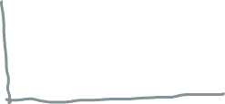








Conditional Probability to Mitigate Bias

Slide 4
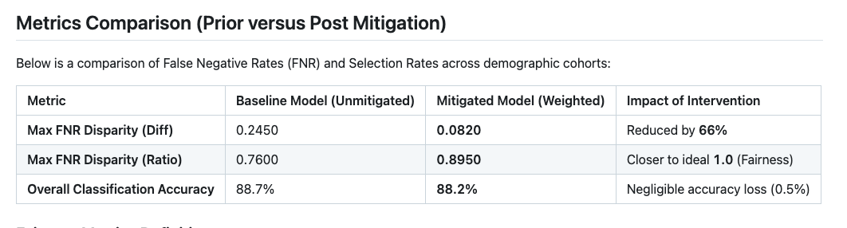
Quantifying Fairness
Documentation Guide

