Slide 1
Brief analysis of local Foursquare recommendation and US Presidential Elections results in Florida
Alejandro Ciriano
April, 2020

Slide 2
Problem
Predicting the vote intention of the population is really difficult nowadays despite of we are a developed society.
Many specialists try to forecast what the trend is in each of the states, in order to use that information and convey an adapted message to each of them in the electoral campaign.
Find out connections between politics and other facts of the real life can decide who will be the winner of the next Elections.

Slide 3
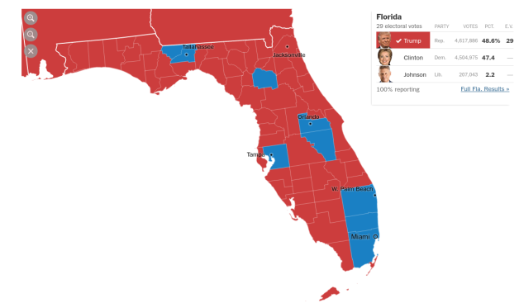
Florida results in US Presidential Elections 2016

Slide 4
Question
Answer
Is there any connection between trending venues and the vote intention of the population?
Let’s collect some data from Foursquare to cluster Florida counties and compare the results with the Elections results.

Slide 5
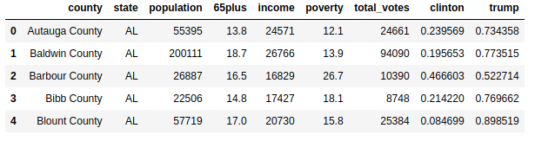
Data acquisition
US Presidential Elections 2016: the results of the Presidential Elections. Contains one register per county with the state, population, income, poverty and much more interesting parameters. Only some features are chosen. (https://www.kaggle.com/prashant111/us-presidential-election-data)

Slide 6
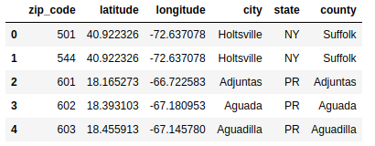
Data acquisition
Counties locations: The second dataset contains the coordinates of the cities of every county. It is necessary for making queries in Foursquare, setting the latitude and the longitude of the point where search for venues. (https://docs.gaslamp.media/download-zip-code-latitude-longitude-city-state-county-csv/)

Slide 7
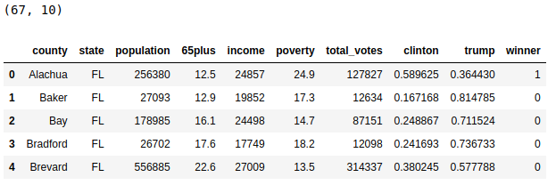
Selecting and Cleaning data
Votes in Florida: we can filter and select the counties where state = ‘FL’ to obtain the counties of Florida. It is also needed to modify the column ‘county’, each county name ends with the word ‘County’. We should delete this word.

Slide 8
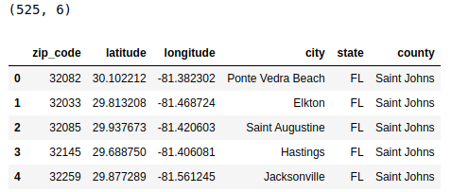
Selecting and Cleaning data
Locations in Florida: Next step is filter the locations data. Again, we can filter and select locations from Florida by state = ‘FL’. To reduce the total number of locations, only the closest point to the center of each city is selected. Finally, to avoid incompatibilities with the other dataset, some counties names are exchanged (’De Soto’ -> ’DeSoto’, etc.)

Slide 9
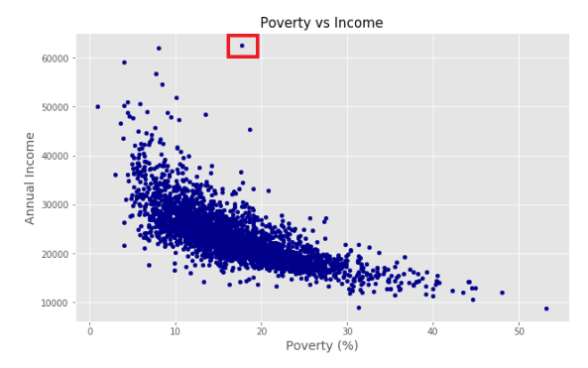
Exploratory Data Analysis: correlation
Correlation factors between parameters show that the unique facts that are linked are poverty and income. It’s normal that if poverty goes up, wealth goes down, but we can check it:
New York County(red square) is the most polarized region in poverty and income. The rest of the counties behave as we expected.

Slide 10
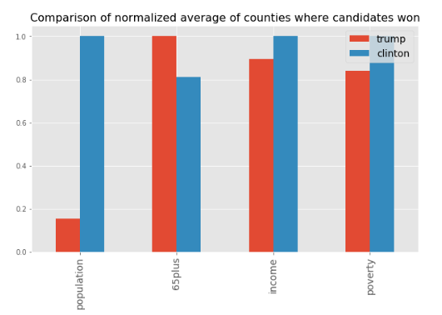
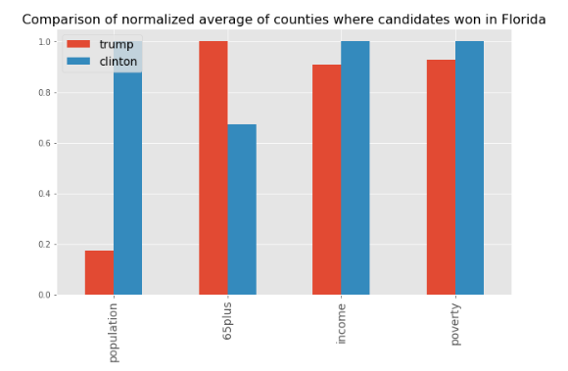
Exploratory Data Analysis: candidates and voters
Clinton was more popular in populated counties with young people. She was also more popular in counties where the wealth is not equally distributed (higher income and poverty).

Slide 11
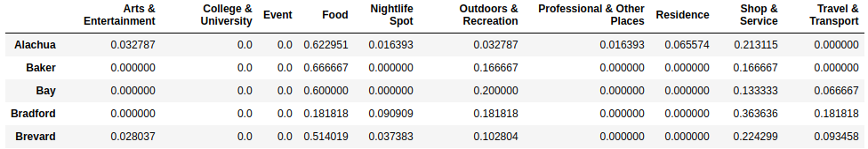
Collecting from Foursquare
For each location in Florida, get its latitude and longitude.
Send a request to the Foursquare API about recommendation in the zone with explore. The limit is 20 and the radius 2 Km.
Extract the parent categories of the venues that appear in the response and store them in the county register.
Normalize the result.

Slide 12
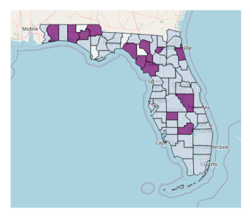
Counties clustering
Applying KMeans algorithm to the counties based on the information that was collected from Foursquare, the result is not as good as we want:

Slide 13
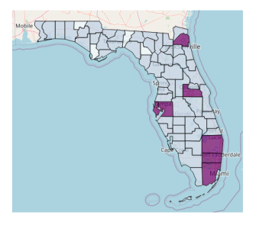
… but, if we include demographic data, the accurate improves a lot:
Error rate with Foursquare venue recommendations: 19.40 %
Error rate with recommendations + poverty, income, population and age: 7.42 %

Slide 14
Conclusions
If we compare the maps with the result after clustering the counties and the map with electoral results, we can see that is more relevant and describes better the people behaviour the data from population, medium age, income or poverty levels than the data from venues in local zones.
It does not mean that the venues and business are not connected with the political ideology or the vote intention. In this project only a few data have been used, and we cannot draw conclusions from this.
With much more information of trendings and venues we could deploy a better model which integrates this massive data from each city and then achieve better results after clustering counties.
Despite of the fact that the results of the elections in Florida show a deep correlation with population volume and income, final results and real results are close enough to be validated, and the resources of this project have been really limited.

