Slide 1
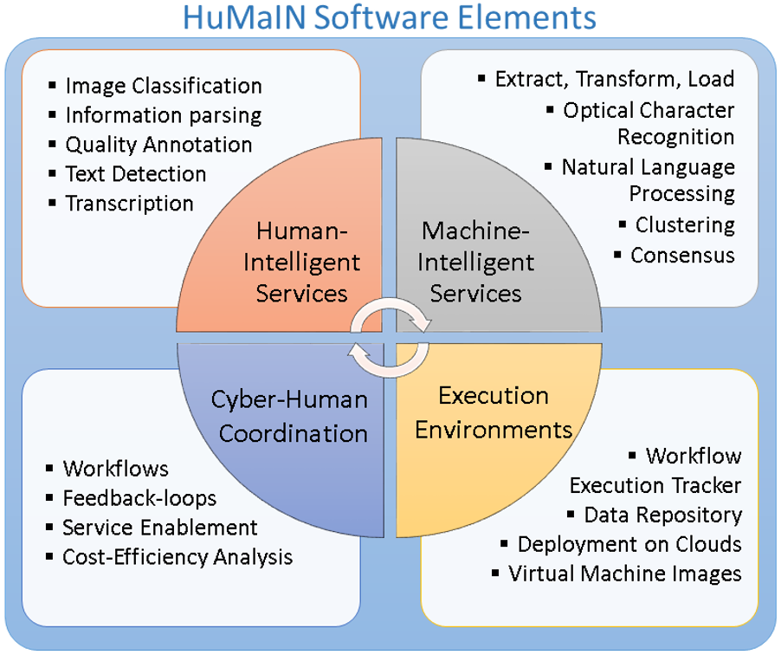
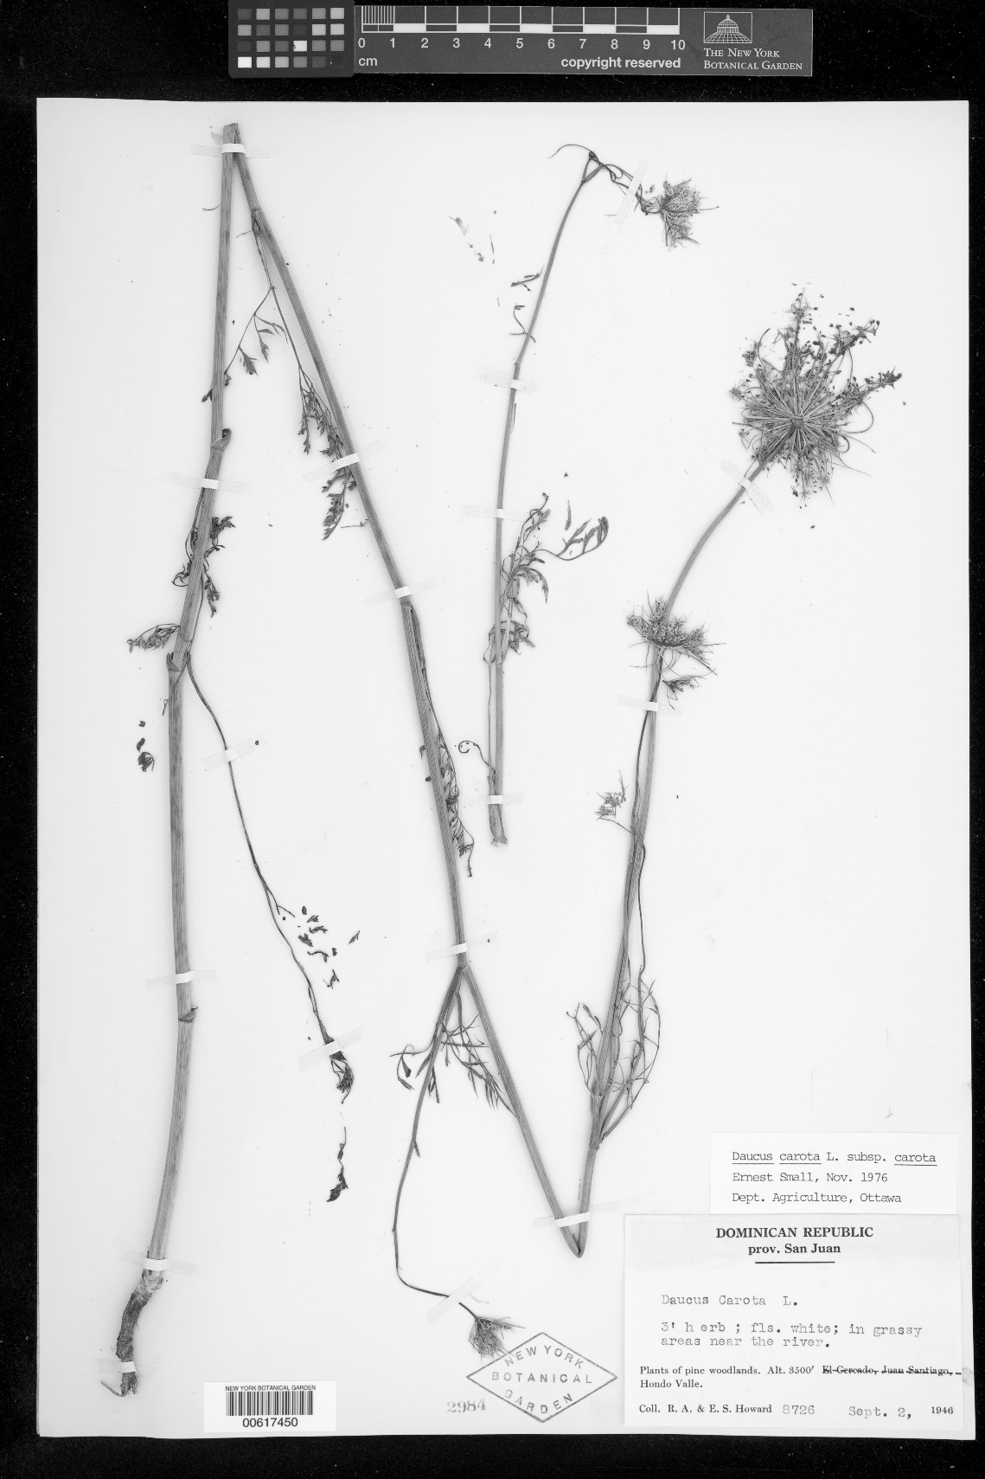

HuMaIN: Human- and Machine-Intelligent Network software elements
Icaro Alzuru, Andréa Matsunaga, José A.B. Fortes
Introduction and Motivation
Big Data scientists in all communities spend the majority of their time and effort collecting, integrating, curating, transforming, and assessing quality before actually performing discovery analysis.
Data is often in non-structured form, not compatible with analytics tools.
Two main approaches to deal with these challenges:
Crowdsourcing (Human-Intelligent processes)
Machine Learning (Machine-Intelligent processes)
Each method has its strengths and weaknesses. However, very little has been done to simultaneously take advantage of both types of solutions.
Implementing crowdsourcing or machine learning solution use to demand a lot of time and resources.
The vision of the Human- and Machine-Intelligent Network (HuMaIN) project is to accelerate scientific digitization through fundamental advances in the integration and mutual cooperation between human and machine processing in order to handle practical hurdles and bottlenecks present in data digitization.
During the project, the information extraction process from the scientific data collected by the Integrated Digitized Biocollections (iDigBio) project will be used as a motivating example: https://www.idigbio.org/.
Goals
Research and development of HuMaIN software elements in four main areas:
Human-Intelligent services
Machine-Intelligent services
Cyber-Human Coordination
Execution Environments
Providing a platform for reusing the HuMaIN software elements as RESTful services in other projects.
Experimental Progress and Results
The hardware platform, software, and web site for the HuMaIN Software Elements project was setup: http://humain.acis.ufl.edu
OCRopy (https://github.com/tmbdev/ocropy) is being tested as the OCR software for the HuMaIN project
Several scripts have been created to automatize the process, detecting the language of the text, and extracting some fields: date, country.
Cropping the text area of the image improves importantly the quality of the OCR result.
These first tries of the OCR process made us decide beginning by the 5th step of the Development Plan:
Human-only and machine-only workflows were setup for digitizing the label of scientific data from the iDigBio project.
2 Hybrid workflows were also prepared and we expect to demonstrate these perform better than the human-only or machine-only approaches.
Anybody can help us to complete the crowdsourcing tasks at: http://humain.acis.ufl.edu/app.html
0 1 2 3 4 5 6 7 8 9 10
cm copyright reserved
The New York
Botanical Garden
Daucus carota L. subsp. carota
Ernest Small, Nov. 1976
Dept. Agriculture, Ottawa
DOMINICAN REPUBLIC
prov. San Juan
Daucus Carota L.
3' herb ; fls. white; in grassy
areas near the river.
Plants of pine woodlands. Alt. 3500' El Cercado, Juan Santiago, Hondo Valle.
Coll. R. A. & E. S. Howard 8726 Sept. 2, 1946
NEW YORK
BOTANICAL
GARDEN
NEW YORK BOTANICAL GARDEN
00617450
2984
OCR
Fields
extraction
DB
Development Plan and Deliverables
Machine-Intelligent Components
Adding an interface to OCRopy tool to manage training sets for different fonts
Expose OCRopy to a set of alternative methods to deal with noise
Selecting and integrating Carrot² clustering algorithms and parameters
Human-Intelligent Components
Create a set of Javascript sensors to detect the number, time, and sequence of user interactions
Extending PyBossa to support configurable and reusable microtasks
Machine-Intelligent Services Enablement
Implementing the automatic generation of RESTful services using CLAWS (Command-Line Application Wrapper service)
Extending PyBossa to support configurable and reusable microtasks
Human-Intelligent Services Enablement
PyBossa with management of batches of tasks and user qualification
Set of complex tasks making use of multiple developed micro-tasks
Evaluation of alternative human-intelligent workflows using sensors from step 2
Workflows with Human- and Machine-Intelligent Services
Build a workflow with only machine-intelligent services (image binarization, OCR, and NLP)
Build a workflow with only human-intelligent services (image selection, text interpretation, and transcription)
Build a workflow where human- and machine-intelligent services improve machine-only and human-only processes.
Feedback-loops between Human- and Machine-Intelligent Services
Online feedback loop workflow with CrowdConsensus controlling a multi-step text interpretation workflow.
Online feedback loop workflow with OCR errors triggering need for additional training sets.
Online feedback loop workflow with chain of user expertise controlling the need for assessment of a worker
Execution Environments
Dedicated private compute and storage cloud for HuMaIN research and development.
Middleware to support workflows and feedback loops.
Tutorials and how-to documents
Cyber-Human System Cost-Efficiency
Cost-effect comparative analysis of 1. and 7.
Surveys with selected customers of HuMaIN.
Challenges
OCR (Optical Character Recognition): Text mixed with other elements (cropping), different fonts and sizes, handwritten text, different languages, underlined text, overlapped text, OCR performance.
Information extraction: Data cleaning, multiple formats, incomplete data, natural language processing, field value standardization, consensus, processes efficiency, data completion, deduplication, ambiguity, spelling errors, dictionaries, abbreviations / data truncation.
Future Work
The 5th step of the Development Plan will be completed
Based on the gained experience, we are going to continue with steps 2 and 1 of the Development Plan, making these software components reusable and the improving the workflows, environment, and efficiency.
Summary and Conclusions
Human- or machine-only approaches for information extraction have weaknesses that the integration of human- and machine-intelligent processes can improve.
Information extraction is a complex problem with imperfect solutions that can rescue the knowledge buried in not digitized formats.
HuMaIN project will provide a platform of services to reuse the human- and machine-intelligent processes in other areas of knowledge.
Acknowledgements
iDigBio (Integrated Digitized Biocollections): National Science Foundation's Advancing Digitization of Biodiversity Collections Program (Cooperative Agreement EF-1115210).
NSF SI2 PI Workshop : February 16-17, 2016
The Advanced Computing and Information Systems Laboratory is supported by
the National Science Foundation under Award Number: 1535086.

