Slide 1
Data Products with Python
Workshop

Slide 2

Before we get started

Slide 3



About me
Agenda
Manager Analytics, Krakow
Team of 8 people
~$4B Segment
~10 years python experience
5 years financial analyst
Outside work
Kayaking, hiking, cooking
Why data products
Business Case for data products
How we work
Workshop

Slide 4





The world is changing
Increasing data content
Too much data!
Automation
“Big” data (= does not fit in Excel)
Communication
Enterprise tooling
Pros
Supported
UIs
Cons:
Expensive
Hard to scale
Edge cases

Slide 5
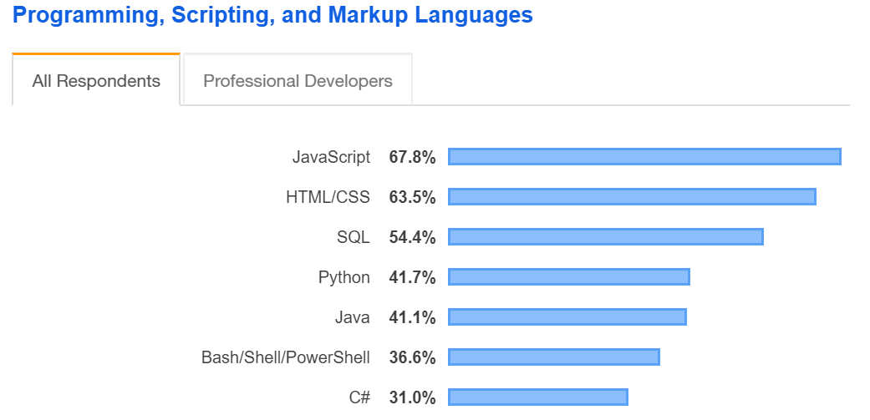
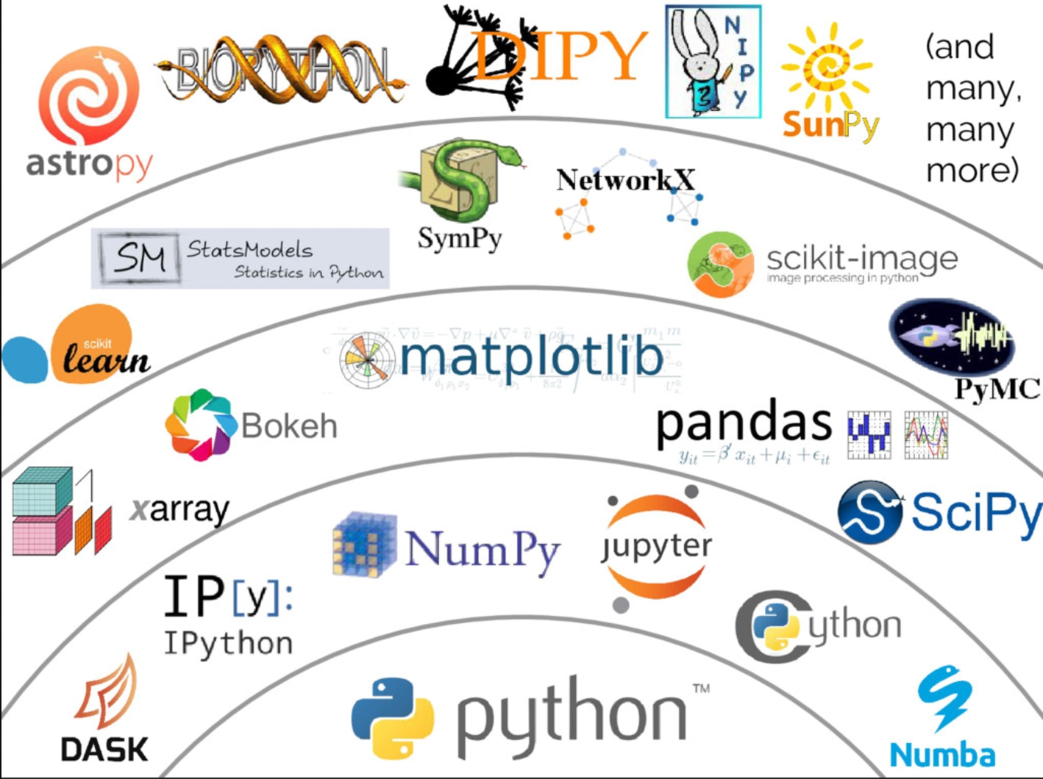
Python & SQL open source data ecosystem to the rescue
Pros
Mature
Community
Edge cases
Scales
Free
Cons
Harder to navigate
Support
GUIs are not that great
2019 Stack Overflow Survey
Most Popular
Best of both worlds?
Enterprise + Open Source

Slide 6
Data Product Business Case
Bonus Incentive Plans
~1,000 participants
$$ costs in the millions

Slide 7
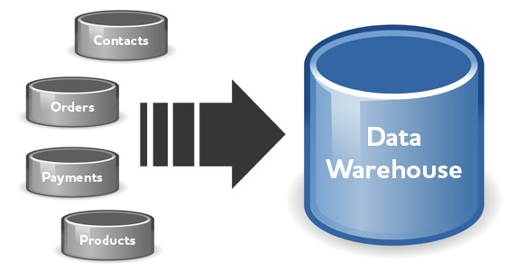

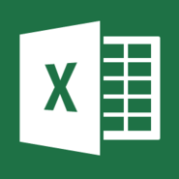

Calculating Bonus Plans for ~1,000 people world wide
Individual Reporting
Data Warehouse
Employees information
Updated results
Bonus Letters
Targets
Calculate actuals vs targets
Payouts Calculations
Salesforce pipeline and conversion

Slide 8

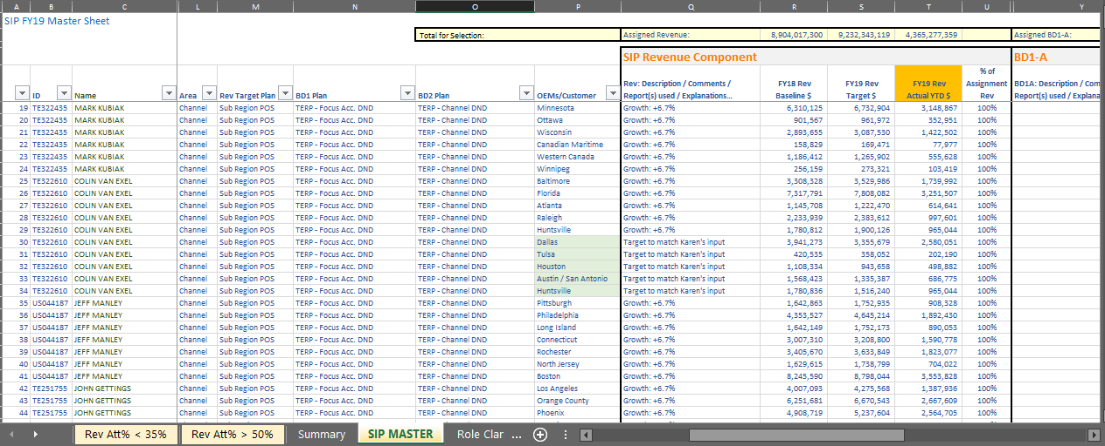
Blending datasets manually -> errors and resource issues
Multiple deliveries that are hard to manage due to the high number of sales people in the BU
Individual Reporting
Multiple data sources to be consolidated and kept in sync manually
Data Warehouse
Employees information
Updated results
SIP Letters
Targets
Payouts
Salesforce pipeline and conversion
Manually calculate actuals vs targets for each SIP/PMIP KPI

Slide 9
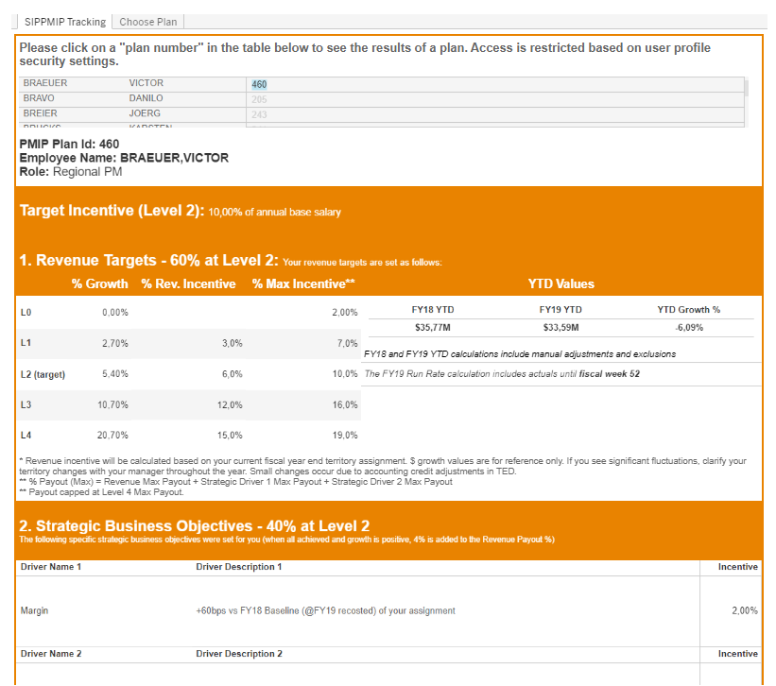
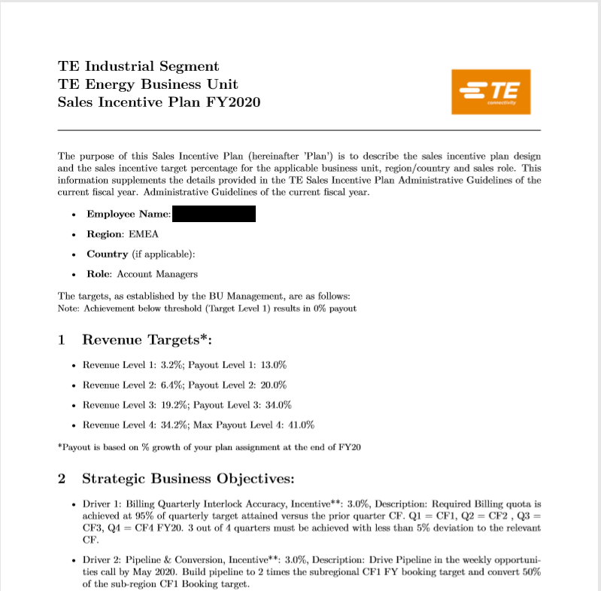

Data Product -> automate, consolidate, avoid errors
Individual Reporting
1
Individual reports are automatically refreshed
Data Warehouse
Employees information
Data
SIP Letters
2
Updated results
Targets
Salesforce pipeline and conversion
3
Data is consolidated and managed by application.
No more manual updates
Payouts
Automatically calculate actuals vs targets for each SIP/PMIP KPI
Letters are created and sent automatically

Slide 10









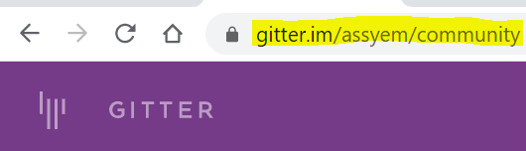
How we work
Focus on doing but in the right way
Become your own teacher
Build data products with others
Great learning resources for building data products with Python (do focus both on technical & selling skills)

